Slide 1
5th ACST-2 Collaborators’ Meeting
5th September 2017 Oxford
Session 3: Italian innovation
Proximal protection device: Mo.Ma.
A. Lauricella
Azienda Ospedaliero – Universitari a Modena Chirurgia Vascolare
Chirurgia Vascolare, Ospedali di Modena
Azienda Ospedaliero - Universitaria di Modena
Università di Modena e Reggio Emilia

Slide 2
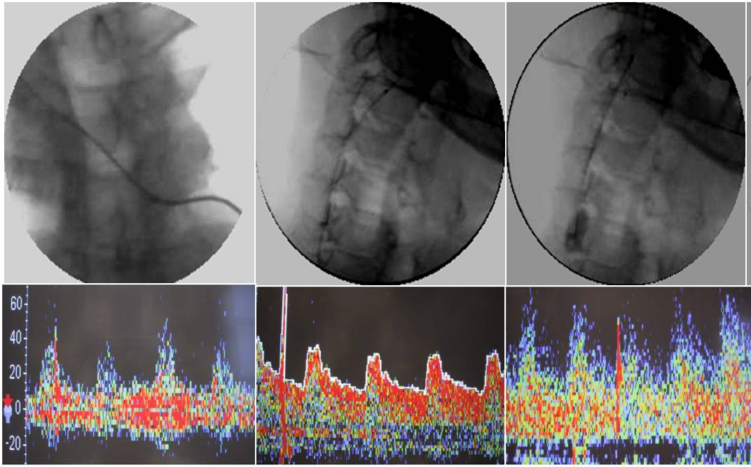
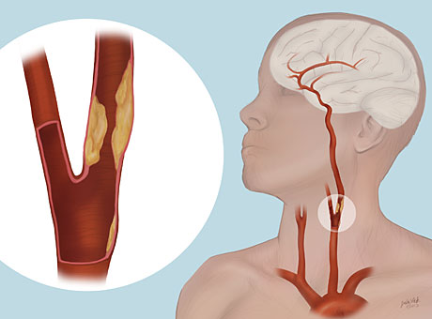
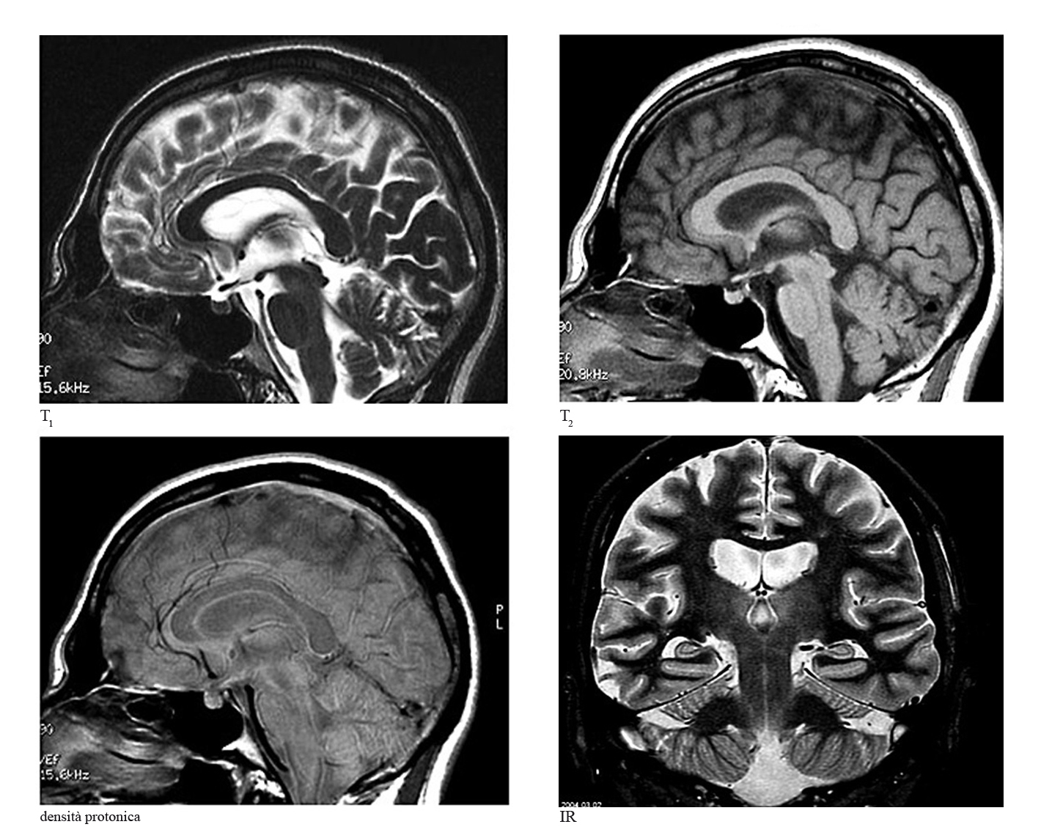
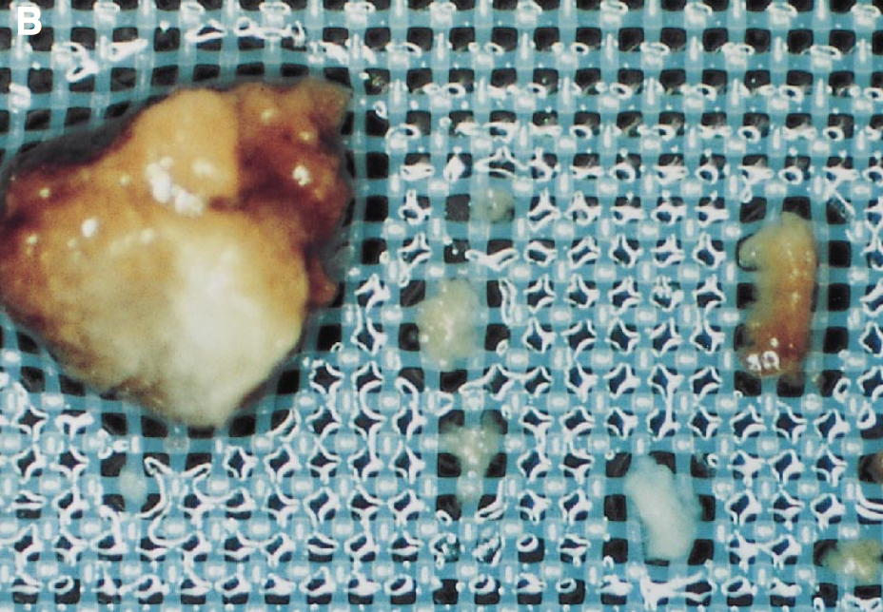
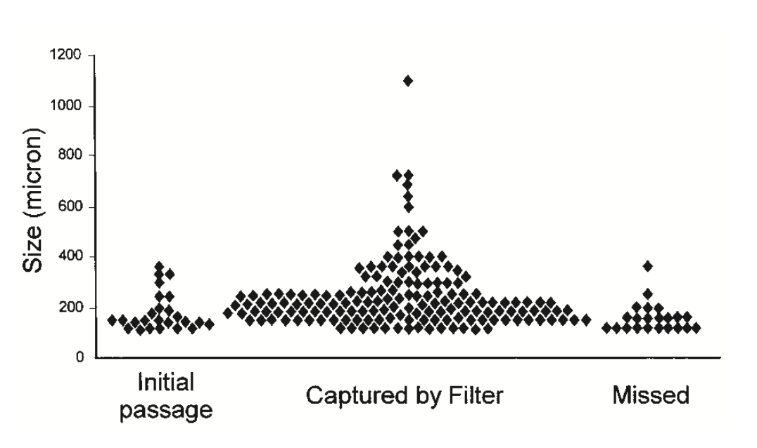
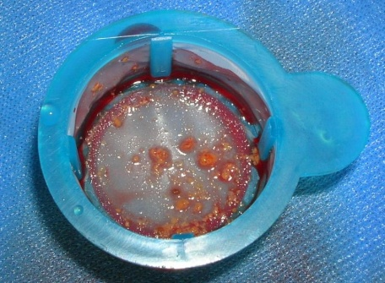
CEREBRAL EMBOLISATION:
the most crucial issue concerning CAS
Ohki T et al. - J Vasc Surg - 1999;30:1034-44
Azienda Ospedaliero – Universitari a Modena Chirurgia Vascolare
THE MOST RELEVANT OBSTACLE FOR CAS EXPANSION
Chirurgia Vascolare Azienda Ospedaliero – Universitaria di Modena
Notes:
The risk of embolization is one of the most crucial issue concerning CAS

Slide 3
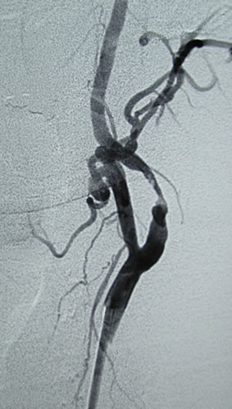
Characteristics of Ideal EPD System
Easy to use
Stable device position
Applicable to all plaque morphology
Capture debris of all sizes
Maintain cerebral perfusion
No restriction on landing zone
Documented results in high-risk lesions and patients

Slide 4
EPD: why should I use proximal protection?
Ensure Complete Protection for ALL steps of CAS procedure
Proximal Protection devices
avoid risk zone
during placement manouvers
CAS: risky maneuvers are forbidden

Slide 5
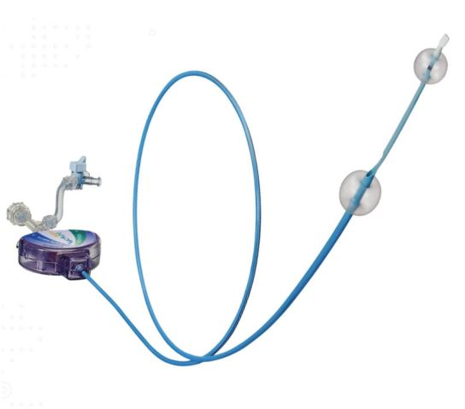
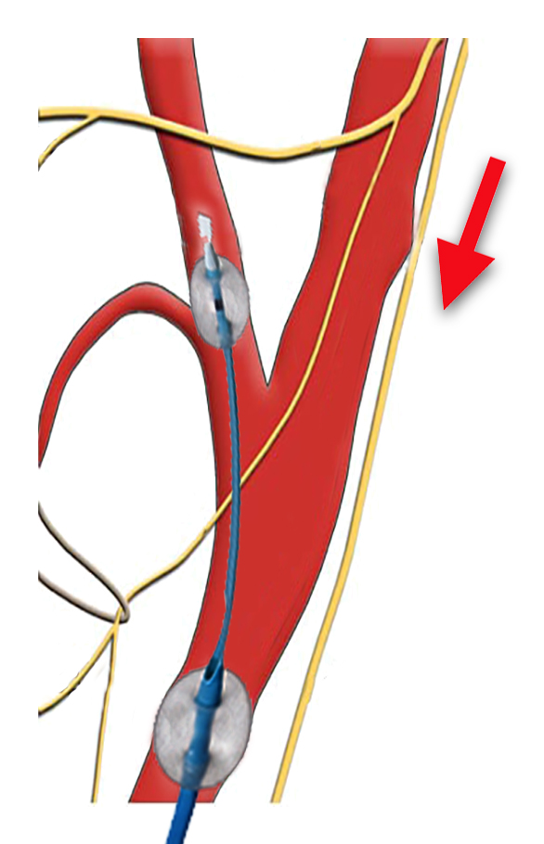
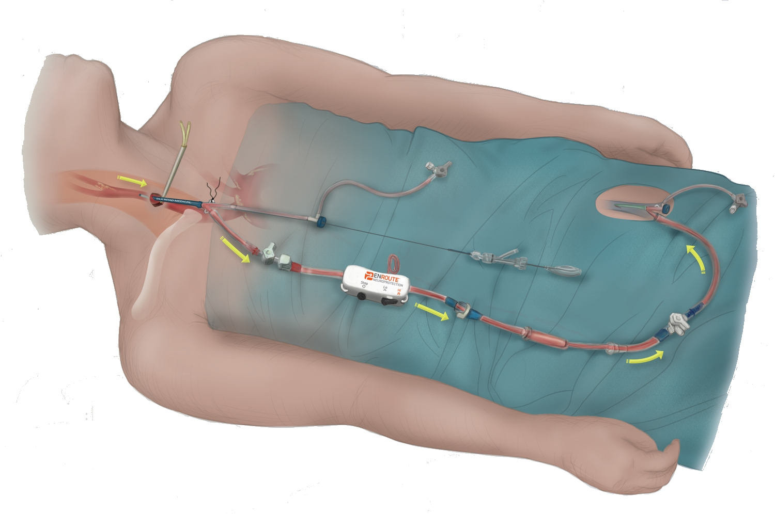
EPD: which one?
1998
2007
2009
Gore Reversal Flow System
Mo.Ma.
miming surgery clamping
Proximal Clamping System
Reversal Flow Systems (femural vein shunt)
No literature evidence of superiority over MoMa, …….with some additive problems
Proximal Occlusion (CCA – ECA) with blockage of flow in the ICA
Higher incidence of clamping intolerance
More invasive procedure (much more for SilkRoad)
Notes:
No evidence in literature of superiority over MoMa, with some additive problems:
-procedure is more invasive
-higher incidence of clamping intolerance
-Silk road system (half surgical/half endovascular treatment , not enough an angiographic suite, and risky during catheter placement because of limited room from access to carotid bifurcation)

Slide 6
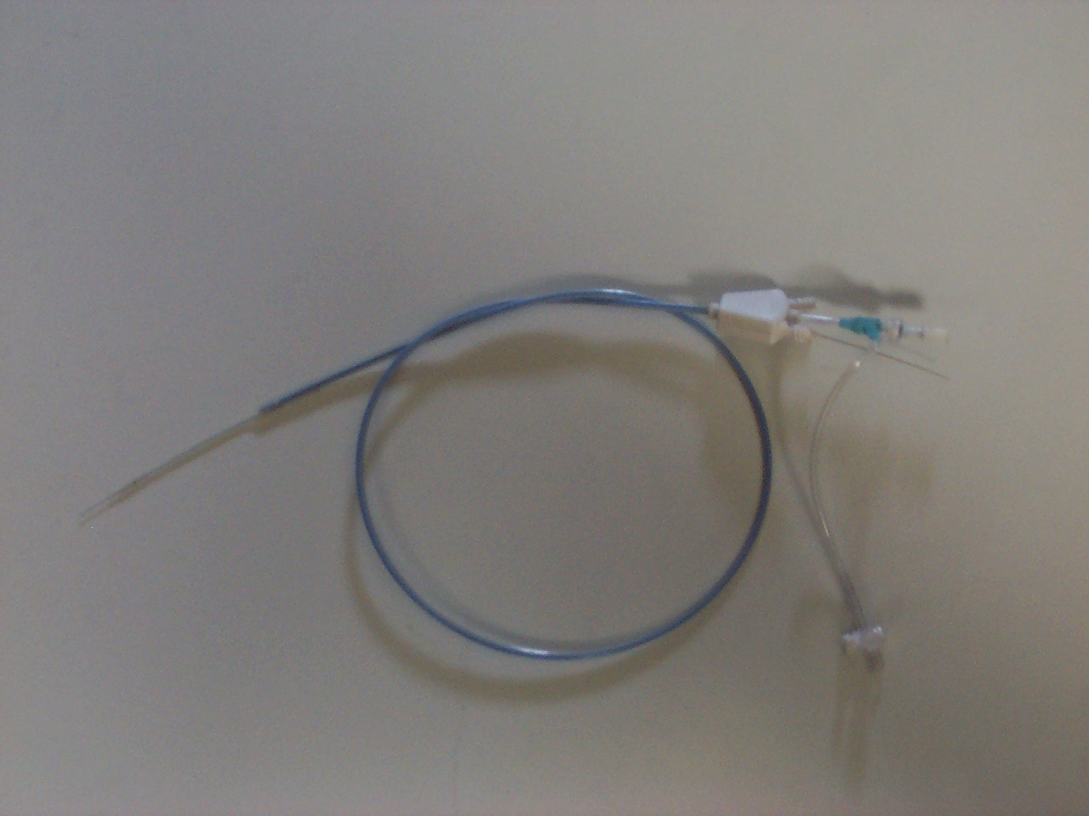
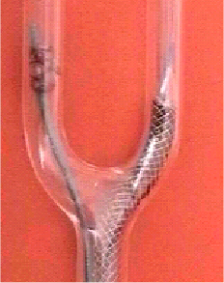
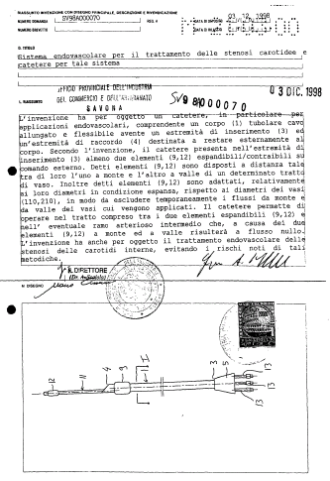
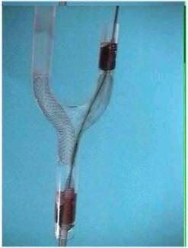
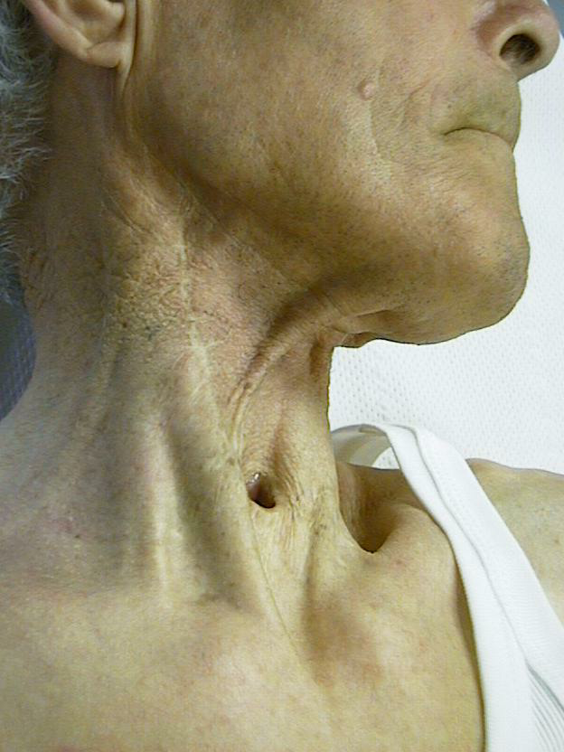
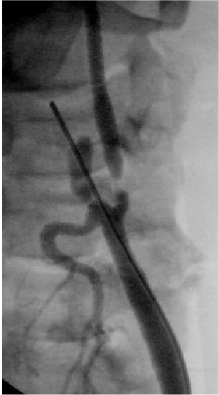
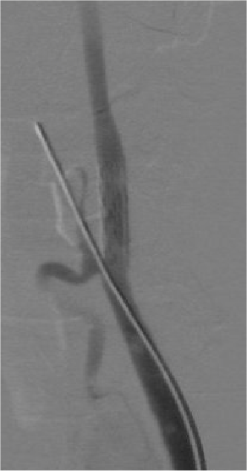
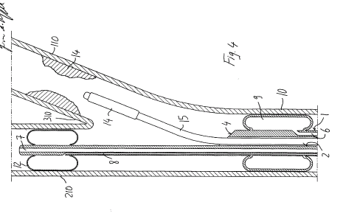
1st prototype 1997
IN VITRO TESTING AND DEVELOPMENT
1st Case – Modena May 1998

Slide 7
EPD: why should I prefer Mo.Ma?
1

Slide 8
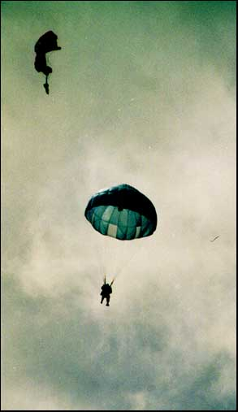
2
EPD: why should I prefer Mo.Ma?
Mo.Ma. is not a Filter
Filters:
Pass through plaque without any protection
May cause ICA spasm/dissection
Difficult to use in tortuous ICAs
Sometimes difficult to retrieve
Obstruction could be dangerous
Small debris could be not catched
Incomplete apposition to the wall risk
Filters work only if well opened

Slide 9
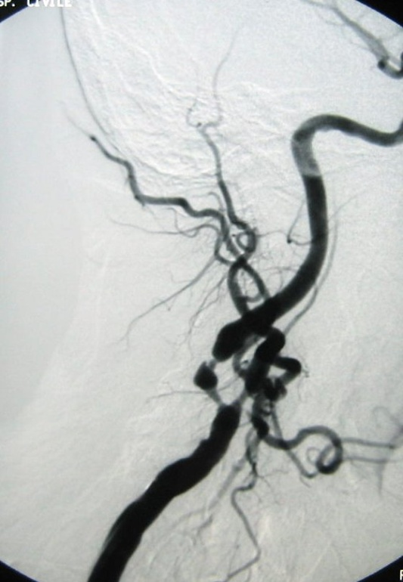
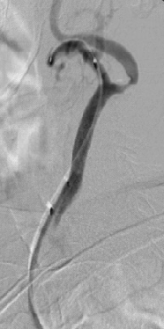
3
EPD: why should I prefer Mo.Ma?
Vulnerable
plaque
Severe ICA
stenosis
Tortuous ICA
Mo.Ma helps you
Born to treat easy lesions,
Mo.Ma revealed
it's enormous potential
Notes:
Il Moma era stato ideato per il trattamento di questo tipo di lesioni…perche non trattare anche quelle piu semplici

Slide 10
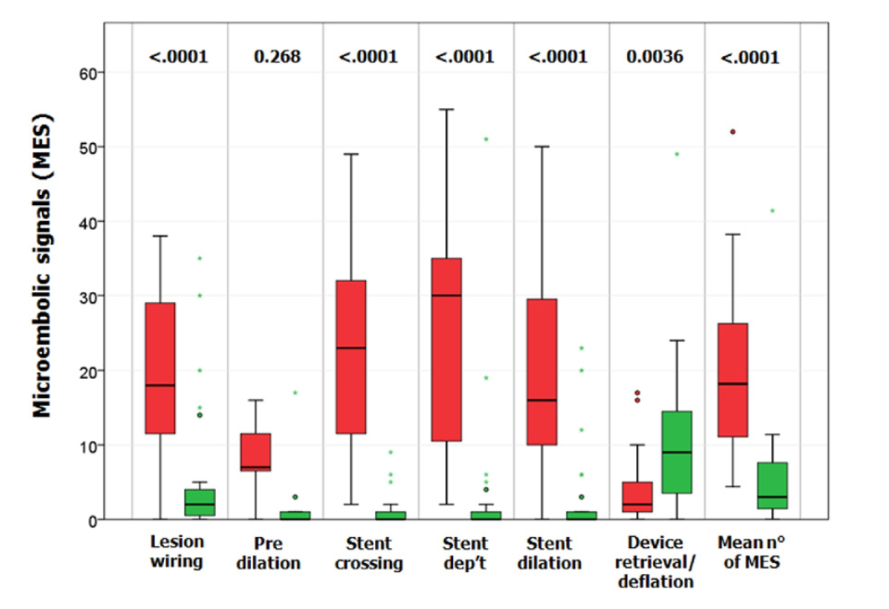
4
EPD: why should I prefer Mo.Ma?
both worldwide experience reported and scientific literature,
are in favour of MoMa
J Am Coll Cardiol 2011;58:1656–63
Conclusions:
….in patients with high-risk, lipid-rich plaque undergoing CAS, MO.MA led to significantly lower microembolization as assessed by using microembolic signals counts

Slide 11
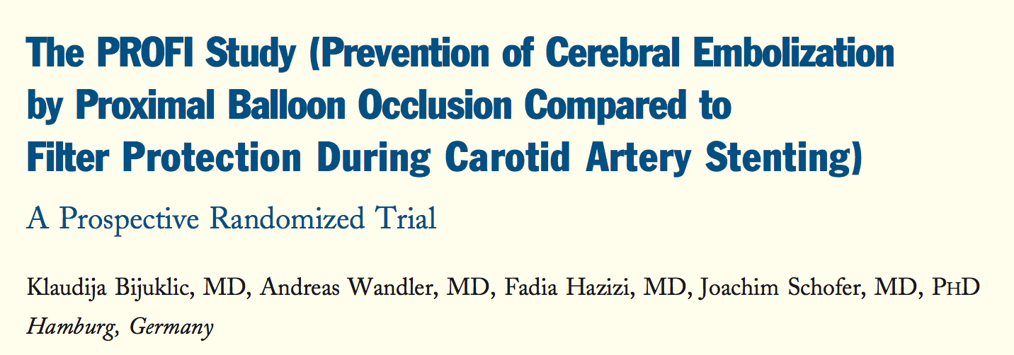
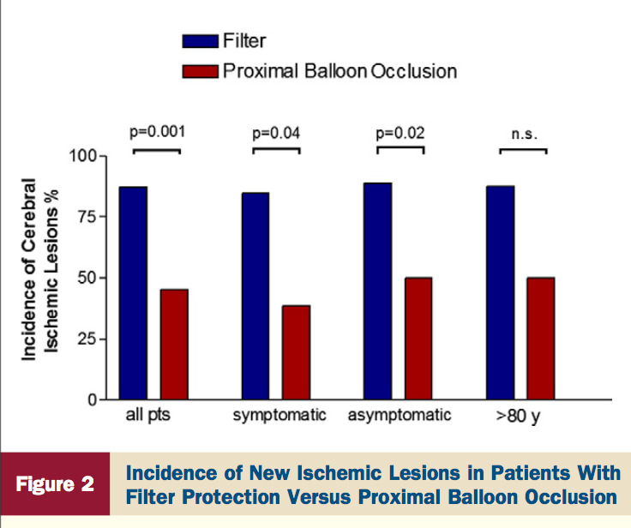
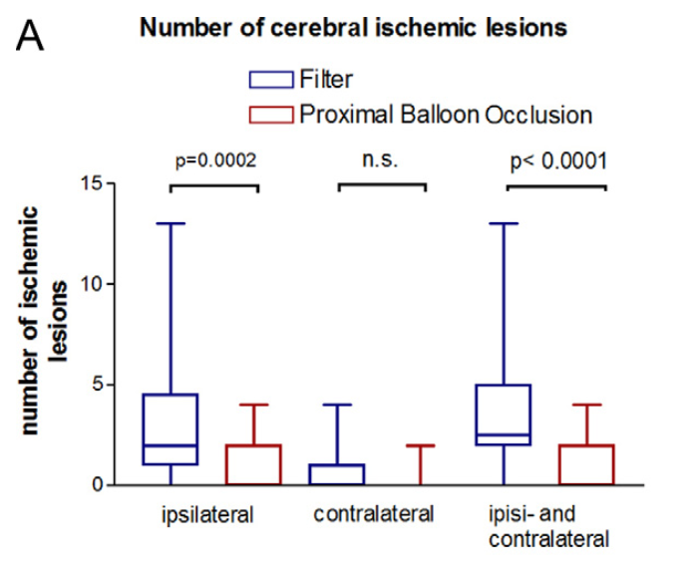
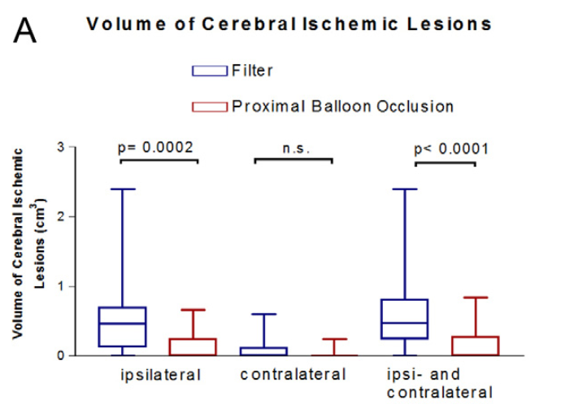
4
EPD: why should I prefer Mo.Ma?
J Am Coll Cardiol 2012;59:1383–9
Conclusions:
…In this randomized trial of patients undergoing CAS,
proximal balloon occlusion as compared with filter protection significantly reduced the embolic load to the brain

Slide 12
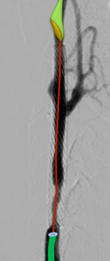
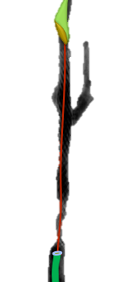
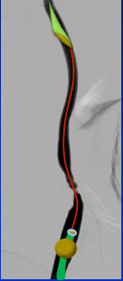
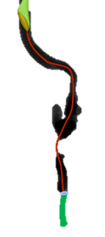
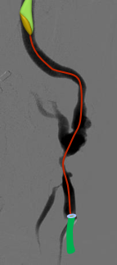
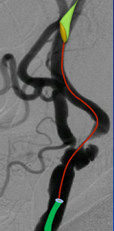
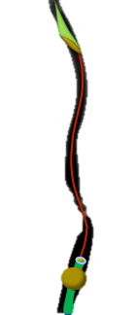
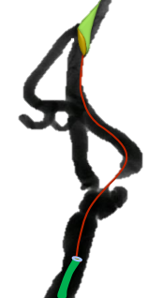
Mo.Ma: when it’s preferred not to use it
Intrastent Restenosis
ECA obstruction
CCA Plaque
ECA Stenosis

Slide 13
EPD: take home message
Proximal embolic protection devices according to scientific and clinical evidence should be preferred during CAS
Effective
therapy
Cerebral Protection
is not only a device,
but a STRATEGY…
Experienced
operators
Scaffolding
Tecnical improvments
Accurate Patient /
lesion selection

Slide 14
1
2
3
4
CAS New Tecnique:
-Maximum Plaque dilatation
-Stenting
-No post stenting dilatation
5
6
7

