Slide 1
Status Update from ACST-2
Alison Halliday
Professor of Vascular Surgery
University of Oxford
LINC Tuesday 26th January 2016

Slide 2
Disclosure
Alison Halliday
I have no potential conflicts of interest to report:

Slide 3
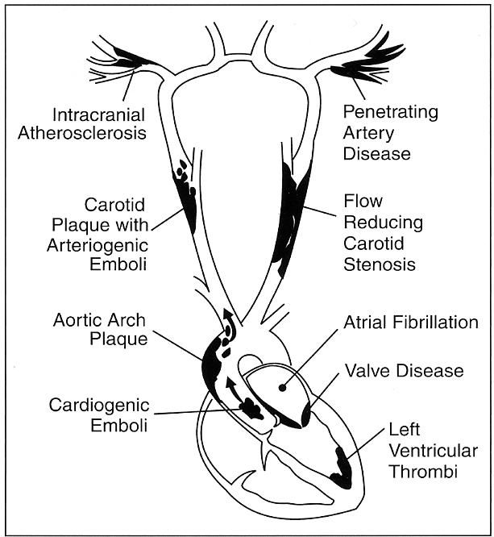
15-20% ischaemic
Strokes are caused by
carotid stenosis
Notes:
3

Slide 4
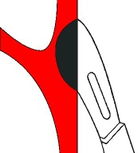
ACST-1
Rationale of ACST-2 – followed from our
first ACST-1 trial
(1993-2008)
Notes:
4

Slide 5
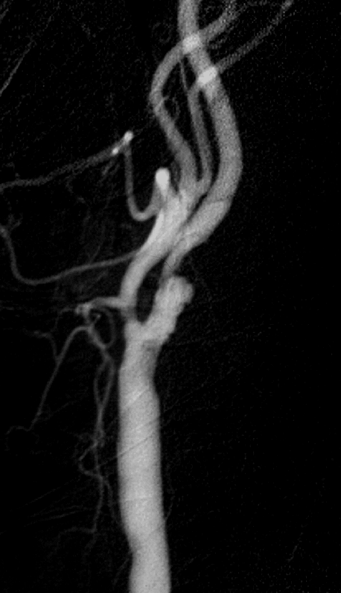
Asymptomatic carotid artery stenosis: narrowing that has not yet caused a stroke
Might intervention prevent stroke?

Slide 6
ACST-1: CEA reduces 10-year stroke risk by 6-7%

Slide 7
With statins - same absolute benefit from surgery

Slide 8
ACST-1 – peri-operative risk
reduced by statin therapy
ACST-1
4.3%
2.2%

Slide 9
Better procedural outcomes for CEA and CAS

Slide 10
Since ACST-1: Falling risks from CEA and CAS
Reduced procedural risk for CEA (Statins)
Reduced procedural risks for CAS…

Slide 11
Falling risks from CEA and CAS
Reduced procedural risk for CEA (Statins)
Reduced procedural risks for CAS…

Slide 12
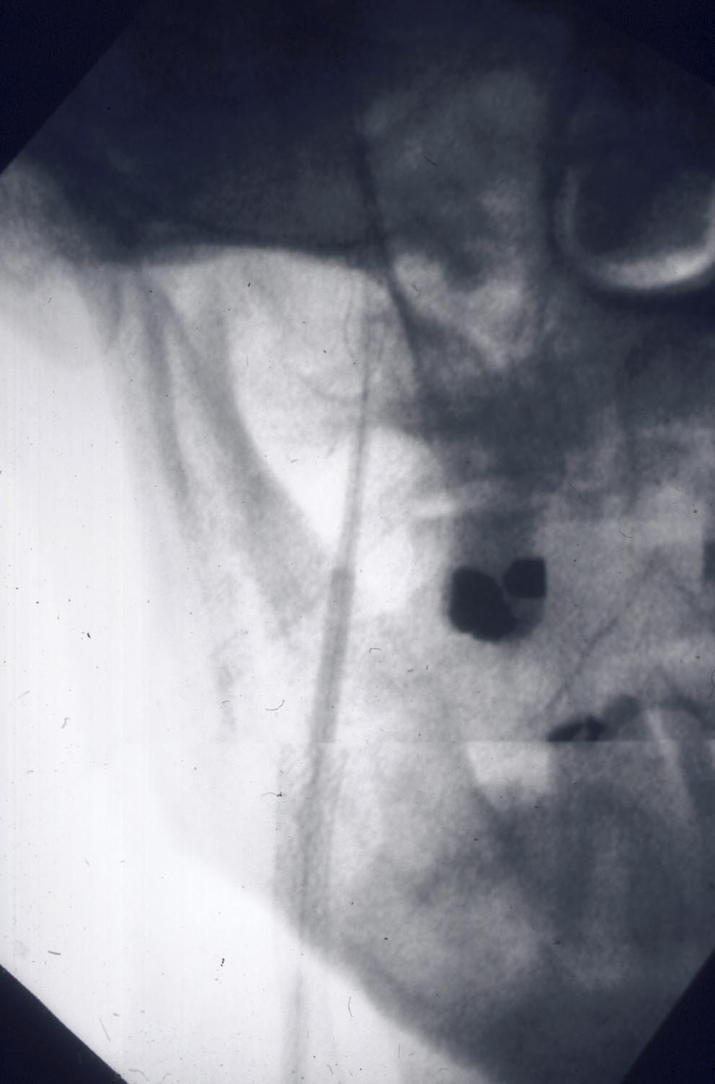
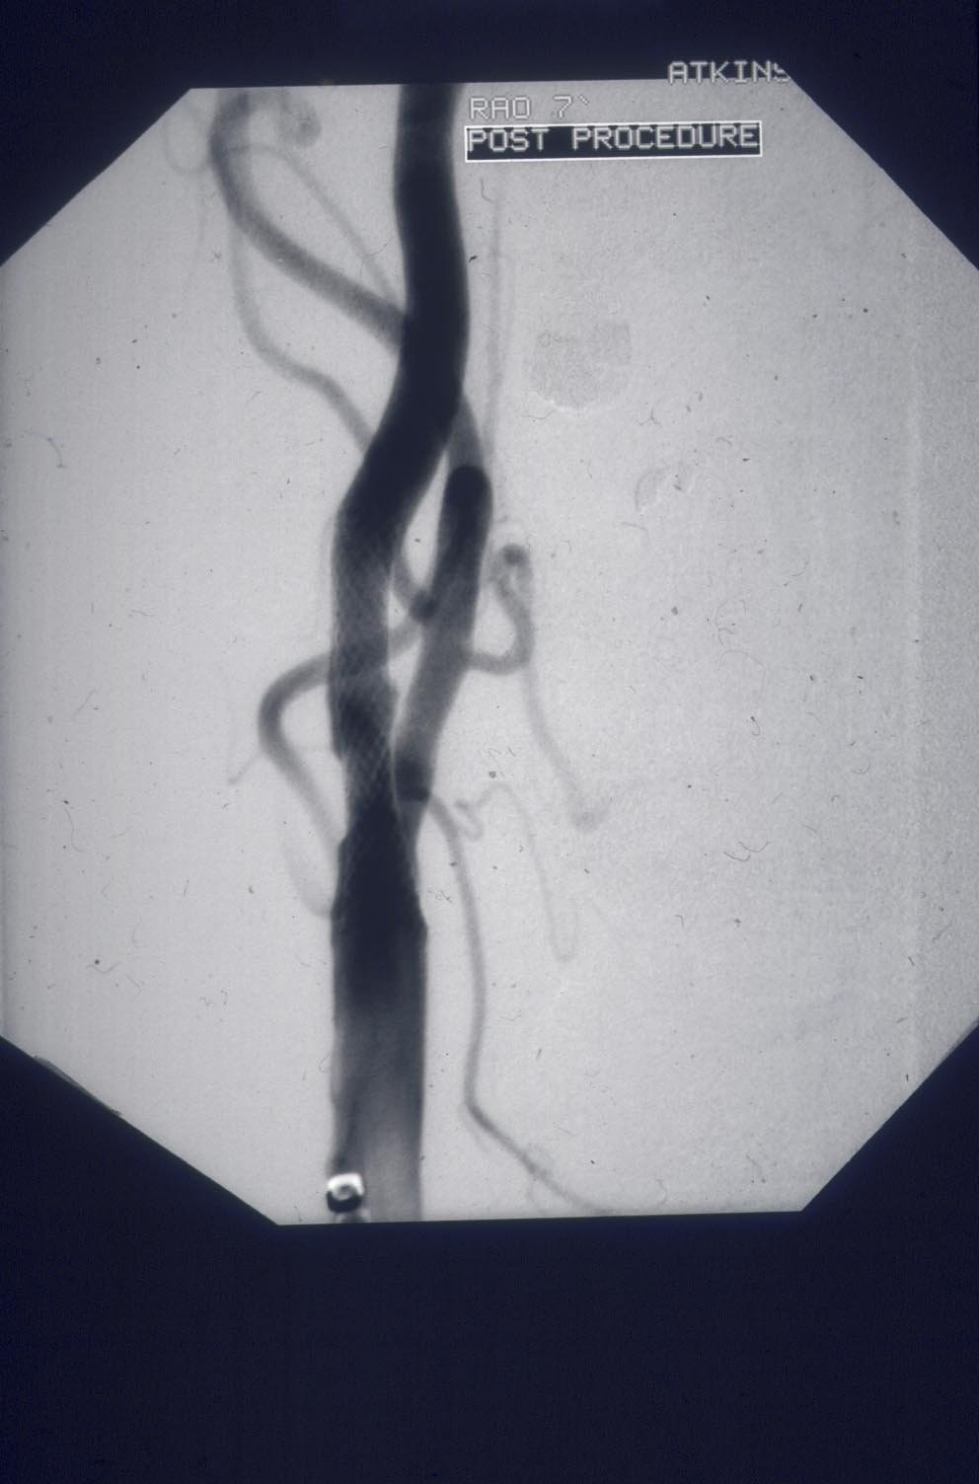
Techniques, devices, experience have all
changed since the early symptomatic trials…
Open vs closed-cell stent design
Closed–cell safer?

Slide 13
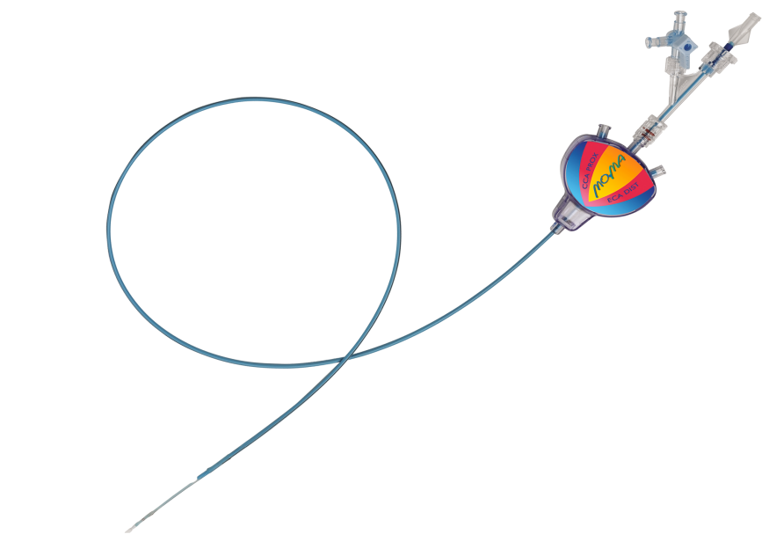
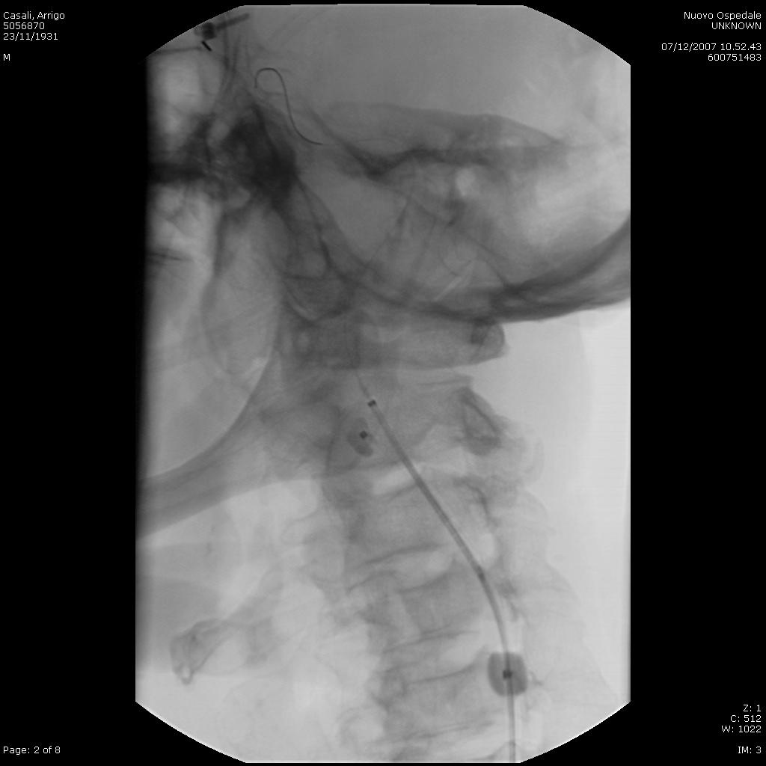
Newer FLOW-reversal systems,
direct puncture, membrane covered stents
Reduce emboli, early results now
comparable to CEA

Slide 14
ACT-1
Abbott-funded (Xact + Emboshield), 3 CAS :1 CEA
(88% of 1658 patients enrolled; stopped because slow)
5 year outcomes (88% alive)
Any stroke 6% CAS vs 5% CEA
Ipsi- stroke (non-procedural) 2.2% CAS vs 2.7%
Any clinical re-intervention 1.6% CAS vs 3.3% (p=0.05)
Conclusions : Lower enrollment reduced power but CAS is non-inferior to CEA up to 1 year, with similar 5-year results, and lower re-intervention rates

Slide 15
ACST-2 Status Update

Slide 16
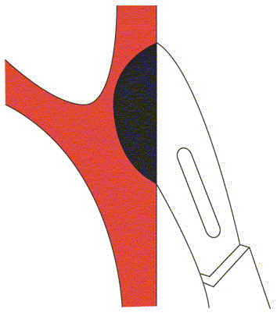
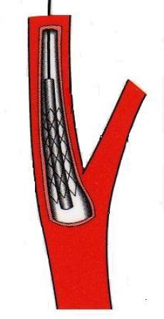


Treatment for asymptomatic carotid artery stenosis:
surgery or stenting?

Slide 17
ACST-2: Overview
First patient randomised: 2008
Some patients are now in their 8th year of follow up
113 Centres in 30 countries

Slide 18
ACST-2 Recruitment - last year at LINC
1694

Slide 19
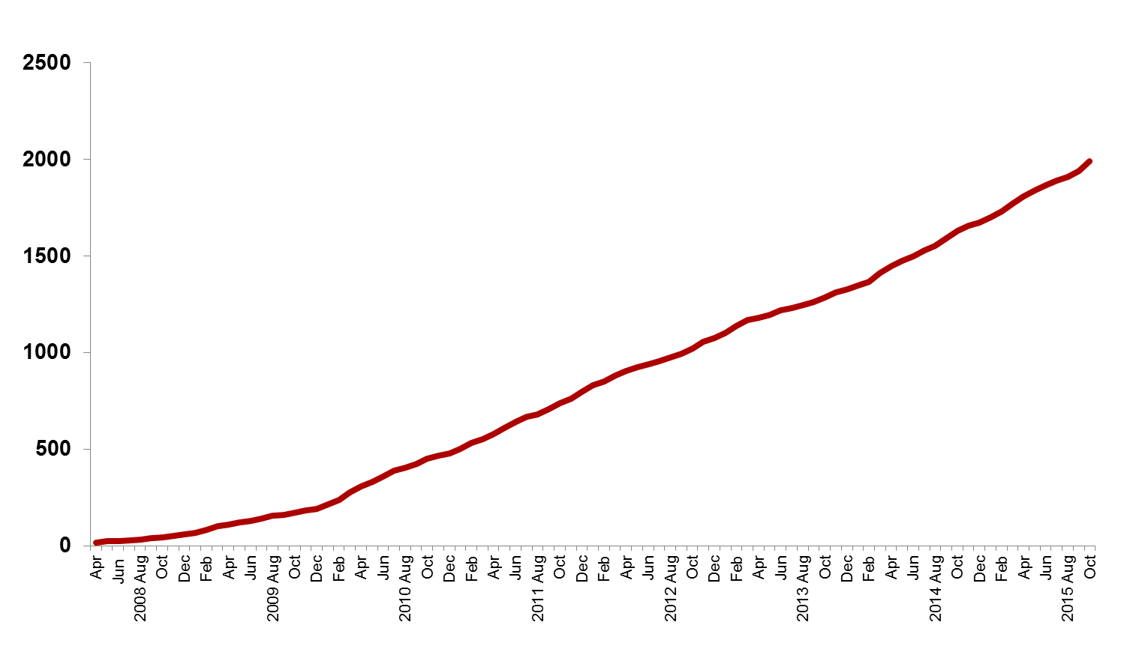
ACST-2 Surgery vs Stenting Target 3600 patients
2061
today

Slide 20
ACST-2:CEA vs CAS
Sex, Age, Co-morbidities:
Men 70%
Mean age 69 years
Ischaemic heart disease 36%
Diabetic 30%
Renal impairment 6%
Stroke risk factors:
Atrial Fibrillation 6%
Age >75 yrs 26%
Previous stroke symptoms or infarct 43%

Slide 21
ACST-2: medical treatments
Yearly direct patient feedback (drug names and doses)
At 2015 follow up
Antithrombotic (aspirin, asasantin, clopidogrel, mono-dual APT, warfarin, NOAC) 96%
BP Medications (1-3 named drugs, none) 84%
Lipid-lowering (specific drugs/doses) 85%

Slide 22
ACST-2 Stents | Protection Devices | Type
Wallstent | Emboshield | Filter
Cristallo Ideale Abbott Xact | Filterwire | Filter
Cordis Precise | Mo. Ma Spider | Prox occ Filter
Ev3 Protégé® RX Abbott RX Acculink | Accunet AngioGuard | Filter Filter
Boston Adapt Sinus | Gore Flow Reversal | Prox occ
ViVEXX | Twin One | Distal balloon
Roadsaver Inspire | FiberNet Viatrac | Filter
Zilver Mer | (87% total)

Slide 23
ACST-2: Open vs Endovascular treatment
Blinded procedural outcomes for 1500 patients
Disabling stroke/death CEA/CAS ACST-2: 1.0%
Lower than for CEA in ACST-1: 1.7%

Slide 24
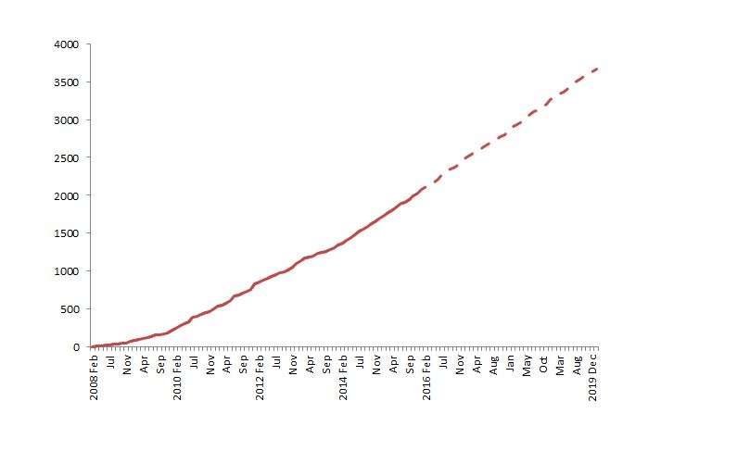
Recruitment plan Feb 2008 – Dec 2019

Slide 25

ACST-2
A very European Trial
– Join us and create the future evidence!
www.acst.org.uk

