Slide 1
ACST-2
Carotid Stenting vs Surgery
Alison Halliday
Professor of Vascular Surgery, University of Oxford
on behalf of all the ACST-2 Collaborators
ECST-2 Collaborators’ Meeting, March 2016

Slide 2
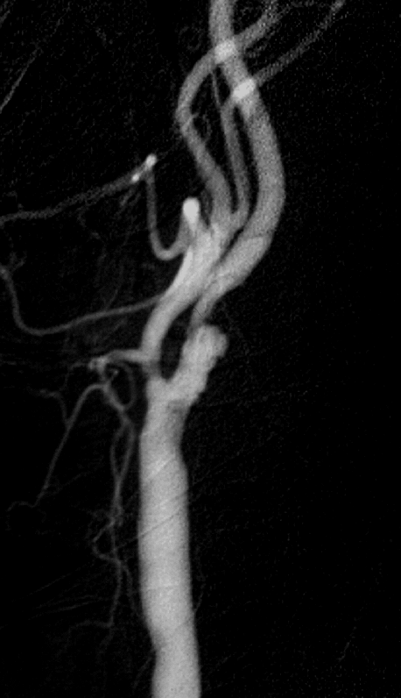
Asymptomatic carotid artery stenosis: narrowing that has not yet caused a stroke
Might intervention prevent stroke?

Slide 3
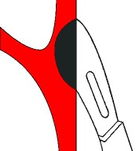
ACST-1
3120 patients, severe stenosis eligible for CEA
randomized to:
Immediate CEA
vs
‘control’
(no CEA unless symptoms occur)
Notes:
3

Slide 4
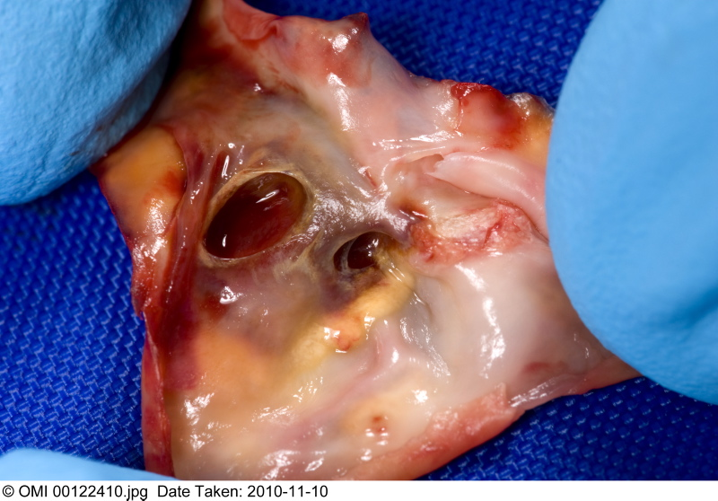
‘Asymptomatic’ - a misnomer?
41% ACST-1 patients had h/o stroke-type symptoms or CT brain infarcts, they were at higher stroke risk ~ 3% yr

Slide 5
ACST-1: CEA reduces 10-year stroke risk by 6-7%

Slide 6
Statins – lower overall stroke risk, but CEA provides additional 6% absolute benefit

Slide 7
In ACST-1 – peri-operative risk
is reduced by statin therapy
ACST-1
4.3%
2.2%

Slide 8
Since ACST-1: Falling risks from CEA and CAS
Reduced procedural risk for CEA (Statins)
Reduced procedural risks for CAS…

Slide 9
Falling risks from CEA and CAS
Reduced procedural risk for CEA (Statins)
Reduced procedural risks for CAS…

Slide 10
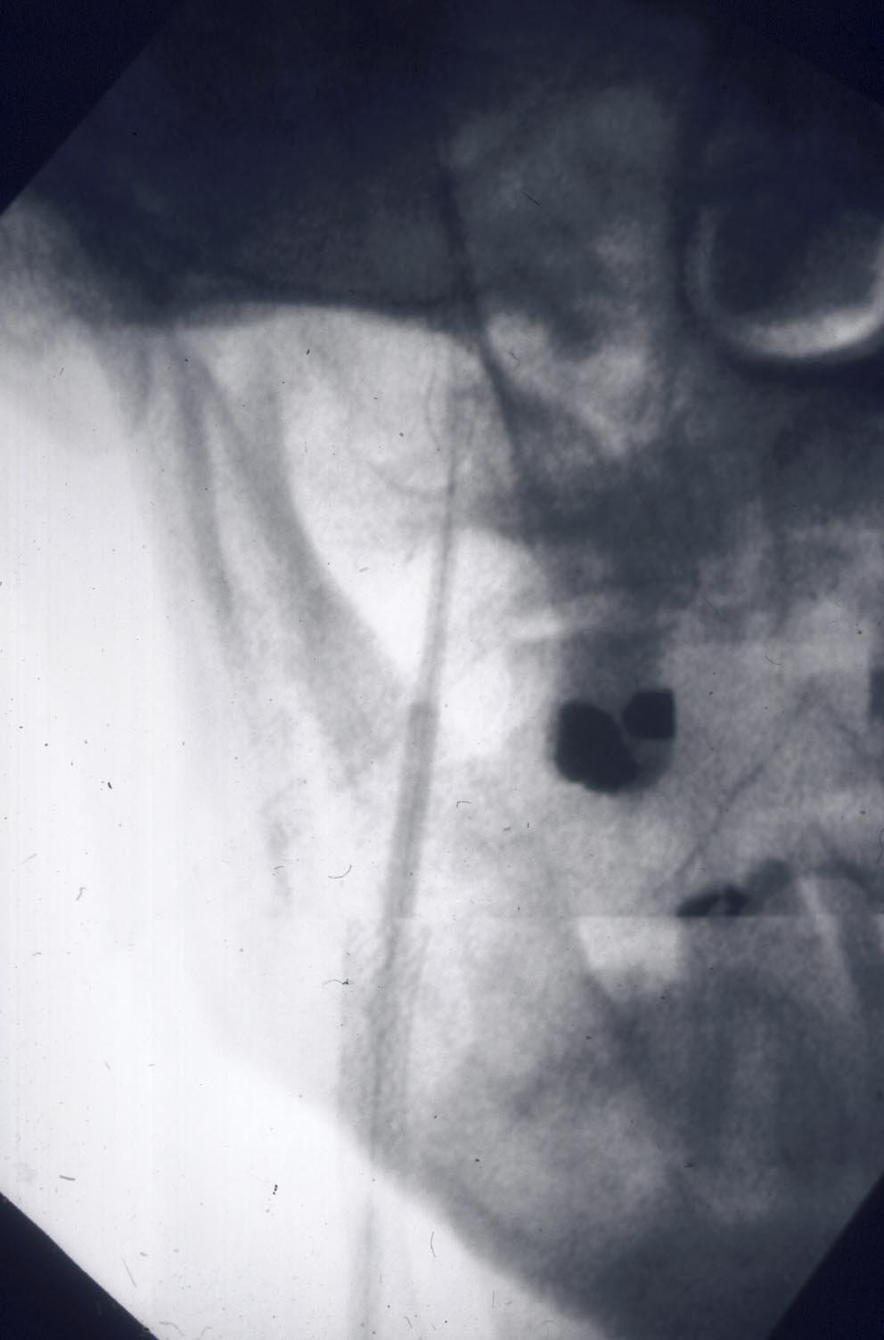
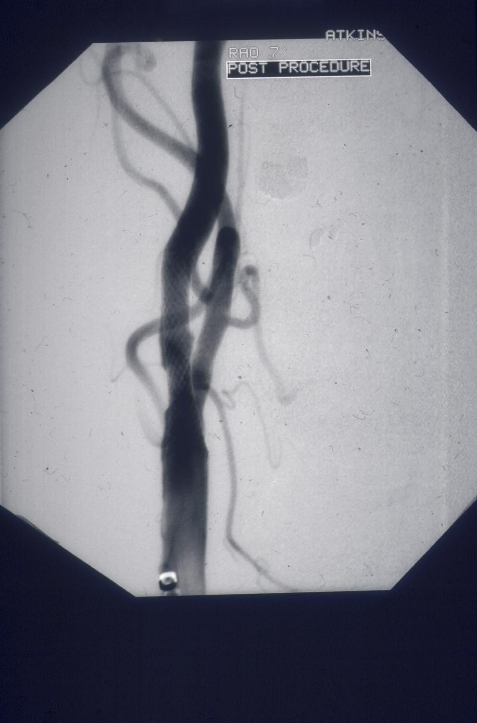
Techniques, devices, experience have all
changed since the earlier symptomatic trials…
Open vs closed-cell stent design
Closed–cell safer?
Now – have FLOW-reversal systems, direct puncture, membrane stents..reduces risk of distal embolisation

Slide 11
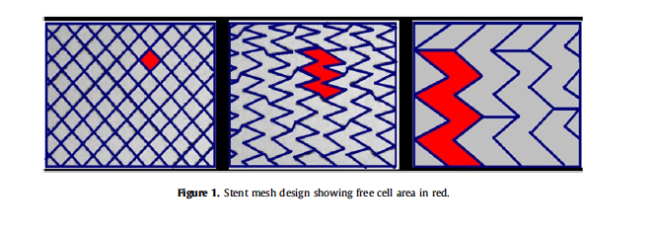
Open and closed-cell stents

Slide 12
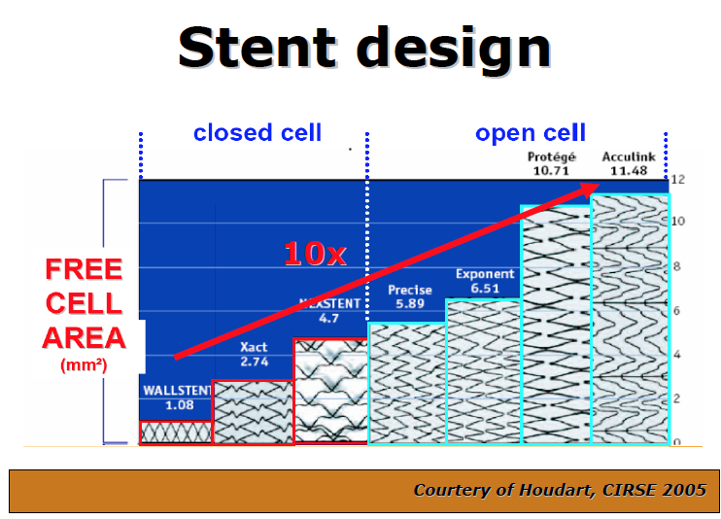

Slide 13
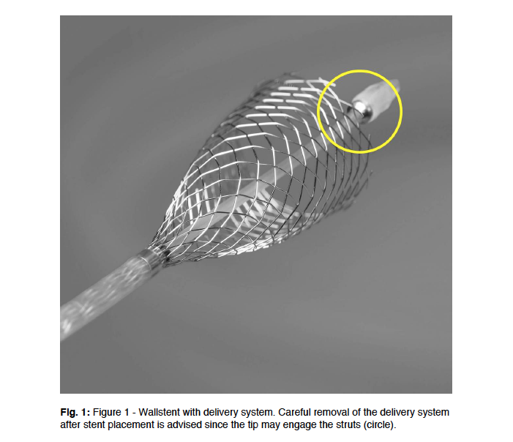
Wallstent closed-cell

Slide 14
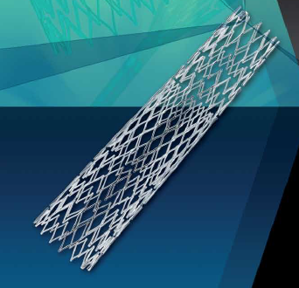
Cristallo Ideale (Hybrid)
Open Cell Stent with Closed Cell Design
Proximal and distal sections – open cell, enhanced flexibility
Central closed cell
section

Slide 15
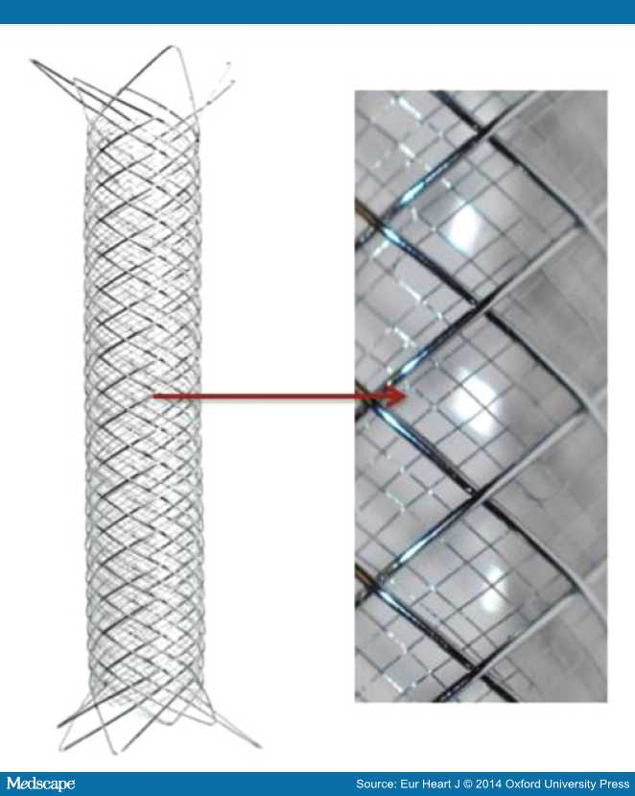
Membrane
Stent
Roadsaver

Slide 16
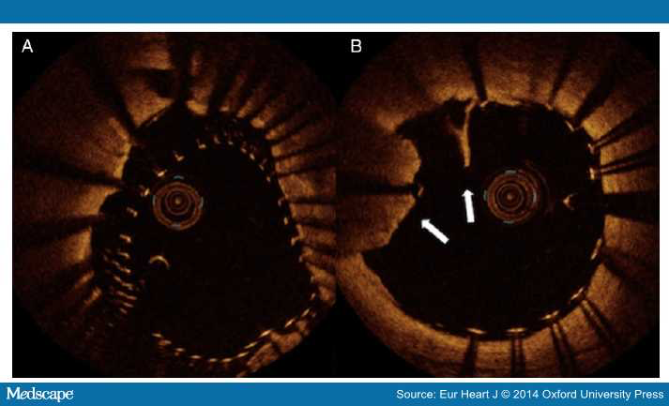

Slide 17
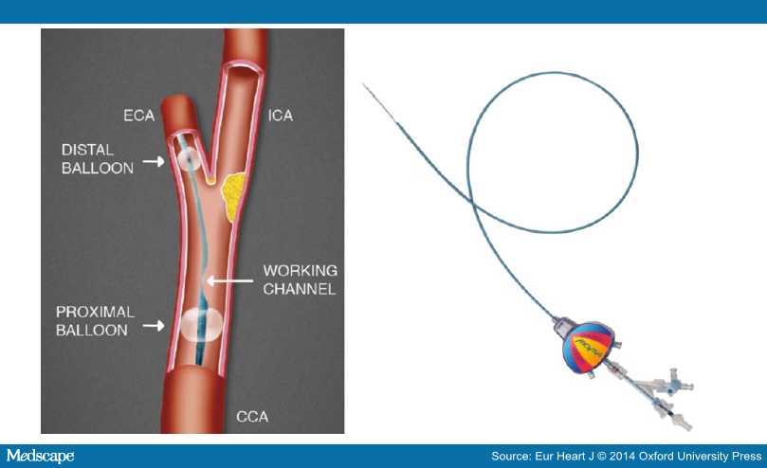
MoMa
Flow-reversal
catheter

Slide 18
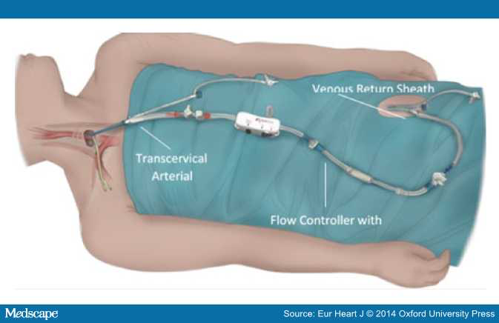
Roadsaver/Silk Road – avoids aortic arch, controlled flow reversal

Slide 19
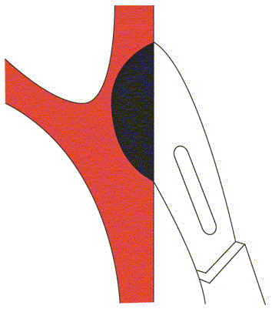
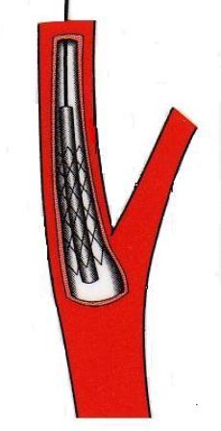


Treatment for asymptomatic carotid artery stenosis:
surgery or stenting?
Randomise patients considered to be at high future stroke risk, suitable for both procedures

Slide 20

ACST-2
A very European Trial

Slide 21
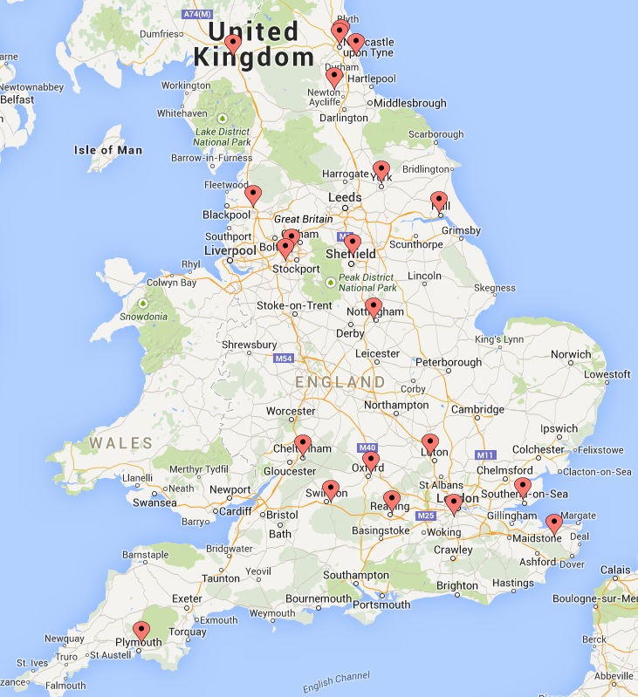
UK Centres in ACST-2

Slide 22
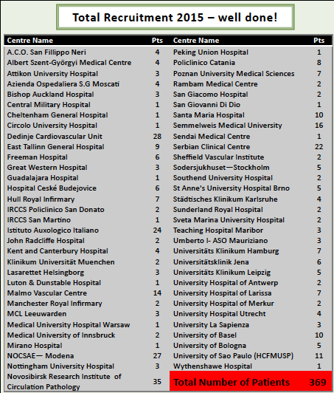
2015 Recruitment
14/62 randomising centres from UK
Overall, 17% ACST-2 patients are from UK

Slide 23
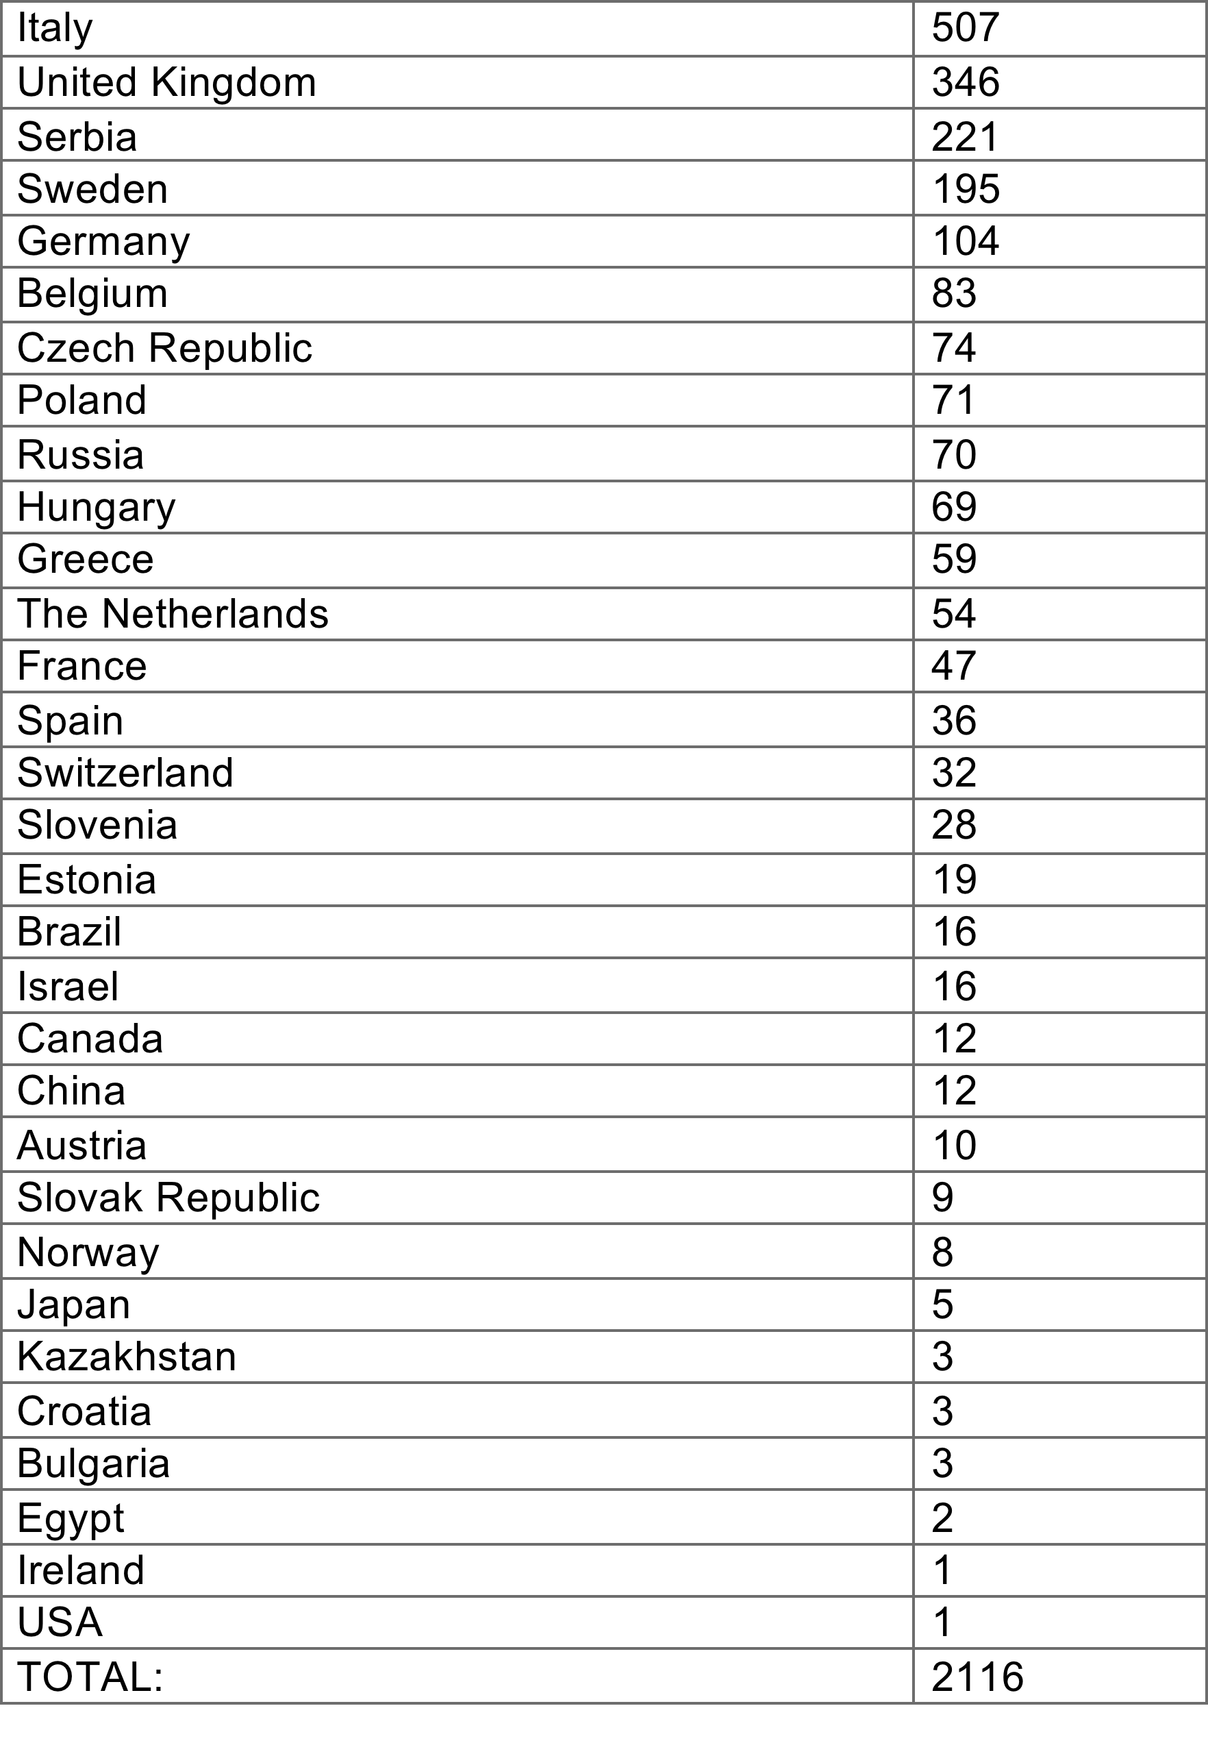
ACST-2
Recruitment
March 2016
2116
today

Slide 24
ACST-2
Sex, Age, Co-morbidities:
Men 70%
Median age 69 years
Ischaemic heart disease 37%
Diabetic 30%
Renal impairment 9%

Slide 25
ACST-2
Stroke risk factors:
Atrial Fibrillation 6%
Age >75 yrs 26%
Previous stroke symptoms or infarct 43%
Medical Treatments at entry:
BP drugs 84%
Lipid-lowering 80%
Anti-thrombotic 86%
good compliance with drug therapy after joining
direct patient feedback every year (includes drug names and doses)

Slide 26
Drug therapy at
1 month follow up (2015)
Antithrombotic (aspirin, asasantin, clopidogrel, single, dual APT, warfarin, NOAC) 99.5%
BP Medications (1-3 named drugs, none) 87%
Lipid-lowering (specific drugs/doses) 88%

Slide 27
Drug therapy at
Annual follow up (2015)
Antithrombotic (aspirin, asasantin, clopidogrel, single, dual APT, warfarin, NOAC) 95%
BP Medications (1-3 named drugs, none) 83%
Lipid-lowering (specific drugs/doses) 84%

Slide 28
ACST-2 Stents | Cerebral Protection | Devices (86%)
Wallstent | Emboshield | Filter
Cristallo Ideale Abbott Xact | Filterwire | Filter
Cordis Precise | Mo. Ma Spider | Prox occ Filter
Ev3 Protégé® RX Abbott Acculink | Accunet AngioGuard | Filter Filter
Boston Adapt Sinus | Gore Flow Reversal | Prox occ
ViVEXX | Twin One | Distal balloon
Roadsaver Inspire | FiberNet Viatrac | Filter
Zilver, Mer | Wirion

Slide 29
ACST-2 Stents | Protection Devices | Type
Wallstent (1.08mm²) | Emboshield Filterwire | Filter Filter
Xact (2.54mm²) Boston Adapt (4.4mm²) | Accunet AngioGuard Spider Fibernet Viatrac | Filter Filter Filter Filter
Precise (5.89mm²) ViVEXX (closed,?mm²) | Mo. Ma | Prox occ
Protégé® RX (10.71mm²) Acculink (11.48mm²) | Gore Flow Reversal | Prox occ
Cristallo Ideale (Hybrid) Sinus (Hybrid) | Twin One | Distal balloon
Roadsaver (membrane) Inspire (membrane)
Zilver, Mer

Slide 30
ACST-2: Blinded Procedural hazards
1500 patients (≤ 30 days)
Disabling/fatal stroke or fatal MI much lower than in symptomatic trials
Despite increasing age and risk factors for stroke,
interventional hazards in ACST-2 are lower than ACST-1:
ACST-1 (CEA) 1.7%
ACST-2 (CEA and CAS) 1.0%
‘blinded’
30

Slide 31


NICE(2011) recommend randomisation in ACST-2
UK Stroke and International Guidelines use this evidence – large vascular trials (many patients, long follow up)
Randomised Trials need to be large…… and work together to answer clinically important questions (who needs intervention, which intervention, how effective are statins for tight carotid stenosis, how low a BP is safe…)
ACST-2 is successfully enrolling patients, many have higher stroke risk because of previous symptoms and cerebral infarcts; this trial with others can help answer important questions
ECST-2, ACST-2, ACT 1, CREST 2, SPACE 2…..modern trials, working together to provide the evidence

