Slide 1
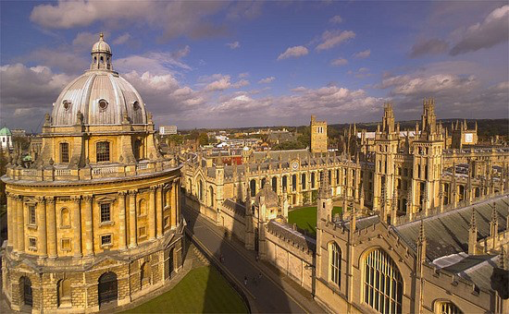
Alison Halliday
Professor of Vascular Surgery, University of Oxford
SCVS, Las Vegas, 15th March 2016
Clinical Trials in Vascular Surgery -
the Pleasure of Uncertainty

Slide 2
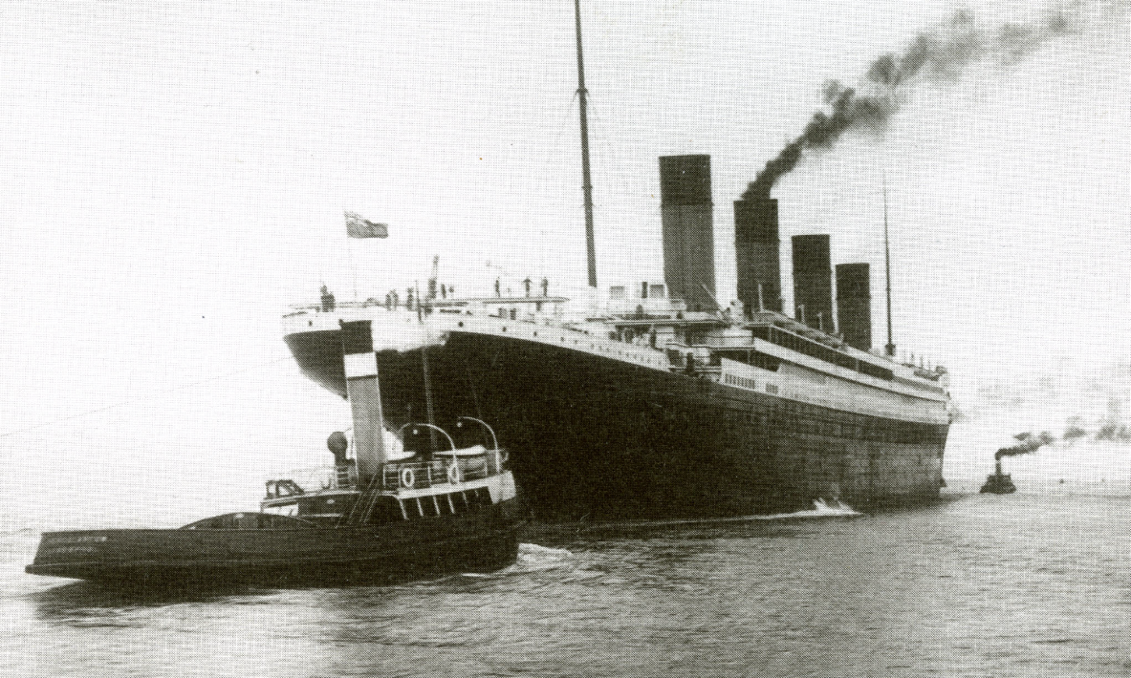

Slide 3
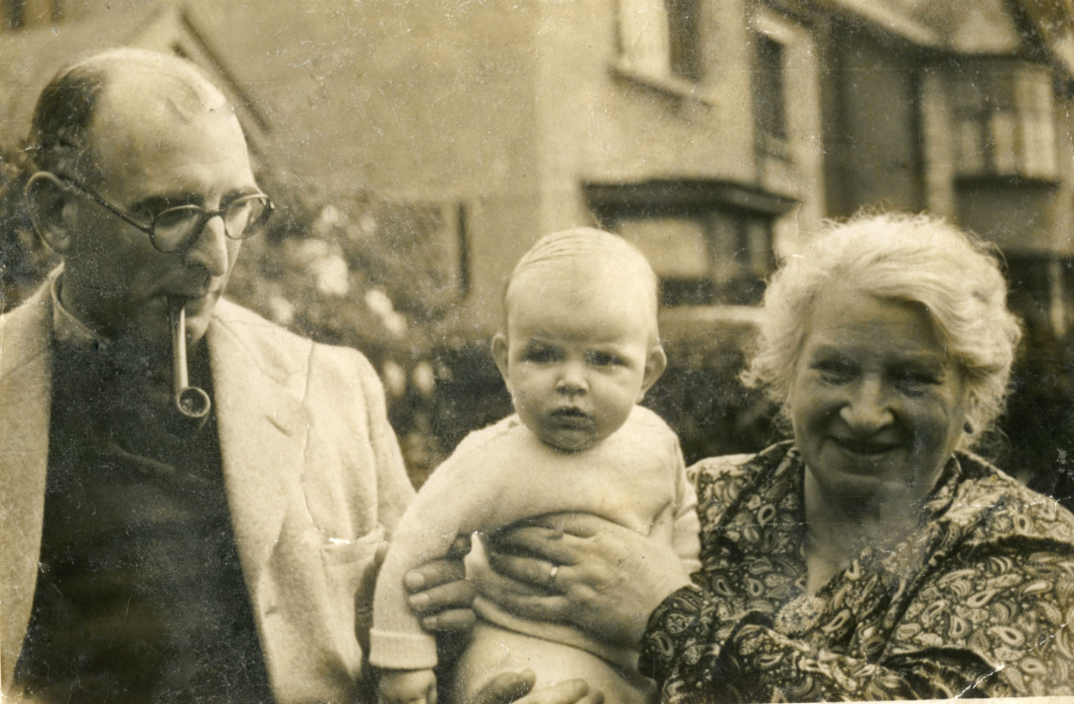

Slide 4
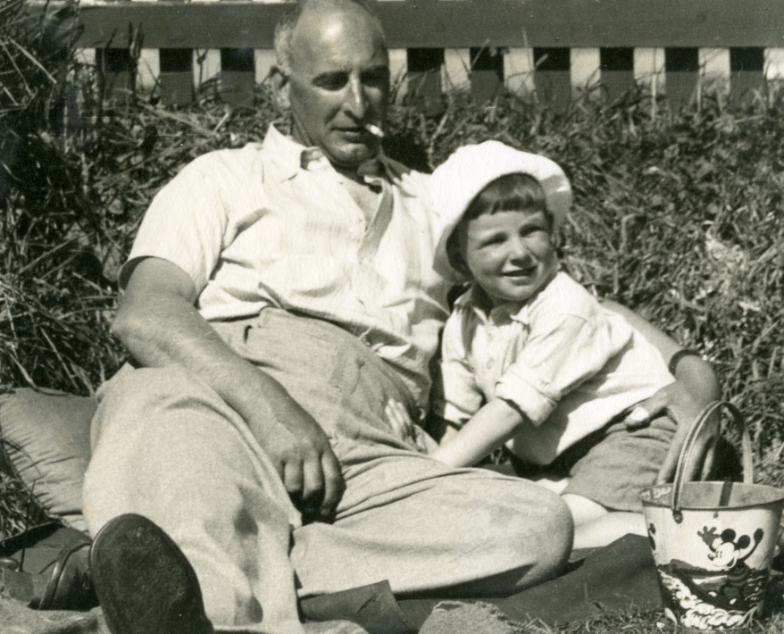

Slide 5
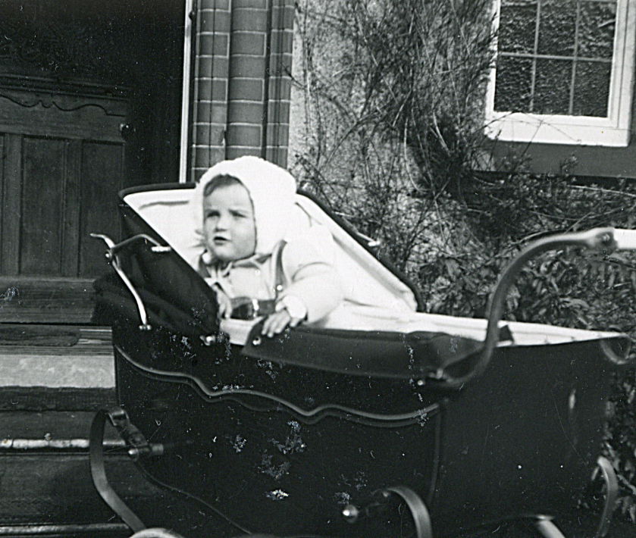

Slide 6
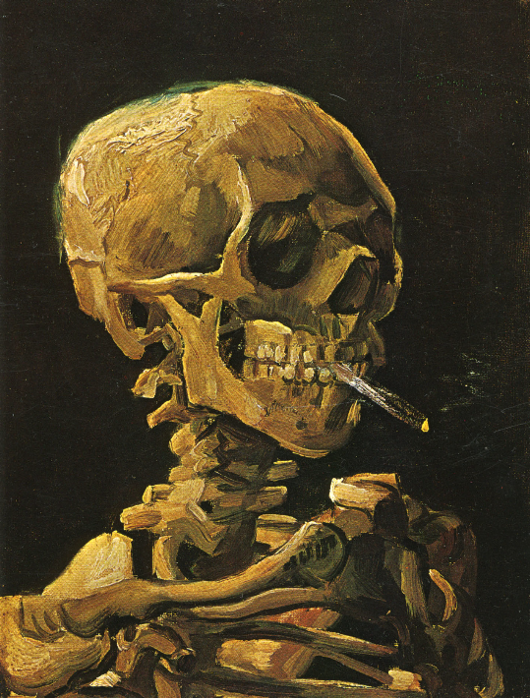

Slide 7
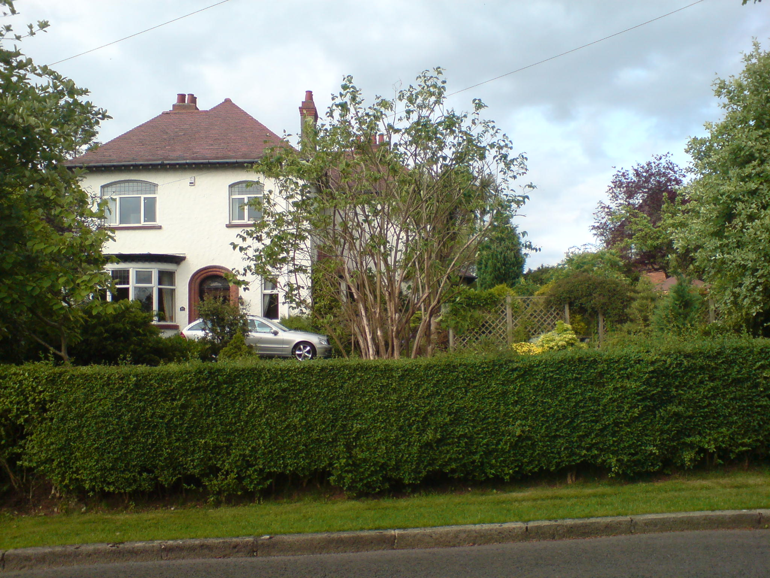

Slide 8
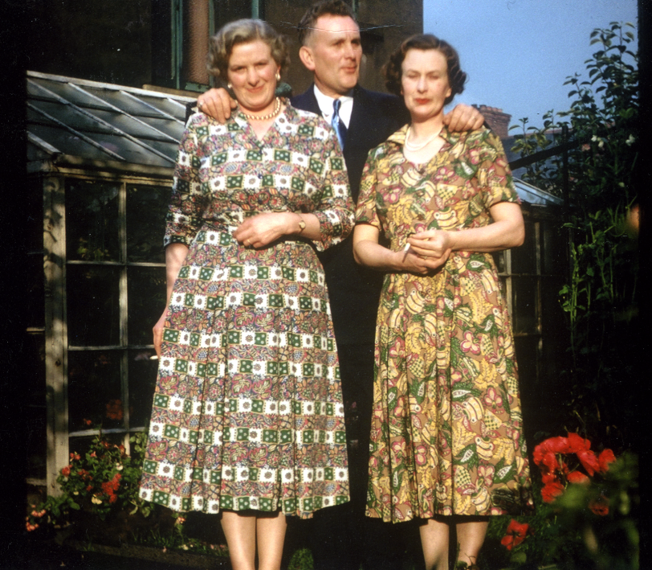

Slide 9


Slide 10
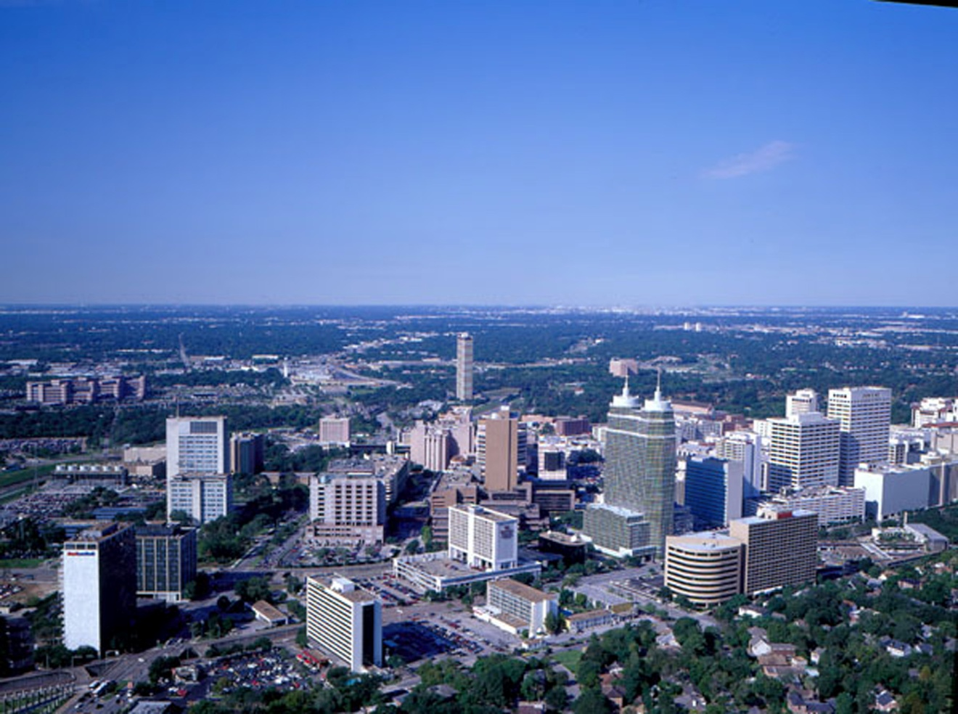
UT Houston, Texas – Early Training in Surgery

Slide 11
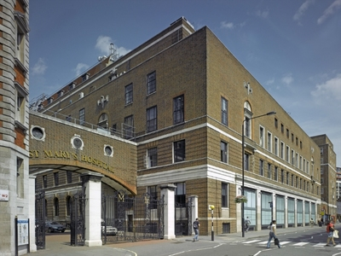
St Mary’s – birthplace of European Carotid Trials
(and of Penicillin.. Alexander Fleming)

Slide 12
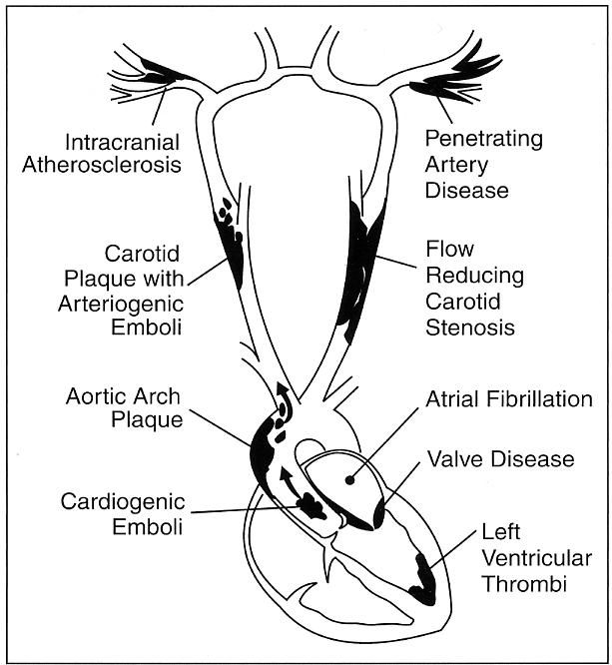
About 20% ischaemic
Strokes are caused by
carotid stenosis
Notes:
12

Slide 13
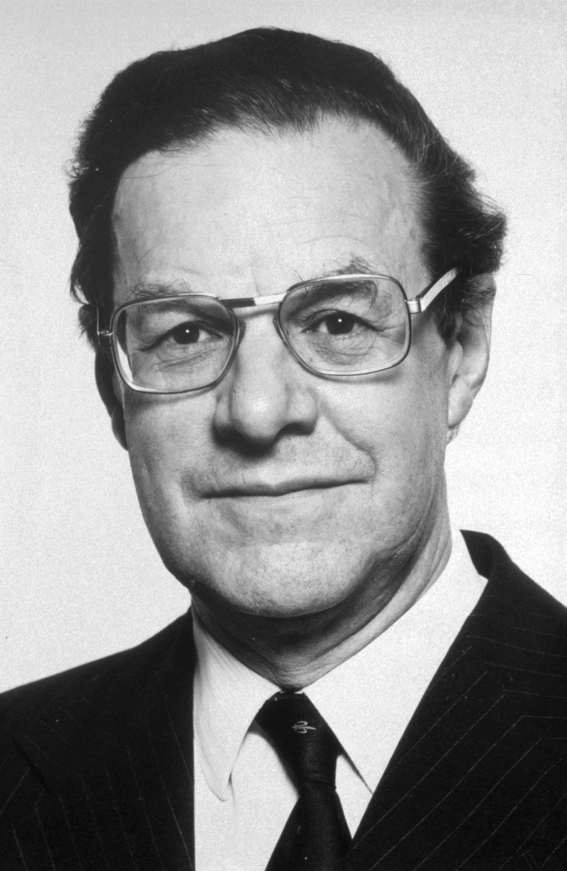
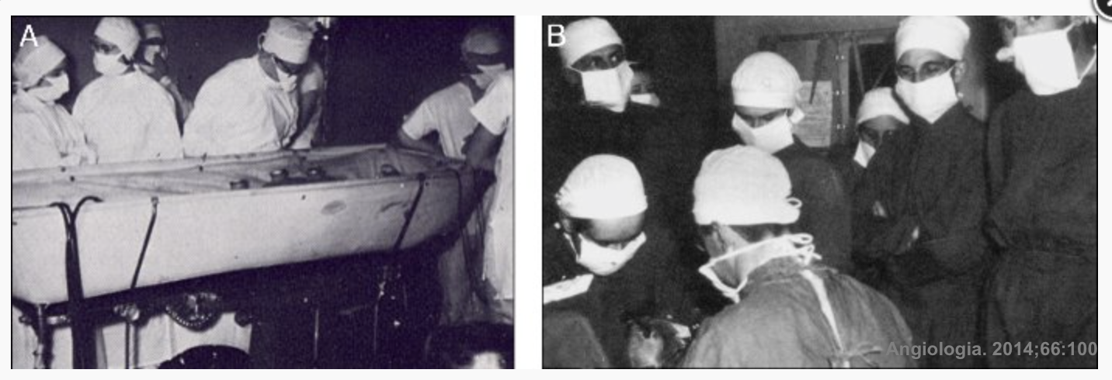
St Mary’s … Charles Rob, Felix Eastcott
the first reported carotid artery procedure to prevent stroke
(Lancet, 1954)

Slide 14
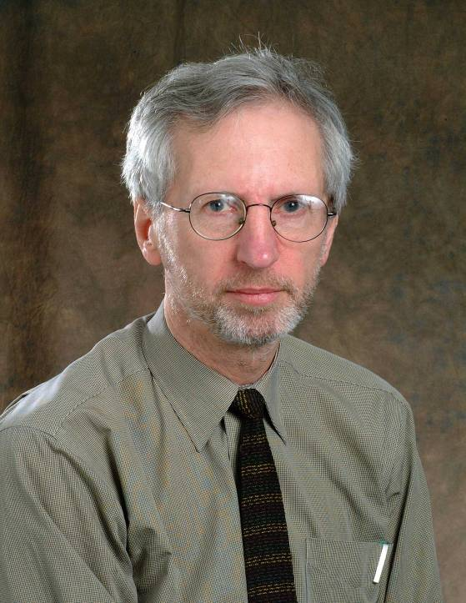
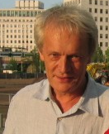
The European Carotid Surgery Trial
(like NASCET, studied patients with recent stroke symptoms and carotid artery narrowing – randomly allocated to operation or not)

Slide 15
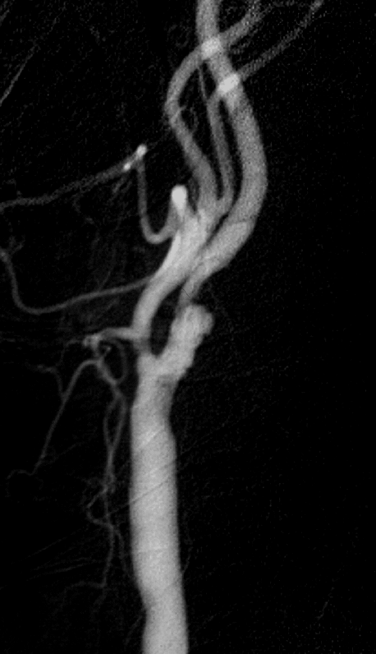
Asymptomatic carotid artery stenosis: narrowing that has not yet caused a stroke
Might intervention prevent stroke?

Slide 16
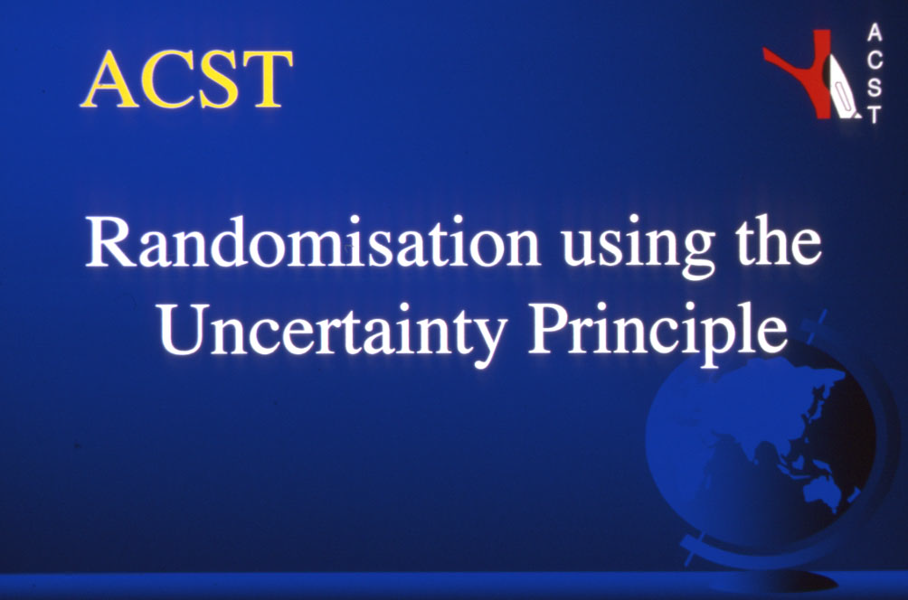

Slide 17
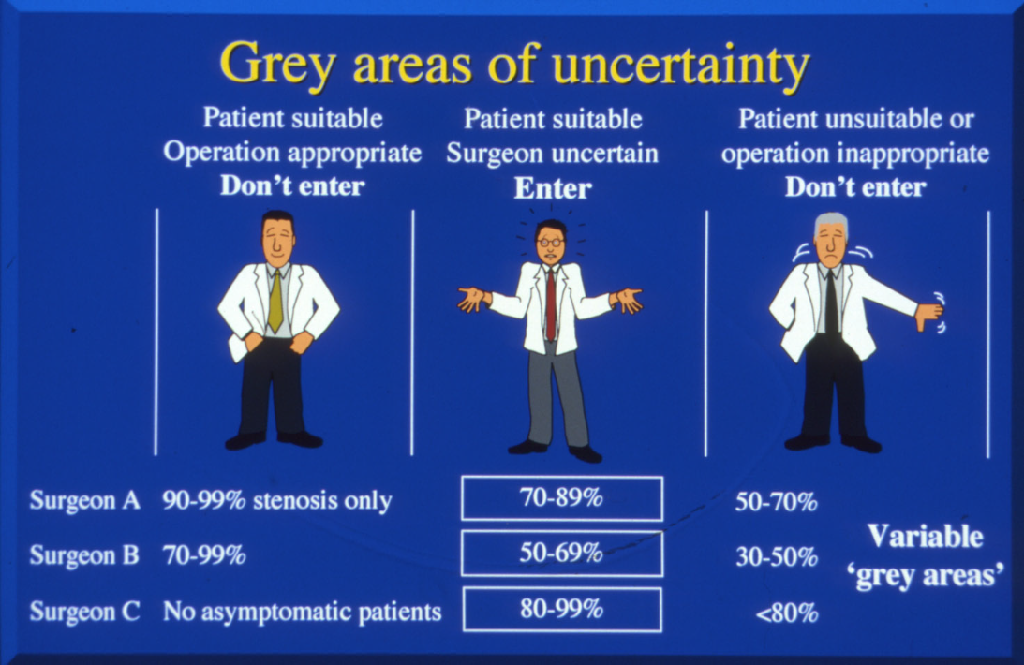

Slide 18
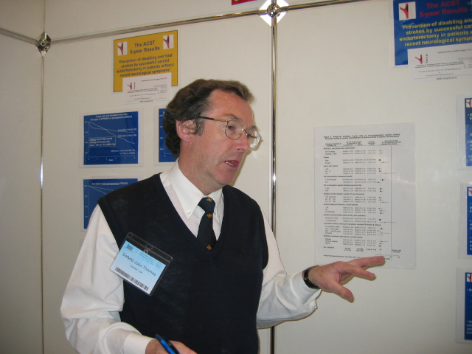

Slide 19
ACST-1: 3120 patients
126 centres in 30 countries
Finland 18
Russia 10
Norway 47
New Zealand: 10
Brazil: 2
Canada: 30
USA 16
Netherlands 132
Sweden 532
: 16
Tunisia: 11
UK 1069
Ireland 7
Czech Republic 18
Belgium 1
Poland 88
Germany 98
Hungary 59
France 2
Yugoslavia 77
Switzerland 6
Bulgaria 6
Austria 30
Italy 328
Israel 245
Cyprus 13
Slovenia 44
Portugal 13
Spain 196
Croatia 2
Greece 10
Notes:
Dafydd Thomas – history of ACST

Slide 20
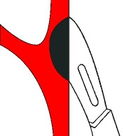
ACST-1
3120 patients, randomized to:
Immediate CEA
vs
‘control’
(no CEA unless symptoms occur)
Notes:
20

Slide 21
ACST-1: CEA reduces 10-year stroke risk by 6-7%

Slide 22
Statins – lower overall stroke risk, but CEA confers an additional 6% absolute risk reduction

Slide 23
ACST-1 – peri-operative risk
reduced by statin therapy
ACST-1
4.3%
2.2%

Slide 24

ACST-1 trial findings
ACST-1
CEA - Early operative hazard (~3% stroke & death), but overall benefit of long-term stroke prevention, which lasts at least 10 years
Stroke risk within 5 years of operation is reduced by more than half
Patients up to 75 years old definitely benefit, and will usually live long enough to enjoy that benefit

Slide 25
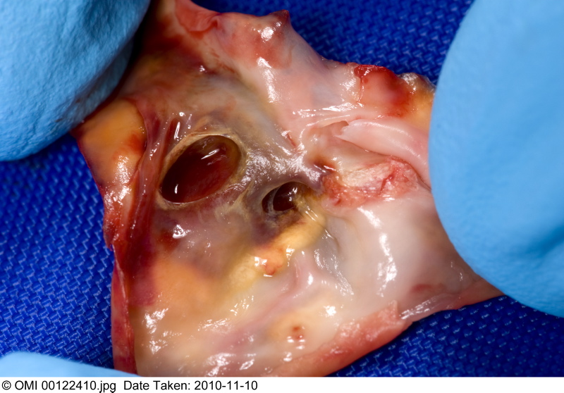
‘Asymptomatic’ - a misnomer?
41% ACST-1 patients had prior stroke-type symptoms or had brain infarcts
they were at higher stroke risk ~ 3% yr

Slide 26
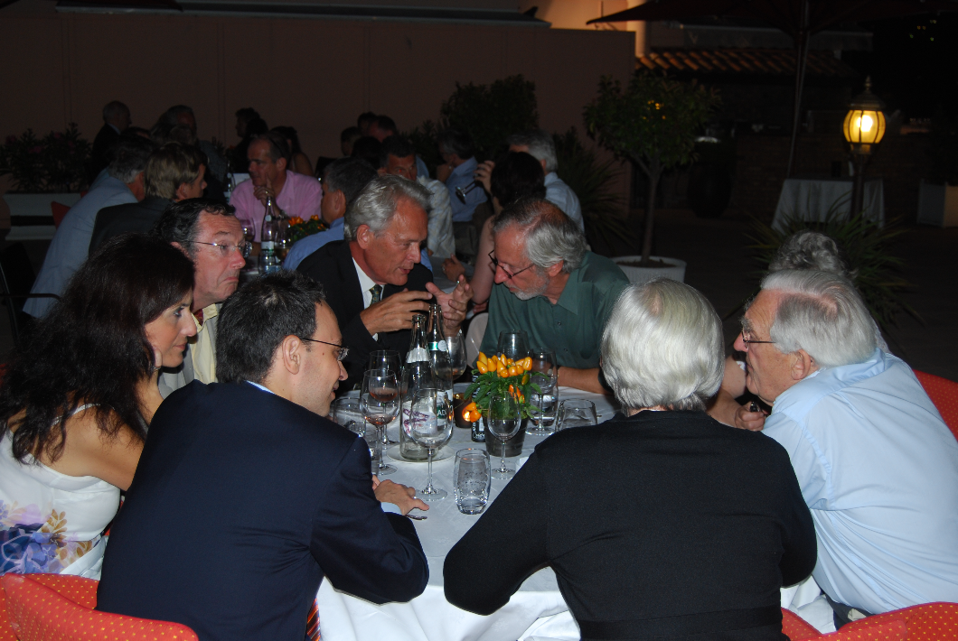

Slide 27

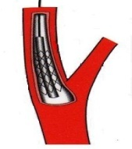
Should we do another trial?
ACST-2
Surgery vs Stenting
(but…. all the symptomatic CEA vs CAS trials were certain CEA was better?)

Slide 28
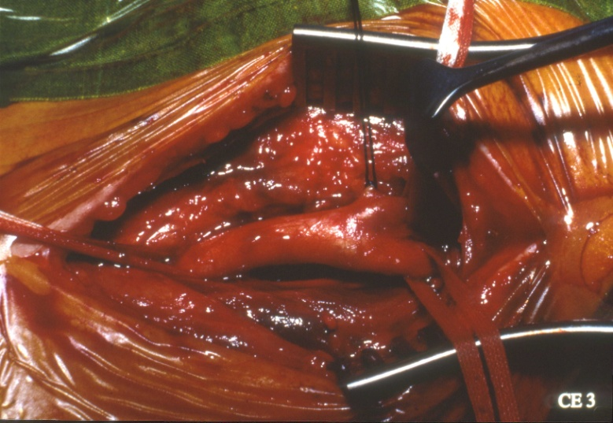
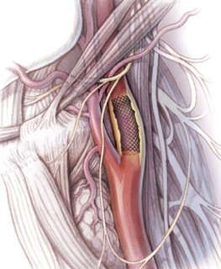
Surgery or Stent? Uncertainty is OK…

Slide 29
Since ACST-1: Falling risks from CEA and CAS
Reduced procedural risk for CEA (Statins)
Reduced procedural risks for CAS…

Slide 30
Falling risks from CEA and CAS
Reduced procedural risk for CEA (Statins)
Reduced procedural risks for CAS…

Slide 31
Recent guidelines clearly show Uncertainty – and so there is a need for ACST-2
AHA Carotid Disease Management Guidelines
It is reasonable to perform CEA in asymptomatic patients who have > 70% stenosis (Evidence Level: A)
Prophylactic CAS might be considered in highly selected patients with asymptomatic carotid stenosis (Evidence Level: B)
Society for Vascular Surgery Carotid Guidelines
Asymptomatic > 60% stenosis
should be considered for CEA (Evidence Level: A)
CAS should not be performed except as part of an on-going clinical trial (Evidence Level: B)
UK NICE Carotid Intervention Guidelines
“NICE encourages clinicians either
to enter patients into the ACST-2 trial, or to submit data to
the Endovascular Carotid Register”
Royal College of Physicians Stroke Guidelines
Surgery or stenting (CEA or CAS) for
asymptomatic carotid artery stenosis should not routinely be performed unless as part of a randomised trial.
Notes:
31

Slide 32
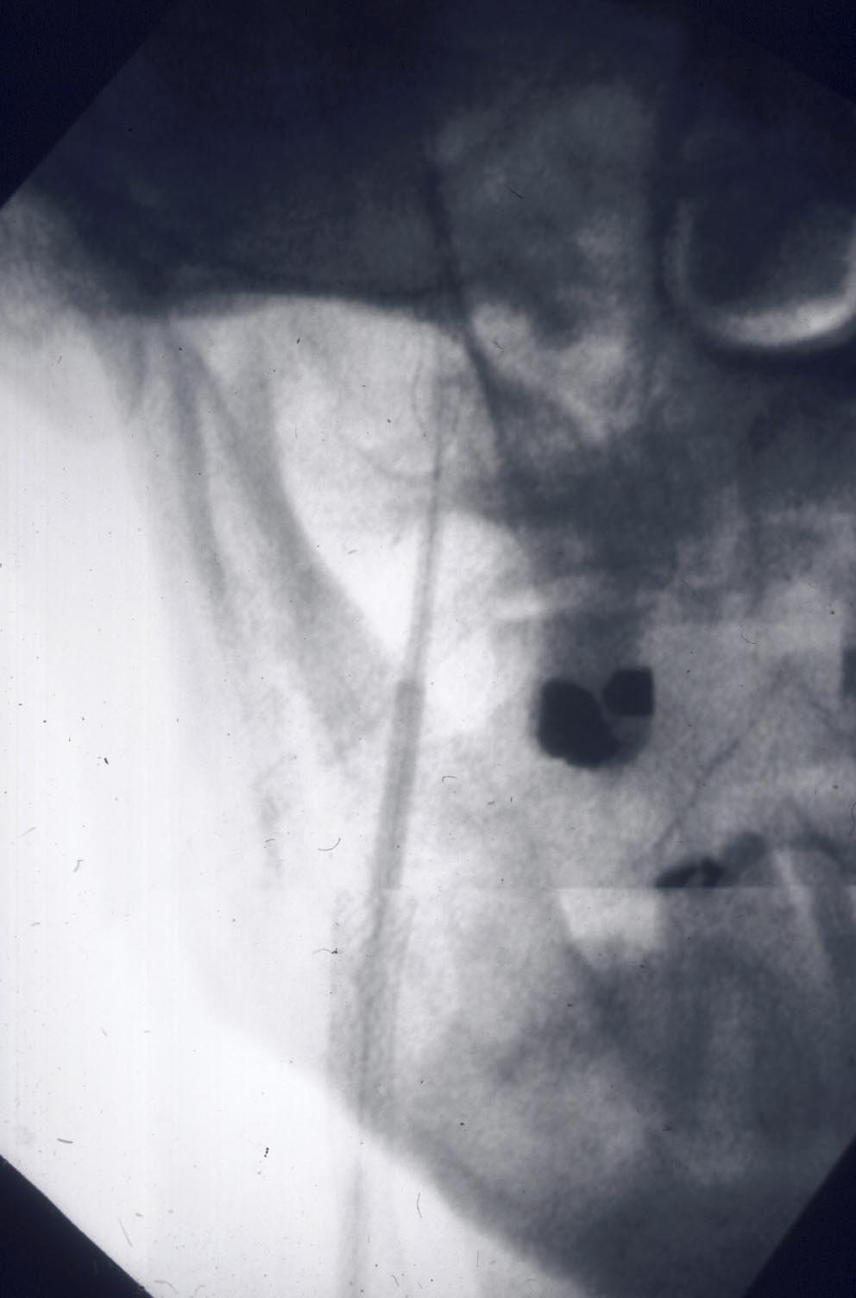
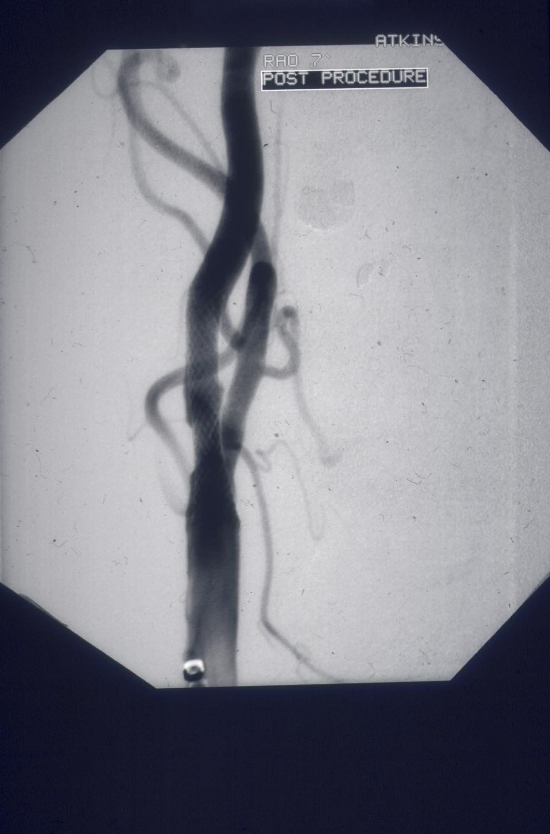
Techniques, devices, experience have all
changed since the early symptomatic trials
showed an excess minor strokes caused by stenting …
Now – have FLOW-reversal systems,
direct puncture, membrane stents.
reducing risk of distal embolisation

Slide 33
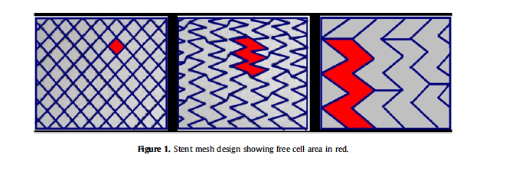
Open and closed-cell stents

Slide 34
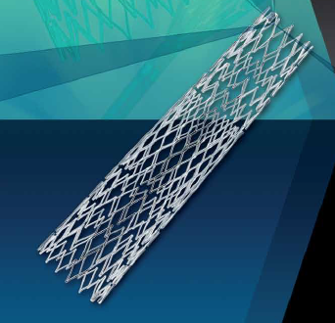
Cristallo Ideale (Hybrid)
Open Cell Stent with Closed Cell Design
Proximal and distal sections – open cell, enhanced flexibility
Central closed cell
section

Slide 35
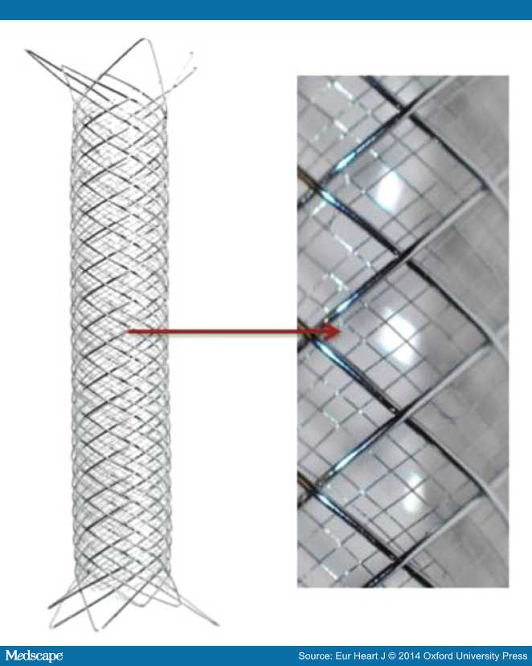
Membrane
Stent
Roadsaver

Slide 36
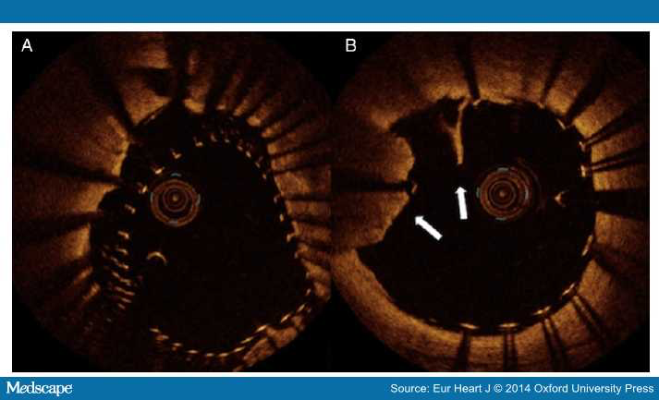

Slide 37
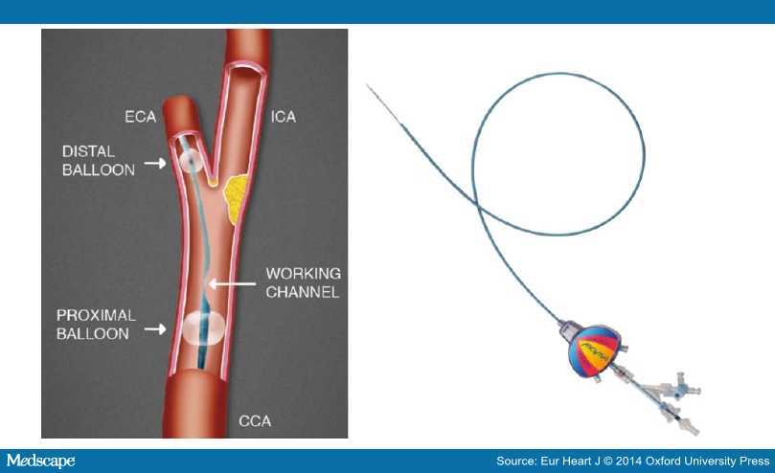
MoMa
Flow-reversal
Protection device

Slide 38
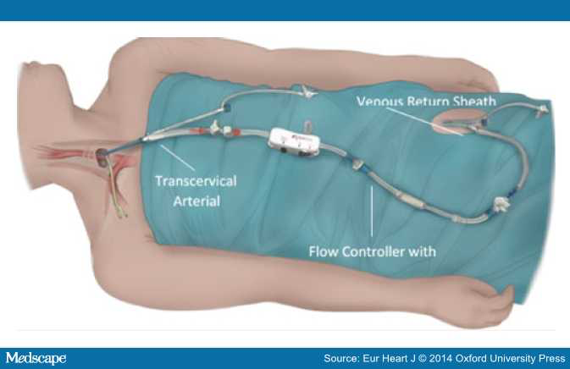
Roadsaver/Silk Road ‘surgical’ approach – avoids aortic arch, controlled flow reversal

Slide 39
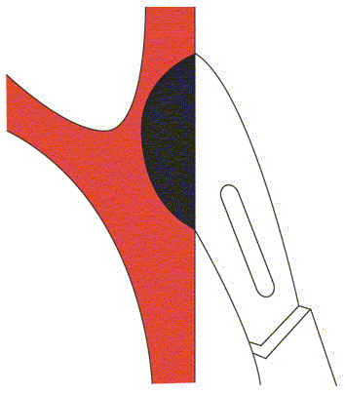



ACST-2 randomises patients considered to be at high future stroke risk, but shown to be suitable for both procedures

Slide 40
ACST-2
Surgery vs Stenting - Target 3600 patients
today
2116

Slide 41
ACST-2
Sex, Age, Co-morbidities:
Men 70%
Median age 69 years
Ischaemic heart disease 37%
Diabetic 30%
Renal impairment 9%

Slide 42
ACST-2
Stroke risk factors:
Atrial Fibrillation 6%
Age >75 yrs 26%
Previous stroke symptoms or infarct 43%
Medical Treatments at entry:
BP drugs 84%
Lipid-lowering 80%
Anti-thrombotic 86%
good compliance with drug therapy after joining
direct patient feedback every year (includes drug names and doses)

Slide 43
Drug therapy at
Annual follow up (2015)
Antithrombotic (aspirin, asasantin, clopidogrel, single, dual APT, warfarin, NOAC) 95%
BP Medications (1-3 named drugs, none) 83%
Lipid-lowering (specific drugs/doses) 84%

Slide 44
ACST-2 Stents | Cerebral Protection | Devices (86%)
Wallstent | Emboshield | Filter
Cristallo Ideale Xact | Filterwire | Filter
Cordis Precise | Mo. Ma Spider | Prox occ Filter
Protégé® RX Acculink | Accunet AngioGuard | Filter Filter
Roadsaver Adapt Sinus | Gore Flow Reversal | Prox occ
ViVEXX | Twin One | Distal balloon
Inspire Zilver Mer | FiberNet Viatrac Wirion | Filter

Slide 45
ACST-2 Stents | Protection Devices | Type
Wallstent (1.08mm²) | Emboshield Filterwire | Filter Filter
Xact (2.54mm²) Adapt (4.4mm²) | Accunet AngioGuard Spider Fibernet Viatrac | Filter Filter Filter Filter
Precise (5.89mm²) ViVEXX (closed,?mm²) | Mo. Ma | Prox occ
Protégé® RX (10.71mm²) Acculink (11.48mm²) | Gore Flow Reversal | Prox occ
Cristallo Ideale (Hybrid) Sinus (Hybrid) | Twin One | Distal balloon
Roadsaver (membrane) Inspire (membrane)
Zilver, Mer

Slide 46
ACST-2: Blinded Procedural hazards
1500 patients (≤ 30 days)
Disabling/fatal stroke or fatal MI much lower than in symptomatic trials
(and lower than ACST-1)
ACST-1 (CEA) 1.7%
ACST-2 (CEA and CAS) 1.0%
46

Slide 47
……the future
ACST trials have included more than 5000 patients …
our eventual plan is to recruit over 6700 by end 2019,
with final follow up to 2025

Slide 48
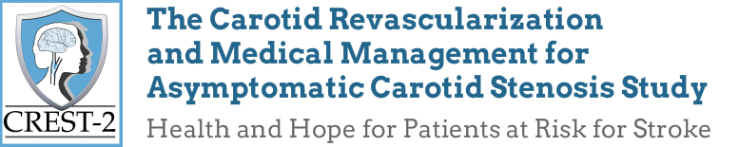
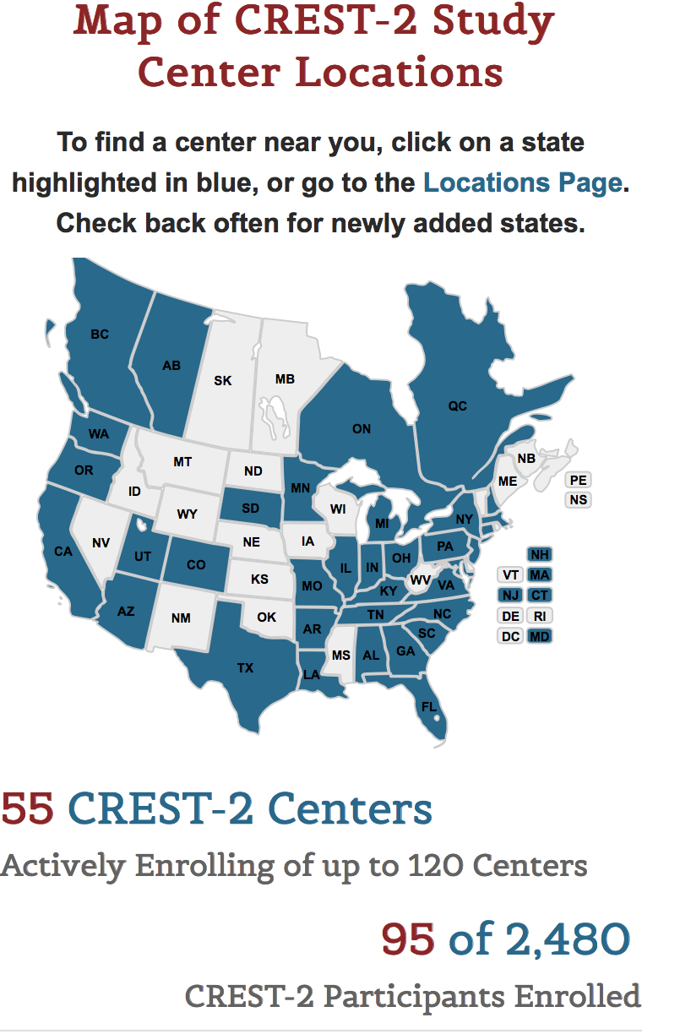
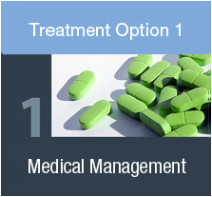


Slide 50

The hazards of smoking
and the benefits of stopping
Notes:
The hazards of smoking
This presentation is about the hazards of smoking
[CLICK]
and the benefits of stopping

Slide 51

Long-term study of persistent smoking
For 50 years, British Doctors’ smoking habits were studied by Richard Doll
Their habits were typical of their generation – many were encouraged to smoke in the army, in the workplace, as part of ‘growing-up’; advertisements even suggested that smoking was good for their health
8
www.deathsfromsmoking.net
Notes:
Long-term study of persistent smoking
The longest-running study of smoking and death was done in the UK. Its early results showed that smoking could cause many different diseases, and its final results (after 50 years) showed for the first time the full life-long risks of smoking. This is because …
[CLICK]
UK men born in the 20th century were the first population in the world to be exposed to really prolonged cigarette smoking
[CLICK]
They were studied for 50 years by Richard Doll
[CLICK]
Source: “Mortality in relation to smoking: 50 years’ observations on male British doctors”. Doll R, Peto R et al. BMJ 2004; 328: 1519-28
The results were published in the British Medical Journal.

Slide 53
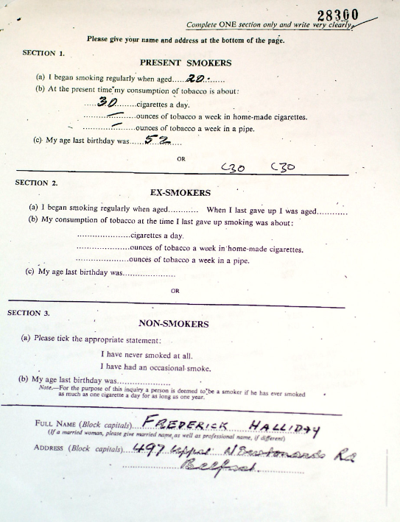

Slide 54
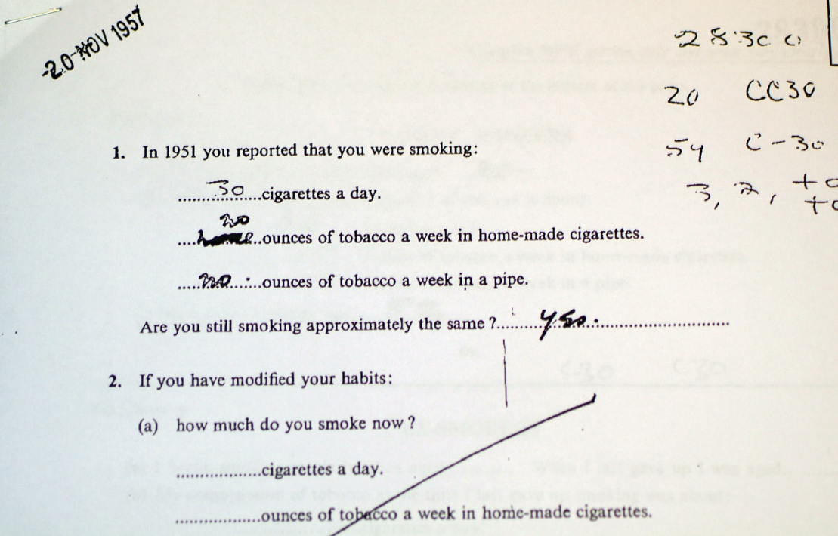

Slide 55

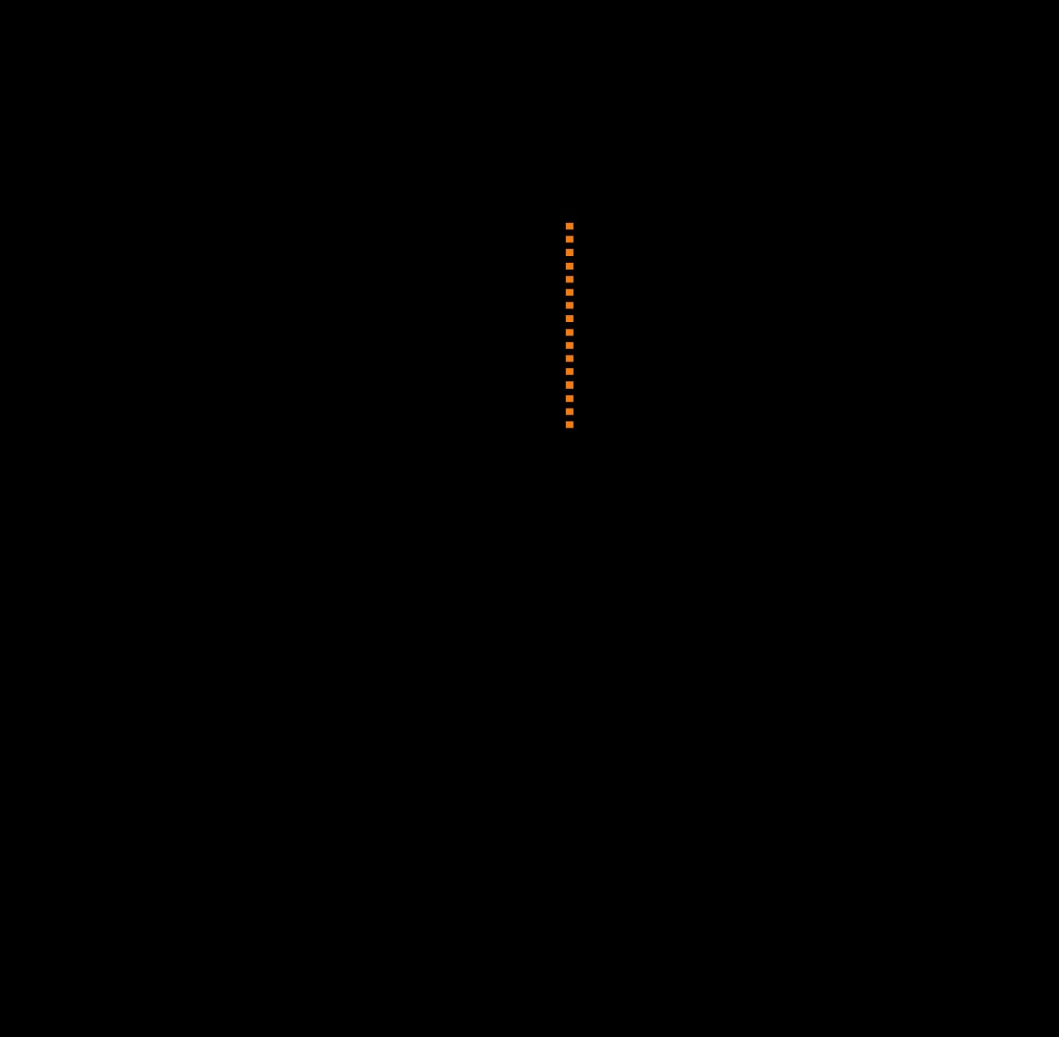
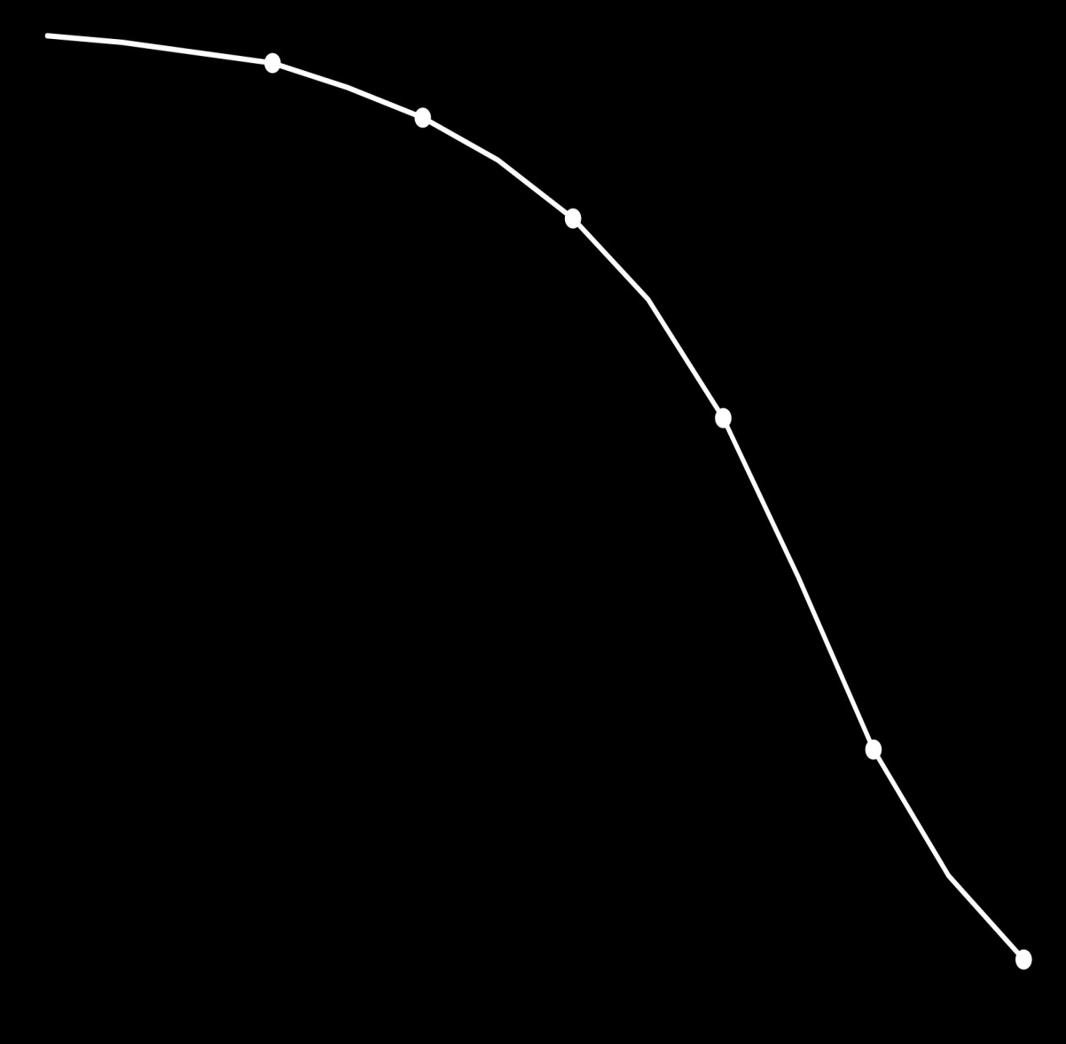
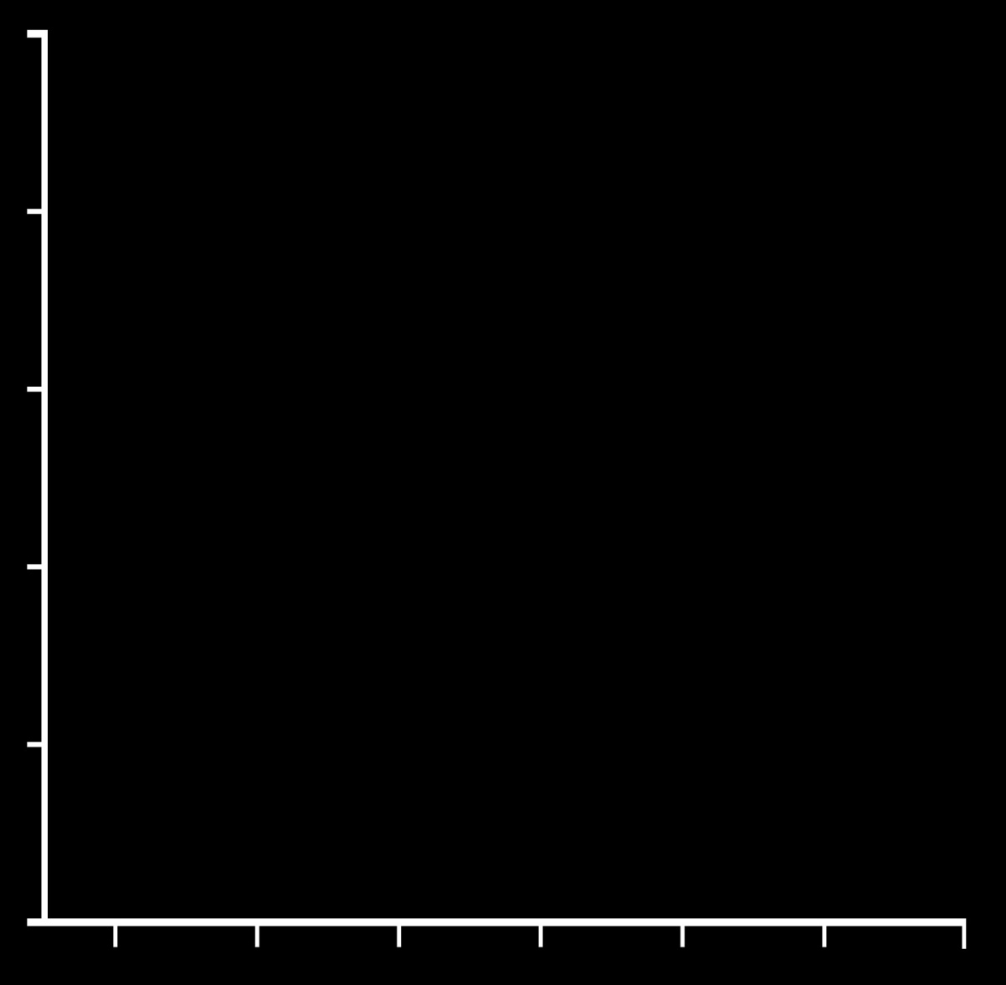
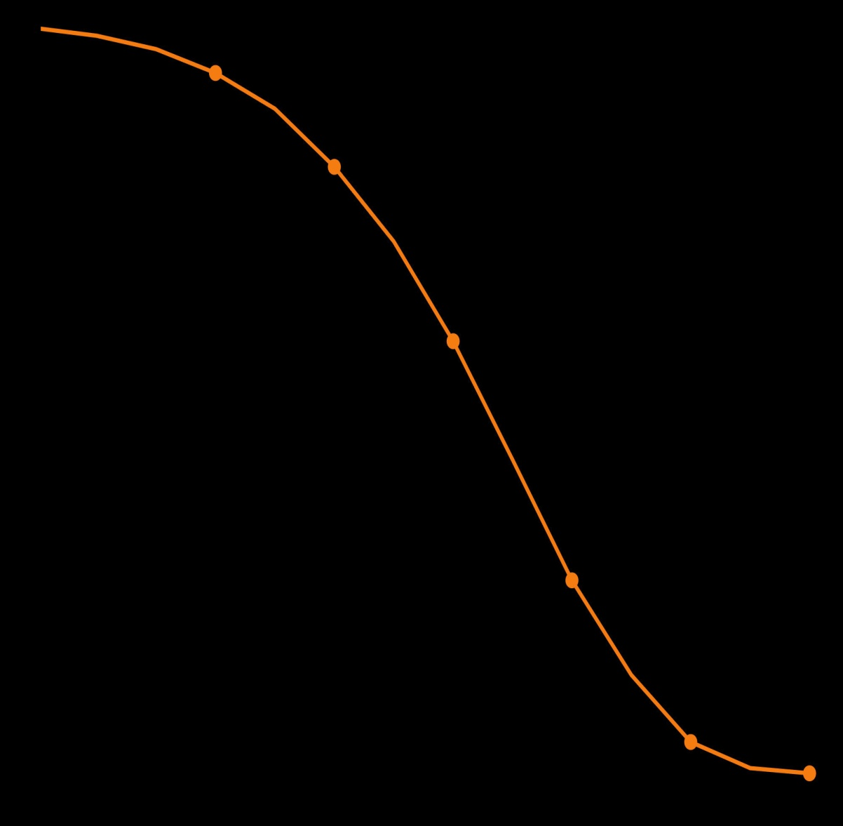


Survival to age 70 and beyond: effect of smoking in male British doctors
100
97
91
94
Non-smokers
80
81%
81
10
years
60
59
% survival
from age 35
58%
10
years
Cigarette
smokers
40
24
20
26
4
2
0
40
50
60
70
80
90
100
Age
Notes:
Survival to age 70 and beyond: effect of smoking in male British doctors
Here are Richard Doll’s main findings for smoking and death in British doctors.
This graph shows the chances of a 35-year-old surviving to age 70 and beyond.
[CLICK]
Here are the non-smokers. 81% were still alive at age 70; that means that only 19% had died in middle age.
[CLICK]
Now here are the cigarette smokers. Only 58% were still alive at 70; that means 42% had died in middle age.
This difference of 23% (between 81% survival in the non-smokers and 58% survival in the smokers) arose because about a quarter of all the smokers had been killed by tobacco when they were still in middle age (35-69), mainly from diseases such as lung cancer, heart attack and chronic lung disease.
[CLICK]
Of course, everybody will die sooner or later: it’s just that, on average, the smokers died 10 years sooner. 81% of the smokers were alive at 60, while 81% of the non-smokers were still alive at 70.
[CLICK]
Likewise, 58% of the smokers were alive at 70, while 59% of the non-smokers were still alive at 80.
Of course this 10-year shift is just the average. Some smokers are not killed by tobacco, while many others lose 10, 20, 30 or more good years.
And, next, the effects of stopping smoking…

Slide 56



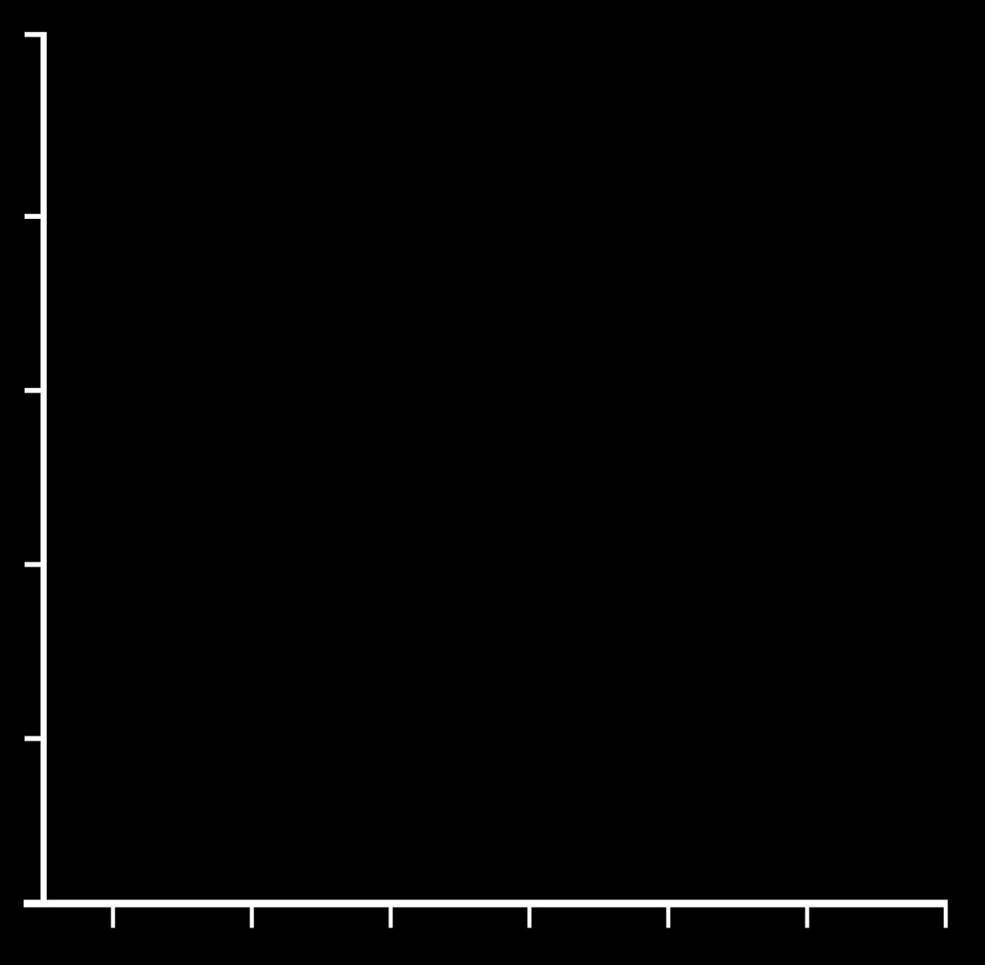
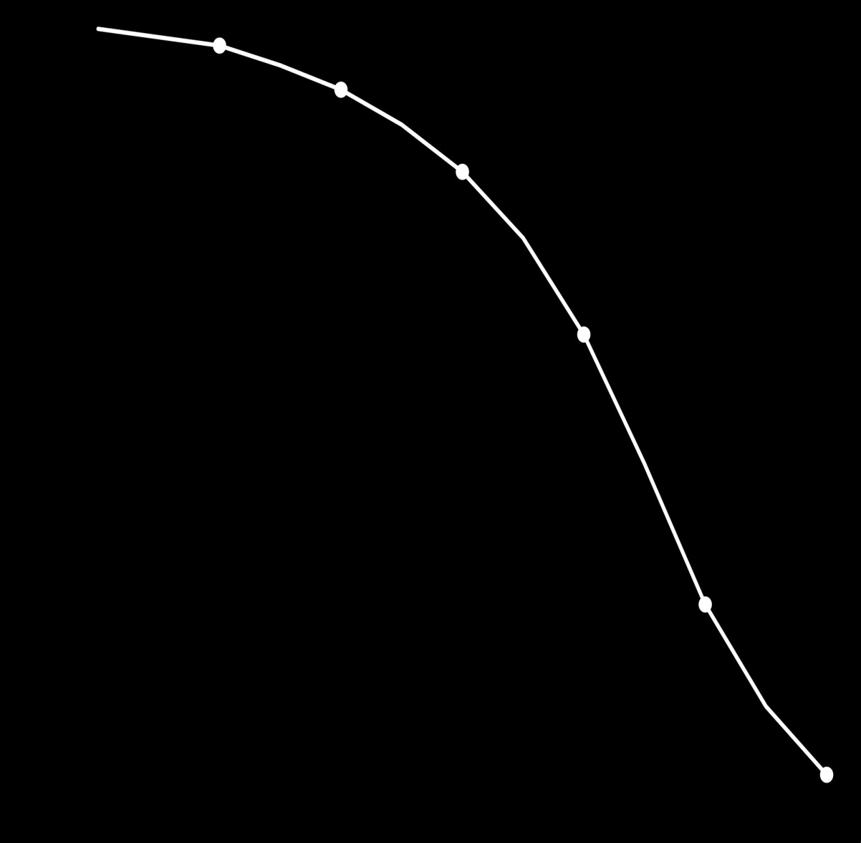
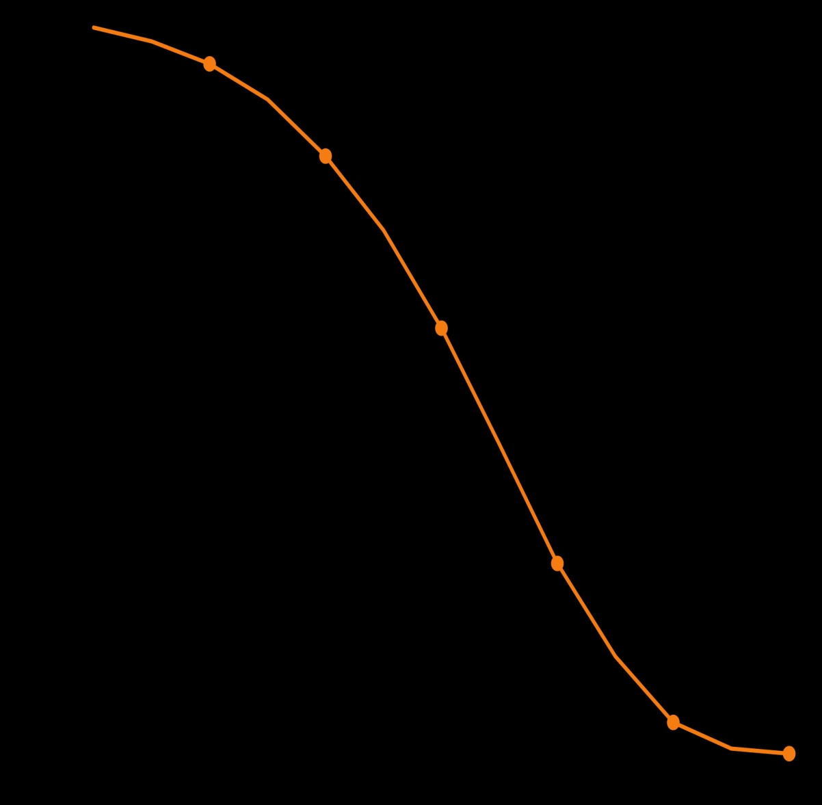
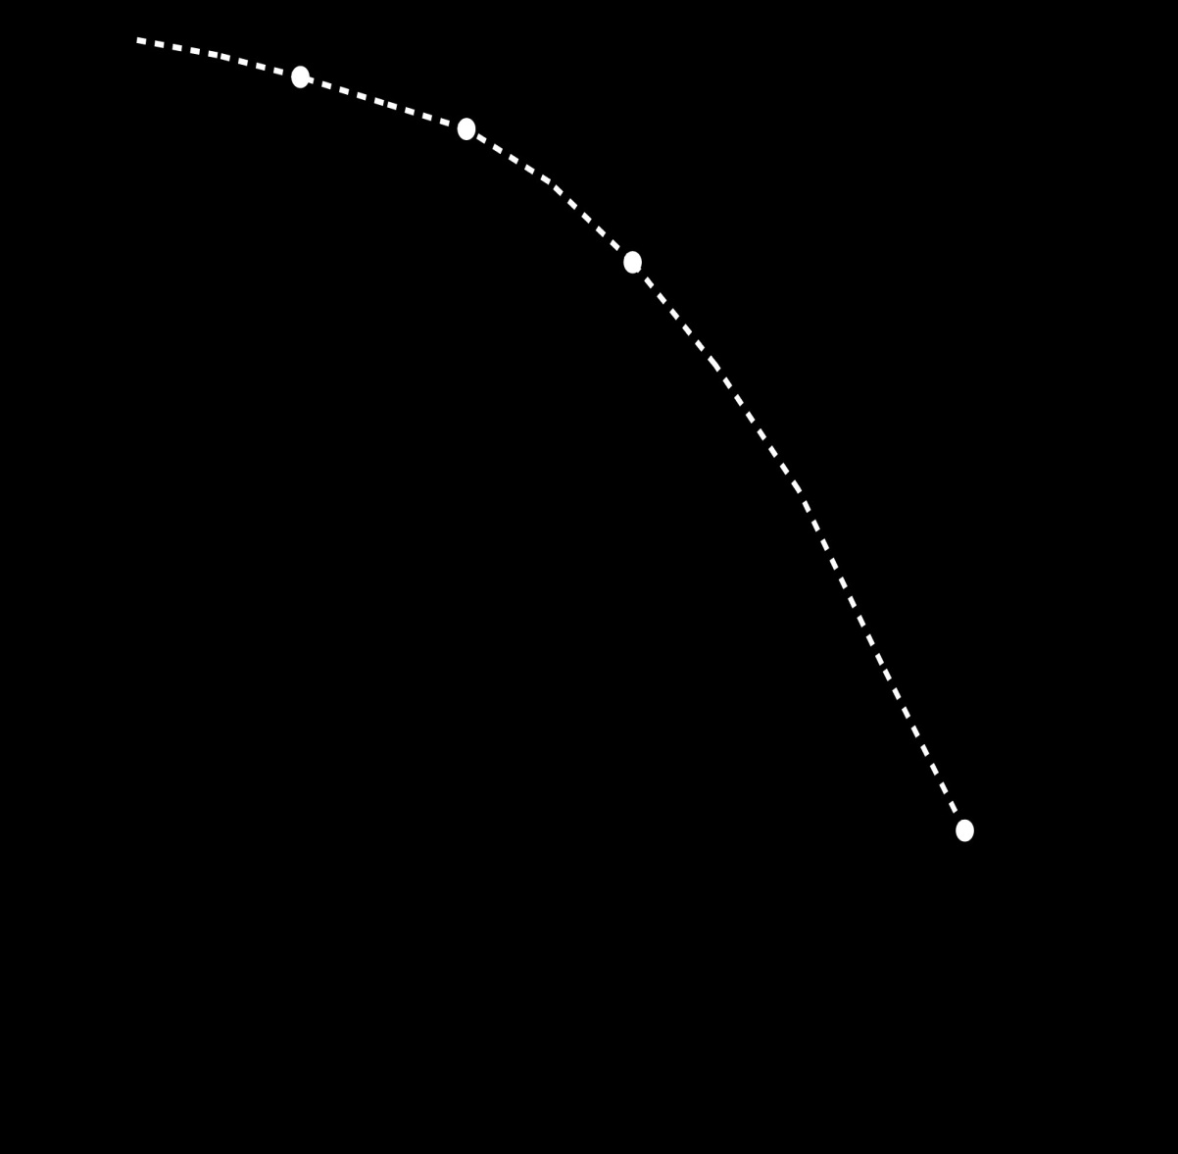

Effect of stopping smoking at about age 40
100
Cigarette
smokers
80
Ex-smokers stopped at 35-44
and gained about 9 years
% survival
from age 40
60
40
Non-smokers
20
0
40
50
60
70
80
90
100
Age
Notes:
Effect of stopping smoking at about age 40
The other main finding from Richard Doll’s study was that stopping smoking worked remarkably well.
Even in early middle age (for example, about age 40) , those who stopped before they had incurable lung cancer or some other fatal disease avoided most of their risk of being killed by tobacco, and stopping before middle age was even better.
These are the results for those who stopped at about 40 years of age.
[CLICK]
Here are the non-smokers …
[CLICK]
And here are the smokers, losing about 10 years on average …
[CLICK]
And here are the people who stopped smoking at about age 40.
Instead of losing 10 years, they lost only about 1 year.
[CLICK]
So, by stopping at 40 they gained about 9 years of life, on average.
Partly because of this study many smokers stopped, and the UK death rates from smoking decreased sharply.

Slide 57
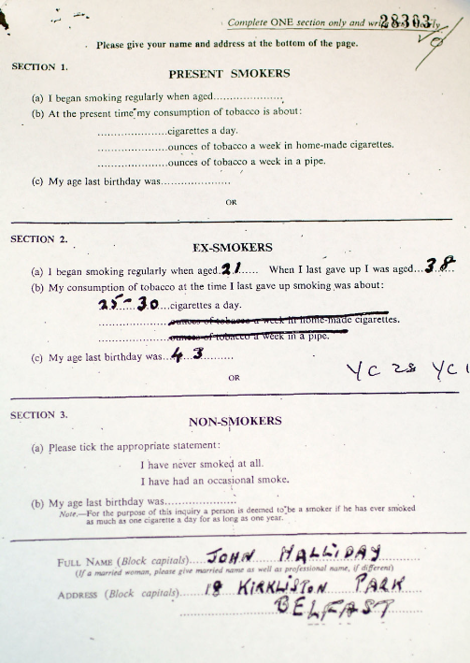

Slide 58
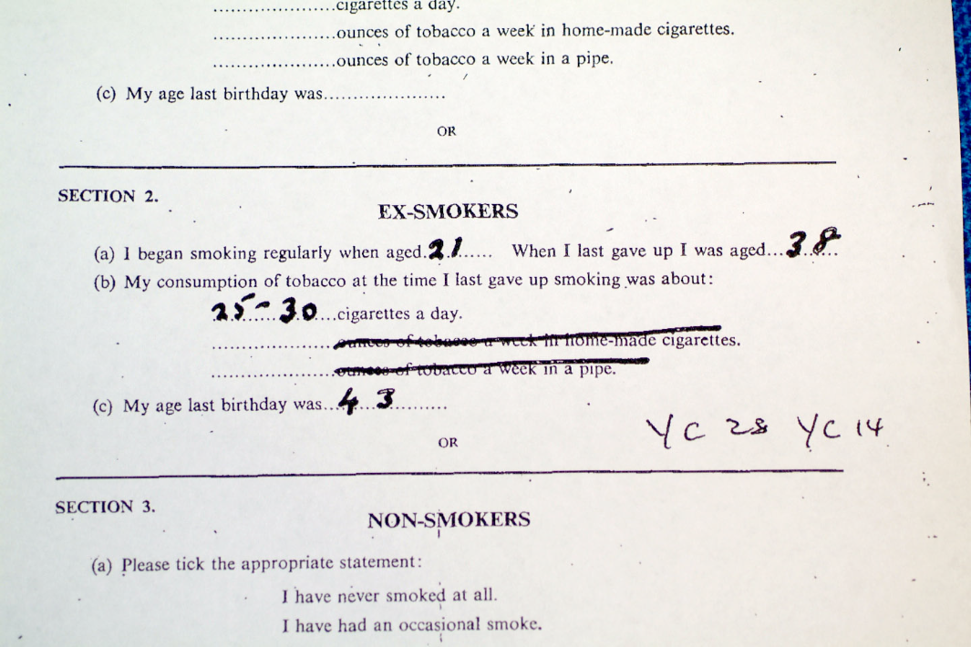

Slide 59
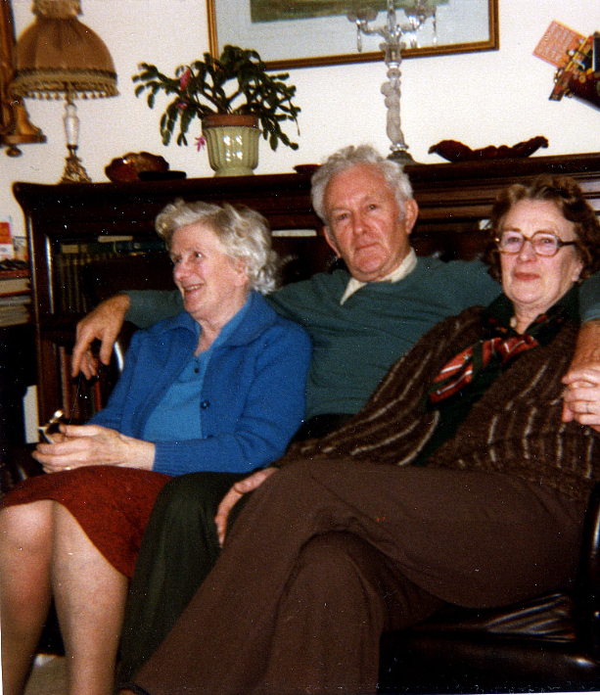

Slide 60

Vascular Surgery and Trials – definitely a pleasure!

