Slide 1
New Insights from the ACST-2 Trial
Alison Halliday, Professor of Vascular Surgery, University of Oxford

Slide 2
ACST-2 a 30-country collaboration Over 100 centres and more than 2000 patients

Slide 3
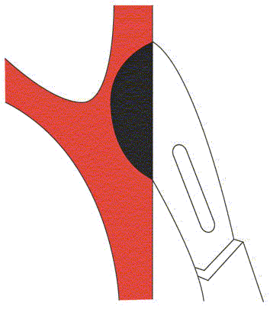
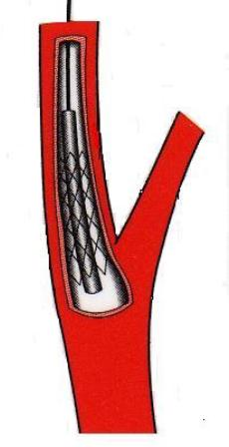
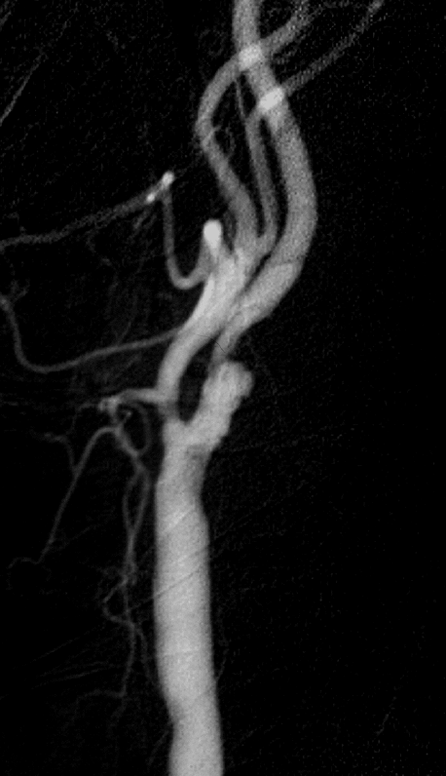
Treatment for asymptomatic carotid artery stenosis:
ACST-2 surgery vs stenting?

Slide 4
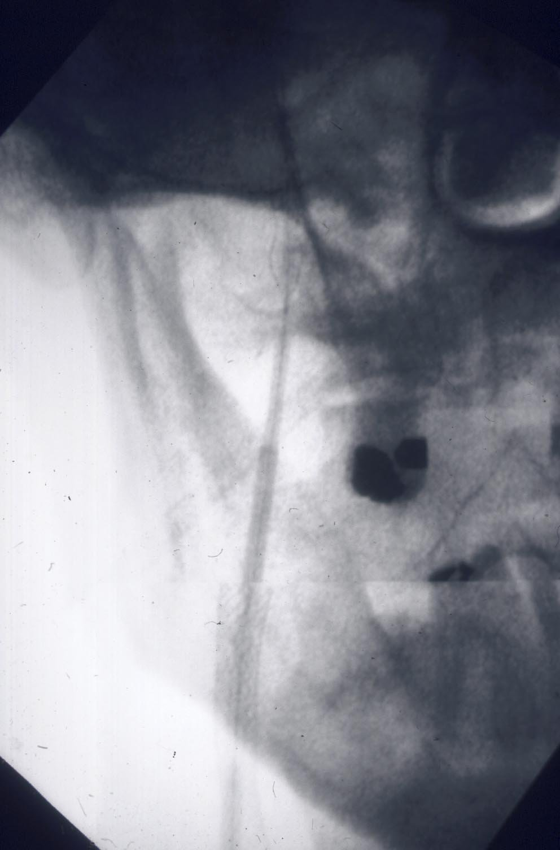
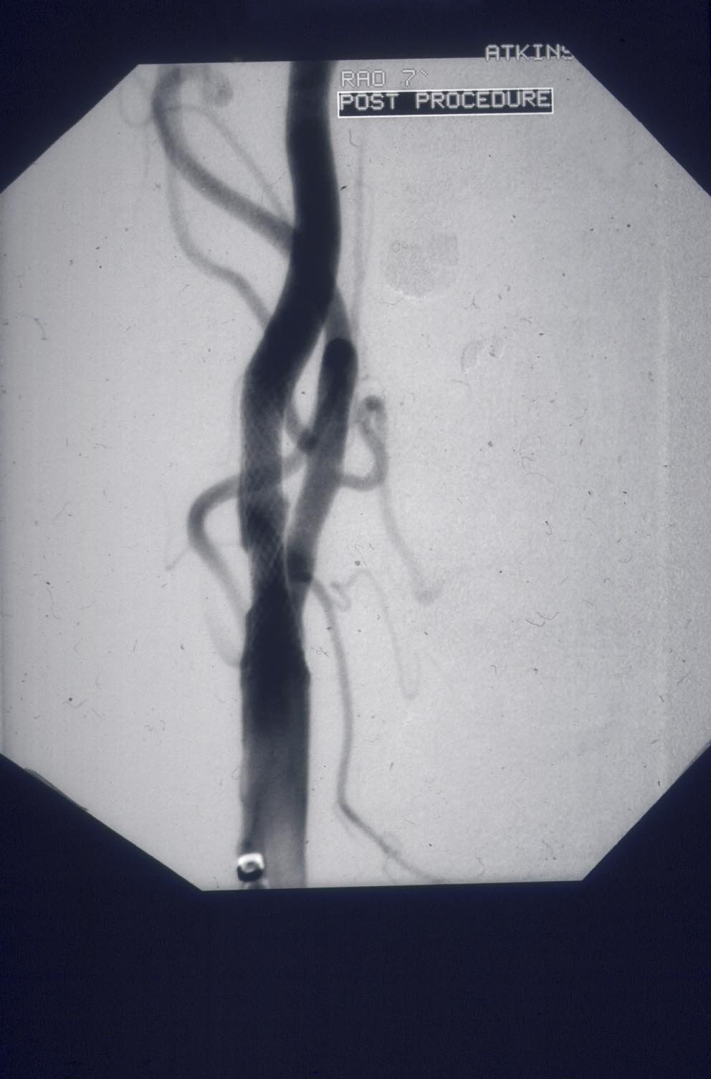
Techniques, devices, experience have all
changed since the early symptomatic trials
showed more minor strokes were caused by stenting
Now – have FLOW-reversal systems,
direct puncture, membrane stents.
reducing risk of distal embolisation

Slide 5
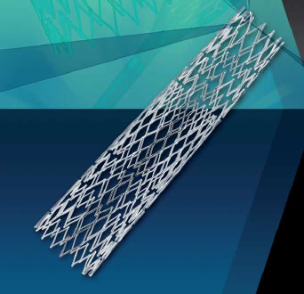
Cristallo Ideale (Hybrid)
Open Cell Stent with Closed Cell Design
Proximal and distal sections – open cell, enhanced flexibility
Central closed cell
section

Slide 6
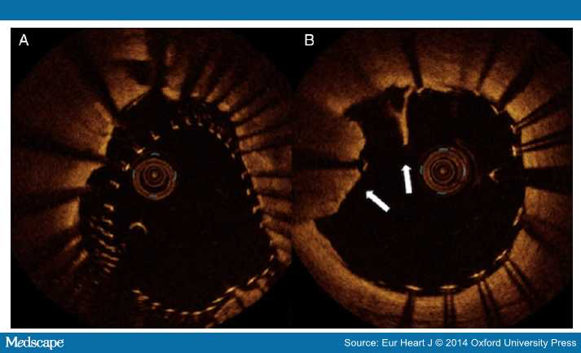

Slide 7
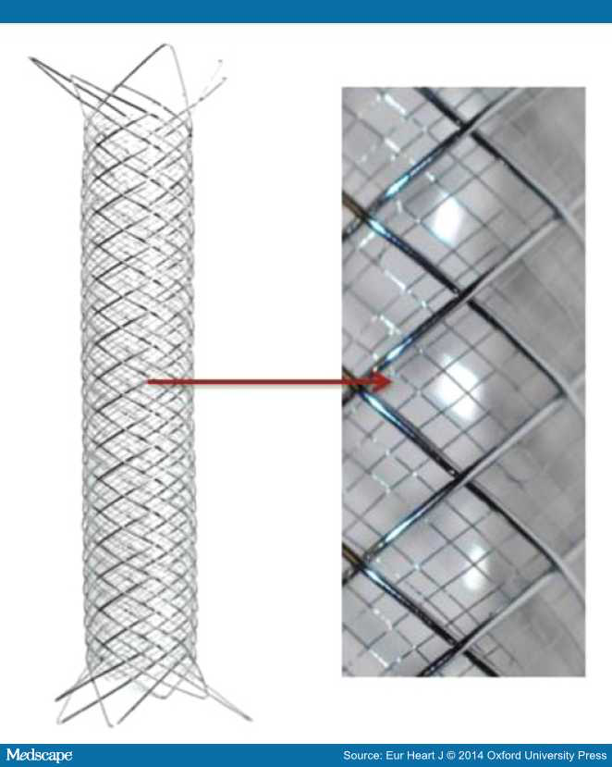
Membrane
Stent
Roadsaver

Slide 8
MoMa
Flow-reversal
Protection device

Slide 9
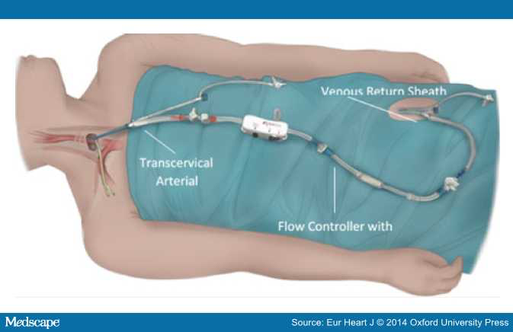
Roadsaver/Silk Road ‘surgical’ approach – avoids aortic arch, controlled flow reversal

Slide 10
ACST-2 patients
Sex, Age, Co-morbidities:
Men 70%
Median age 69 years
Ischaemic heart disease 37%
Diabetic 30%
Renal impairment 9%
Stroke risk factors:
Atrial Fibrillation 6%
Age >75 yrs 26%
Previous stroke symptoms or infarct 43%

Slide 11
ACST-2 Drug therapy at Trial Entry
85% lipid-lowering
88% anti-hypertensive
98% anti-thrombotic (anti-platelet +/or anti-coagulant)

Slide 12
Time from randomisation until procedure
932 CEA: 23 days 887 CAS: 26 days

Slide 13
Compliance with treatment allocated
Allocated procedure | 1-month form entered | Procedure not yet done | Cross-over | Procedure as allocated
CAS | 960 | 61 | 41 | 858
CEA | 961 | 41 | 29 | 891
Total | 1921 (100%) | 102 (5%) | 70 (4%) | 1749 (91%)

Slide 14
Drug therapy at 1 month
 | CAS allocated (n=932) | CEA allocated (n=939) | Total allocated procedures done (n=1871)
Anti-hypertensive | 797 (86%) | 822 (88%) | 86%
Lipid-Lowering | 812 (87%) | 835 (90%) | 88%
Anti-platelet or anti-coagulant | 929(99%) | 935 (99%) | 99%
On at least one of aspirin or clopidogrel | 908 (97%) | 894 (95%) | 96%
On both aspirin and clopidogrel | 619 (70%) | 138 (15%) | 40%

Slide 15
At 1-month

Slide 16
Stent type | Name | Number used
Closed Stents | Wallstent | 223
 | XAct | 158
 | Precise | 118
 | Adapt | 10
 | ViVEXX | 8
Open | RX Acculink | 90
 | Protégé® RX | 87
 | CGuard | 5
 | Zilver | 4
Hybrid | Cristallo Ideale | 156
 | Sinus Carotid RX | 4
 | Sinus Carotid Conical RX | 6
 | Medtronic Invatec | 2
 | MER Self-expanding carotid | 1
Membrane | Roadsaver | 14
Total |  | 886

Slide 17
Cerebral Protection Devices
Type | Device | Number
Filter | Emboshield | 204
 | Filterwire | 171
 | Spider | 116
 | Accunet | 60
 | AngioGuard | 44
 | FiberNet | 1
 | Wirion System | 1
Proximal occlusion | Moma | 131
 | Gore Flow Reversal | 28
Distal balloon | Twin One | 3
 | Viatrac | 1
None |  | 126 (14%)
Total |  | 886

Slide 18
2015 Annual follow-up
Number due | 1506
Received | 1410 (94%)
Trial Follow-up
CEA: 2.5 person-years CAS: 2.5 person-years

Slide 19
Drug Therapy at 2015 follow-up
 | CAS allocated (n=676) | CEA allocated (n=687) | Total allocated procedure done (n=1363)
Anti-hypertensive | 535 (82%) | 575 (83%) | 1131 (83%)
Lipid-Lowering | 562 (82%) | 578 (83%) | 1140 (82%)
Anti-platelet or anti-coagulant | 632 (93%) | 634 (93%) | 1266 (93%)
On at least one of aspirin or clopidogrel | 583 (86%) | 583 (85%) | 1166 (86%)
On both aspirin and clopidogrel | 87 (13%) | 50 (7%) | 137 (10%)

Slide 20
Lipid Lowering Medications (86% patients)
Annual Follow up 2015
Atorvastatin | 45%
Simvastatin | 40%
Rosuvastatin | 15%
Other statins | 8
Fibrates | 5
Ezetimibe | 5
On 2 drugs | 12%

Slide 21
ACST-2 procedural hazards still much lower than in symptomatic trials (CEA+CAS) and lower than in ACST-1
Disabling and fatal Stroke/MI ≤ 30 days:
1.0% (ACST-2)
Lower than in previous trial of CEA
1.7% (ACST-1)

Slide 22
……and the future
Annual Data Monitoring Committee – 2015 Trial should continue (we) commend the collaborators on their increased recruitment
Next DMC – 2016 (May) – this week
Data is entered and being reviewed

Slide 23
Recruitment 2010 - 2016
2196
today

Slide 24
Recruitment plan

Slide 25
Trials for asymptomatic stenosis
CAS v CEA
ACT-1 n=1450; CAS:CEA 3:1 (industry, reported)
ACST-2 ongoing (2200/)3600 planned by 2019
CEA v BMT, CAS v BMT
SPACE 2 stopped n=500,
ECST-2 n=150, pilot, plan 2000 (+asymp) lower risk
CREST 2 n=200/(2480) – design like SPACE 2
Total 5000-6000 patients

Slide 26
ACST-2 Collaborators’ Meeting

Slide 27
Collaborators from 46 centres in 20 countries met in Belgrade last month

Slide 28
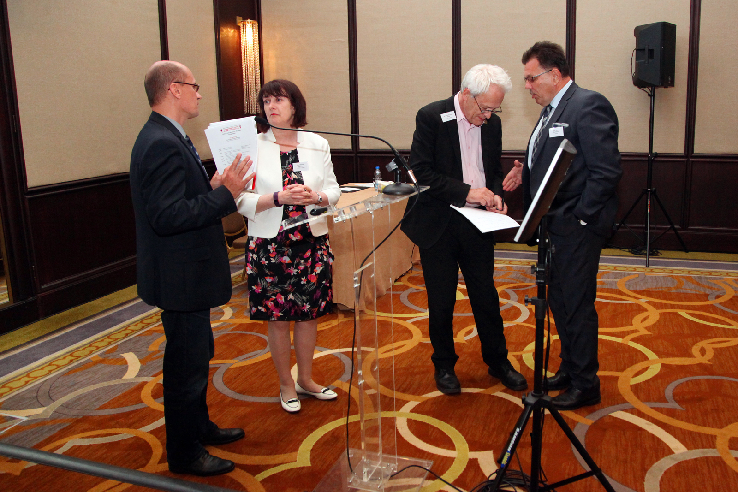
Talks, Debates
Dinner and Prizes

Slide 29
(Nearly) the table football heroes!

Slide 31
ACST-2
A very European (and Italian) Trial
Join us!
www.acst-2.org

