Slide 1
































The Asymptomatic Carotid Surgery Trial – 2
Stenting vs Surgery for tight asymptomatic carotid stenosis
Changing stenting risks with newer techniques?
19th January 2017
NDS Research day

Slide 2
Prevalence of ‘serious’ carotid stenosis
Systematic review, de Weerd, 2009
Adults over 70 years:
≥70% stenosis ~ 3% women
5% men
≥50% 7% women
12% men

Slide 3
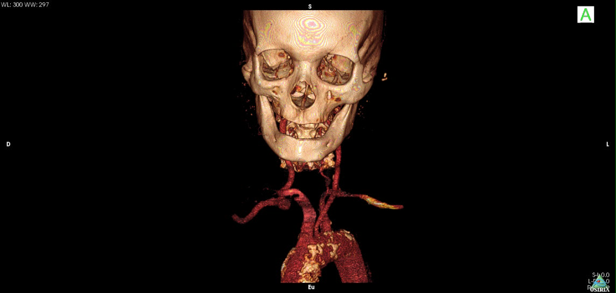

Slide 4
Annual Stroke risk from asymptomatic carotid stenosis
= randomised trial (60-99%) = cohort/non RCT (50%+)
Marquardt et al. Stroke 2010
Notes:
Most studies in this are not RCTs, and indeed all from 2000 on are ‘natural history studies’ usually with patients who have ~50% stenosis and would not normally be eligible for interventions. So the recent stroke risks are less certain, maybe lowered by statins (but so is the risk from intervention)

Slide 5
Carotid Endarterectomy (CEA) to prevent stroke Open surgery vs Medical treatments
5,000 individual patients
in ACST-1, ACAS and VACS Trials
 | VACS | ACAS | ACST-1
Nos. of patients (Immediate vs Deferred) | 444 (211 vs 233) | 1662 (828 vs 834) | 3120 (1560 vs 1560)
Period of randomisation | Apr 83 – Oct 87 | Dec 87 – Dec 93 | Apr 93 – Jul 03
Date of last follow-up | May 1991 | Feb 1997 | May 2008
Median (IQR) follow-up year | 4.5 (2.5-6.0) | 4.2 (2.9-5.0) | 6.1 (3.9-9.1)

Slide 6
Asymptomatic carotid stenosis:
Even on anti-thrombotic, blood pressure lowering and lipid-lowering (triple) medical therapy -
successful CEA halves the stroke
rate over the next 5-10 years.

Slide 7
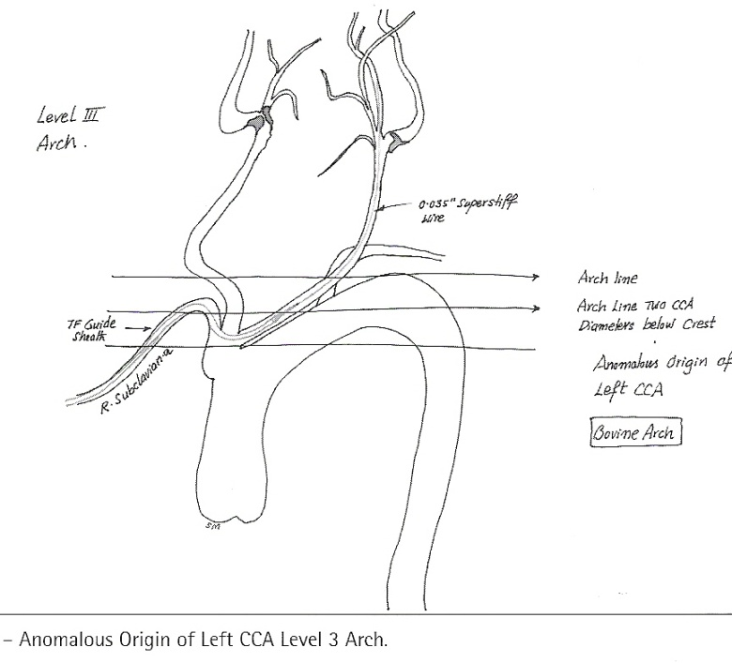
if CT/MR arch imaging shows patient is suitable for both procedures
- then randomise
- but CAS was previously more hazardous than CEA
Now ACST-2 directly compares CEA vs CAS

Slide 8
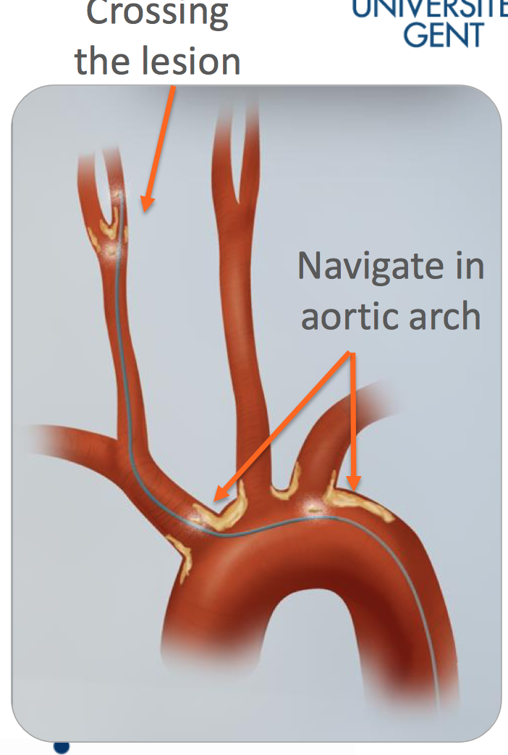
Two hazards – crossing the lesion and navigating in the aortic arch

Slide 9
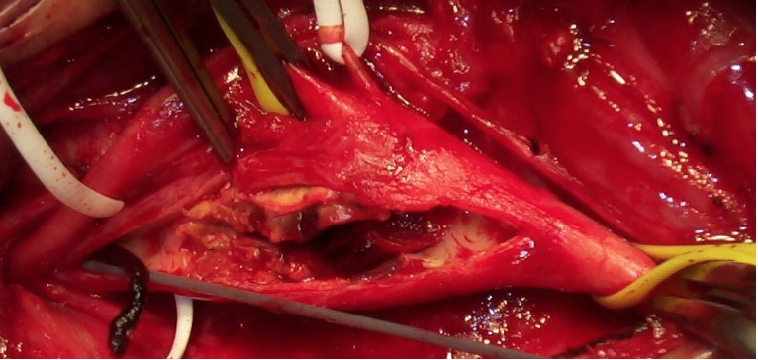
CEA – open removal of atheroma under direct control
Can CAS be as safe – but much less invasive?

Slide 10
Mean follow-up in August 2016
CEA: 2.7 person-years CAS: 2.7 person-years

Slide 11
Drugs at Trial Entry
85% lipid-lowering
88% anti-hypertensive
98% anti-thrombotic (anti-platelet +/or anti-coagulant)

Slide 12
Annual Follow up 2015
Lipid Lowering Treatment
Atorvastatin | 45%
Simvastatin | 40%
Rosuvastatin | 15%
Other statins | 8%
Fibrates | 5%
Ezetimibe | 5%
On 2 lipid-lowering drugs | 12%

Slide 13


Slide 14
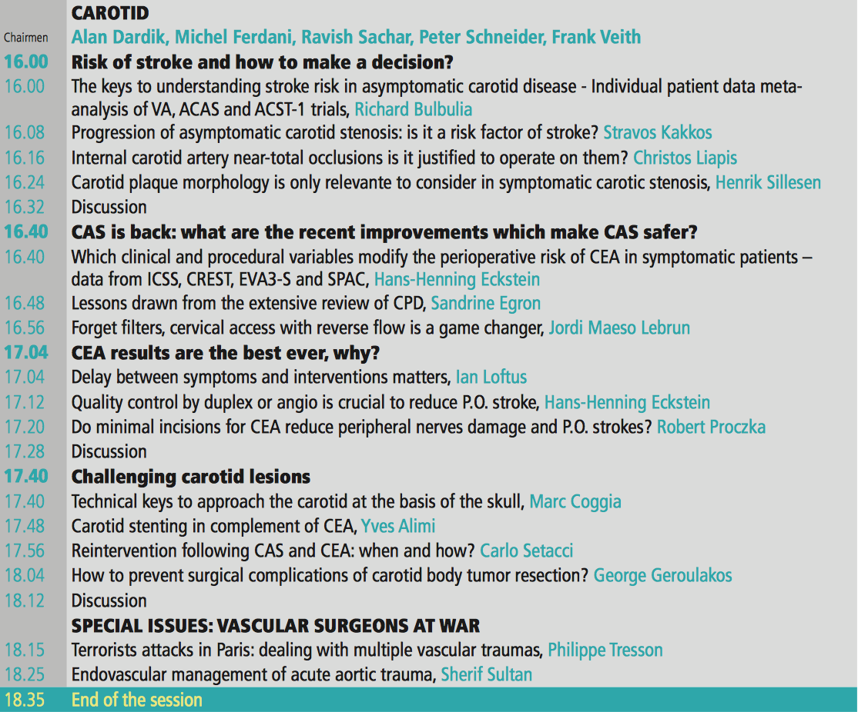

Slide 15
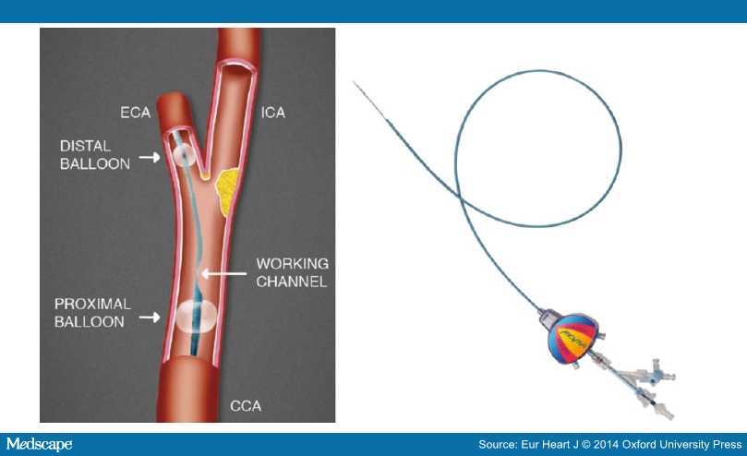
Stent and Device changes since earlier trials
Flow-reversal
Protection
device

Slide 16
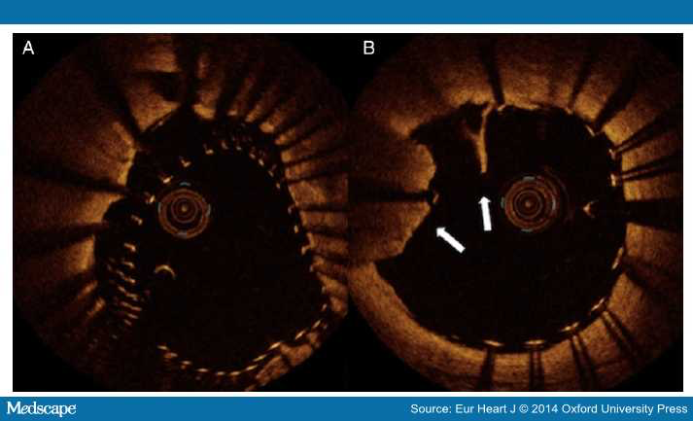
Stent and Device changes since earlier trials

Slide 17
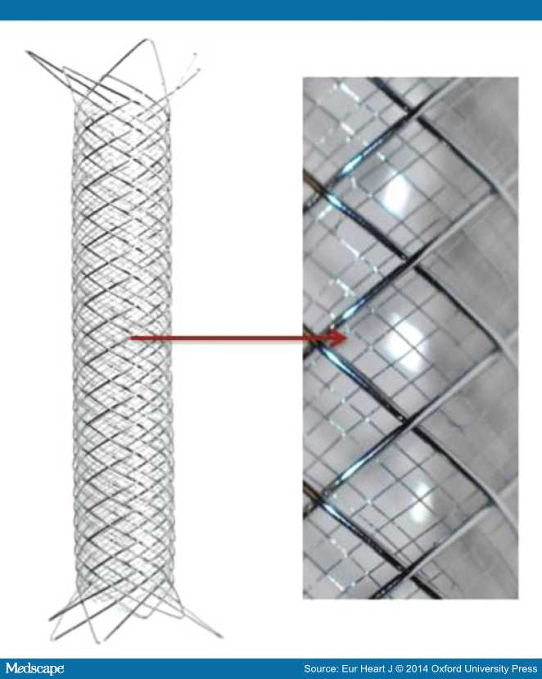
Stent and Device changes since earlier trials
Membrane
covered
Stent

Slide 18
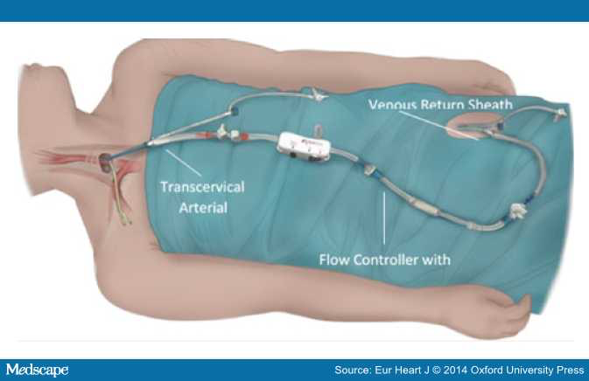
And now: the ‘surgical’ approach to stenting – avoiding aortic arch atheroma, controlling flow reversal

Slide 19
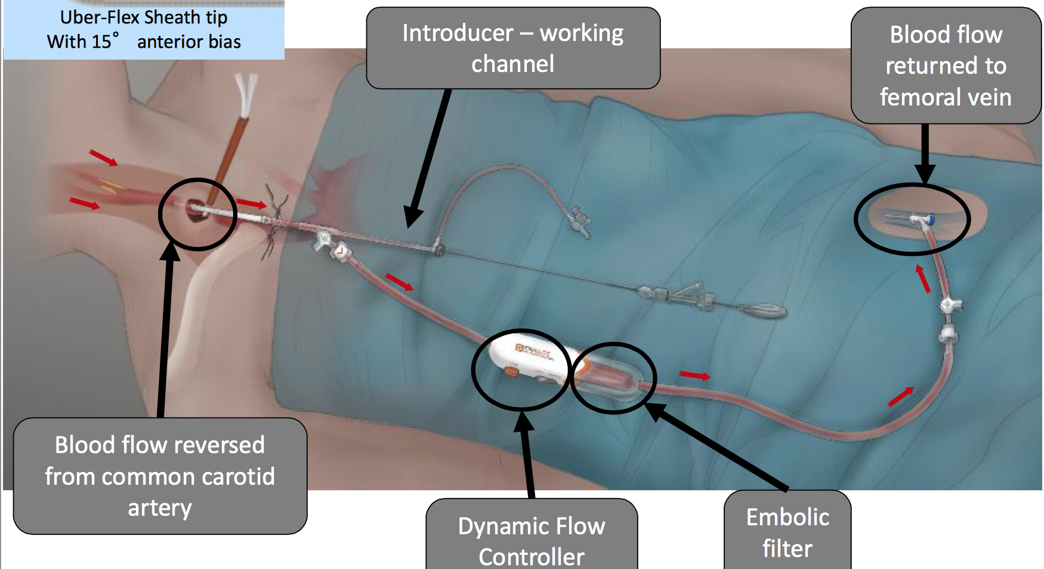
Avoid the aortic arch….and reverse the carotid artery flow before crossing the lesion

Slide 22
ACST-2 procedural hazards much lower than in previous trials
Disabling and fatal Stroke/MI ≤ 30 days for CEA/CAS:
1.0% (ACST-2)
Lower than in previous trial of CEA
1.7% (ACST-1)

Slide 23
Italy – Best recruiters in ACST-2 but every patient counts!

Slide 24

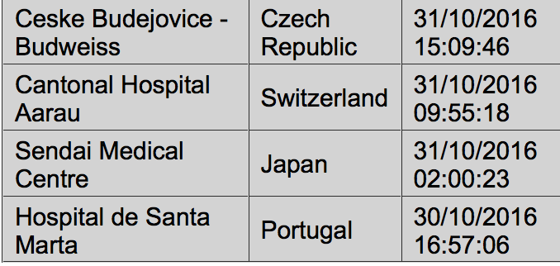
Recruitment – on our Website
October 2016
September 2016
Novosibirsk Research Institute of Circulation Pathology 4
Serbian Clinical Centre 3
University of Bologna 3
UniversitäTsklinikum Leipzig 3
Santa Maria Hospital 2
Sodersjukhuset 2
University of Dresden 'Carl-Gustav-Carus' 2
Cantonal Hospital Aarau 1
Cefalù Fondazione Istituto G. Giglio 1
Ceske Budejovice - Budweiss 1
Dedinje Cardiovascular Unit 1
Hospital de Santa Marta 1
Istituto Auxologico Italiano 1
Mirano Hospital 1
Semmelweis Medical University 1
Sendai Medical Centre 1
St Anne's University Hospital Brno 1
UniversitäTs Klinikum Hamburg-Eppendorf 1
Vascular Endovascular Unit of Perugia 1
Wythenshawe Hospital (University of South Manchester) 1
TOTAL OCTOBER 32
East Tallinn Central Hospital 2
Novosibirsk Research Institute 3
Klinikum rechts der Isar Muenchen 2
Semmelweis Medical University 2
Albert Szent-Györgyi Medical Centre 1
Cheltenham General Hospital 1
Circolo University Hospital 1
Dedinje Cardiovascular Unit 1
Foothills Medical Centre 1
Guadalajara Hospital 1
Kent and Canterbury Hospital 1
Lasarettet Helsingborg 1
Malmo Vascular Centre 1
Mirano Hospital 1
Nottingham University Hospital 1
San Giovanni Di Dio 1
Santa Maria Hospital 1
Serbian Clinical Centre 1
Sodersjukhuset 1
St. Anna University Hospital Ferrara 1
Teaching Hospital Maribor 1
University of Basel 1
TOTAL SEPTEMBER 27
Website Front Page:
Our new patient (s) were randomised from:

Slide 25
ACST-2 target –3600 patients

Slide 26

ACST-2
A very European Trial
Over 30 countries
Large Network:
Neurologists
Surgeons
Cardiologists
Radiologists

Slide 27
