Slide 1
Science is incomparably the most successful enterprise human beings have ever engaged in
Sir Peter Medawar

Slide 2
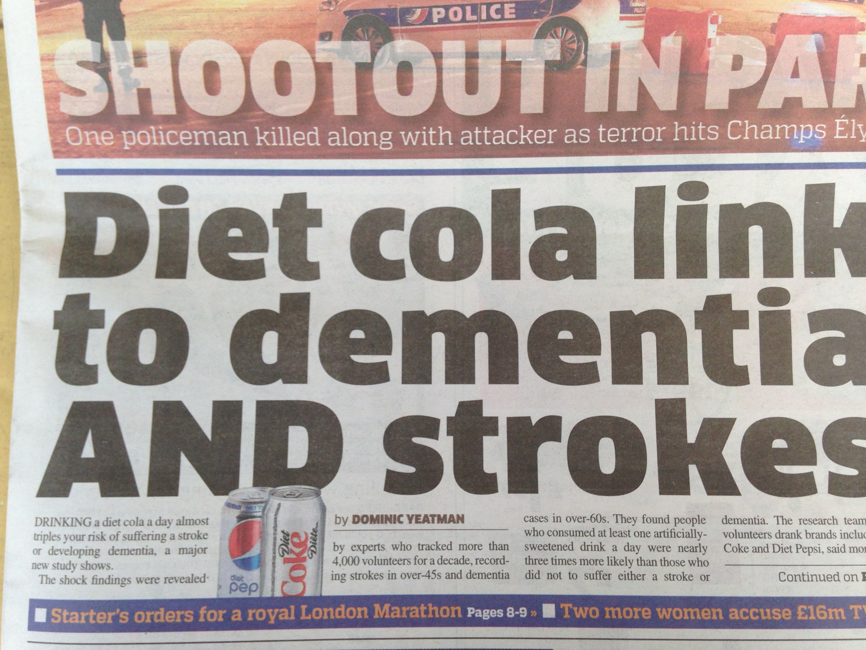

Slide 3


Slide 4
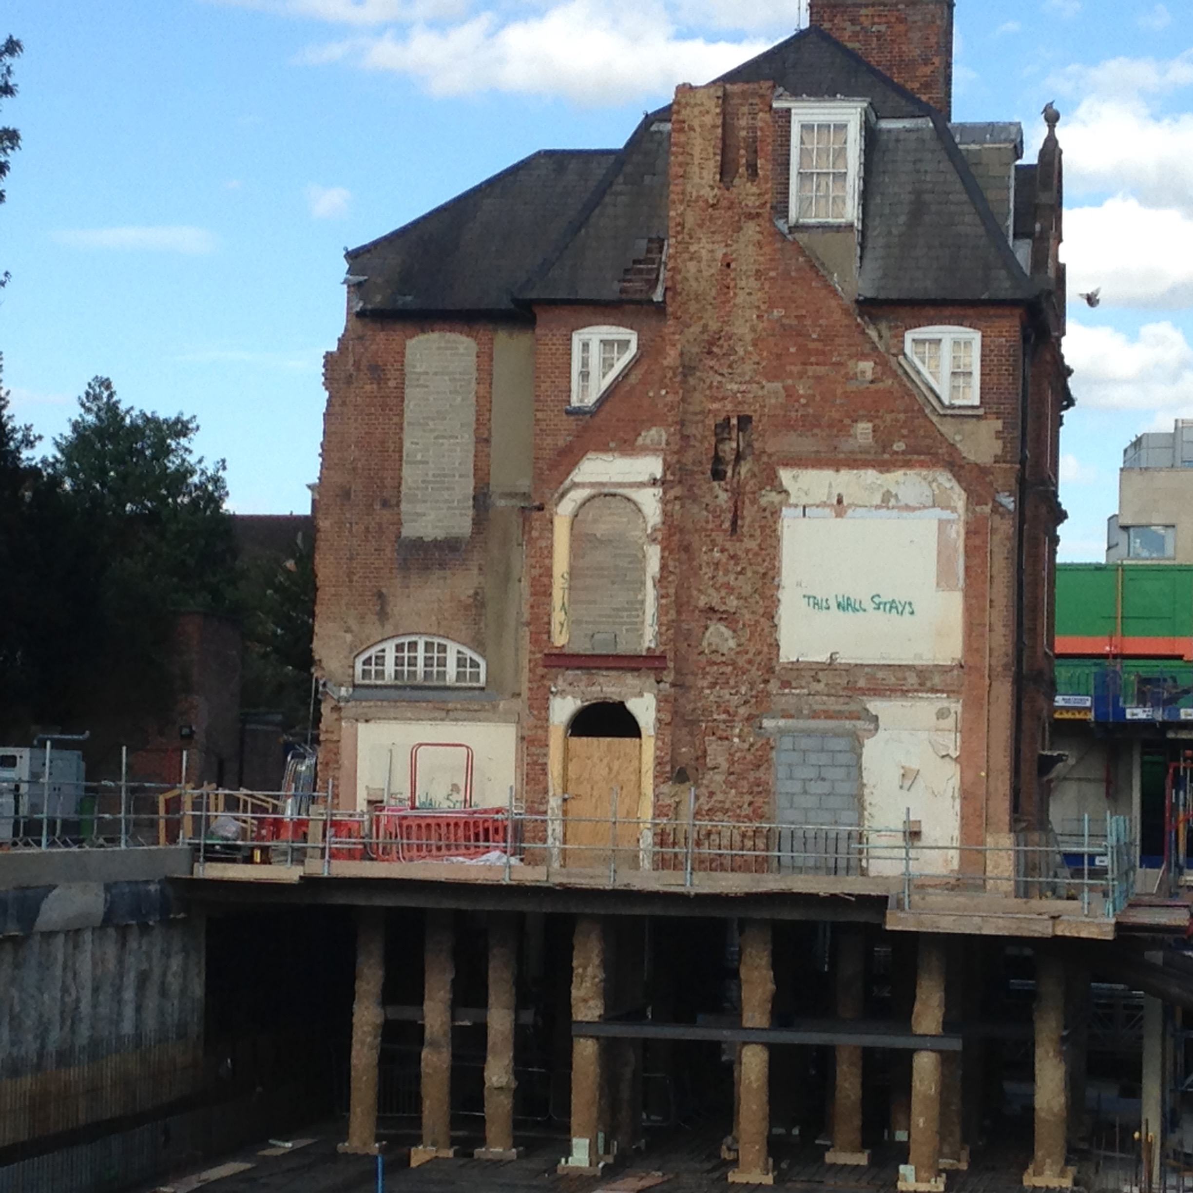

Slide 5


Slide 6
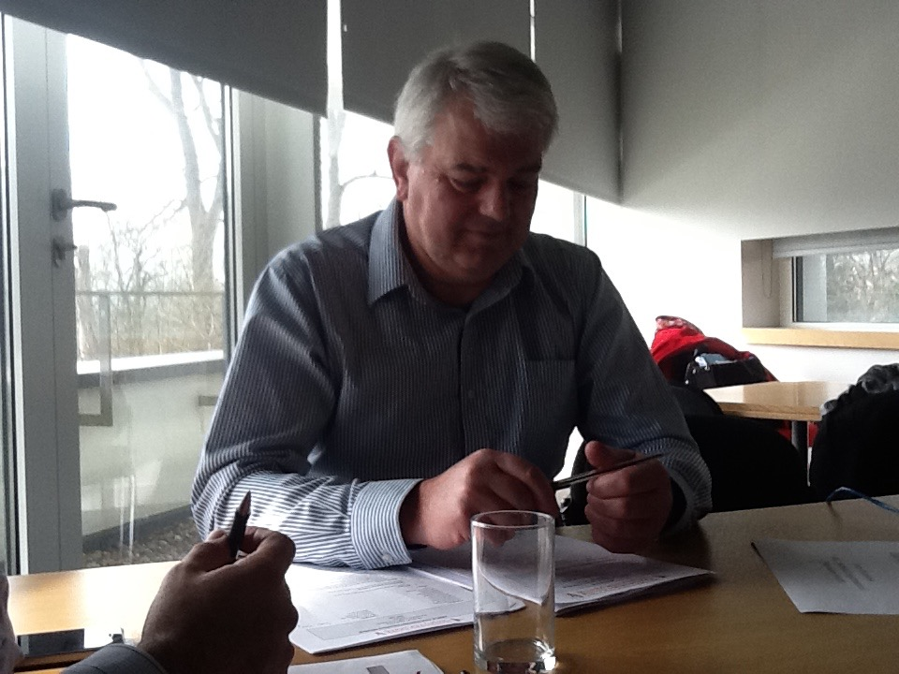

Slide 7
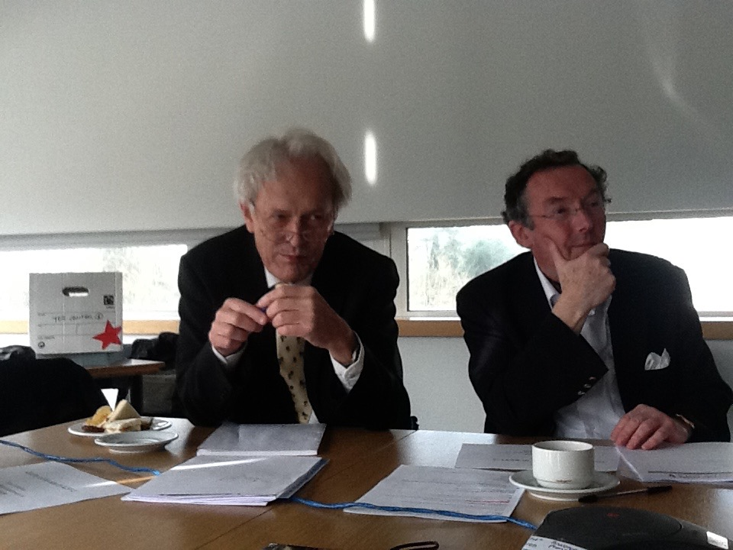

Slide 8
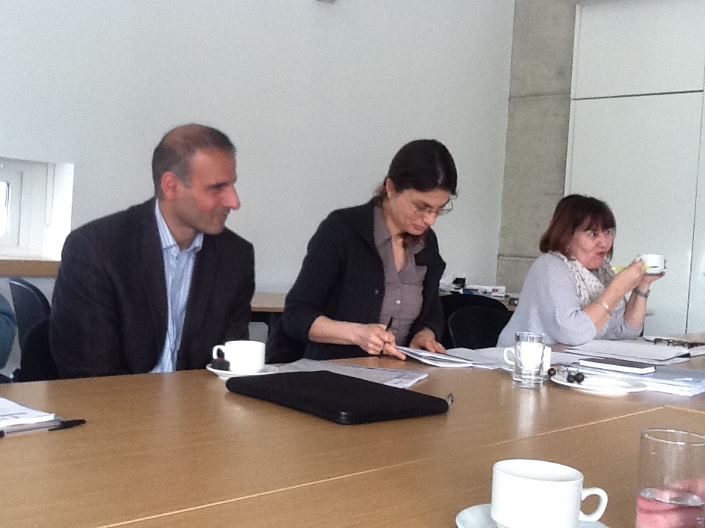

Slide 9
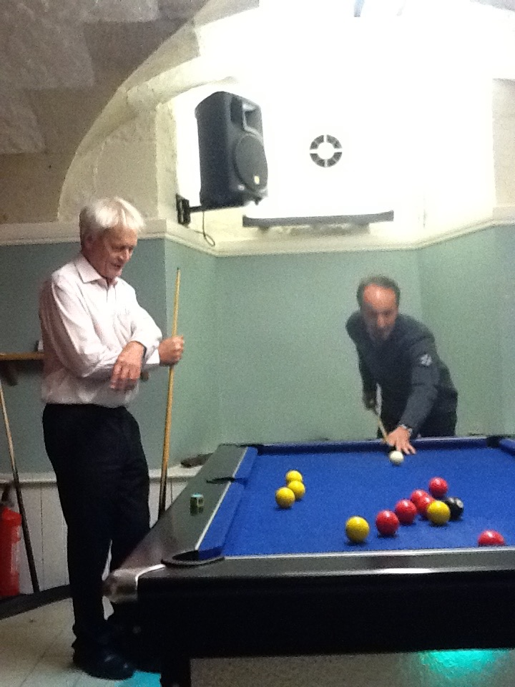

Slide 10
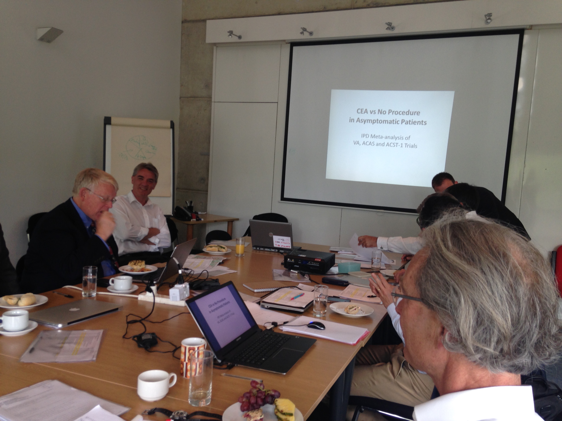

Slide 11
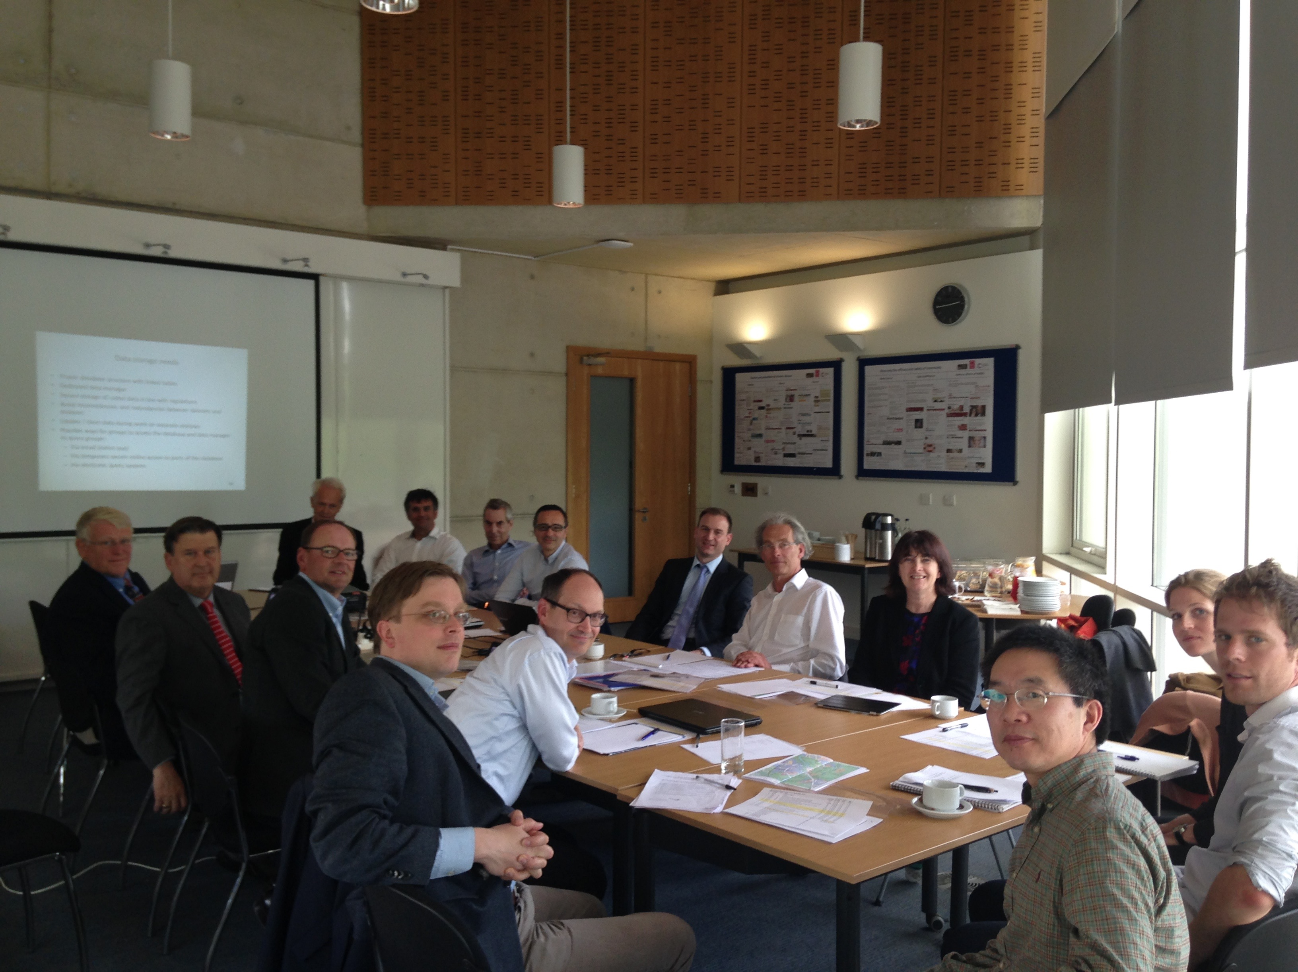

Slide 12
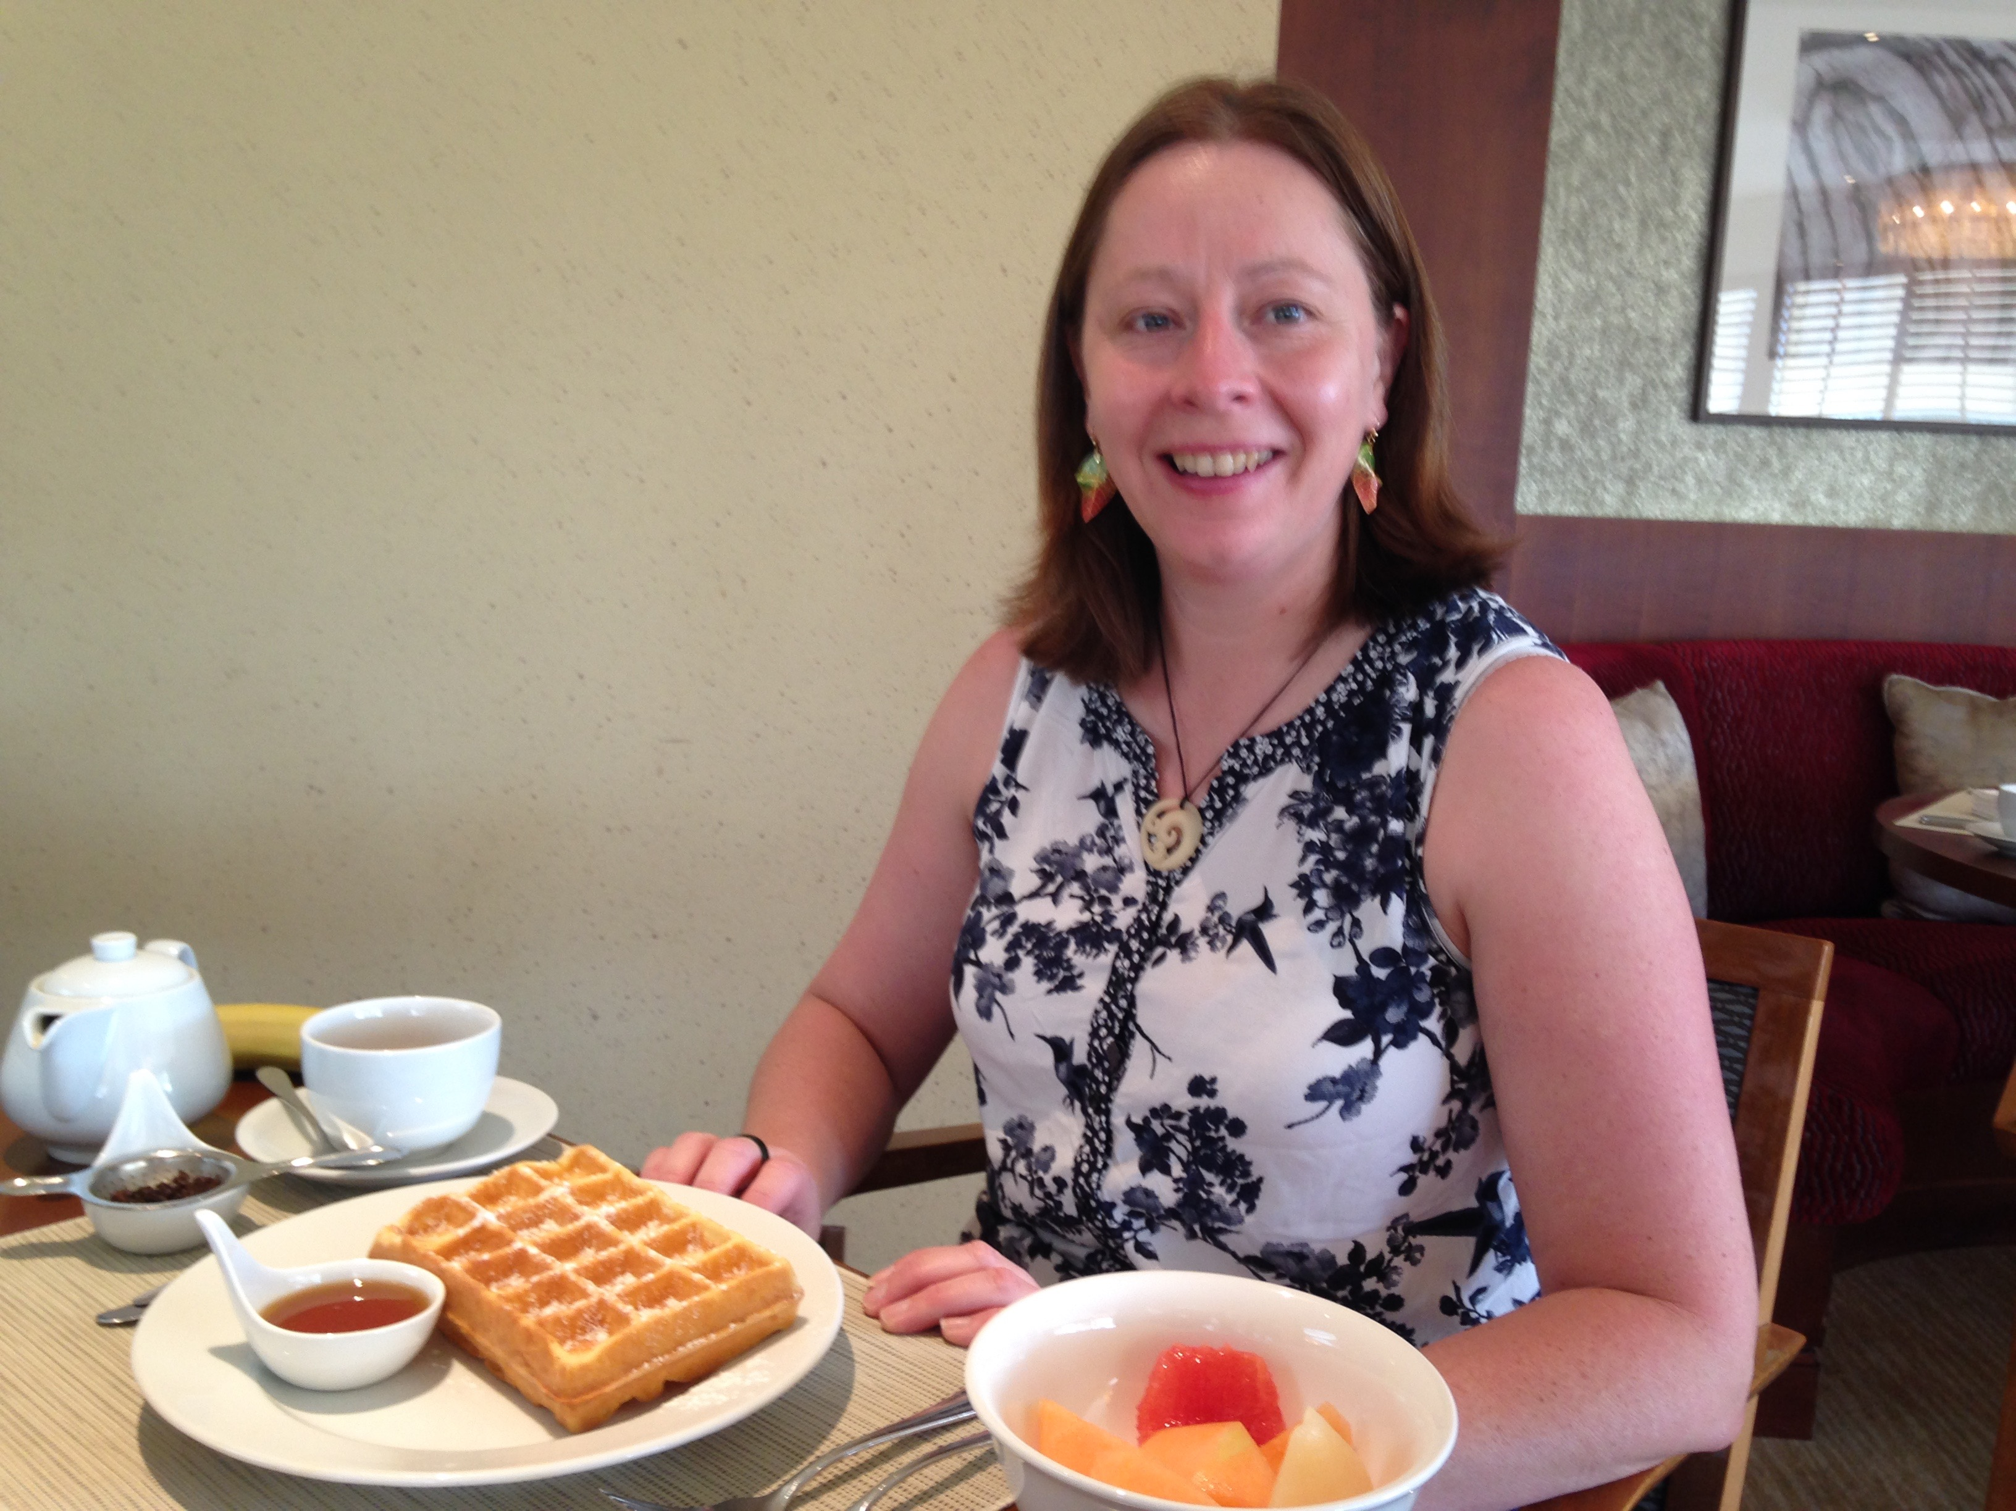

Slide 13
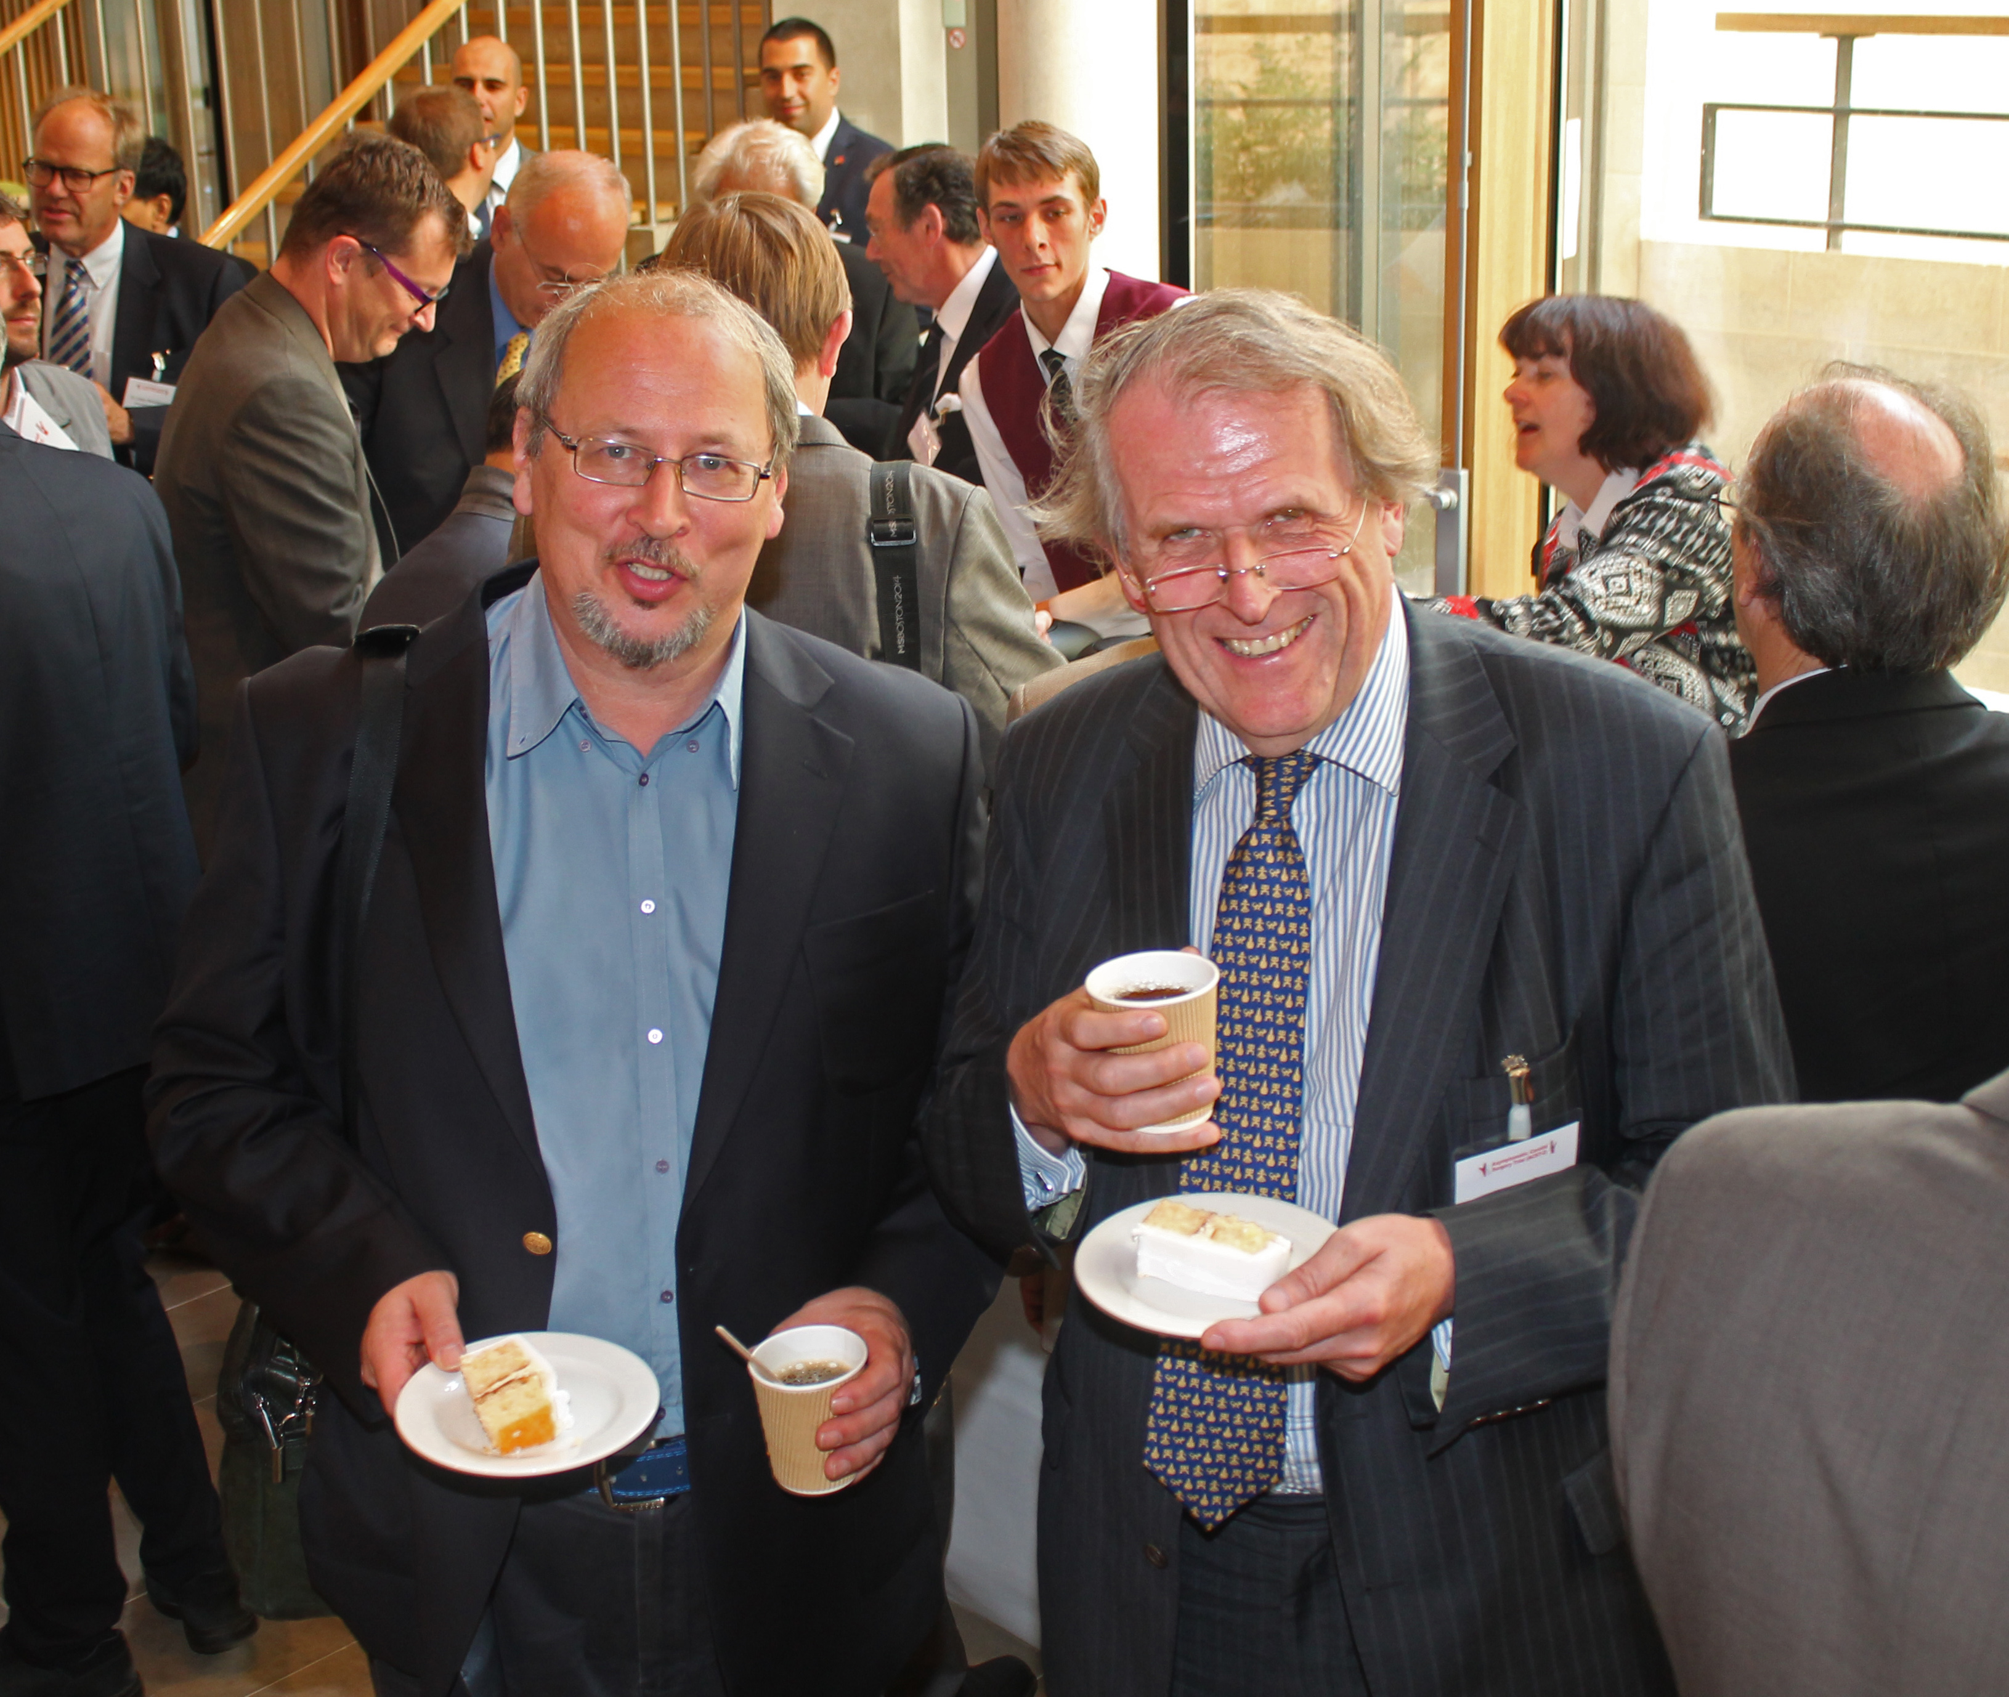

Slide 14
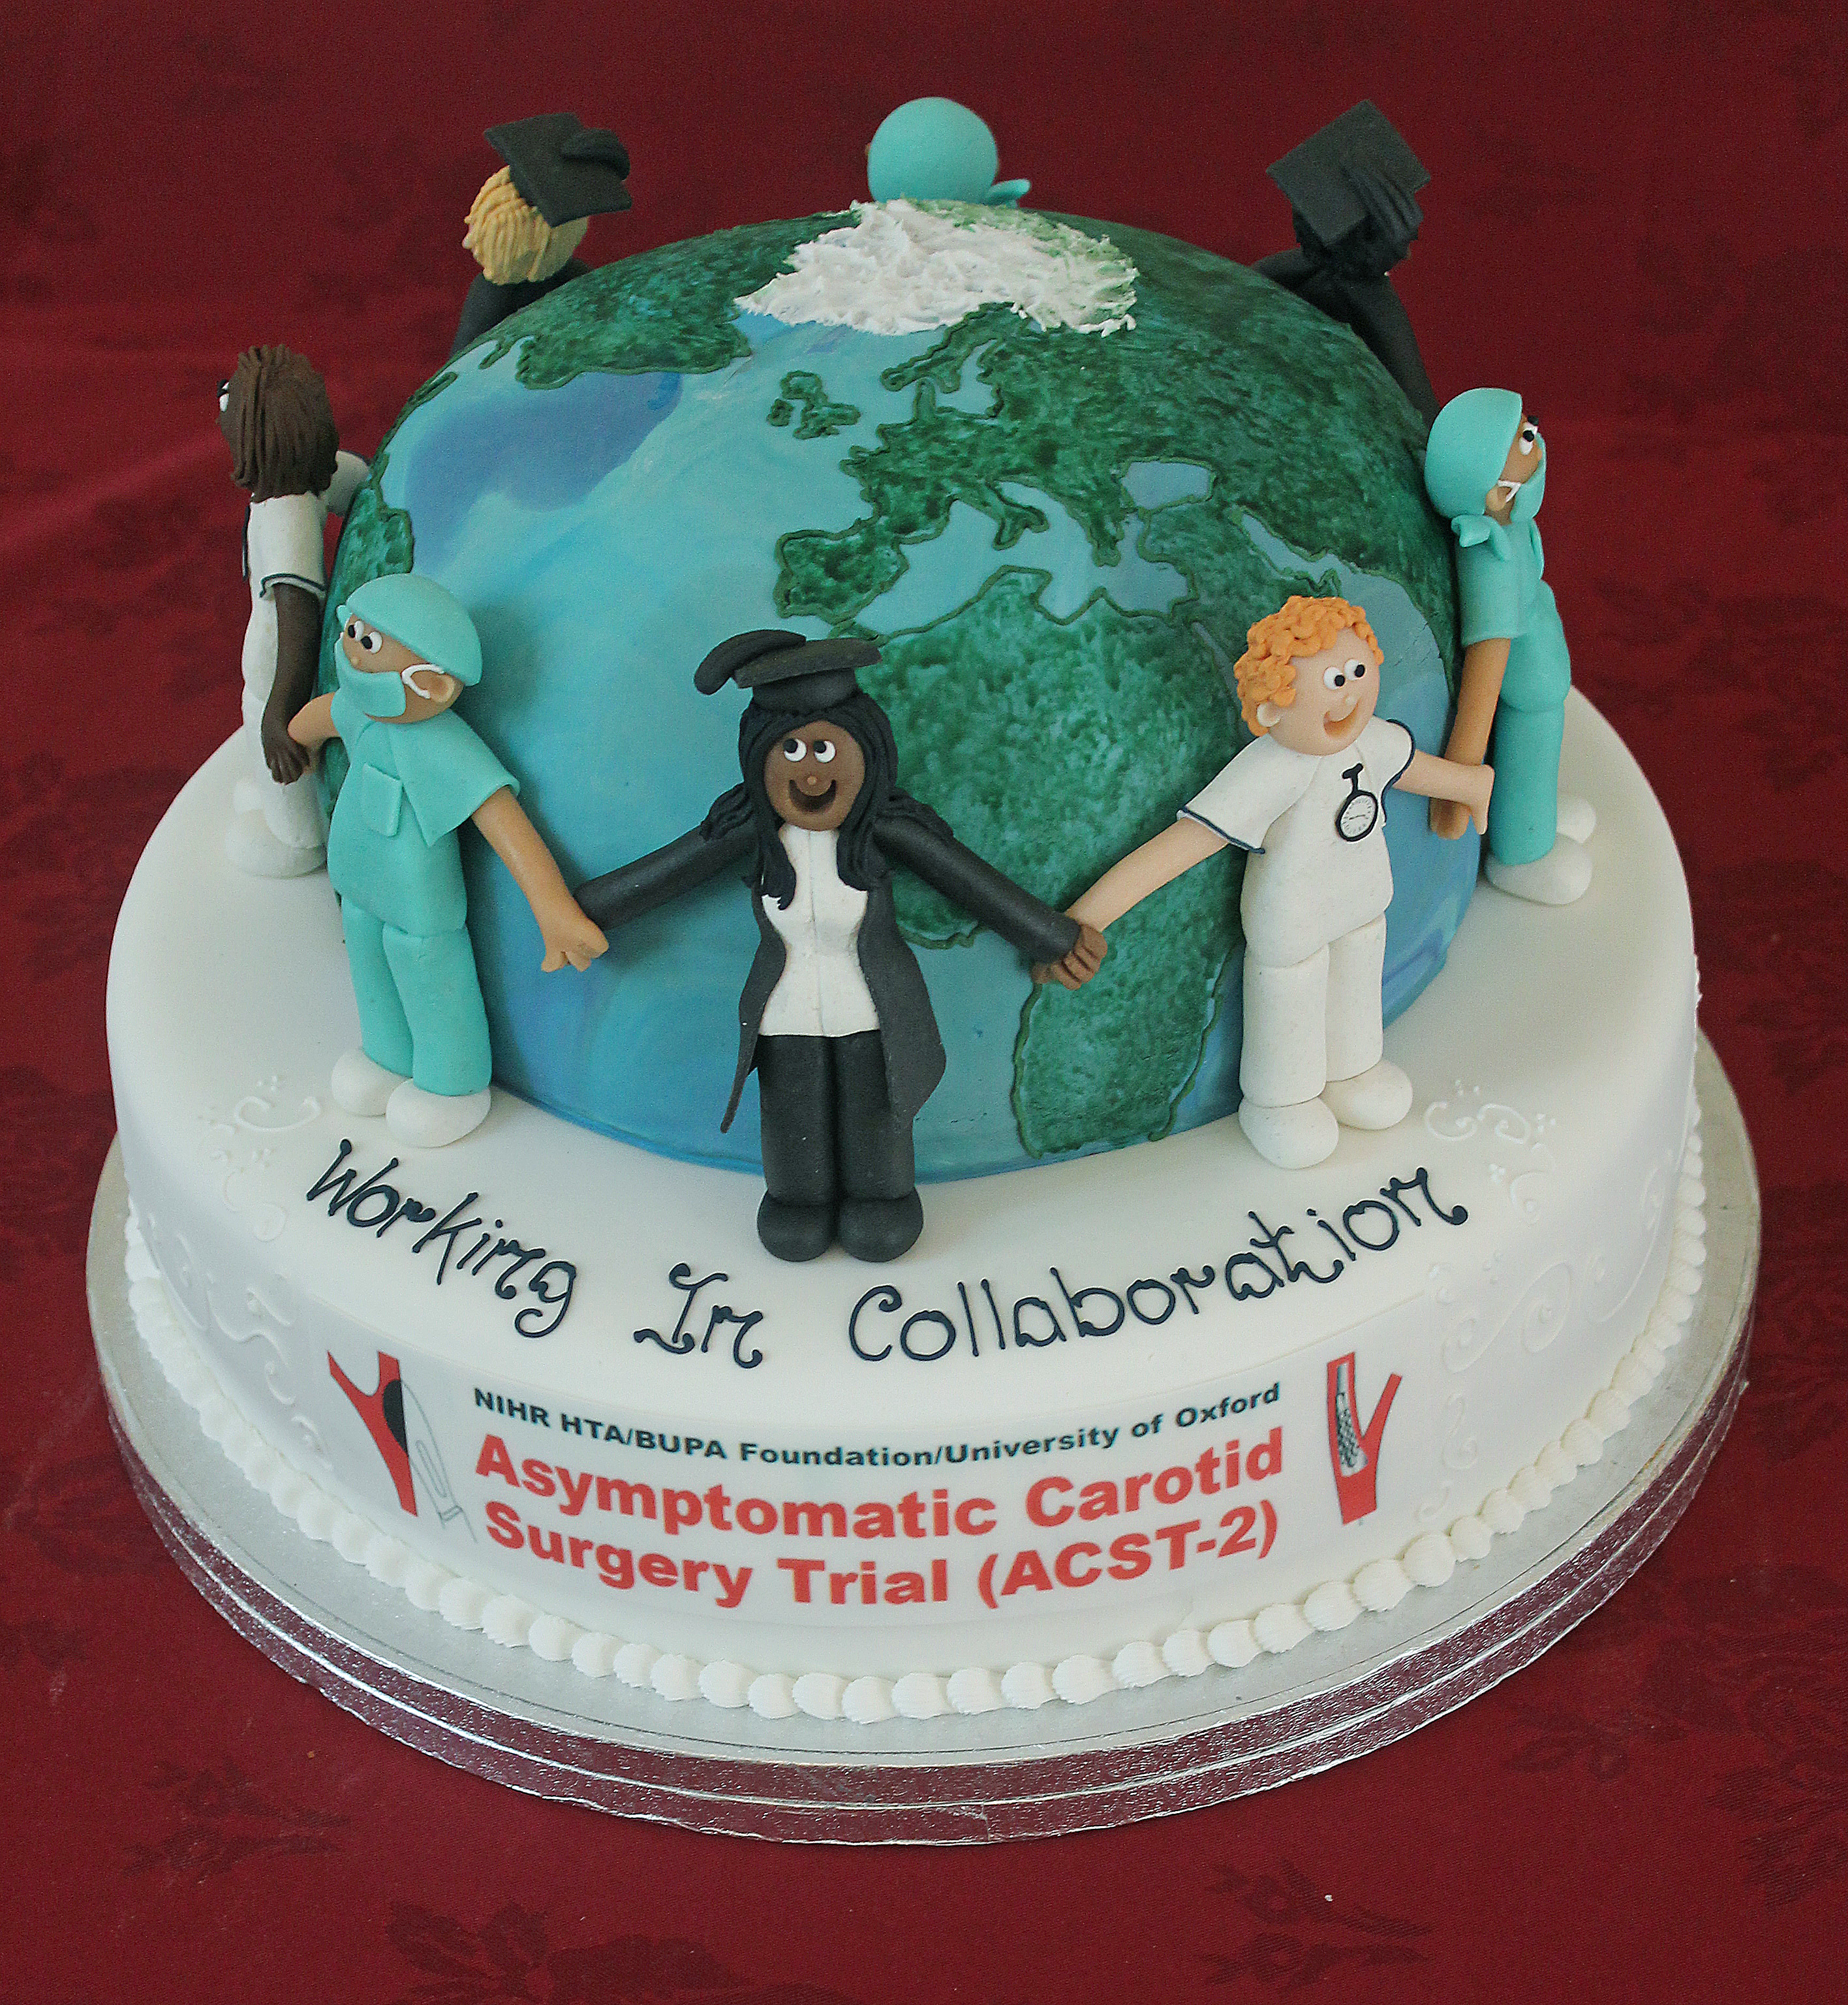

Slide 15
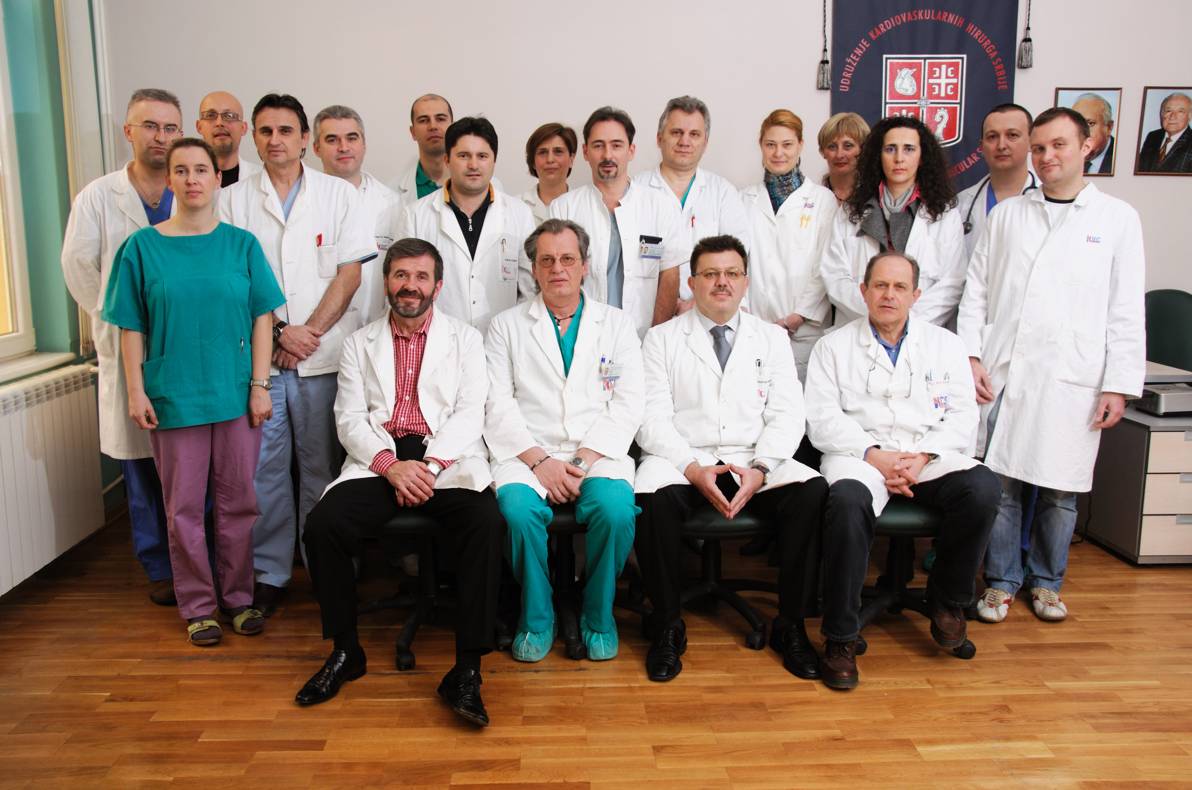

Slide 16
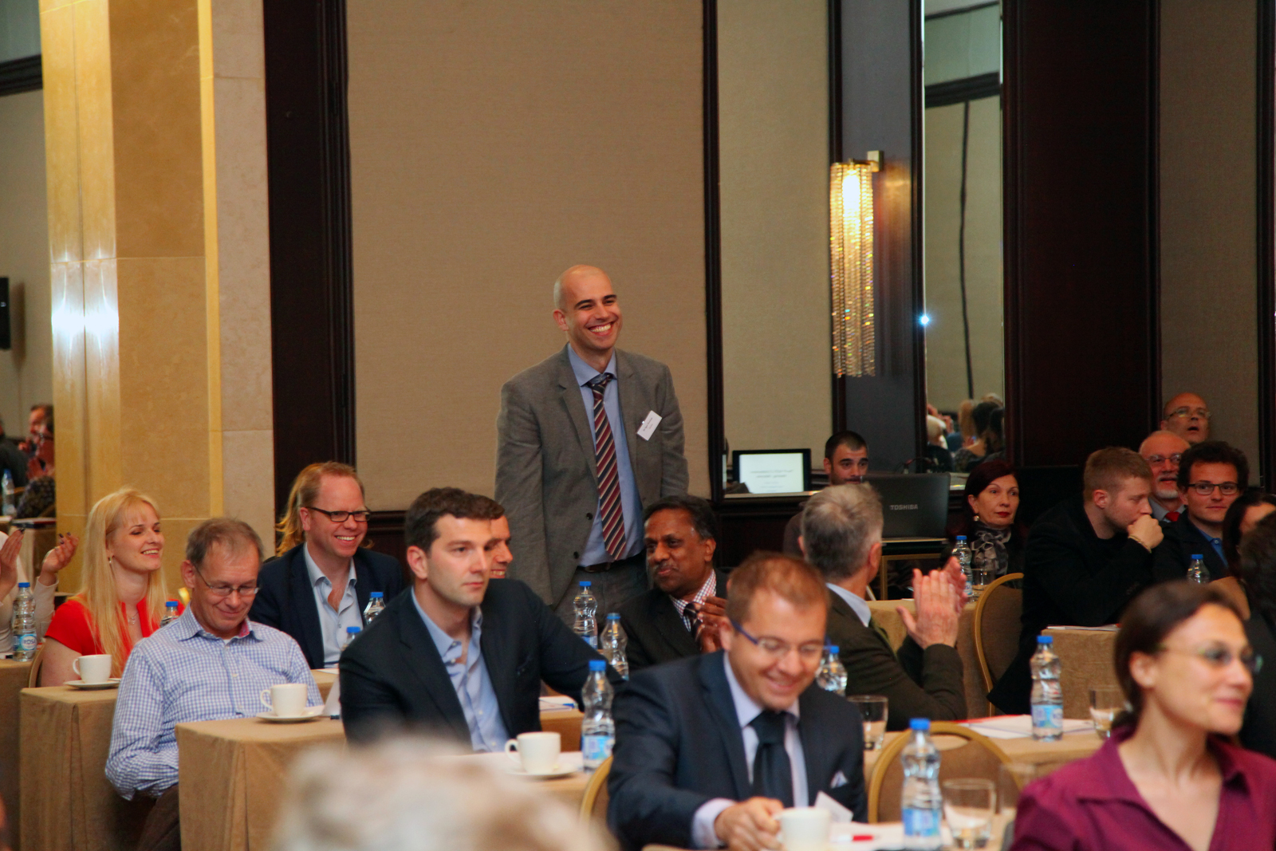

Slide 17
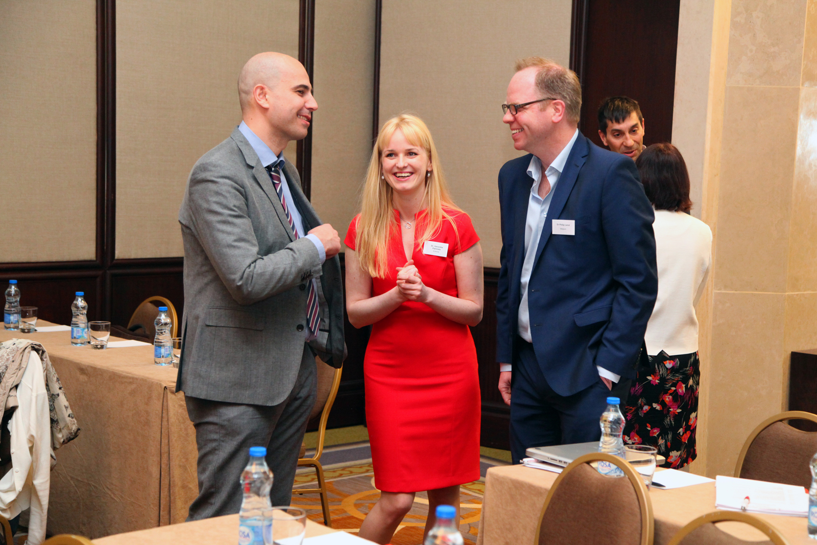

Slide 18
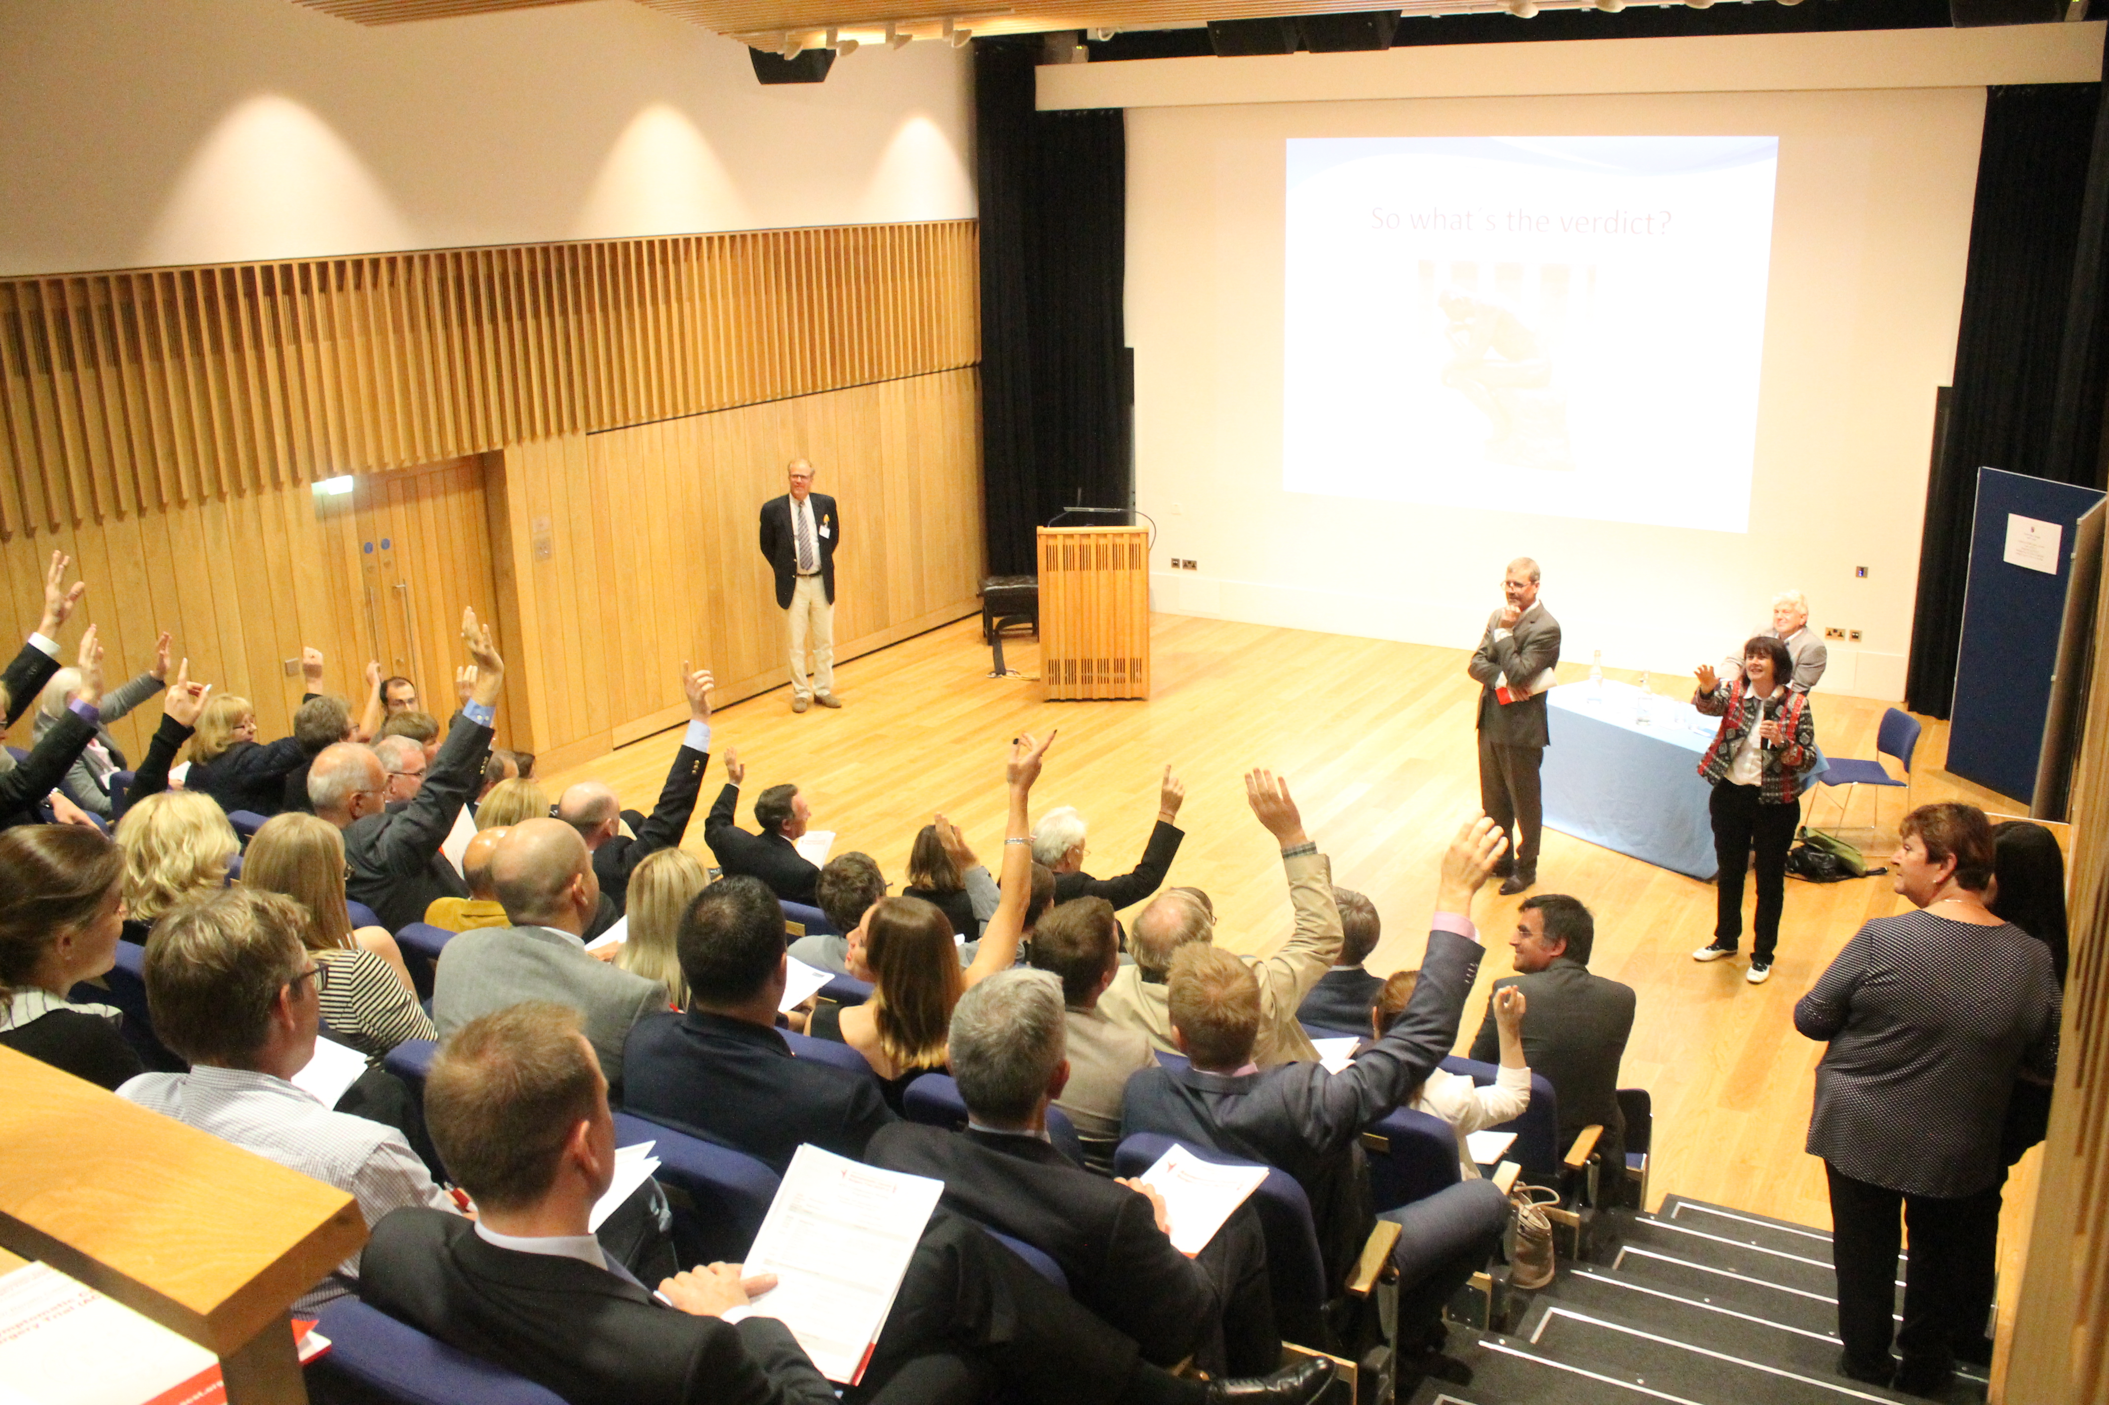

Slide 19
120
Centres
 | Number of centres ever recruited a patient | Cumulative Recruitment
2008 | 11 | 62
2009 | 31 | 193
2010 | 54 | 480
2011 | 67 | 795
2012 | 75 | 1076
2013 | 80 | 1329
2014 | 92 | 1675
2015 | 107 | 2044
2016 | 117 | 2383
Today** | 120 | 2612
**31/08/2017

Slide 20
Recruitment 2010 – 2017

Slide 21
Recruitment 1st August 2017

Slide 22
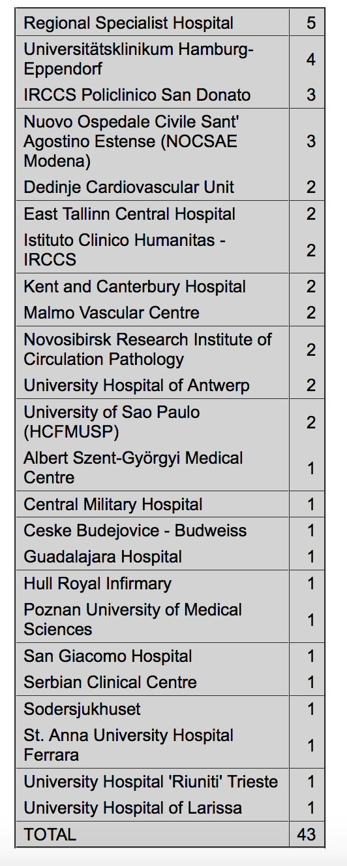
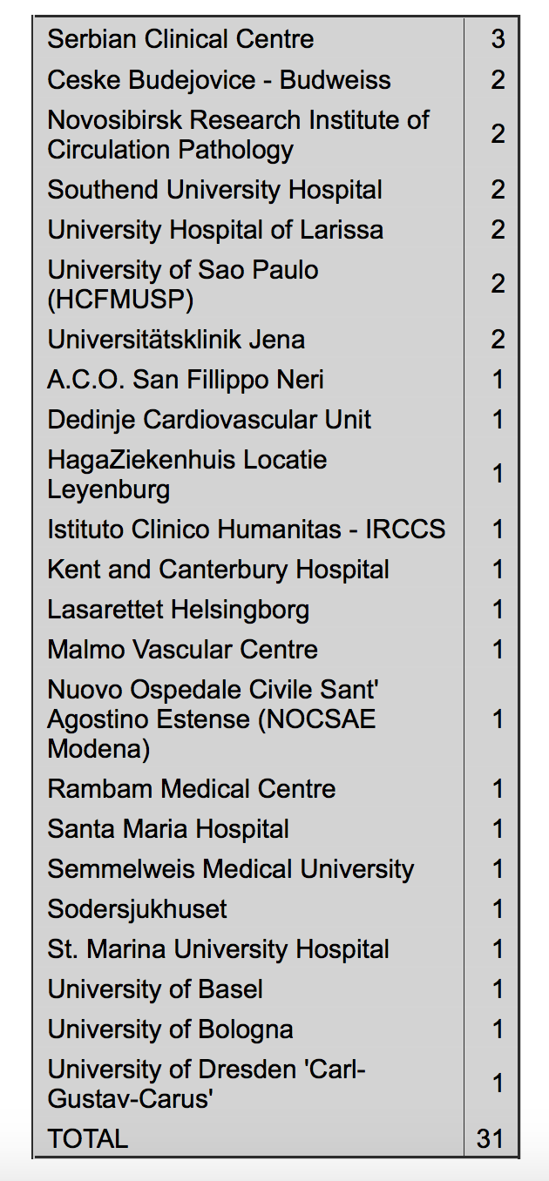

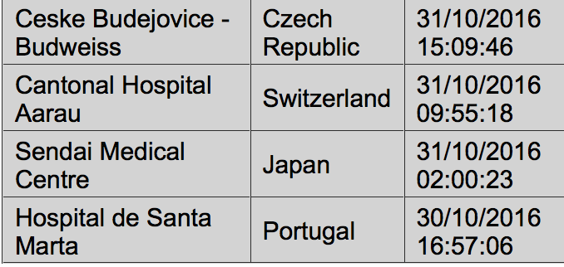
Recruitment: see our Website acst-2.org
March 2017
February 2017
Front Page: daily update
Our new patient (s) were randomised from:

Slide 23
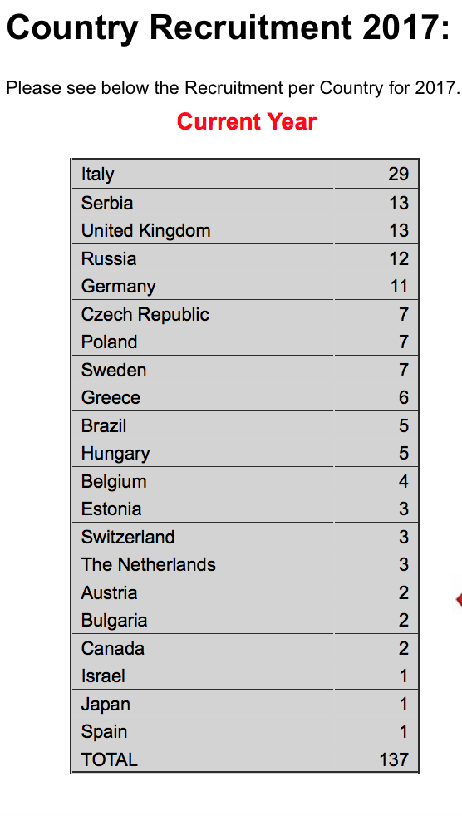
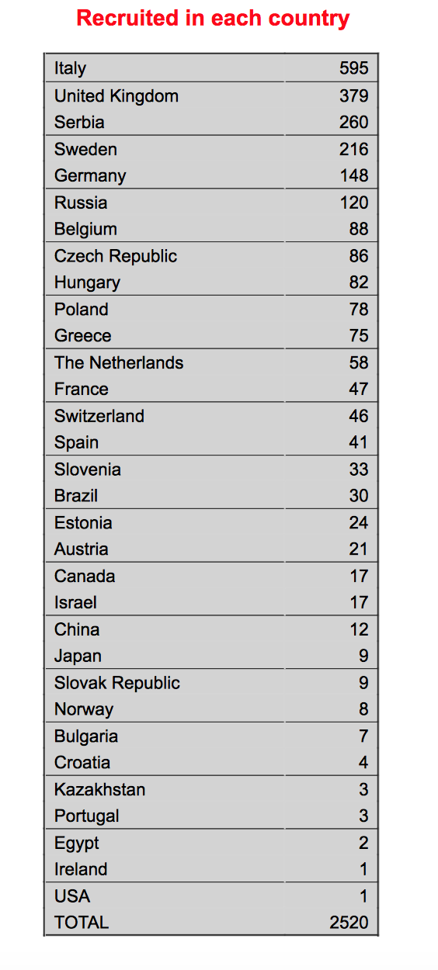
Recruitment data on acst-2.org

Slide 24
Top 10 Recruiting Centres
Istituto Auxologico Italiano, Milan | Italy | 216
Dedinje Cardiovascular Unit, Belgrade | Serbia | 151
Novosibirsk Research Institute of Circulation Pathology | Russia | 128
Serbian Clinical Centre | Serbia | 116
Sodersjukhuset, Stockholm | Sweden | 115
Santa Maria Hospital, Reggio Emilia | Italy | 82
Nuovo Ospedale Civile Sant' Agostino Estense (NOCSAE Modena) | Italy | 79
Freeman Hospital, Newcastle | United Kingdom | 78
Malmo Vascular Centre | Sweden | 75
University Hospital of Antwerp | Belgium | 64

Slide 25
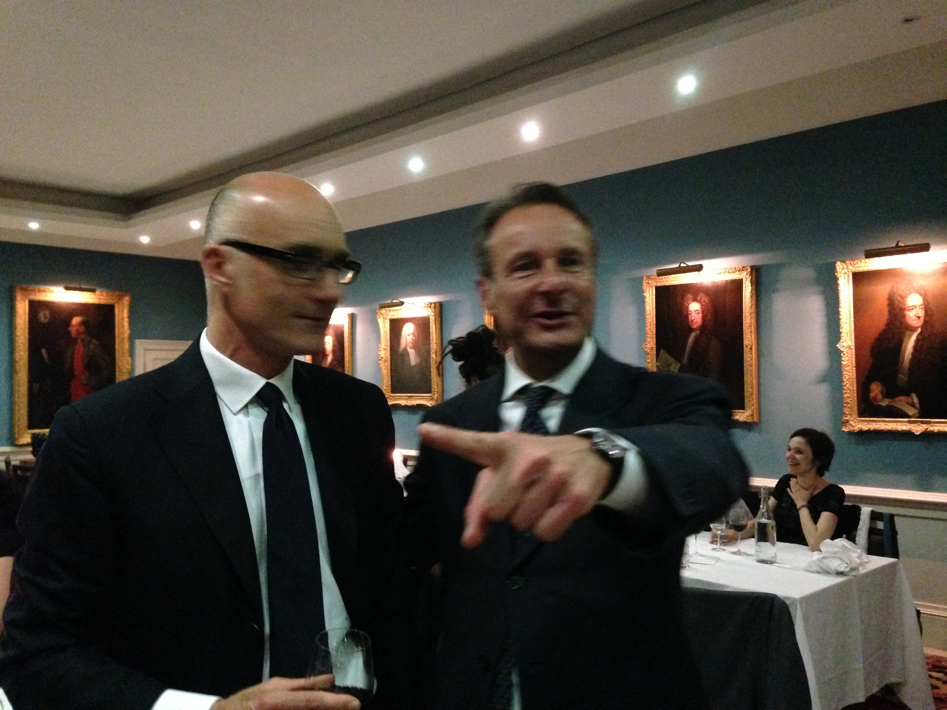

Slide 26
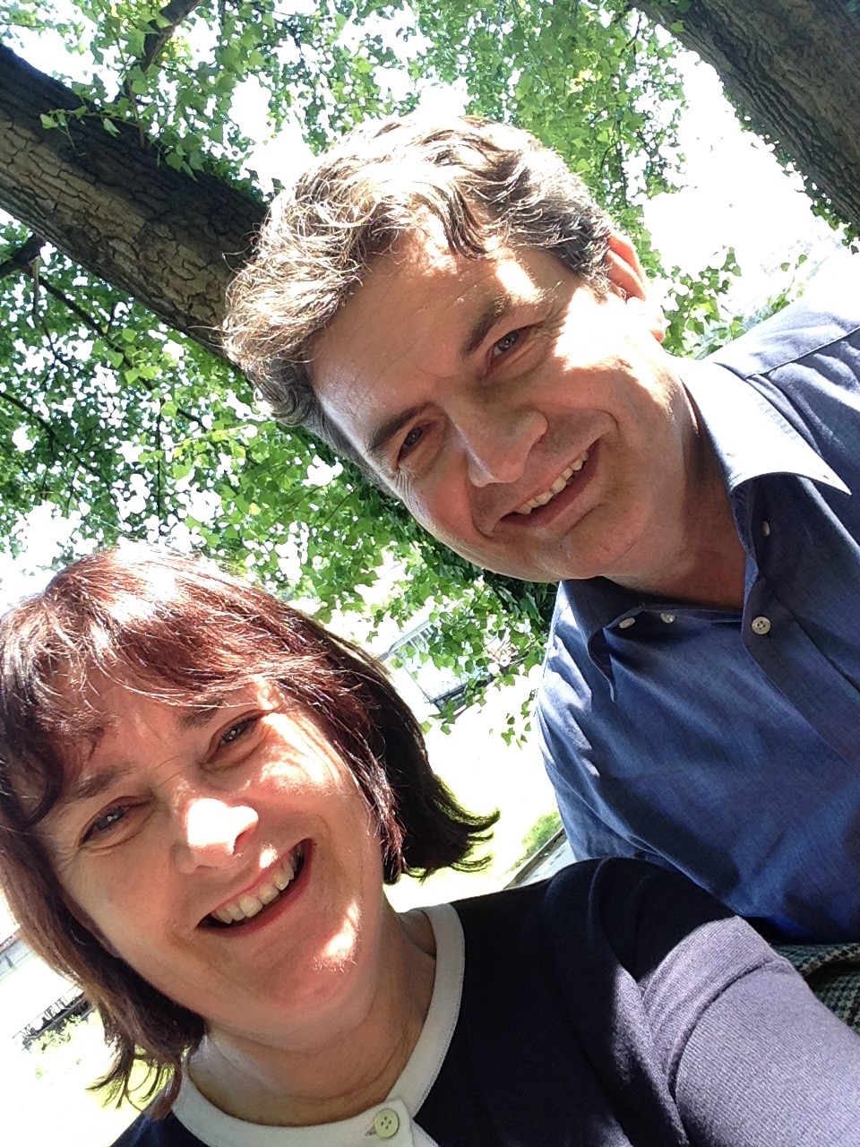

Slide 27
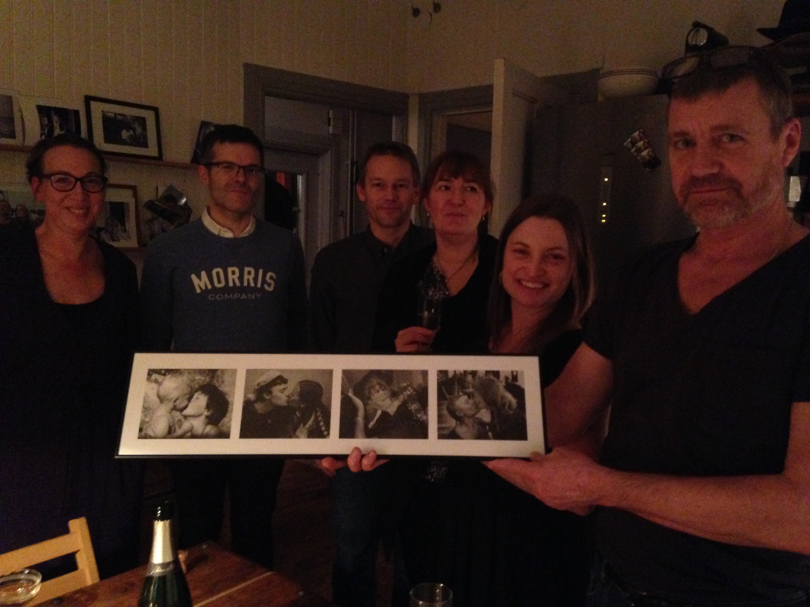

Slide 28
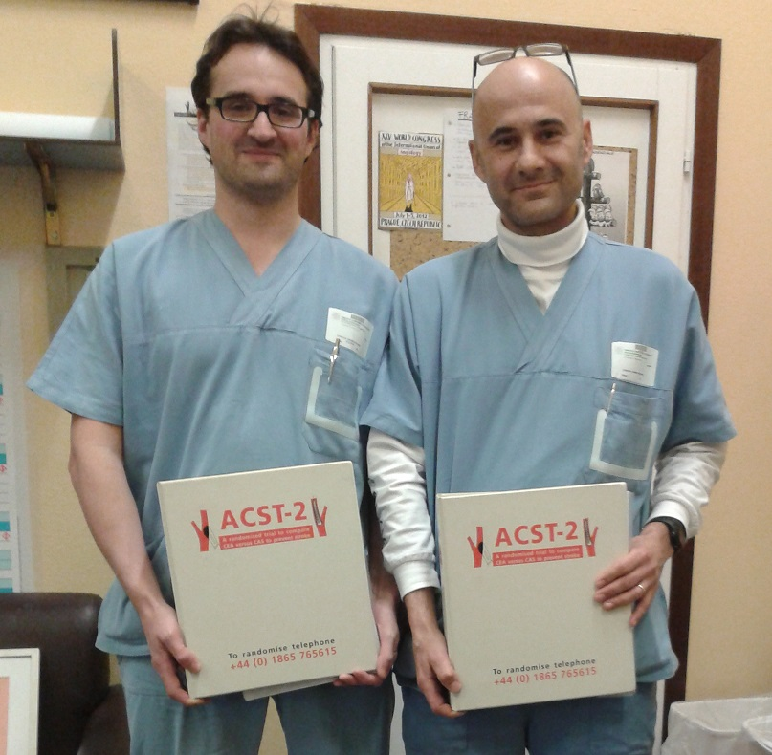

Slide 29
Baseline Patient Characteristics
 |  | CEA | CAS | %
Gender | Male | 914 | 913 | 70.4
Atrial Fibrillation | Yes | 76 | 78 | 5.9
Diabetes | Yes | 381 | 380 | 29.3
Age Range 42-93yrs (Median 69) | < 65 | 379 | 381 | 29.3
 | >=65 and <=74 | 584 | 578 | 44.7
 | >=75 | 336 | 339 | 26
Echolucent | Definitely No | 414 | 415 | 31.9
 | Definitely Yes | 369 | 368 | 28.4
 | Unknown | 516 | 515 | 39.7
Contralateral Stenosis % Median c/l stenosis ( Whole Study 35% ) | <50 | 805 | 804 | 62
 | >=50 and <=79 | 354 | 352 | 27.2
 | >=80 and <100 | 49 | 47 | 3.7
 | 100 | 91 | 95 | 7.2
Ipsilateral Stenosis (%) Median (Whole Study 80%)
 | >=50 and <=69 | 41 | 40 | 3.1
 | >=70 and <=89 | 946 | 945 | 72.9
 | >=90 | 298 | 297 | 22.9
Systolic BP | <=140 | 805 | 793 | 61.5
 | >=141 and <=160 | 378 | 394 | 29.8
 | >=161 and greater | 116 | 111 | 8.7

Slide 30
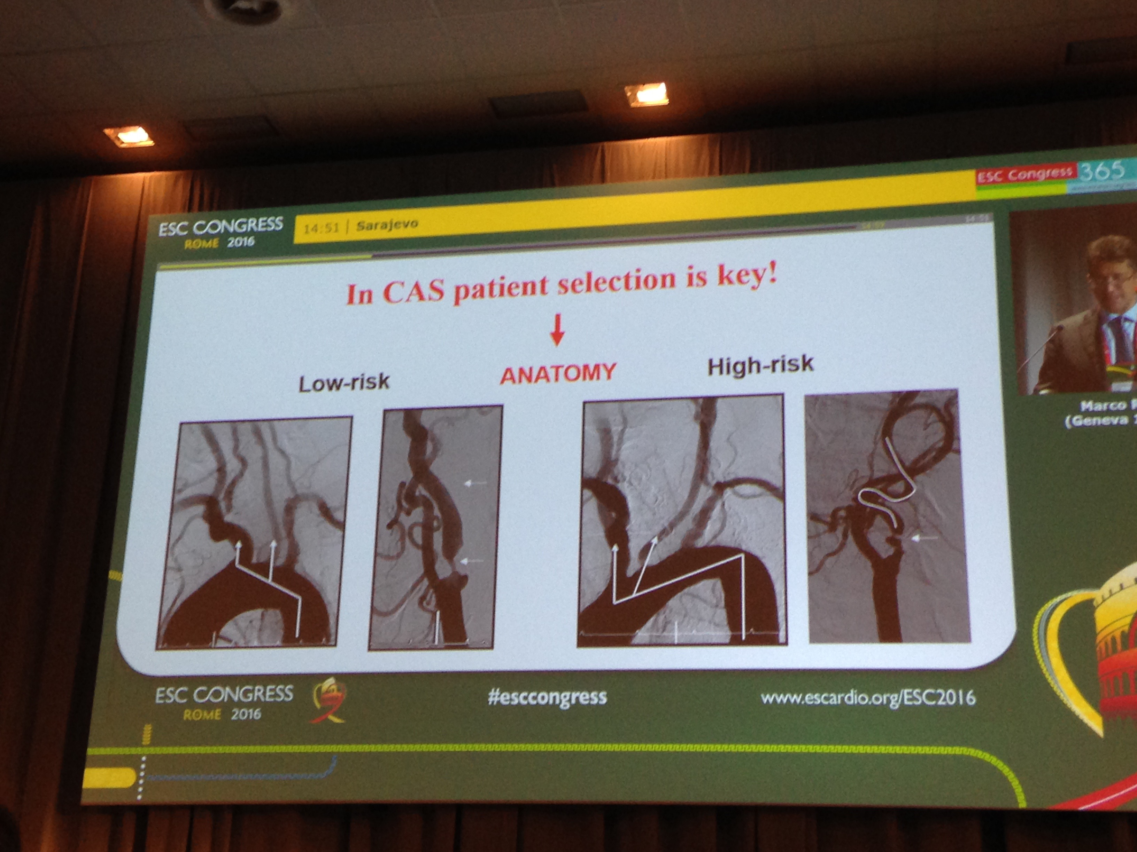

Slide 31
Trial Forms Received by 31st Aug 2017
Randomised | Consent Received | Randomisation Received | 1-month Follow-up (expected) | 1-month Follow-up (received)
2612 | 2542 (97.3%) | 2549 (97.6%) | 2555 (97.8%) | 2448 (93.7%)

Slide 32
Annual Follow-up
Annual Follow-up | 2017 | 2016 | 2015 | 2014 | 2013 | 2012 | 2011 | 2010 | 2009
Sent | 2107 | 1867 | 1564 | 1273 | 1074 | 788 | 432 | 110 | 55
Received | 932 | 1678 | 1430 | 960 | 1032 | 716 | 320 | 108 | 55
as % | 44.2% | 89.9% | 91.4% | 75.4% | 96.1% | 90.9% | 74.1% | 98.2% | 100.0%

Slide 33
Compliance with allocated treatment reported to DMC 28th March 2017
Allocation | 1-month form entered/verified | Procedure not yet done | Cross-over (4%) | Procedure as allocated
CAS | 1109 | 65 | 51‡ | 993
CEA | 1102 | 43 | 33† | 2026
Total | 2221 | 108 | 84 | 2019
‡ CEA done, no deaths or disabling stroke
† CAS done, no deaths or disabling stroke

Slide 34
Mean days from randomisation to procedure, mean person-years follow-up from entry
31st August 2017
Of 2266 procedures 1150 had CEA: 24 days 1116 had CAS: 26 days Those allocated CEA: mean follow up 3.6 p-y Those allocated CAS: mean follow up 3.6 p-y

Slide 35
Peri-procedural risks (blinded) in 2103 patients
Disabling Stroke and Death (within 30 days)
1.0%

Slide 36
Achieved/Planned Recruitment
Jan 2010 – end December 2019

Slide 37
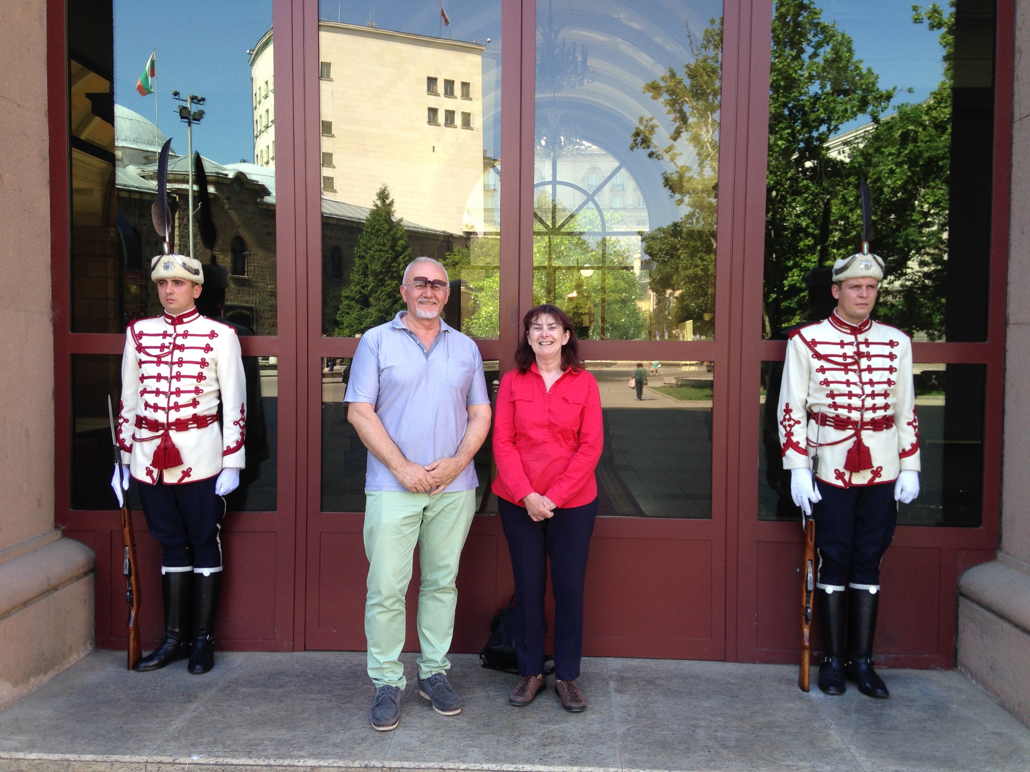

Slide 38
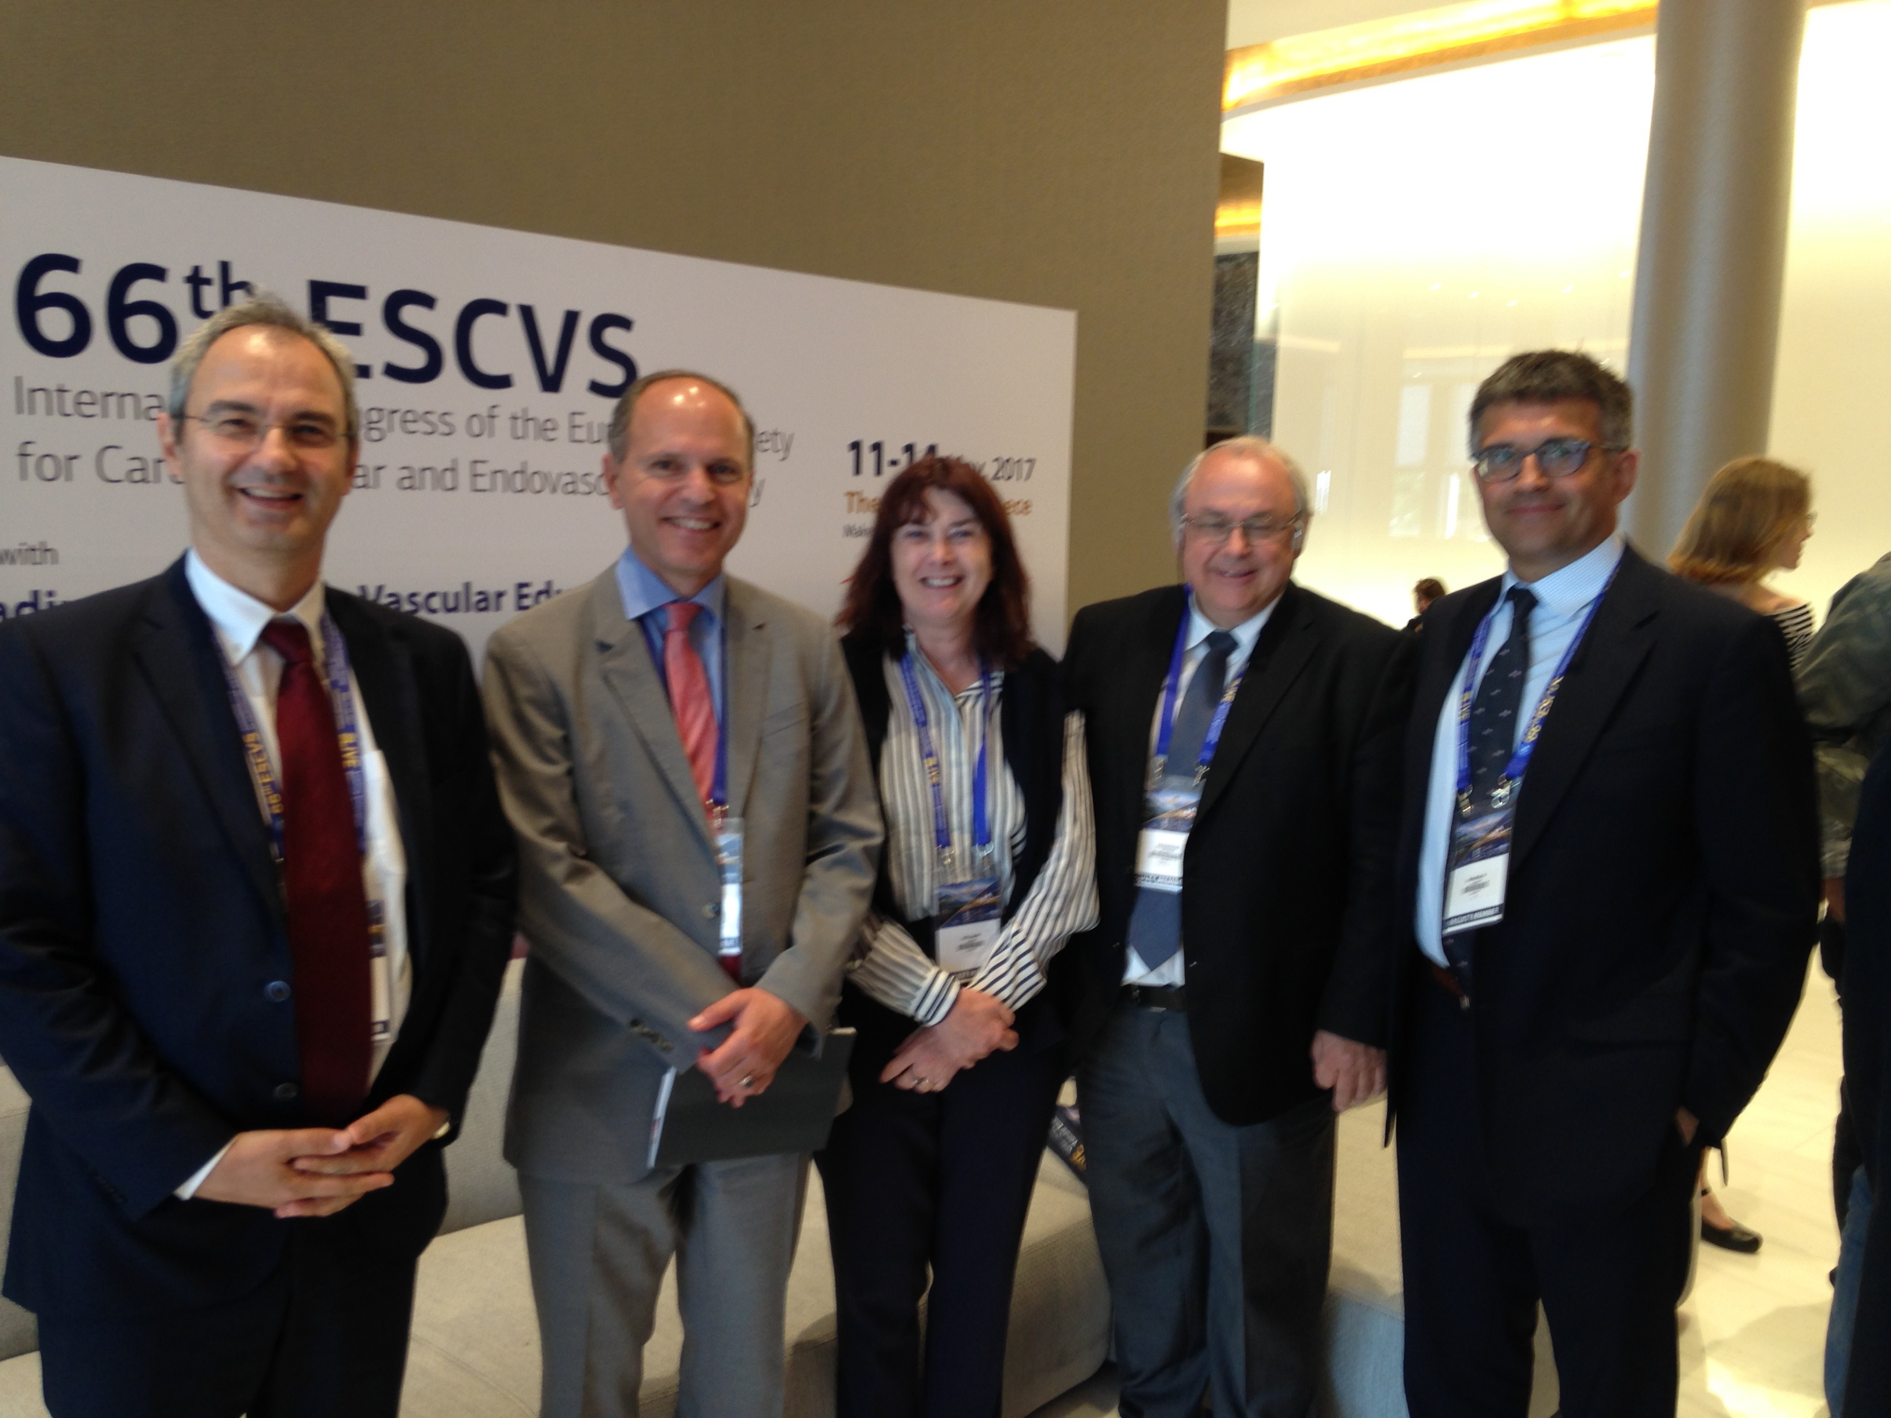

Slide 39
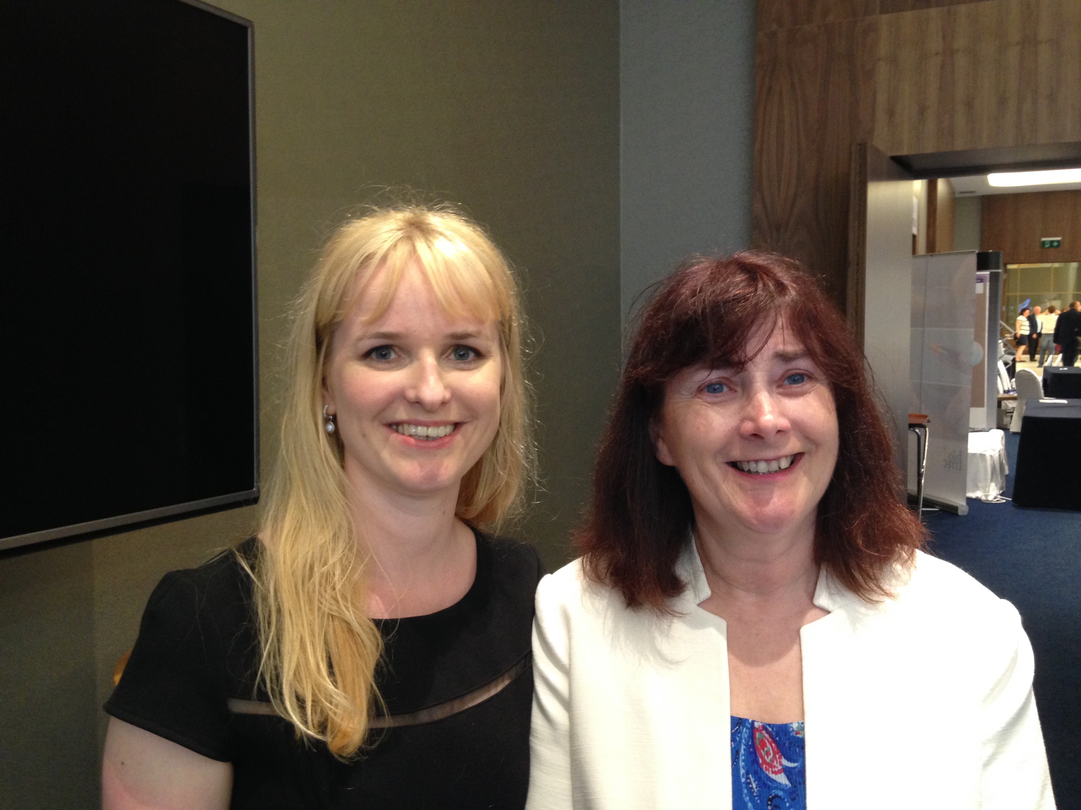

Slide 40
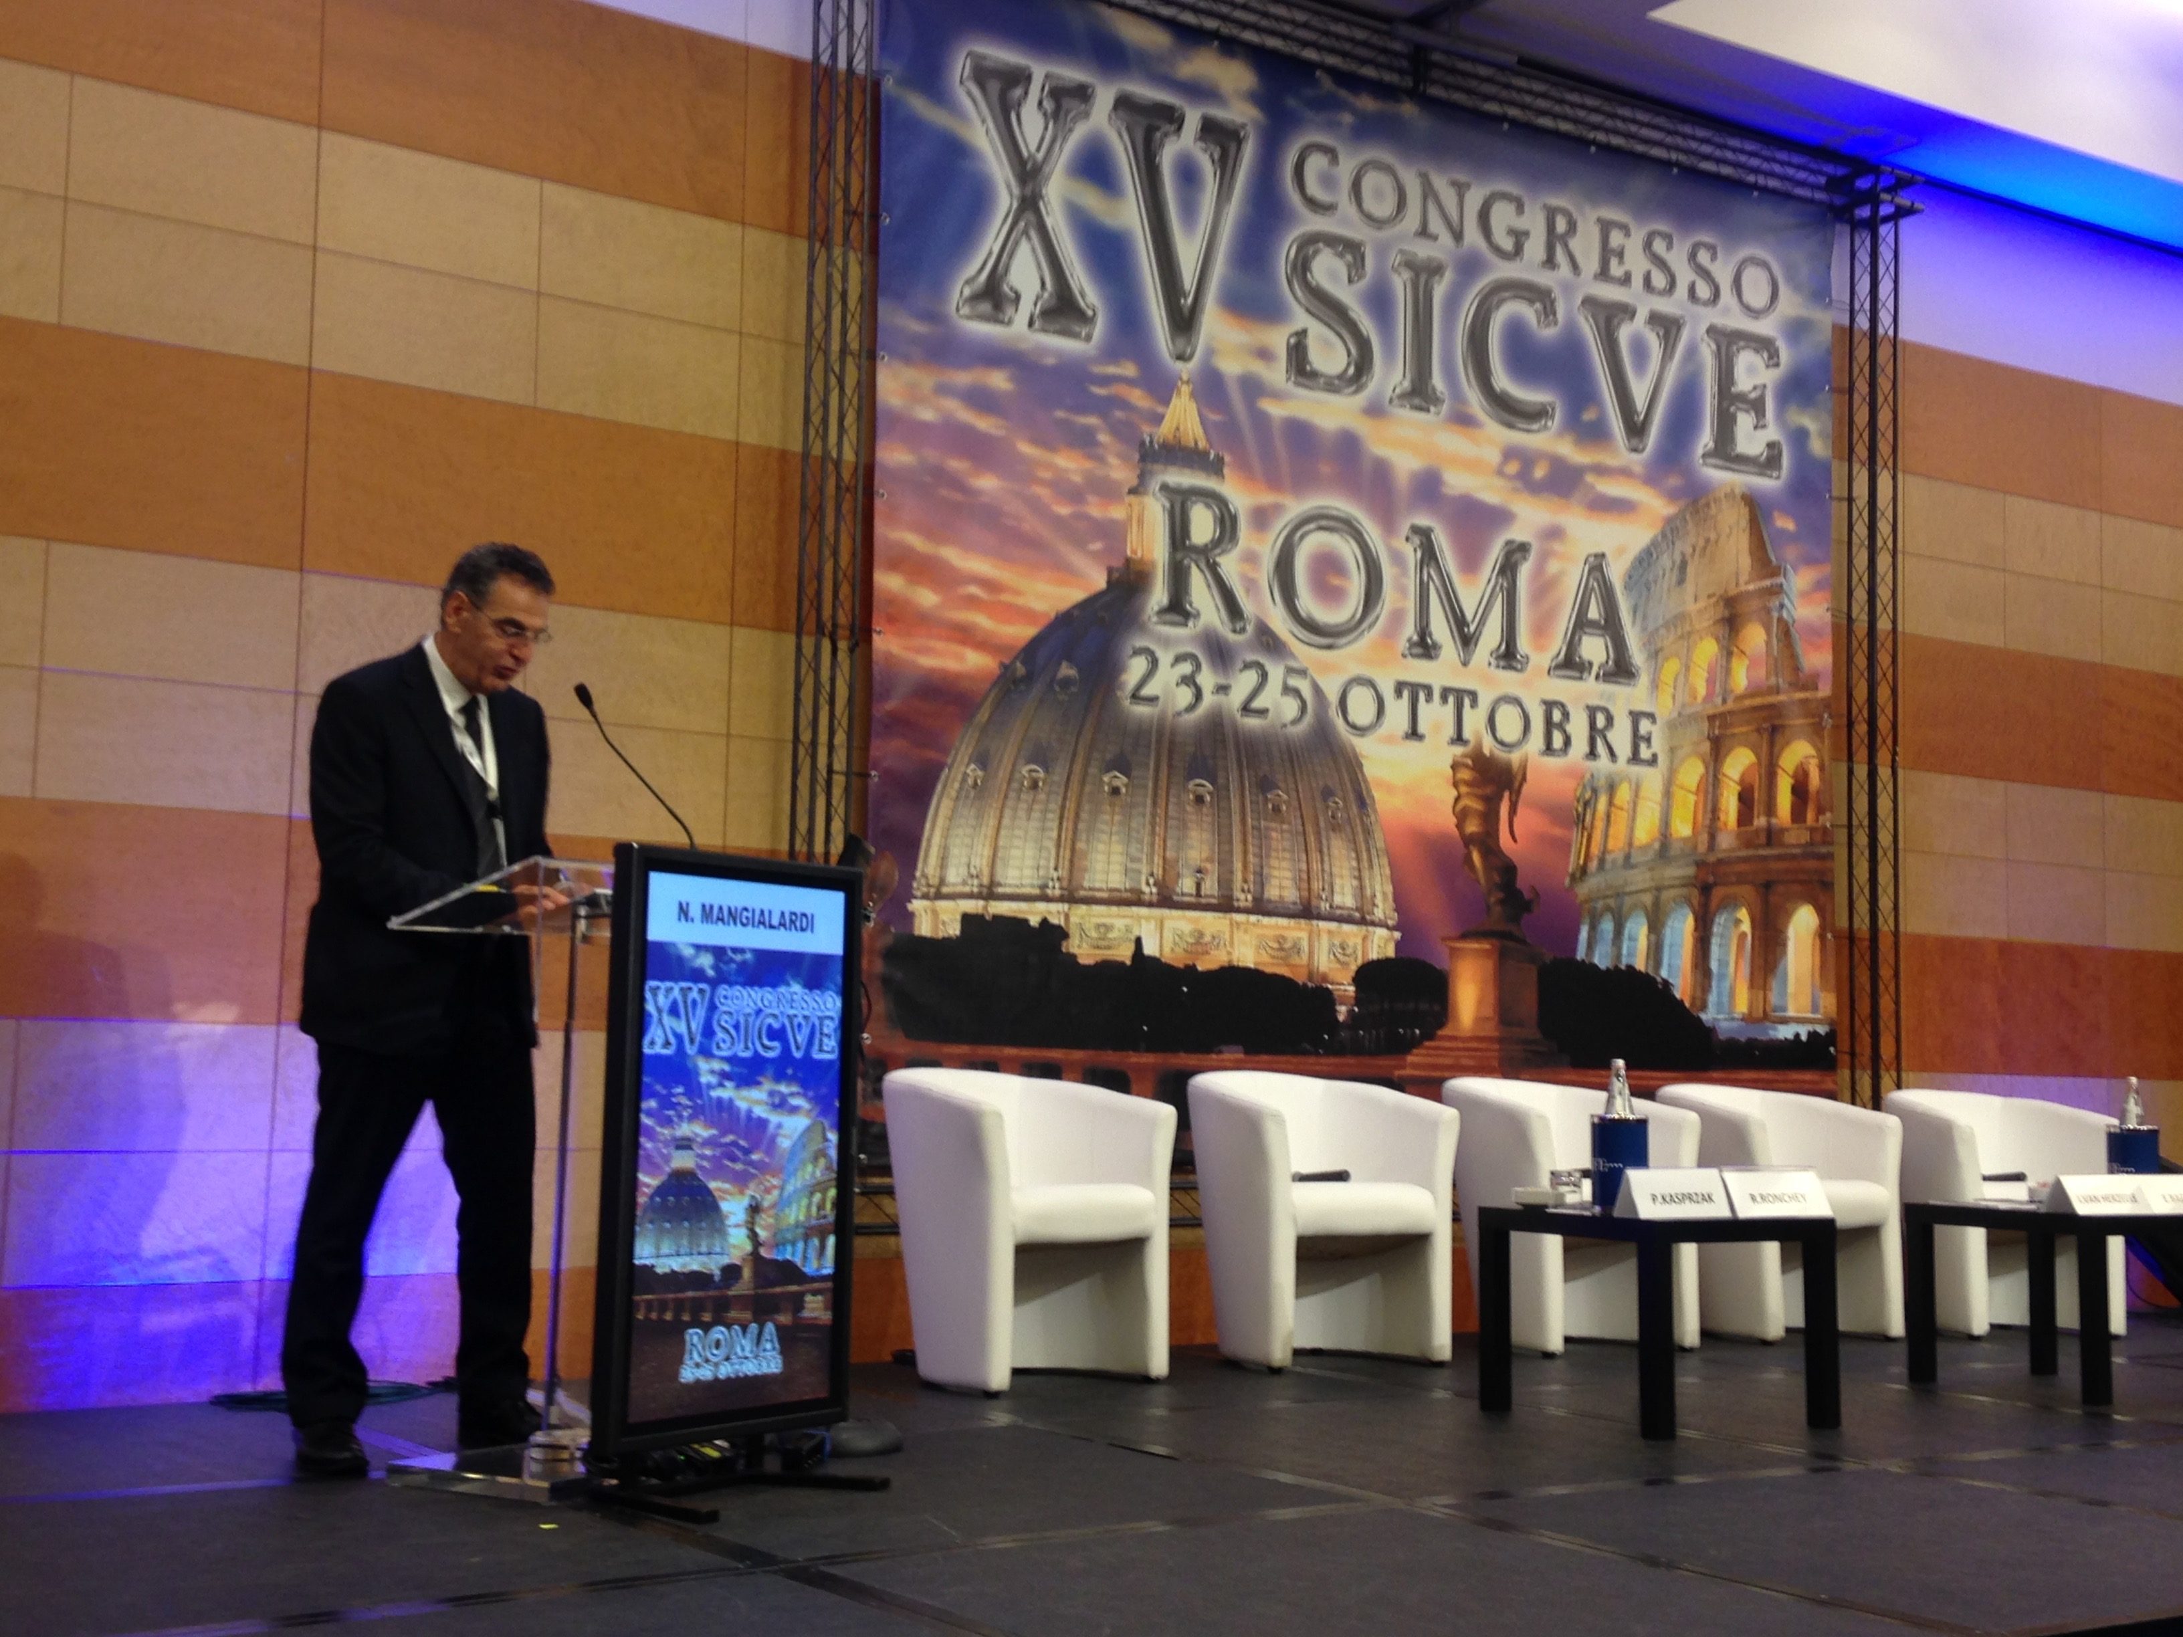

Slide 41
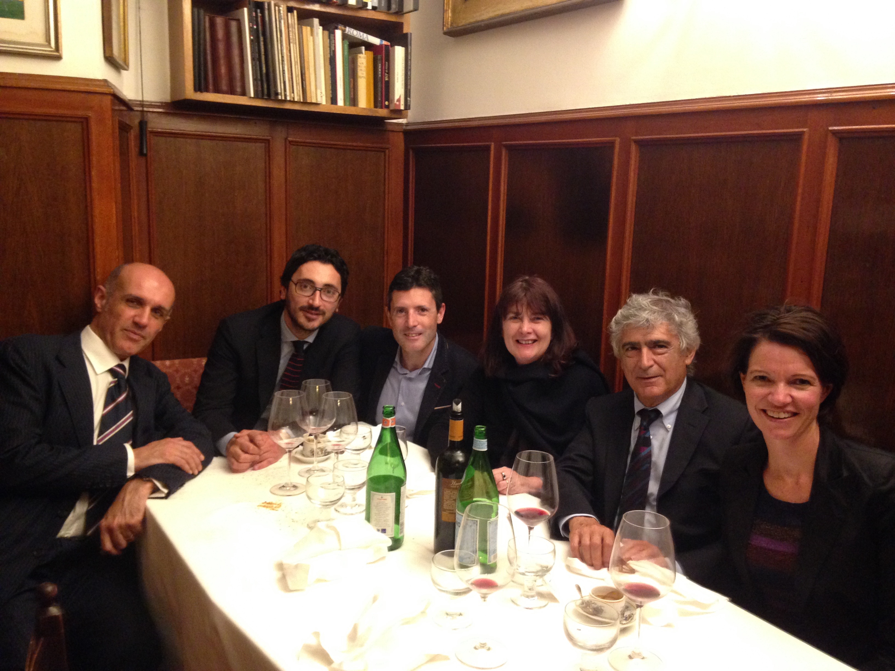

Slide 42
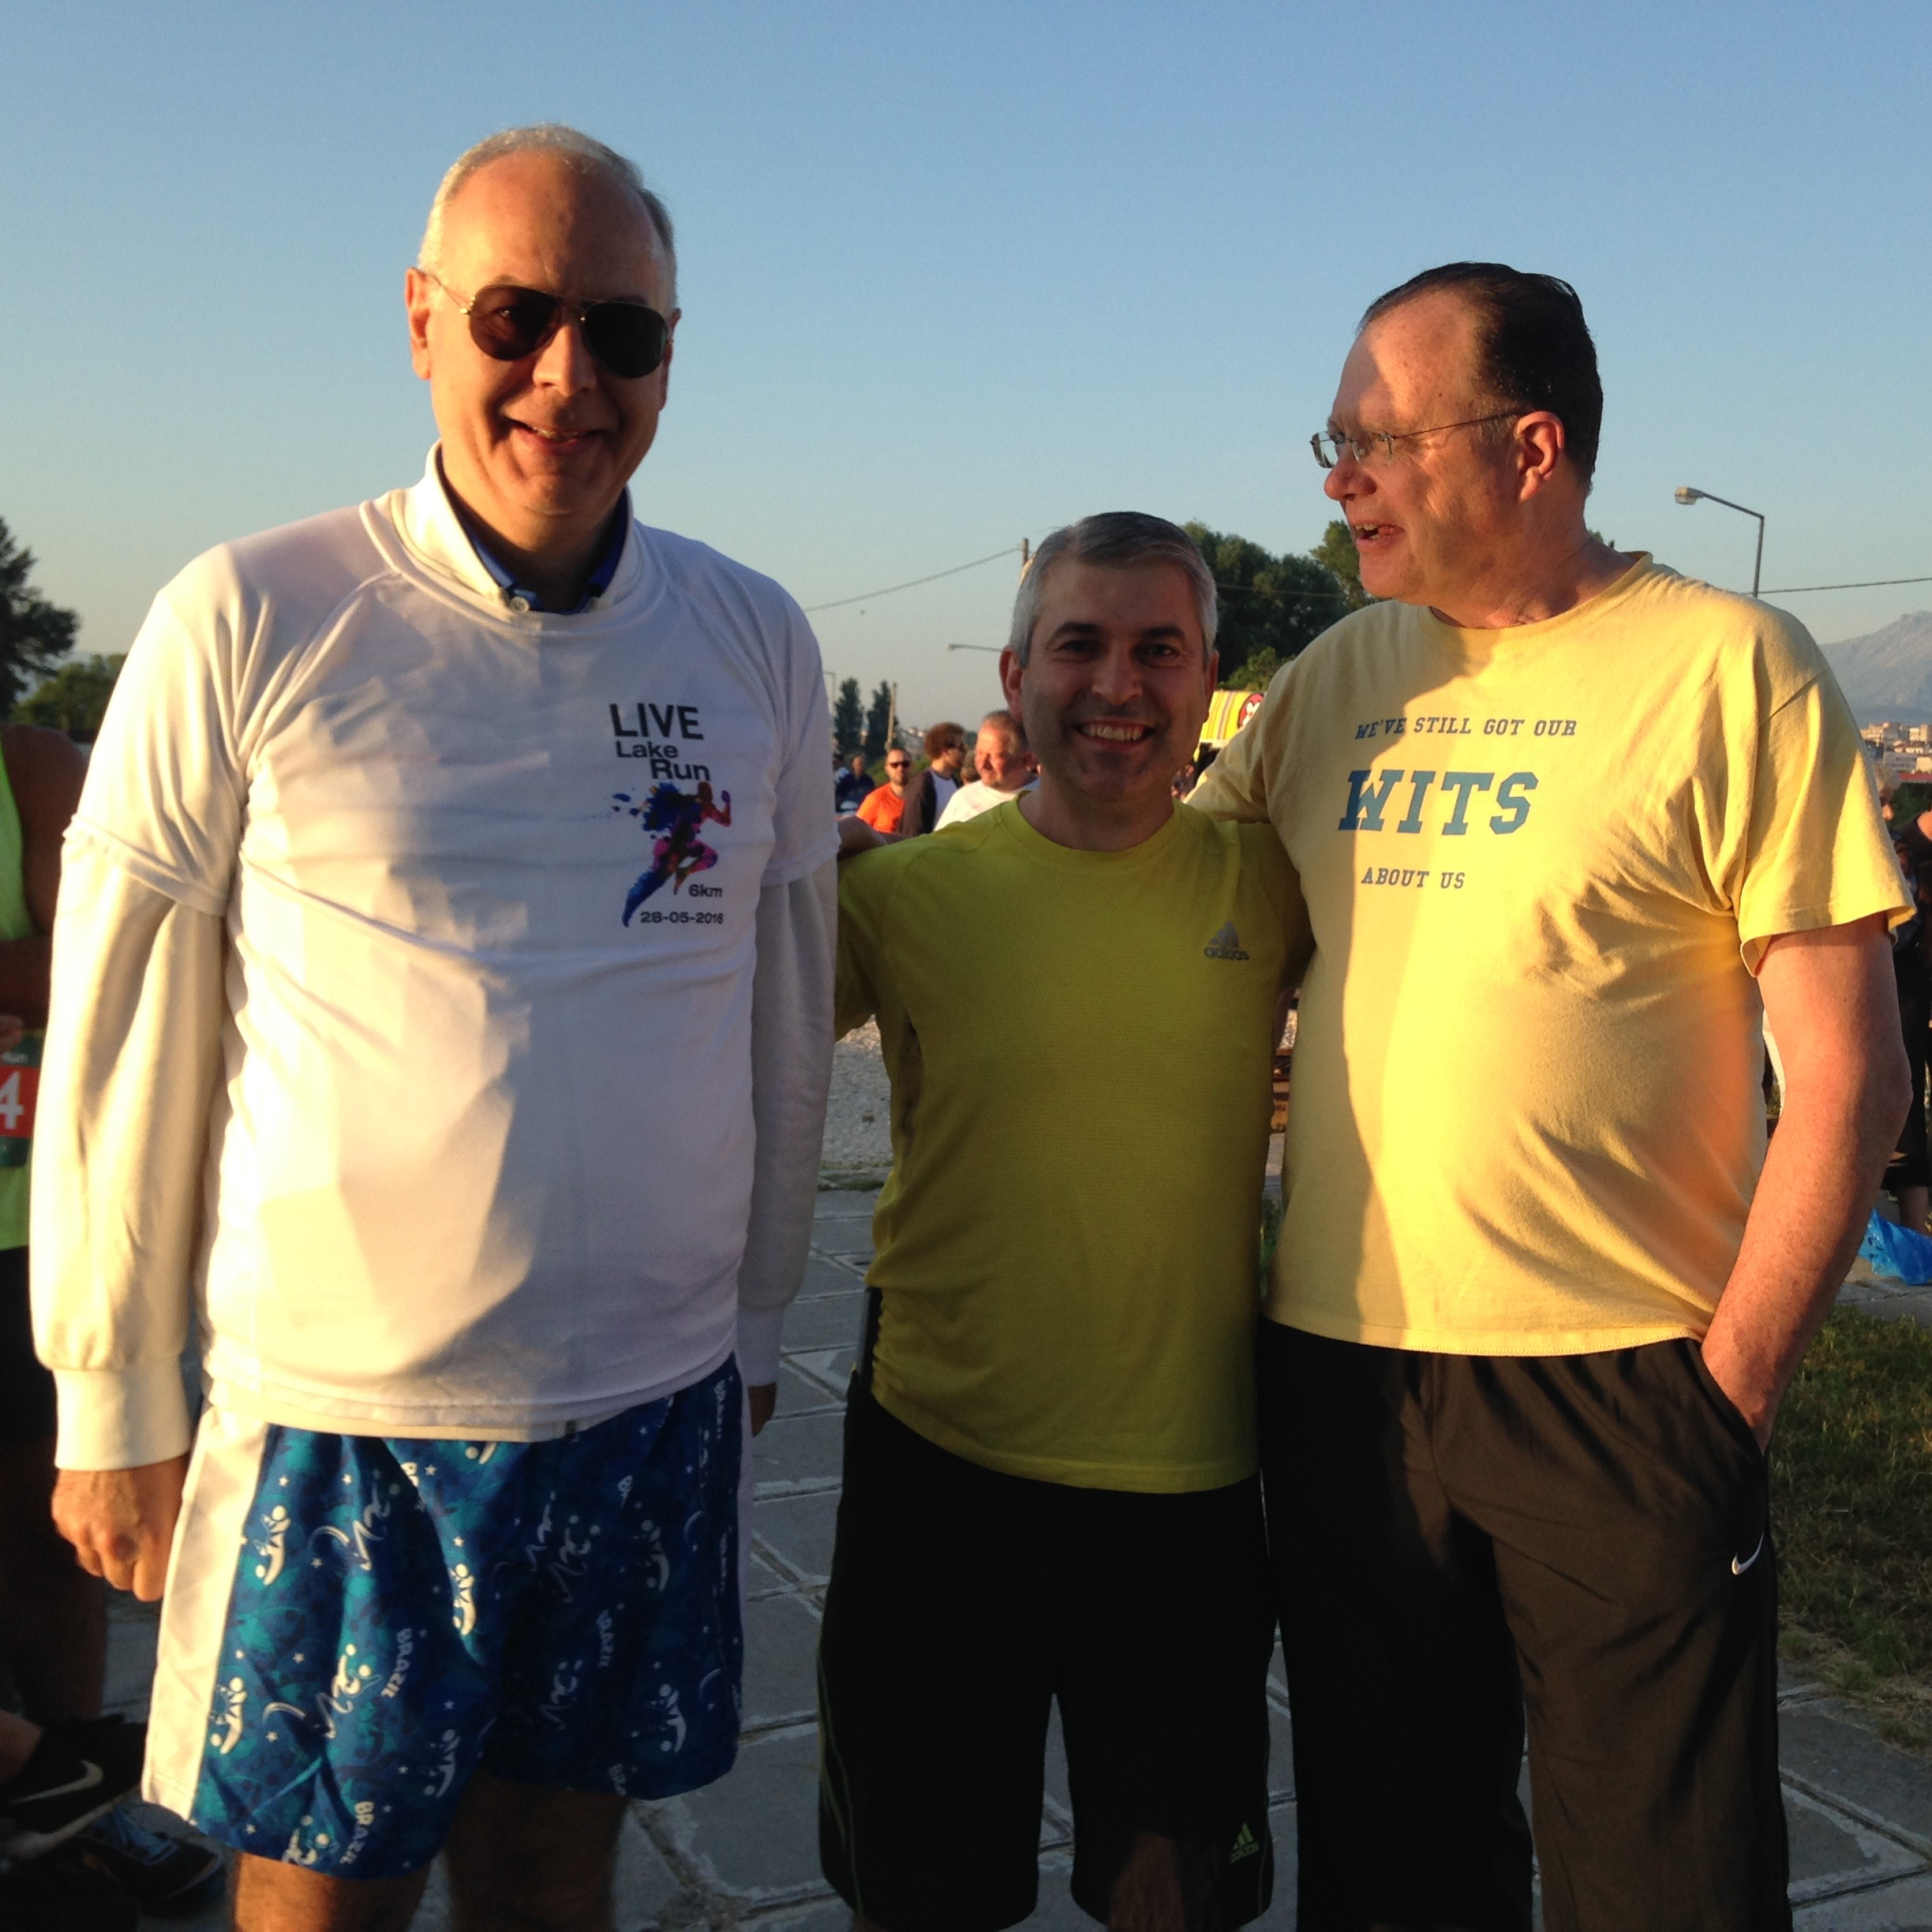

Slide 43
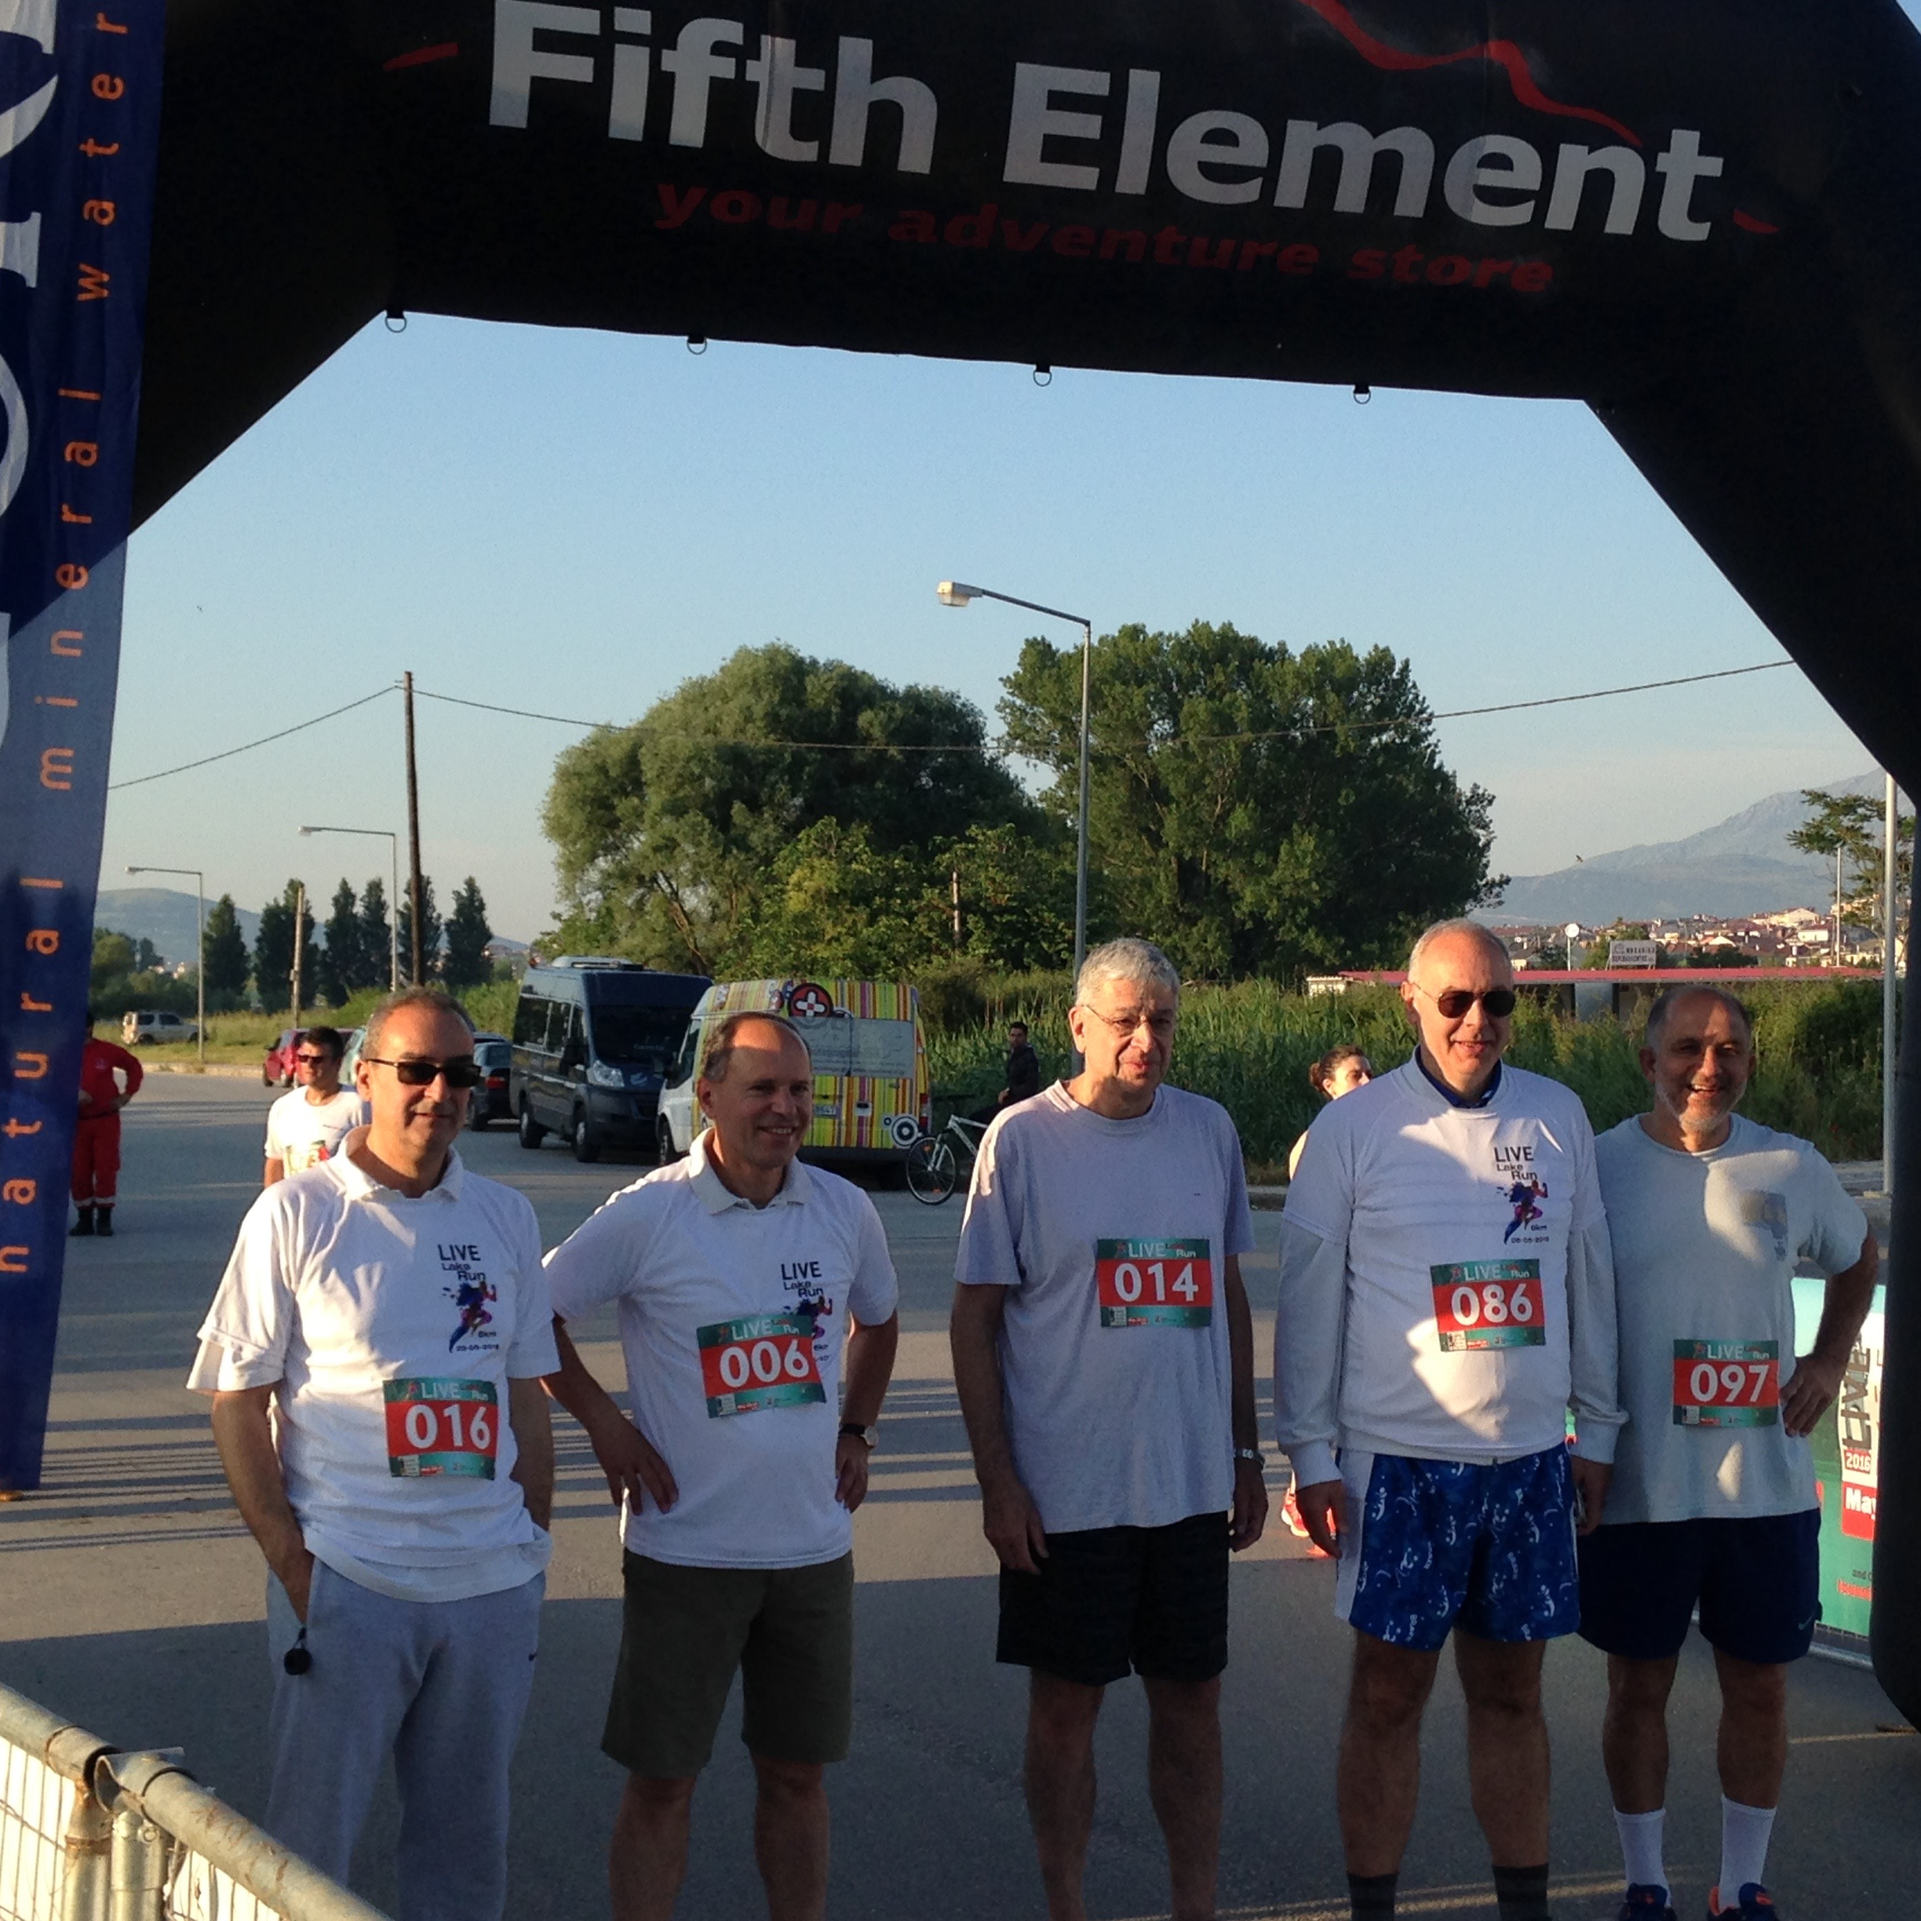

Slide 44


Slide 45
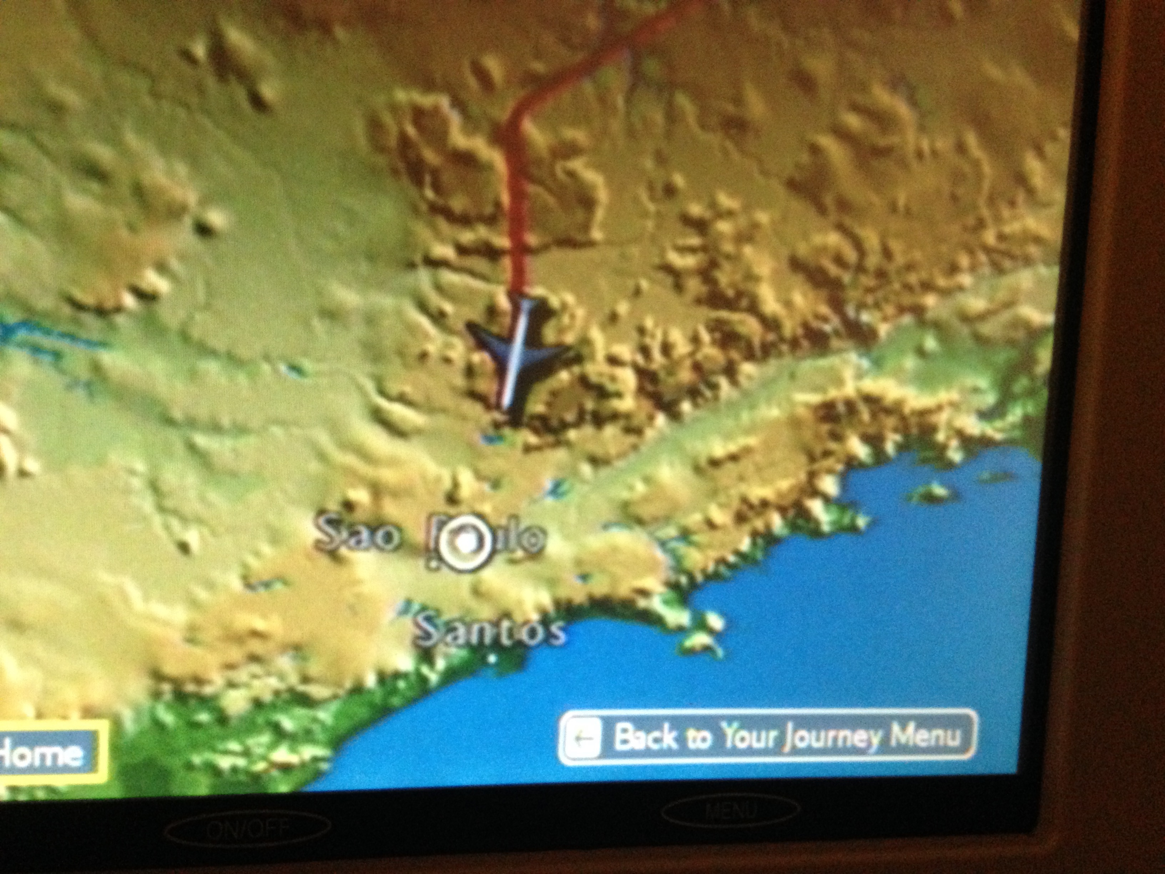

Slide 46
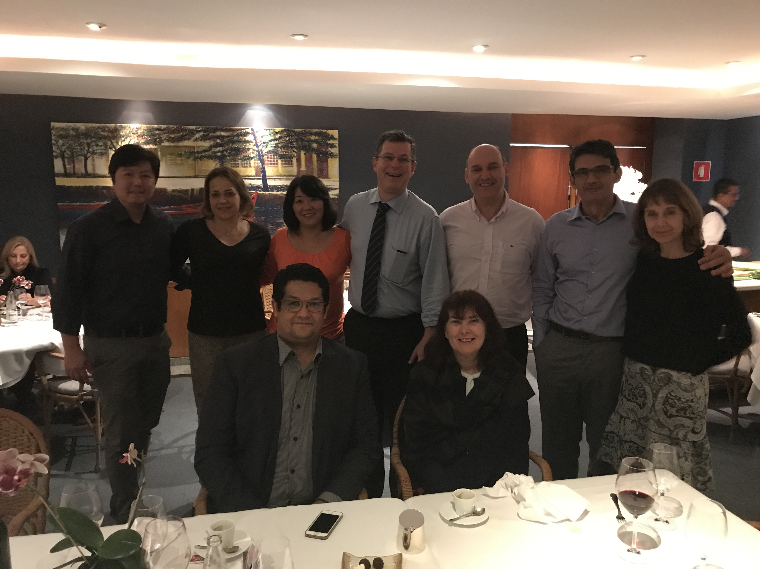

Slide 47
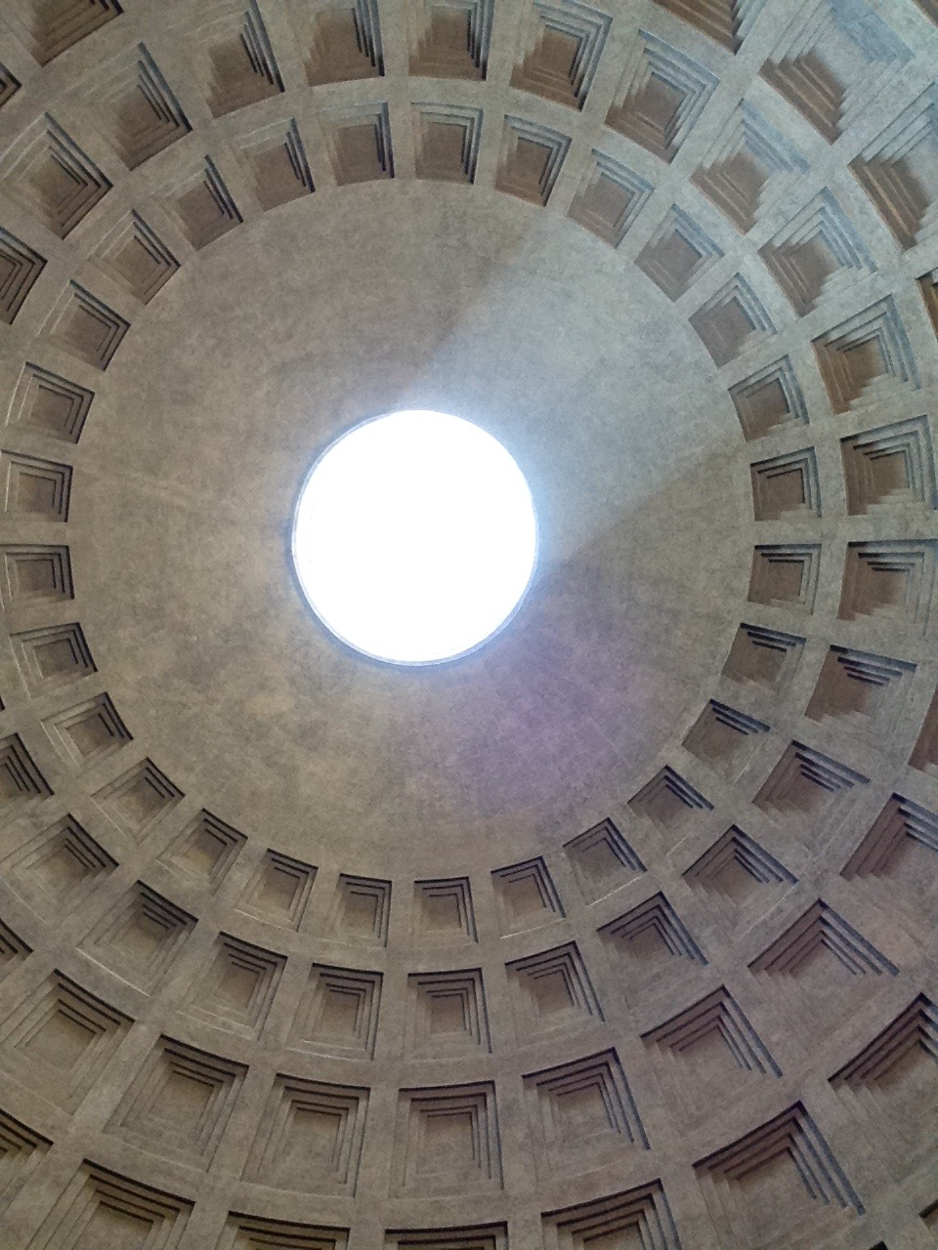

Slide 48
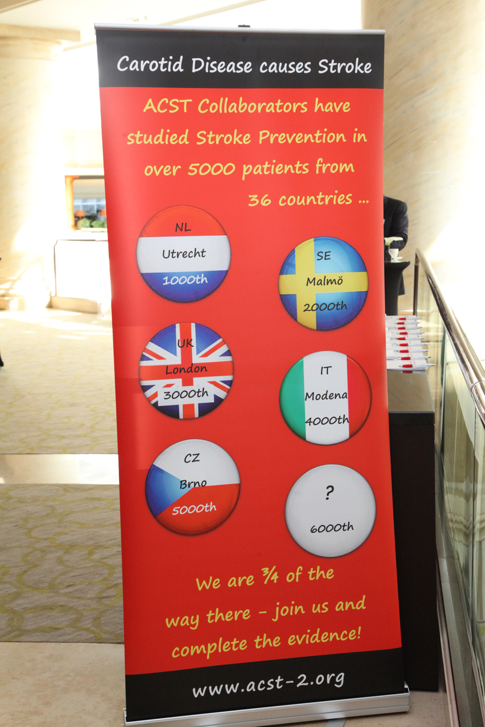
Patient 6000 in the ACST trials – only 268 away!

Slide 49
How does ACST-2 fit with the New Guidelines?

Slide 50
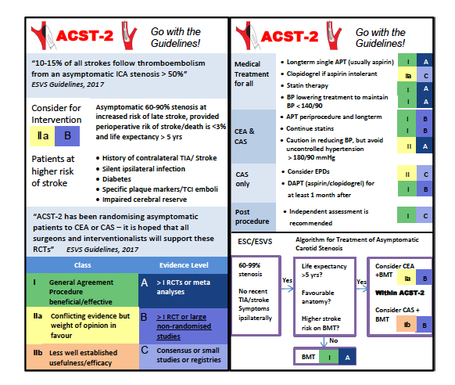
The New ESVS and ESC Guidelines

Slide 51
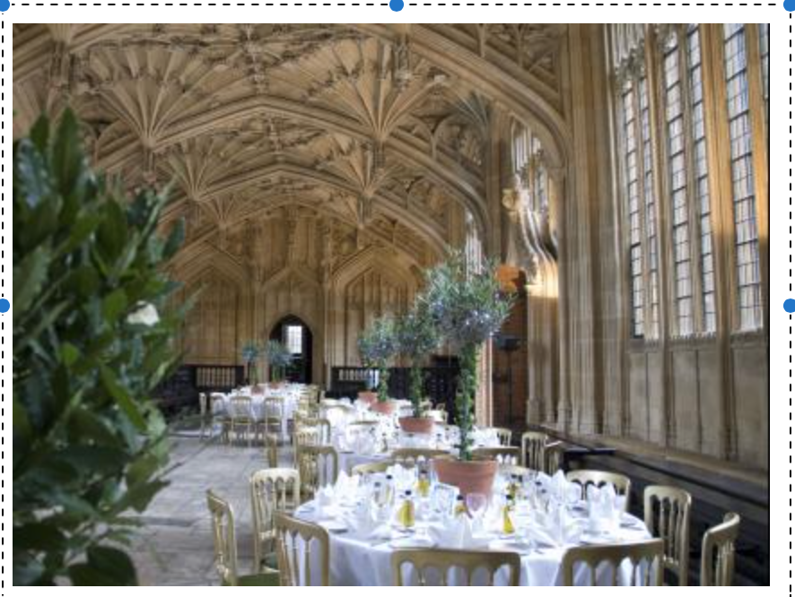
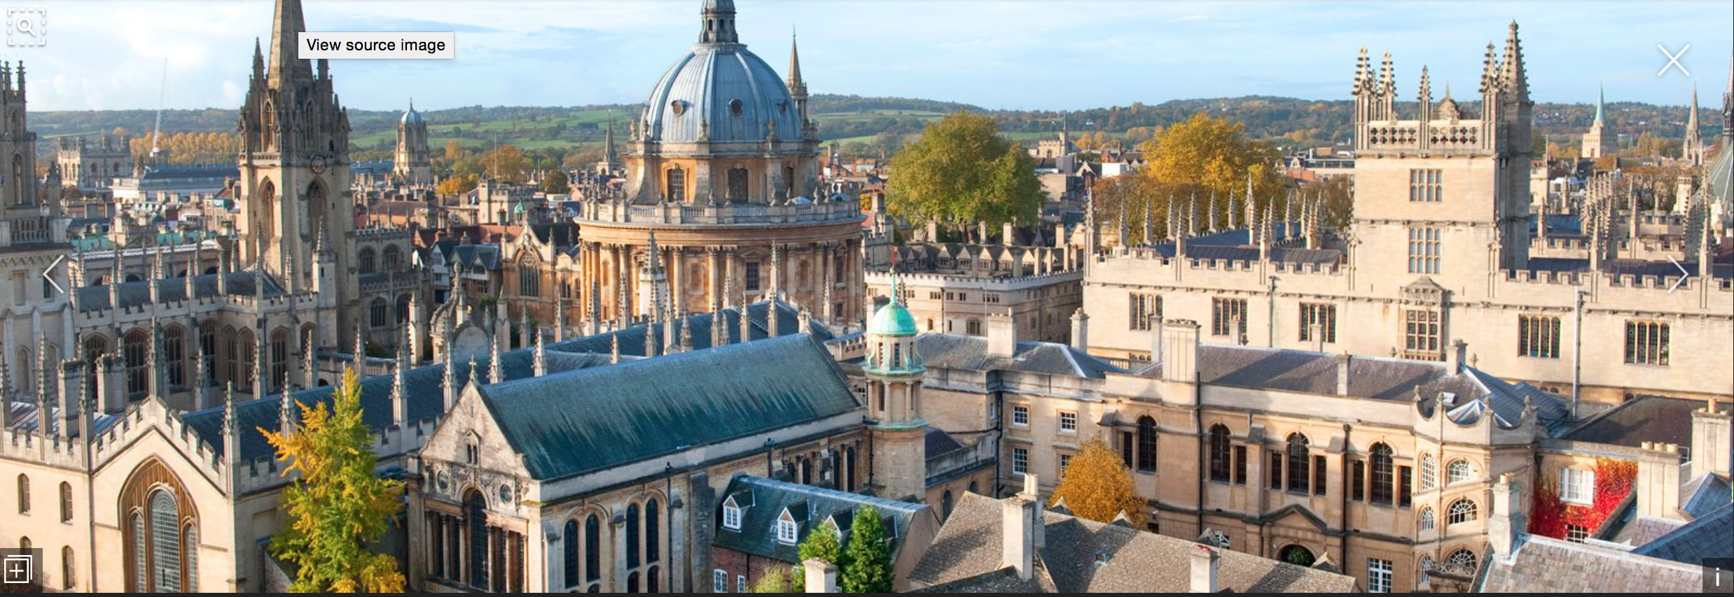

5th Collaborators’ Meeting
ACST-2 update
4th September 2017

Slide 52


Slide 53
