Slide 1



Aiming for complete data
Alison Clarke & Wojtek Brudlo

Slide 2


ACST-2 overview
First patient randomised: 15/01/2008
Patients are now in their 9th year of follow-up
120 active centres from 32 countries
2612 patients recruited
Goal: 3,600 patients
988 patients to go

Slide 3
Initial forms received
Randomised | Consent | Randomisation | 1-month Follow-up (of expected)
2612 (100%) | 97.3% | 97.6% | 95.8%
Verified | 97.0% | 97.0% | 93.3%
88 forms with outstanding data queries
111 1-month forms still overdue (16 over 2 years!)
We would like you to return the forms:
Consent and Randomisation Forms – 1 week after randomisation
One Month Follow-up Form – 30 days after the procedure (after Doppler + outpatient appointment)

Slide 4
Annual follow-ups
Year | Forms sent | Forms received (of expected)
2016 | 1867 | 94.5%
2017 | 2107 | 53.8%
Aim - at least 96% of Annual Follow-ups
Collaborators are responsible for 40%
11th September 2017 – 1st reminder to patients
We are still expecting 964 forms
If you haven’t returned these, please do it soon!!!

Slide 5
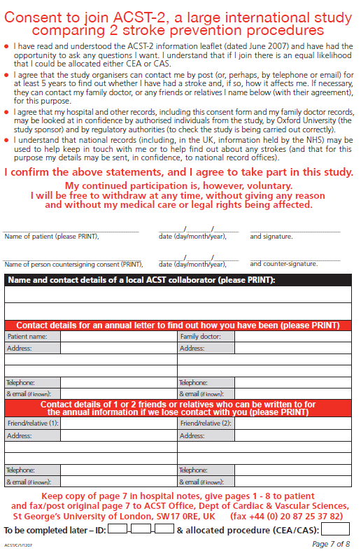
Consent Form
What we need, please:
Dates must match!
On the day, patient and COLLABORATOR must sign – form must NOT be signed by a relative
Please make sure patients DO NOT put their Date of Birth
Please provide addresses for patient, patient’s GP, and alternative contacts
Write patient ID & Procedure

Slide 6
IMPORTANT
DO NOT randomise before patient has signed consent
Please use the correct consent form (approved by your local Ethics committee)
If you’re anonymising patients (DE, A, CH), remember to remove names and signatures before sending us the consent

Slide 7
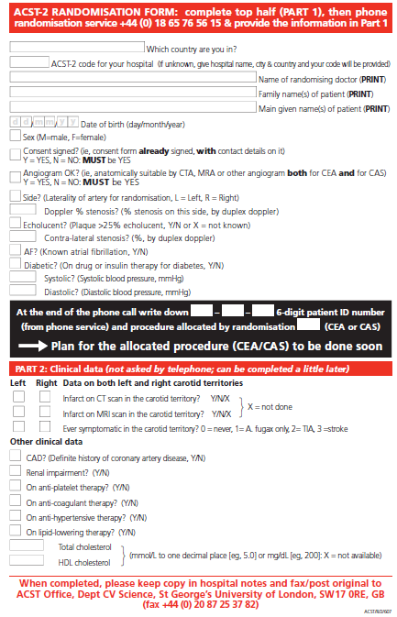

Randomisation Form
Write patient ID and procedure here
Please complete all this before randomisation!
Please indicate using numbers
0 if ‘no’ or 1, 2, or 3
Please do not leave empty boxes!
Required for Form Submission.
Can be completed after randomisation.

Slide 8
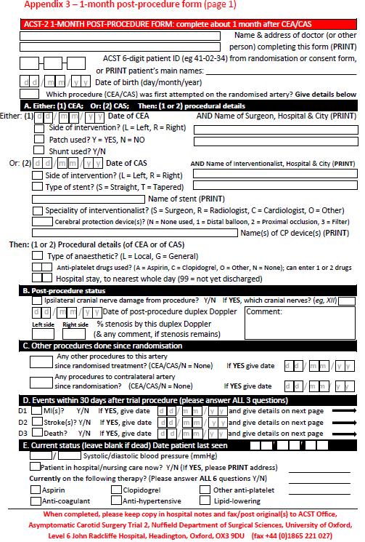
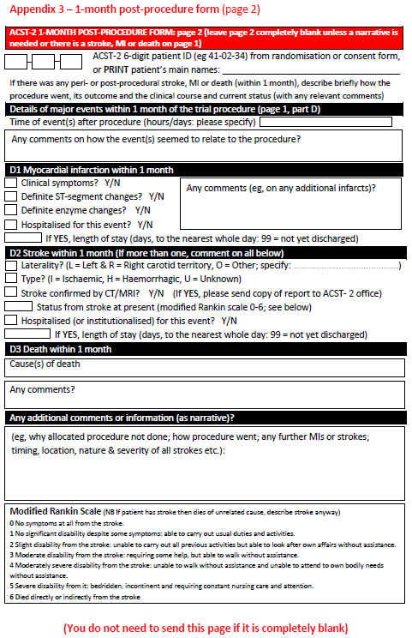
1-month post-procedure form
Complete all the items with details about the procedure (CAS or CEA) and the name of the surgeon or interventionalist
If a patient has MI, stroke or death tell us right away.
Indicate what event occurred (might happen in hospital or at home) and provide as much detail as possible. Send the form to our office.
It is compulsory that we have the date of duplex and % of stenosis.
Answer all of these questions
And provide the date the patient was last seen

Slide 9
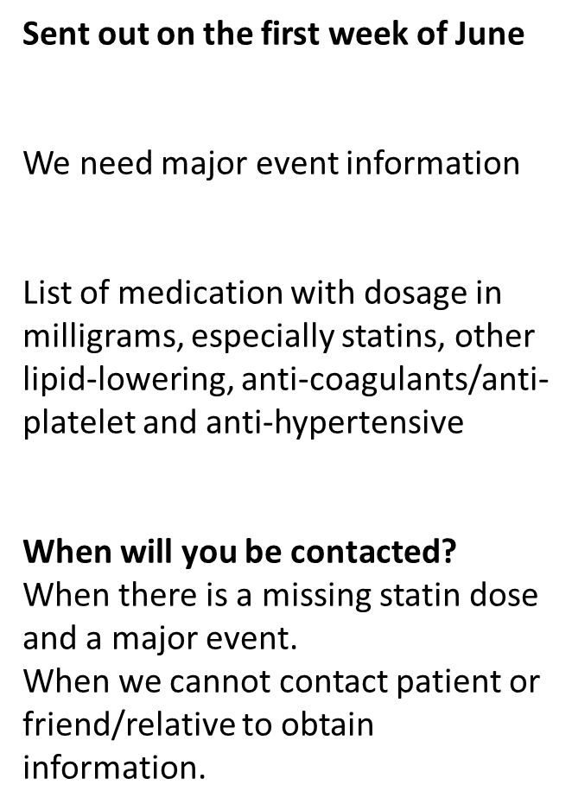
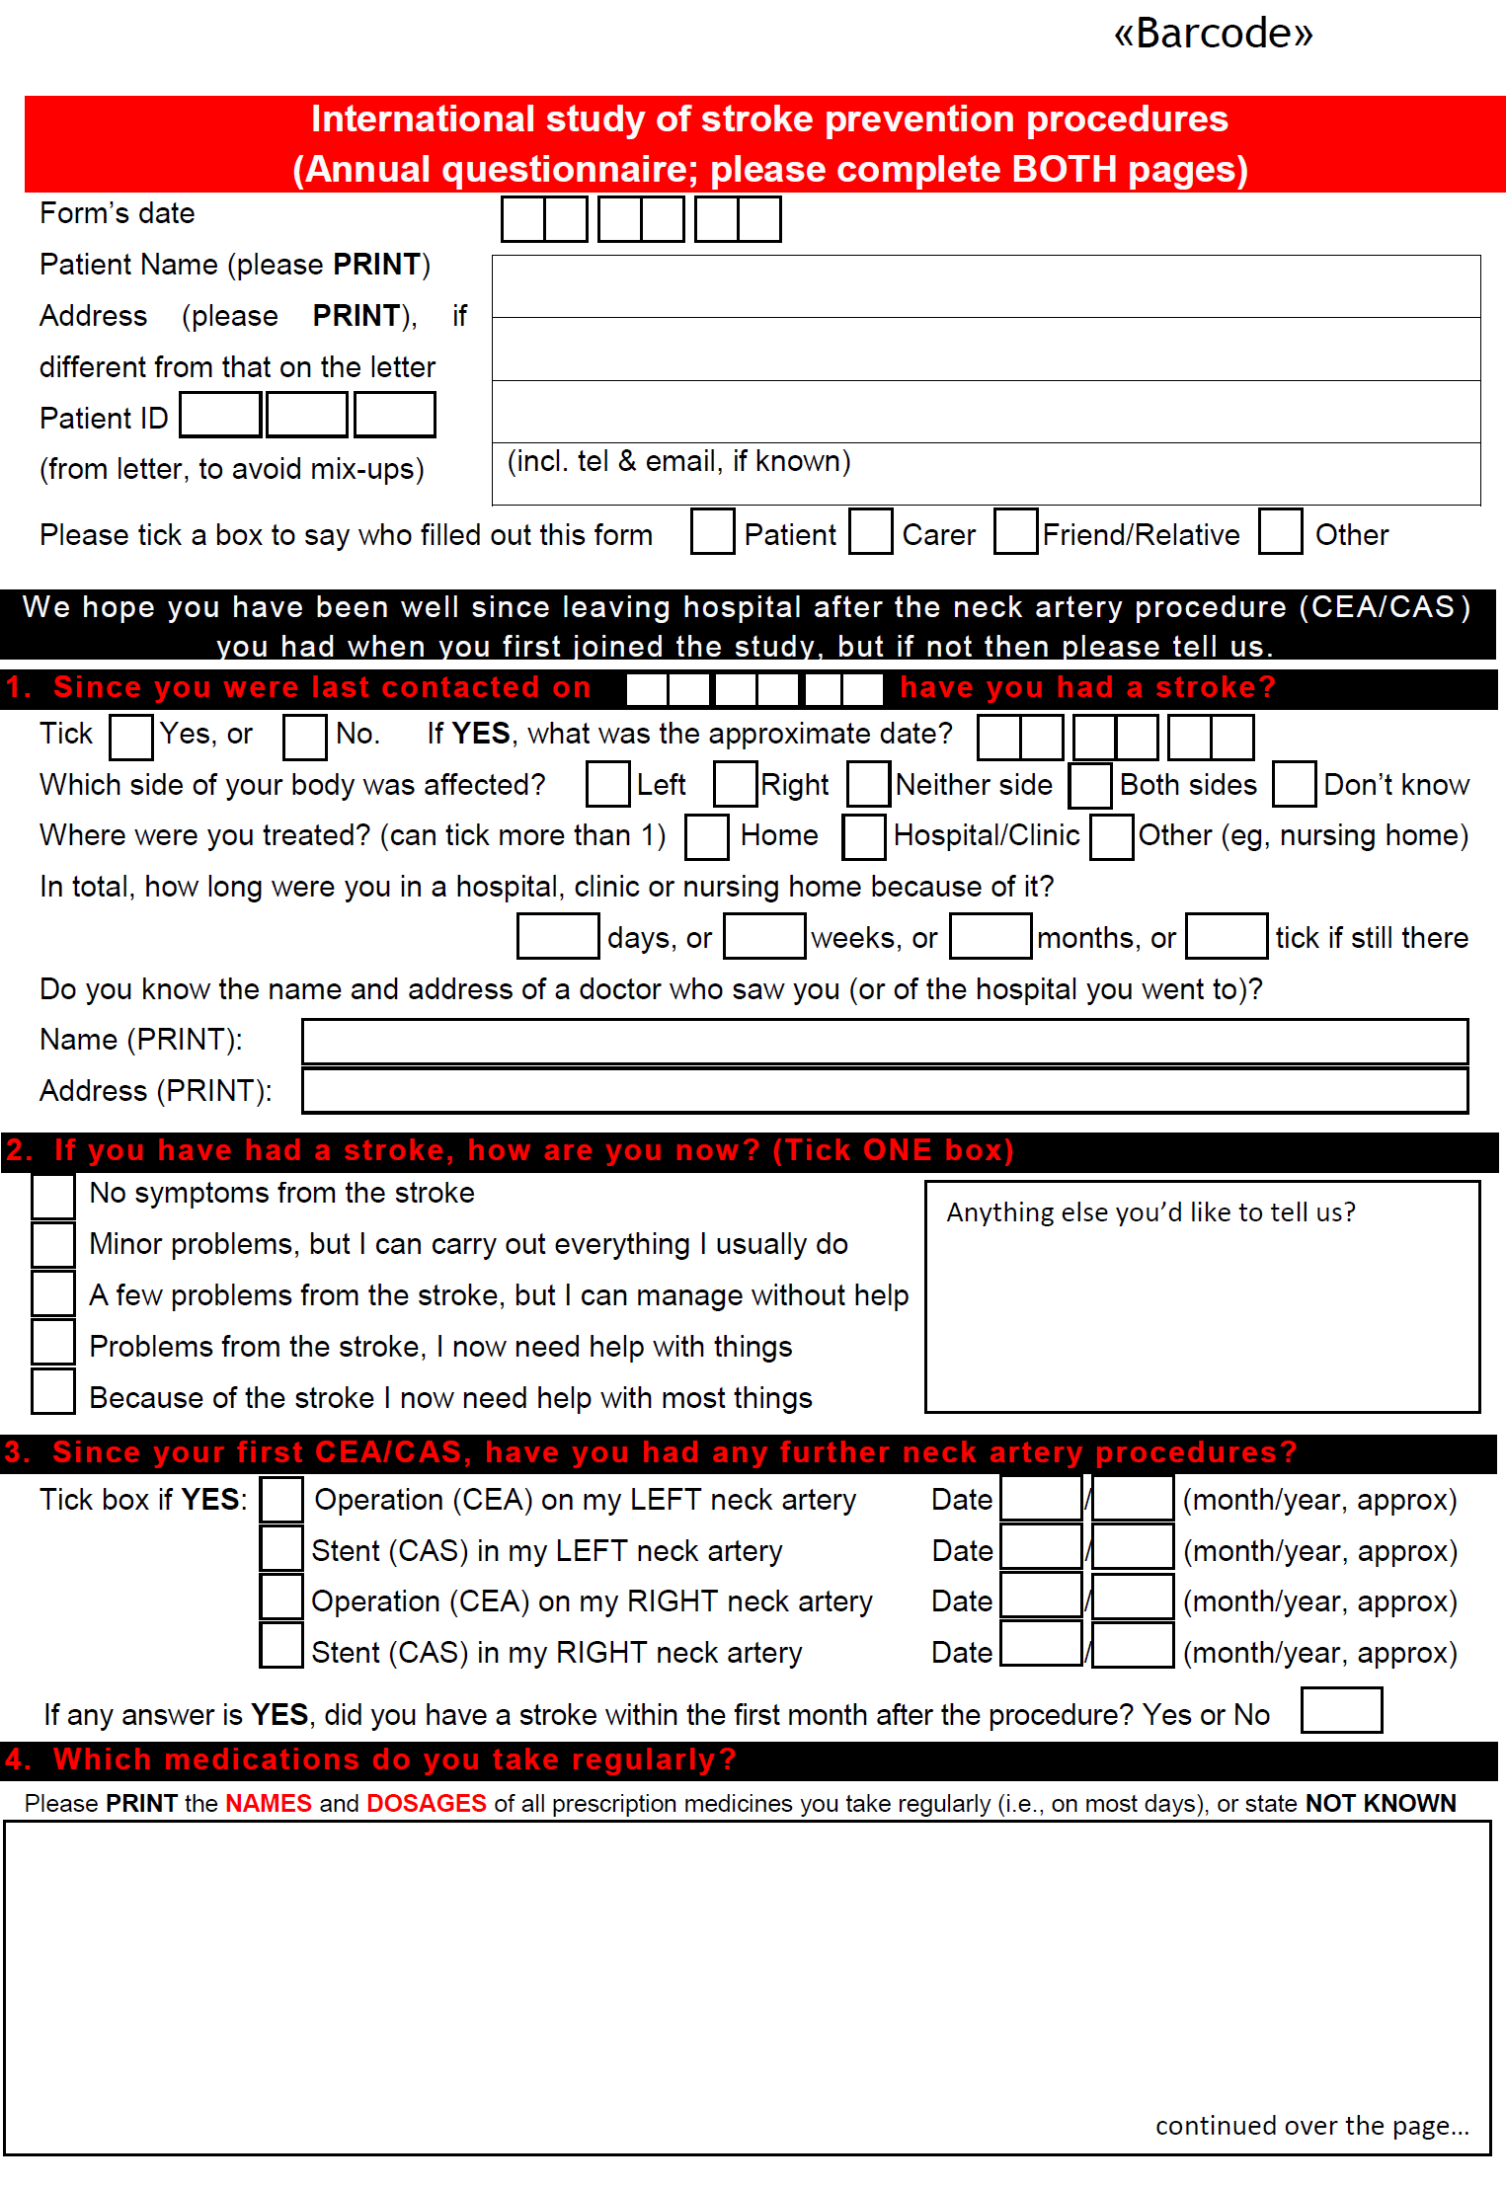
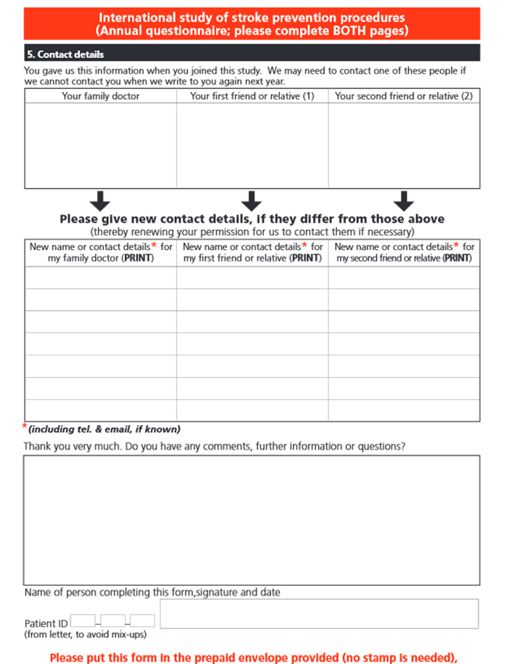

Annual form

Slide 10
Why do we want complete data?
Primary end point
  MAJOR EVENTS
      Within 30 days
      Stroke and death more than 30 days
Research
  Responsibility to the patients
  Present accurate data on the study
Notes:
If we don’t provide the data why do the research?

Slide 11
Major events within 30 days of treatment
Stroke, MI and Death
  Might be whilst they are still in your care at the hospital
  Might be in the days after discharge
  Still need the information
  Type of information we need:
    Imaging reports
    discharge summary
    echocardiogram
    cause of death

Slide 12
Major Events after 30 days
Stroke and death
ACST-2 office often know before centres
Need the centres to fill in the blanks
    imaging reports
    date and cause of death
Because the centre is the last to know it makes it harder to find information!

Slide 13
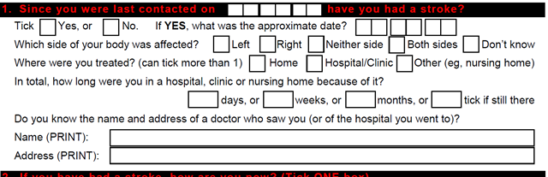

Does having the major event information make a difference?
So having the correct information makes a difference
Notes:
526 patients fill in different areas on this form suggesting that that they had a stroke. If we believe all 526 patients that they had a stroke then the stroke rate would be 25%
However the centres provide information which confirms that only 4 patients have had a stroke then the stroke rate is 0.2%

Slide 14
Dates and data
1 month form sent to the office has the date the patient was last seen was 24th October 2016
The 2017 annual follow up form returned by patients wife saying patient died 19th October 2016
Who is right???
Notes:
These are further examples of where having the correct data makes a difference. Dates play an important role
The implications of this are vast – Major event info, to altering the 1 month data that we present

Slide 15
Dates and data
Collaborator had kindly been filling in the annual follow up form for a patient as ACST-2 office not getting any reply from the patient for a couple of years
Finally the ACST-2 office get a response from the patients relative asking us to
“stop sending the questionnaire the patient died 4 years ago!”
Notes:
Another example and there have been 4 or 5 instances where this has happened. The collaborator is relying on information from the hospital systems which might not be up to date

Slide 16
Key Dates we look for
Consent
    Before the patient is randomised
Date of procedure
    After date of consent and randomisation
Date last seen
    Usually at least 30 days after the procedure
Date of last annual follow up
Notes:
So when we are looking for complete and accurate data we look at the following

Slide 17
Data from annual follow up
A bad year 2014
Annual follow up forms sent | 1273
Annual follow up forms received | 946
So we can say that in 2014
785 patients | AP only
57 | AC only
22 | Both AC and AP
842 | AC or AP, not Both
41 | Neither AC nor AP
41 | Blank medication Data
Notes:
We struggled to get follow up forms back from patients as well as collaborators.

Slide 18
Data from annual follow up
A good year 2015
Annual follow up forms sent | 1564
Annual follow up forms received | 1430
So we can say that in 2015
1211patients | AP only
74 | AC only
37 | Both AC and AP
1285 | AC or AP, not Both
78 | Neither AC nor AP
23 | Blank medication Data

Slide 19
Research questions
Medication
Yes patients are on medication
or
1336 patients on a lipid lowering medication
or
662 on Atorvastatin
or
180 patients are taking 40mg of Atorvastatin
Notes:
So by asking as Wojtek has already highlighted, by asking for the statin dose on the annual follow up we actually add to the body of research in this area and maybe influence statin regimes going forward

Slide 20
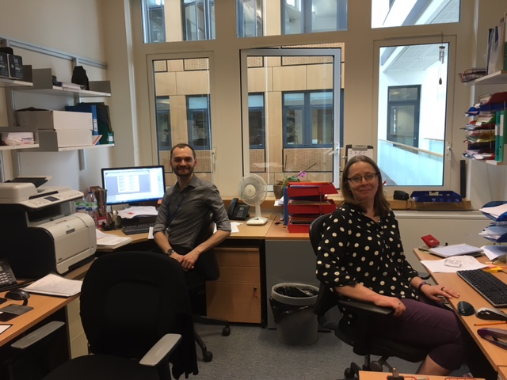
Thank you

Slide 21
