Slide 1
ACST-2 MRI substudy - An update
Mandy Müller
Leo Bonati
Department of Neurology and Stroke Center, University Hospital Basel, Switzerland
ACST-2 Collaborators’ Meeting
Oxford, 4th-5th September 2017

Slide 2
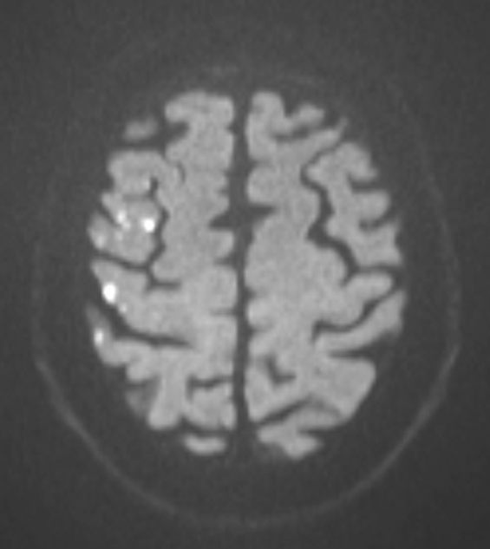
Background
New DWI lesions after carotid interventions in the ICSS-MRI substudy
Associated ischaemic events between initiation of treatment and post-treatment scan:
 | CAS | CEA
Stroke | 8 | 3
Retinal infarct | 1 | 0
TIA | 0 | 0
None | 53 | 15
Bonati et al., Lancet Neurol 2010; 9: 353–62

Slide 3
Background Brain MRI in carotid interventions
MRI is sensitive in detecting cerebral embolism
Most MRI lesions are asymptomatic
MRI lesions correlate with stroke risk
→ MRI is a useful surrogate outcome measure to investigate treatment effects and potential modifiers thereof within clinical trials
MRI can be analysed blinded to treatment

Slide 4
ACST-2 MRI substudy Objectives
To compare the incidence of symptomatic and silent cerebral ischaemia between CAS and CEA using MRI as blinded, surrogate outcome assessment
To investigate whether plaque imaging and vascular anatomy predict cerebral ischaemia in CAS or CEA

Slide 5
ACST-2 MRI substudy: Study flow chart
Randomisation in ACST-2
Randomised to CAS
Randomised to CEA
1-7d before treatment
MRI
Treatment
Treatment
After treatment
Module 1: Brain MRI (mandatory)
1-3d after treatment
MRI
30d after treatment
CAS: carotid artery stenting, CEA: carotid endarterectomy

Slide 6
ACST-2 MRI substudy: Study flow chart
Randomisation in ACST-2
Randomised to CAS
Randomised to CEA
1-7d before treatment
MRI
Treatment
Plaque Imaging
Treatment
Biomarkers
After treatment
Module 1: Brain MRI (mandatory)
Module 2: Plaque Imaging (Ultrasound and/or MRI)
Module 3: Biomarkers
Biomarkers
1-3d after treatment
MRI
30d after treatment
Biomarkers
CAS: carotid artery stenting, CEA: carotid endarterectomy

Slide 7
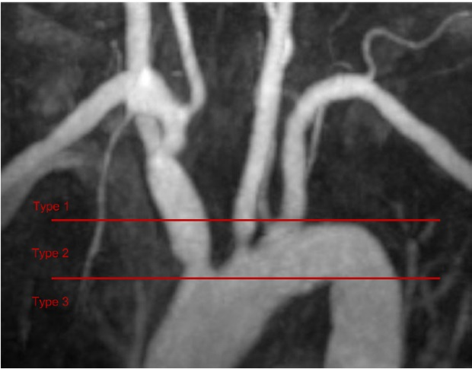
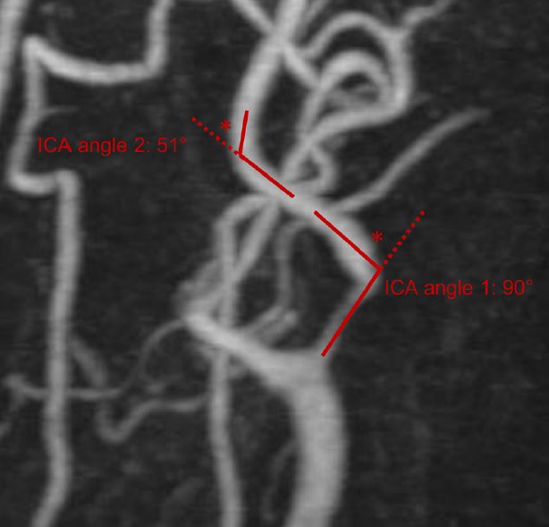
Vascular anatomy predicts risk of CAS in symptomatic patients (ICSS)
Müller M. et al., Stroke 2017; 48:1285-1292

Slide 8
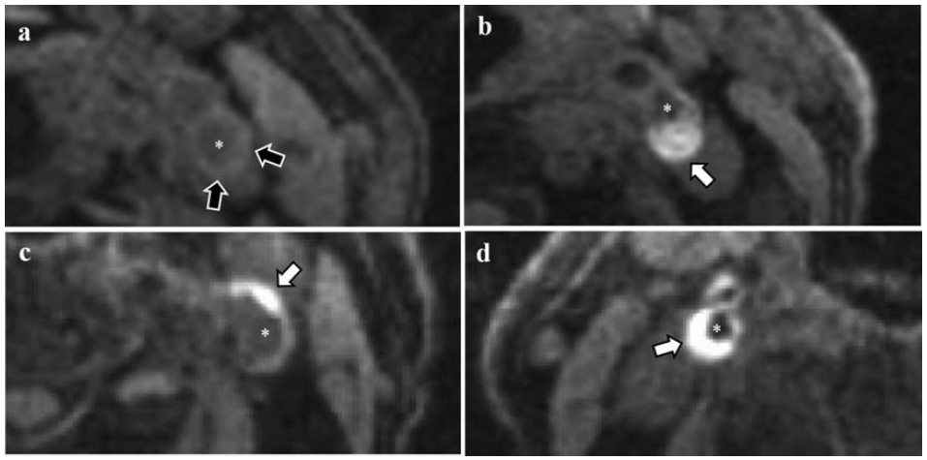
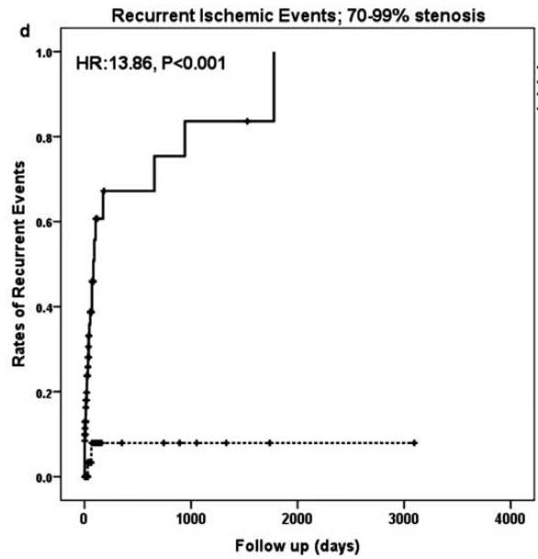
MRI Plaque Imaging Intra-plaque haemorrhage
Recurrent ischaemic events
70-99% carotid stenosis
IPH +
179 patients with symptomatic carotid stenosis ≥50%
Follow-up of up to 9 years
IPH -
Hosseini A. et al., Ann Neurol 2013;73:774–784

Slide 9
Participating centres & enrolment
108 patients are currently enrolled
Active centres:
University Hospital Basel (CH): 40
University Hospital of Larissa (GR): 24
UMC Utrecht (NL): 11
Serbian Clinical Centre Belgrade (CZ): 11
Istituto Auxologico Milano (IT): 11
Klinikum rechts der Isar München (DE): 8
La Sapienza Rome (IT): 3

Slide 10
Participating centres & enrolment: eCRF
Please complete data entry for all your patients
Only patients with complete data entry can be used for analysis
Please let us know if you have questions or need new logins for the database

Slide 11
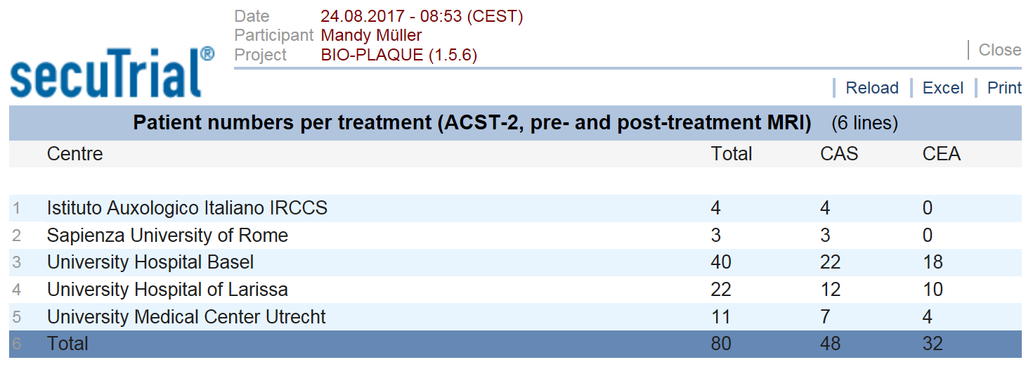
Participating centres & enrolment
Please enter all substudy patients in the eCRF
Please enrol both CAS and CEA patients in the substudy
Outlook: prospective screening log specifying reasons for exclusion of ACST-2 patients from the substudy at participating sites

Slide 12
Centre remuneration & contact details
400 Euros per patient with completed pre- and postprocedural MRI scan AND completed eCRF
(Swiss Heart Foundation)
Do you need further information or are interested in joining?
Mandy Müller – Mandy.Mueller@usb.ch
Leo Bonati – Leo.Bonati@usb.ch

Slide 13
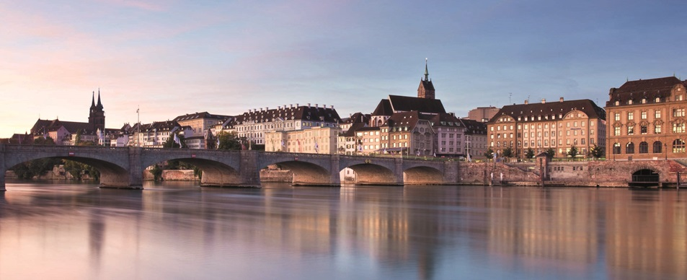
Thank you for your attention!

