Slide 1
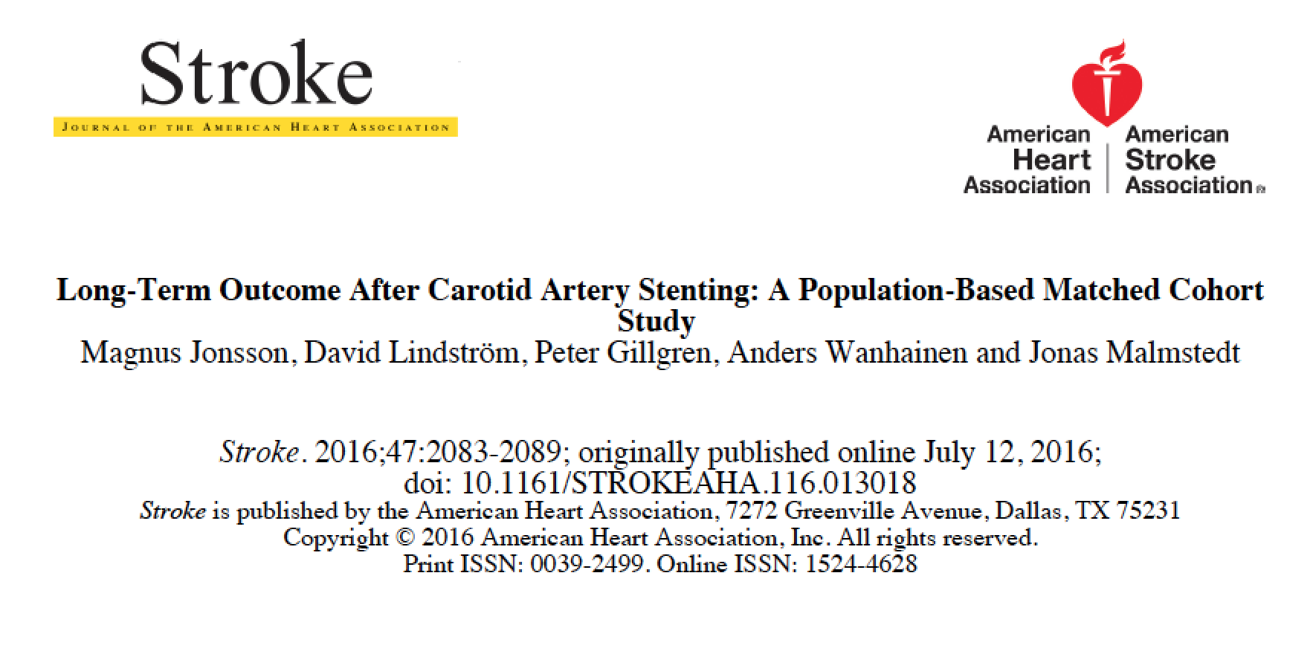

Slide 2
“Real world” long term results excluding peri-op period (>30d) are lacking.
What are the long-term results after CAS as compared to CEA in our National registry?
Notes:
Little is known about the long term results of CAS outside the RCTs
Need for long term studies in a real world setting

Slide 3
Matched Cohort
All Primary CAS in Sweden 2005 – 2012 (n=409)
  No restenosis (7 yr look back)
  No dissections
  No trauma
  No carotid by-passes
748 CEA controls; matched for sex, indication, year and age → Well balanced groups
Total number of carotid procedures 2005 -2012: 7826

Slide 4
Primary endpoint (as in RCT’s):
ipsilateral stroke or death > 30d post CAS/CEA

Slide 5
Follow-up
Median follow-up 4.1 yr (IQR 2.4-5.8) = 4000 p-yr
394 new admissions w a stroke dx after CAS/CEA (InPatient Registry)
393 of 394 records scrutinized → confirm or dismiss new stroke, and side → 174 confirmed
Death from SNPR (100% accurate)

Slide 6
Results: Ipsilateral stroke or death
> 30d – cumulative incidence 5 yr:
  CAS 30.8 %
  CEA 20.7 %

Slide 7
Survival analysis
(Cox regression)
Outcome > 30 d | HR (95% CI) for CAS vs CEA
 | Adjusted for#
Ipsilateral stroke/death >30 d | 1.6 (1.2-2.2)
Any stroke or death >30 d | 1.5 (1.1-2.0)
Death >30 d | 1.2 (0.8-1.7)
# Smoking, pulmonary disease, diabetes, hypertension, heart disease, renal disease, atrial fibrillation.
Notes:
No difference

Slide 8
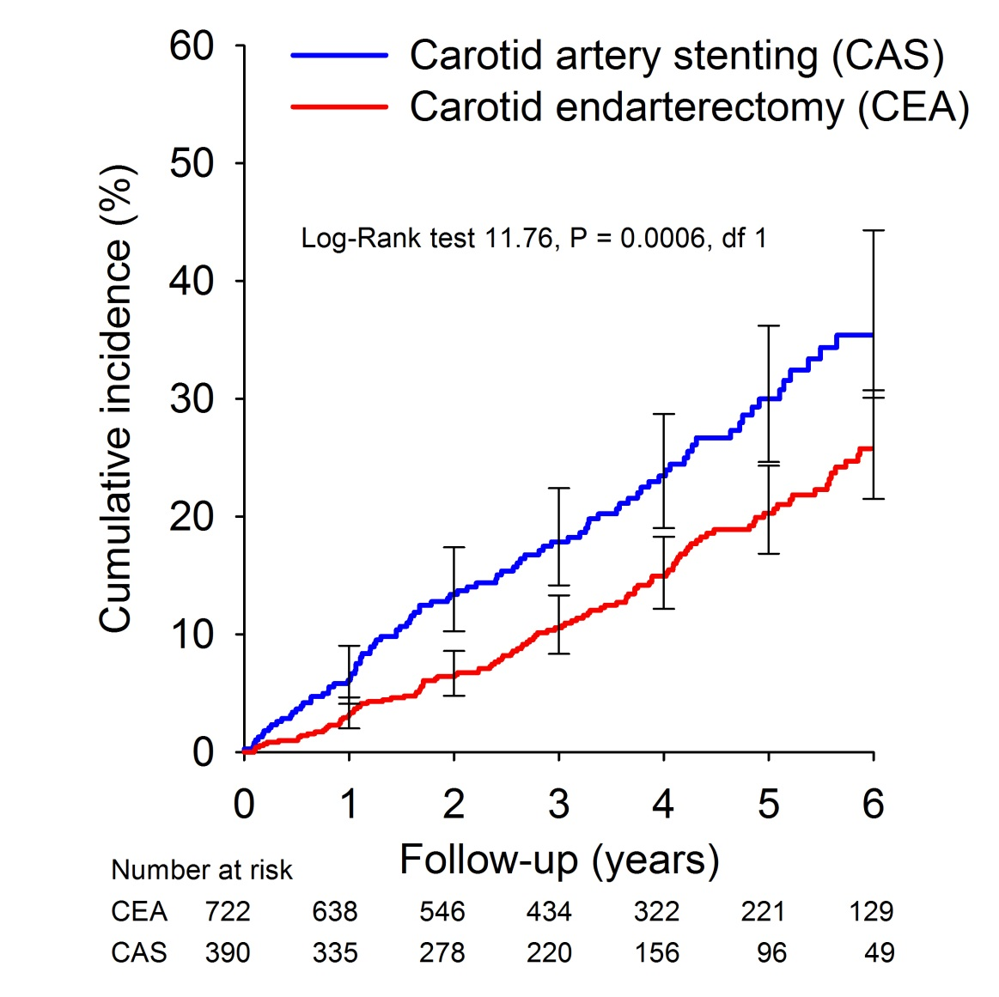
Ipsilateral stroke or death > 30d

Slide 9
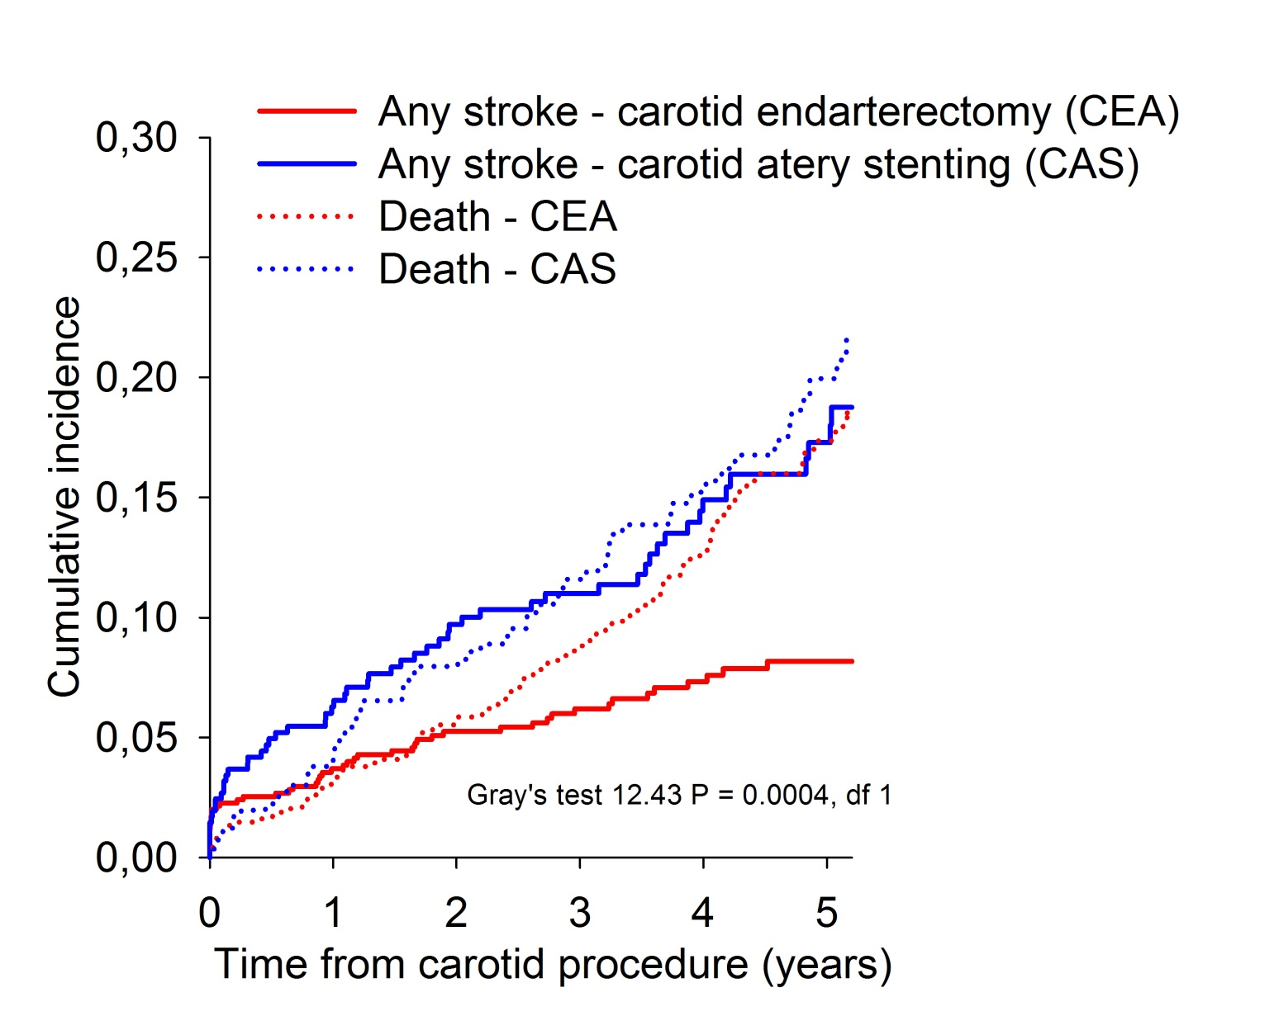
Stroke (w death as competing risk)

Slide 10
Conclusion
CAS is associated with higher risk for ipsilateral stroke and death after the post-op period, as compared to CEA.

Slide 11
Registries vs. Randomised trials
Diff in interventionists competence/experience
Patient selection; “all on clinical selection” in registries
vs. included in RCT
Center selection
Internal validity high (RCT), external could be questioned.

Slide 12
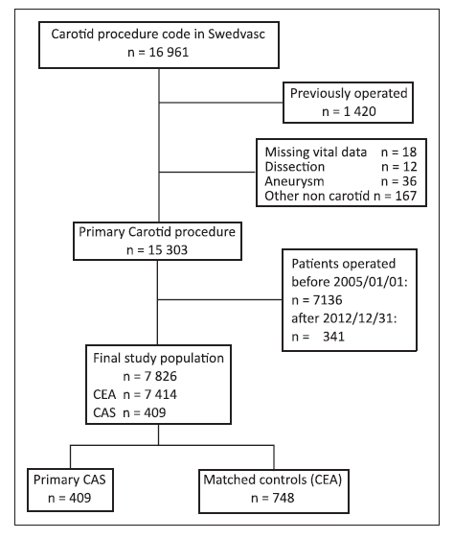

Slide 13
Study III. Long-term results after CAS
Baseline characteristics
 | CAS n=409 | CEA n=748 | p-value
Atrial fib | 15 % | 10 % | 0.011
Diabetes | 26 % | 20 % | 0.026
Coronary disease, Pulmonary disease, Renal insuff, Hypertension, smoking |  |  | NS
Notes:
Kommentera särskilt att vi tittade på A fib och medicinering vid tidpunkten för stroke och att det inte skilde sig

Slide 14
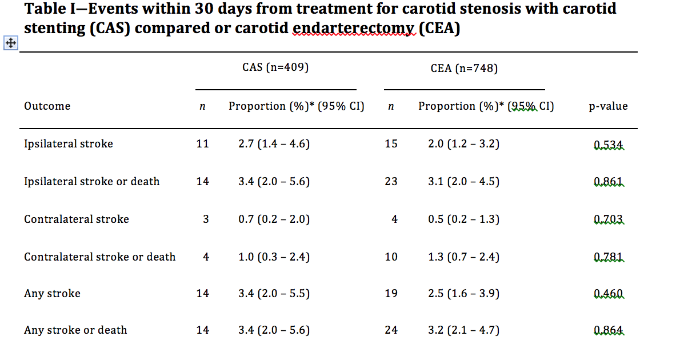
30 day results

Slide 15
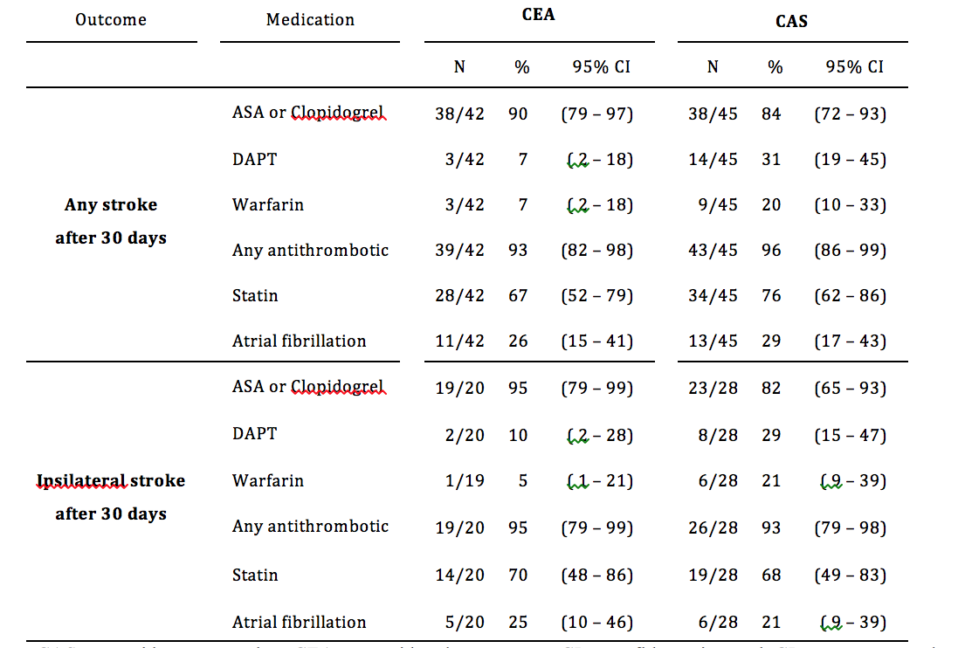
Medication and AFib

Slide 16
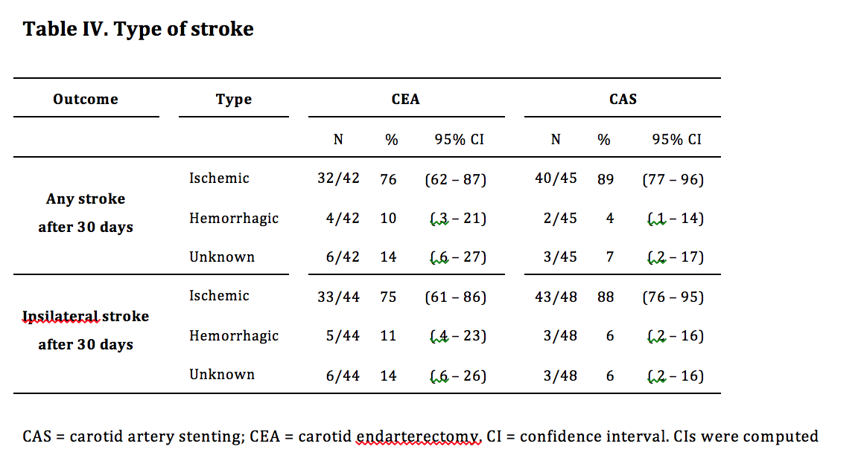
Type of stroke

Slide 17
Ipsilateral stroke/death > 30 days
CAS
CEA
Notes:
As u can see on this graph the incidence of stroke and death was higher in the CAS group beyond the first 30 days after operation.

Slide 18
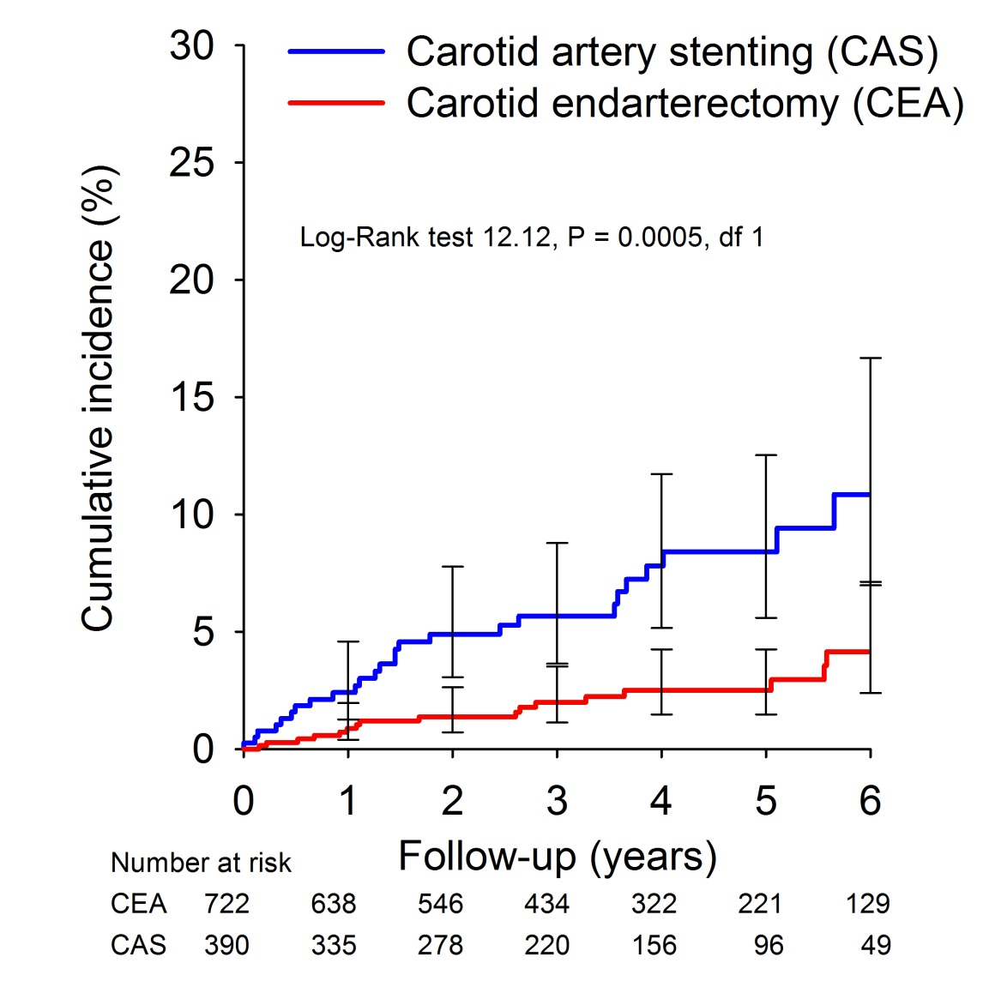
Ipsilateral stroke > 30 days
CAS
CEA
Notes:
Ipsilateral stroke

Slide 19
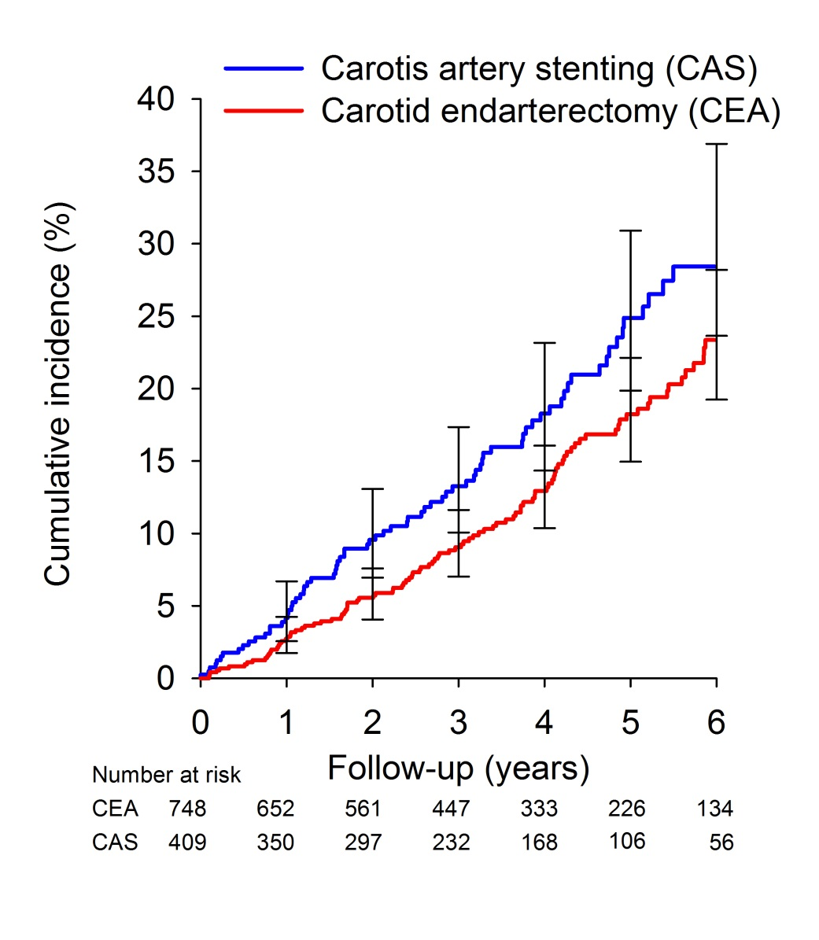
Death
CAS
CEA
Notes:
Death did not differ
Although the groups were matched, they were not identical with respect o factors that may affect the result. We therefor performed a COX
Regression analysis and adjusted for known confounders

Slide 20
Results: Ipsilateral stroke or death
< 30d – 3.4% CAS vs 3.2 % CEA
> 30d – cumulative incidence 5 yr:
  CAS 30.8 %
  CEA 20.7 %

Slide 21
Survival analysis
(Cox regression)
Outcome > 30 d | HR (95% CI) for CAS vs CEA
 | Adjusted for#
Ipsilateral stroke >30 d | 3.4 (1.5-7.5)
Ipsilateral stroke/death >30 d | 1.6 (1.2-2.2)
Any stroke or death >30 d | 1.5 (1.1-2.0)
Death >30 d | 1.2 (0.8-1.7)
# Smoking, pulmonary disease, diabetes, hypertension, heart disease, renal disease, atrial fibrillation.
Notes:
No difference

