Slide 1
Worldwide burden of stroke in the Global Burden of Disease Study
Derrick Bennett

Slide 2
What is the Global Burden of Disease project?
The Global Burden of Diseases, Injuries, and Risk Factors Study (GBD) is the single largest and most detailed scientific effort ever conducted to quantify levels and trends in health.
Led by the Institute for Health Metrics and Evaluation (IHME) at the University of Washington
Collaboration with over 2,500 researchers from more than 100 countries, including 26 low- and middle-income countries, participating in the most recent update.

Slide 3
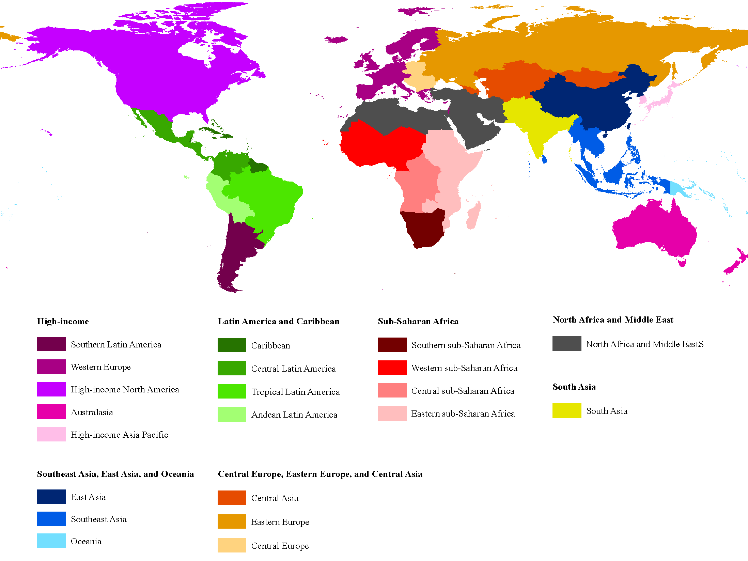
21 Regions of GBD

Slide 4
Metrics used by GBD

Slide 5
Years of life lost (YLLs)
Years of life lost (YLLs) are years lost due to premature mortality.
YLLs are calculated by subtracting the age at death from the longest possible life expectancy for a person at that age.
For example, if the longest life expectancy for men in a given country is 75, but a man dies of stroke at 65, this would be 10 years of life lost due to stroke.

Slide 6
Years lived with disability (YLD)
YLD can be described as years lived in less than ideal health.
This includes short-term conditions such as influenza, which may last for only a few days, or long-term conditions such as epilepsy, which can last a lifetime.
It is measured by taking the prevalence of the condition multiplied by the disability weight for that condition.
Disability weights reflect the severity of different conditions and are developed through surveys of the general public.

Slide 7
Disability-adjusted life year (DALY)
DALY is a universal metric that allows researchers and policymakers to compare very different populations and health conditions across time.
One DALY equals one lost year of healthy life.
DALYs allow the estimation of the total number of years lost due to specific causes and risk factors at the country, regional, and global levels.

Slide 8
DALYs = YLL + YLD
DALY = Disability-adjusted life year
YLL = Year of life lost (mortality)
YLD = Year of life lived with disability (non-fatal sequelae)

Slide 9
GBD stroke sub-component

Slide 10
GBD Stroke Experts Group
Thomas Truelsen
Yukito Shinohara
Derrick Bennett
Majid Ezzati
Matrin O’Donnell
Myles Connor
Wenzhi Wang
Andrew Moran
George Mensah
Andrew Moran
Laurie Anderson
Hannah Gardener
Mohammad Forouzanfar
Ralph L. Sacco
Jeyaraj Durai Pandian
NV Ramani
Carlene Lawes
Emma Witt
Suzanne Barker-Collo
Rita Krishnamurthi
Valery Feigin
Notes:
NV Ramani Ramani_NV@nuhs.edu.sg
Thomas Truelsen

Slide 11
Case definitions
Stroke was defined according to WHO diagnostic criteria (TIA excluded)
Acute stroke
Date of incidence of a first-ever stroke through day 28 following the event
Chronic stroke
Beginning 28 days following the occurrence of the event (includes sequelae of an acute stroke AND all recurrent stroke events [adopted for GBD 2015])

Slide 12
Ischaemic stroke (IS)
Definition: First ever IS based on clinical diagnosis by a physician using diagnostic imaging
Considered to include all vascular events leading to limited blood flow to brain tissue
With resulting infarction, including atherosclerotic and thromboembolic strokes
Excluding stroke which the underlying cause in intracranial haemorrhage.

Slide 13
Haemorrhagic or other strokes (HS)
Definition: Includes all non-ischaemic strokes of a vascular cause including subarachnoid and stroke due to intracranial haemorrhage
ICD codes used for inclusion of hospital data:
G45-46.8, I60-I61.9,I62.0-I62.03,I63-I63.9,I65-I66.9,I67.0-I67.3,I67.5-I67.7,I69.0-I69.198,I69.20-I69.398,I67.2,I69.3-I69.398,I67.0,I67.1,I67.7,I69.0-I69.198,I69.20-I69.298.

Slide 14
Where do the data come from?
Published studies in the medical literature – systematic reviews of published data.
Government sources: vital statistics, household surveys, censuses, health service administrative data.
Other household surveys and studies conducted by international organizations and other groups.
All data sources used in the GBD for a country are catalogued in the Global Health Data Exchange (GHDx) available online at http://ghdx.healthdata.org
Data analyzed centrally at IHME using bespoke software.

Slide 15
GBD stroke results

Slide 16
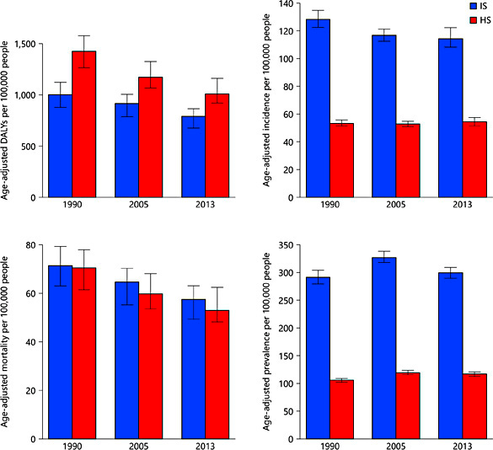
Age-adjusted DALYs, incidence, mortality and prevalence rates
DALYs
Incidence
Mortality
Prevalence

Slide 17
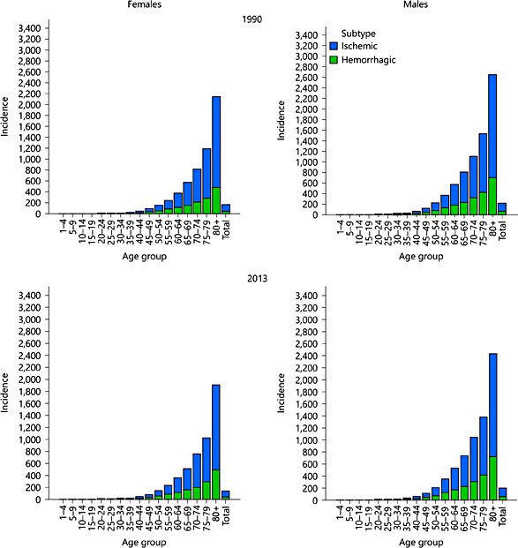
Age-specific incidence by sex
1990
2013

Slide 18
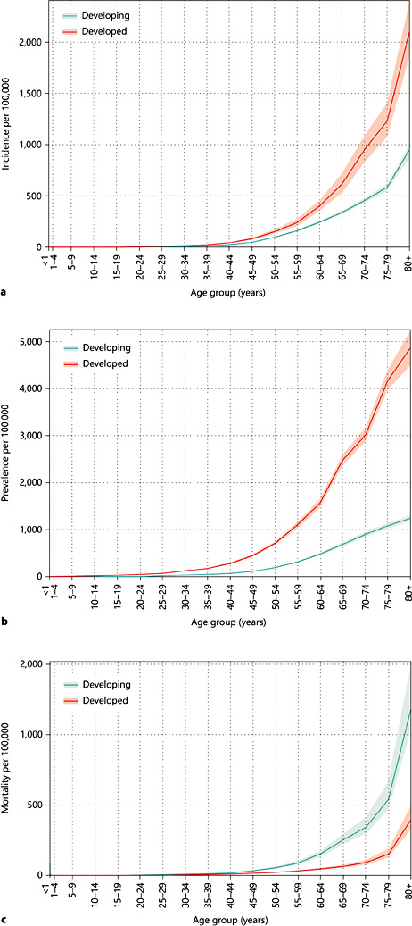
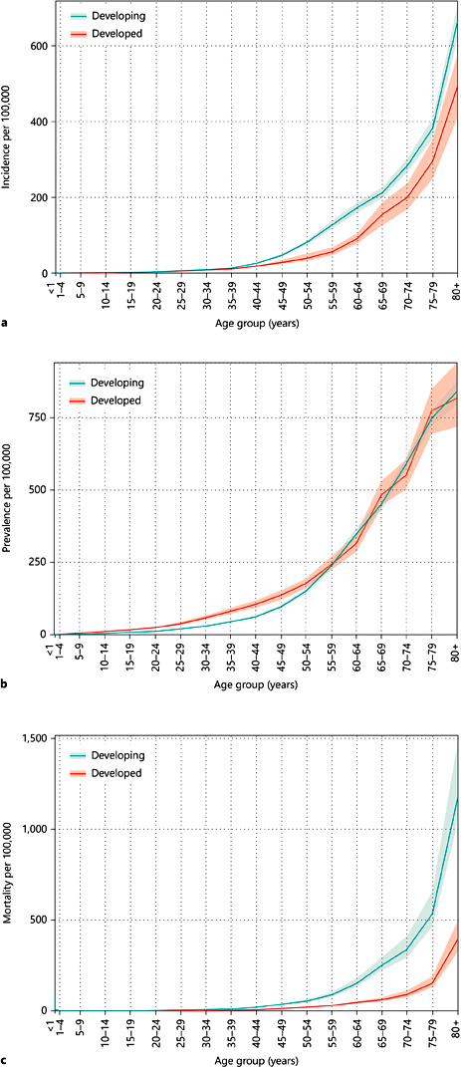
Ischaemic stroke 2013
Haemorrhagic stroke 2013
Incidence
Prevalence
Mortality

Slide 19
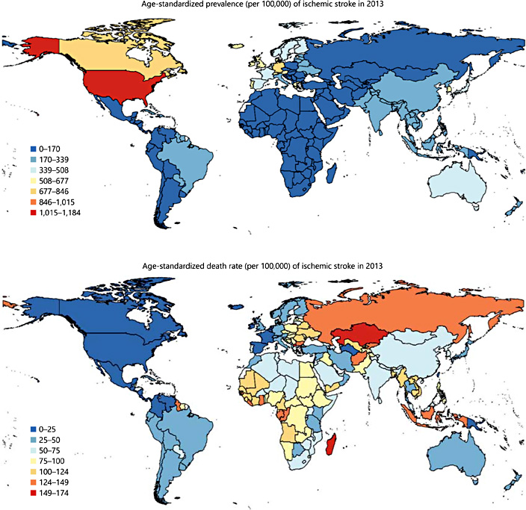
IS age-standardized
prevalence 2013
IS age-standardized
death rate 2013
Highest
Moderate
Low
Lowest

Slide 20
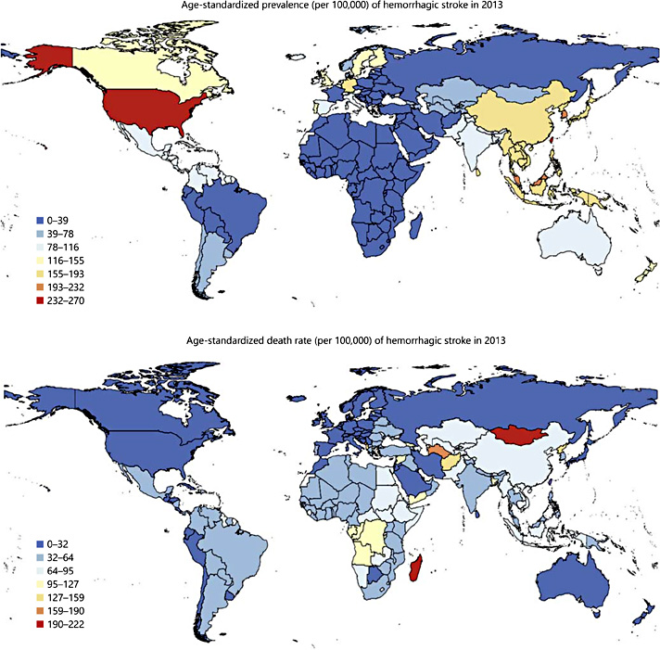
HS age-standardized
prevalence 2013
HS age-standardized
death rate 2013
Highest
Moderate
Low
Lowest

Slide 21
Summary of key findings
Stroke is currently the second largest contributor to DALYs after IHD globally in developing countries
Third largest contributor to DALYs in developed countries.
Between 1990-2013, there was a greater reduction in stroke mortality rates in developed countries than those in developing countries
Globally, men had a higher incidence of IS than women while significant sex differences in the incidence of HS were not observed.
The total health loss due to stroke as measured by DALYs was similar for men and women for both stroke subtypes in 2013, with HS higher than IS.

Slide 22
GBD updates/refinements
Currently there are 188 countries with data from 1990 to present.
Sub-national assessments for some countries.
GBD 2013 (China, Mexico, UK)
GBD 2015 (+USA, Brazil, Japan, Sweden, Saudi Arabia, Kenya, S Africa)
306 diseases and injuries, 2,337 sequelae, 79 risk factors or clusters of risk factors.
Since 2015 updated annually; release planned for September each year.
GBD 2015 capstone papers published in Lancet 2016
GBD 2015 Neurological disorders paper (including stroke) under review by Lancet)
Mid-September 2017: GBD 2016 capstone papers will be published

