Slide 1
ACST-2 Collaborators Meeting, 2017
Is moderate drinking protective?
Genetic evidence from China
The China Kadoorie Biobank Study
Richard Peto, University of Oxford

Slide 2
Is moderate drinking protective?
Traditional epidemiology in Western populations: just ask what people drink, then follow them up
1.2
Cardiac
mortality
rate ratio
1.0
0.8
0 2 4 6 drinks/day
Meta-analysis: Roerecke and Rehm, Addiction 2012

Slide 3
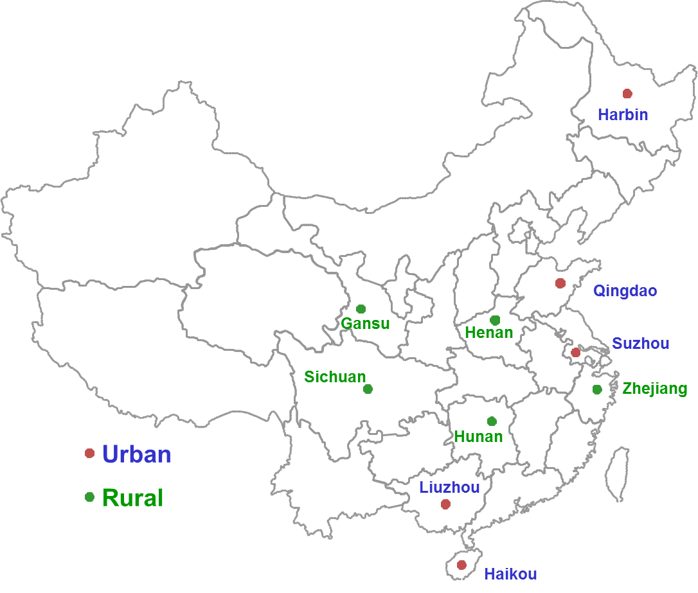
Is moderate drinking protective? What is causal?
Traditional and genetic epidemiological evidence
from prospective study of 500,000 Chinese adults

Slide 4
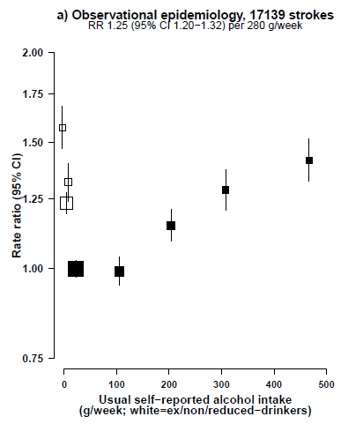
Men in China (as elsewhere): traditional epidemiology * suggests some protective effect of moderate alcohol use
against stroke – but, is the apparent protection real?
*ask what men drink, then follow them up
17,000 incident strokes

Slide 5
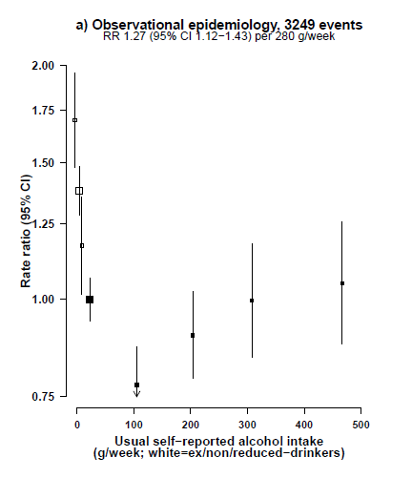
Men in China (as elsewhere): traditional epidemiology * suggests some protective effect of moderate alcohol use
against stroke & CHD – but, is apparent protection real?
*ask what men drink, then follow them up
17,000 incident strokes
3,000 incident CHD events

Slide 6
In China, common genetic variants determine whether men can drink comfortably; genetic epidemiology relates these genotypes to risk

Slide 7
In China, common genetic variants determine whether men can drink comfortably; genetic epidemiology relates these genotypes to risk
Some Chinese can drink as comfortably as Europeans
(but, although they could drink, some still don’t, as in Europe);
some are made MODERATELY uncomfortable by drink (so, most with this genotype don’t drink, & only a few drink much);
and some are made HORRIBLY uncomfortable by drink
(so almost all with this genotype don’t drink, & none drinks much).

Slide 8
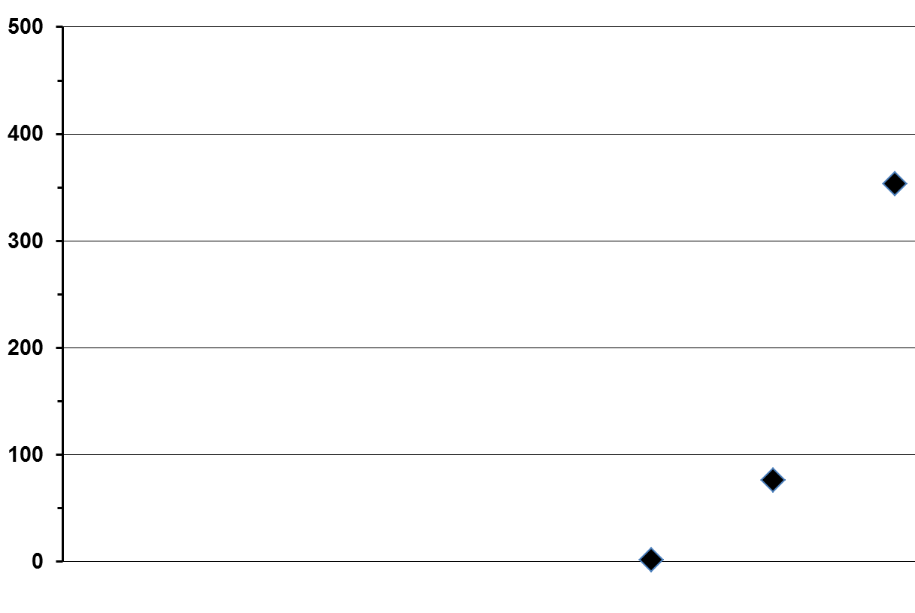
Genotype & mean alcohol use by men in Sichuan, according to the main East Asian genetic variant
(3 possible ALDH genotypes: AA, AG or GG)
GG
mean ~5
drinks/day
Mean alcohol, g/week
AG mean ~1
drink/day
AA mean <1 drink/week
(as it’s like being on disulfiram)

Slide 9
Alcohol metabolism
ADH
ALDH
Alcohol
Acetaldehyde
Acetate
Accumulation causes nausea and flushing

Slide 10
Alcohol metabolism
ADH
ALDH
Alcohol
Acetaldehyde
Acetate
Accumulation causes nausea and flushing
ALDH East Asian variant
(rs671) G>A
This causes the main East Asian flushing syndrome

Slide 11
Alcohol metabolism
ADH
ALDH
Alcohol
Acetaldehyde
Acetate
Accumulation causes nausea and flushing
ADH East Asian variant
(rs1229984) G>A
ALDH East Asian variant
(rs671) G>A
This causes the main East Asian flushing syndrome

Slide 12
Genotype & mean alcohol use by men in Sichuan, according to the main East Asian genetic variant
(3 possible ALDH genotypes: AA, AG or GG)
GG
mean ~5
drinks/day
Mean alcohol, g/week
AG mean ~1
drink/day
AA mean <1 drink/week
(as it’s like being on disulfiram)

Slide 13
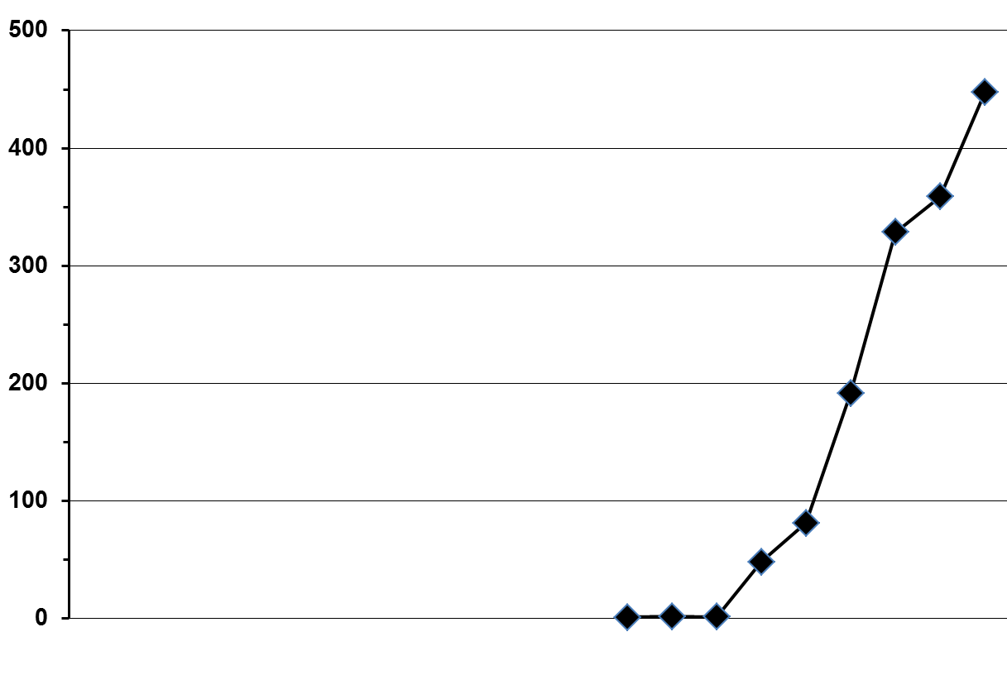
Genotype & mean alcohol use by men in Sichuan, according to the 3x3=9 ALDH /ADH Asian genotypes (alphabetically, AA/AA, AA/AG, ... , to GG/GG; AA /AA = fully Asian)
GG / GG
GG / GA GG / AA
Mean alcohol, g/week
AG / GG
AG / GA AG / AA
AA / AA, AA / AG, AA / GG

Slide 14
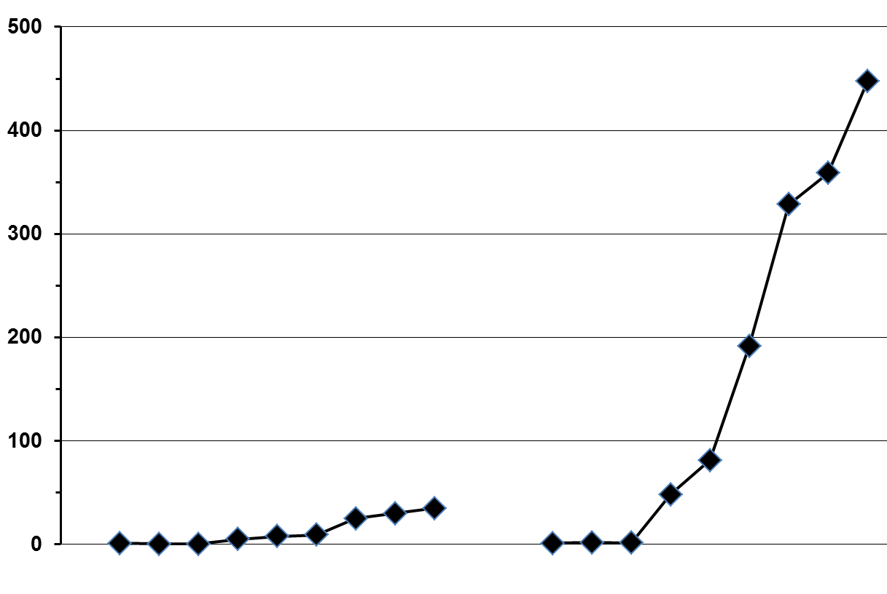
Genotype & mean alcohol use by men in 2 areas, according to the 9 East Asian genotypes
Mean intake, g/week
Gansu
Sichuan

Slide 15
Genotype & mean alcohol use by men in 2 areas, according to the 9 East Asian genotypes
Mean intake, g/week
Gansu
Sichuan

Slide 16
China Kadoorie Biobank (CKB) prospective
study of 500,000 Chinese adults has 10 areas

Slide 17
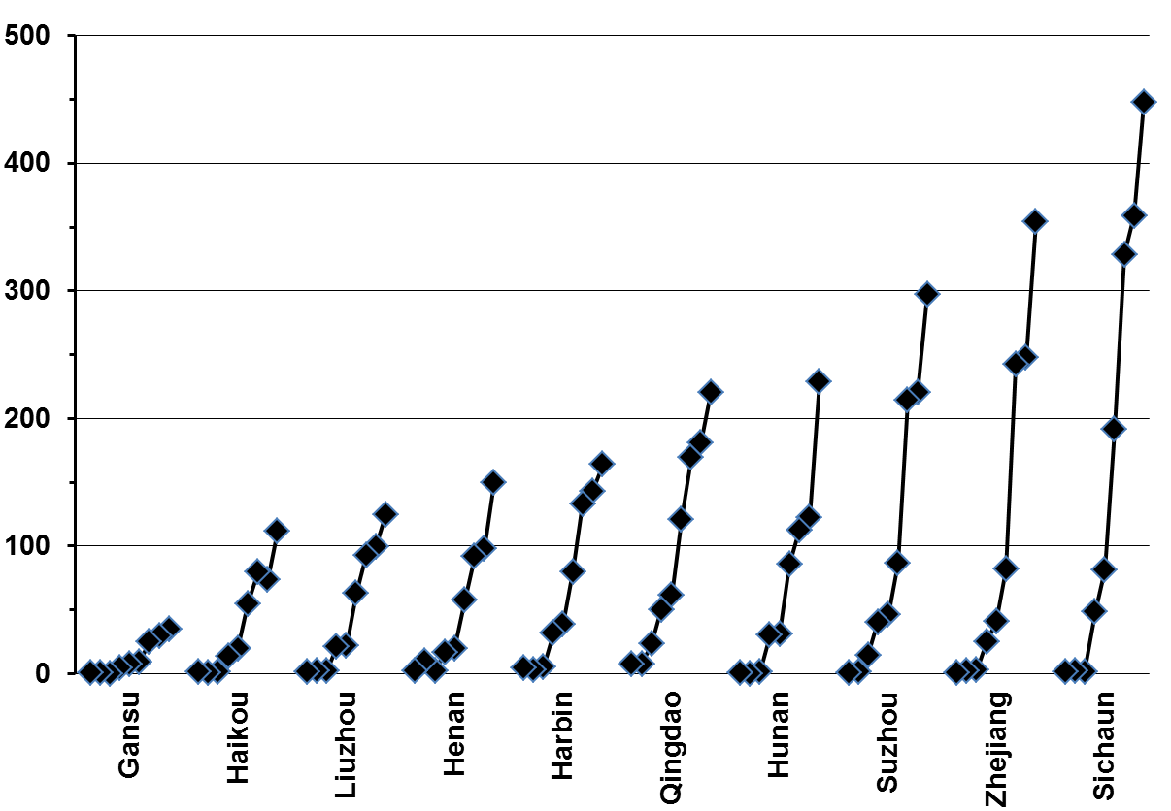
Genotype & alcohol: men in 10 study areas
Mean alcohol, g/week

Slide 18
Mean alcohol intake in 5 categories of men, defined only by genotype and area
Mean drinks
per day
in each
category
Mean alcohol, g/week
~3
~2
~1
<1
<1/week

Slide 19
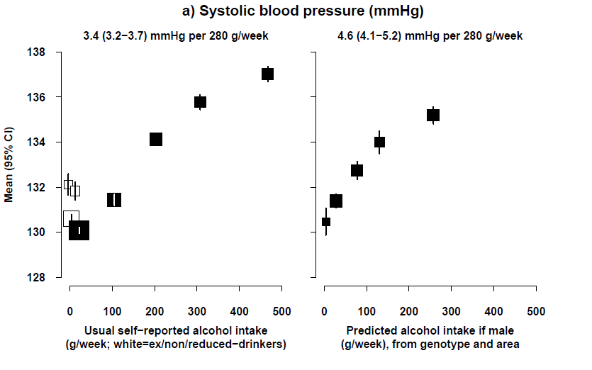
Traditional and genetic evidence on alcohol use
and SBP in Chinese men, stratified for study area
Traditional evidence Genetic evidence
(alcohol questions vs SBP) (based on 5 categories)
SBP
(mm
Hg)

Slide 20
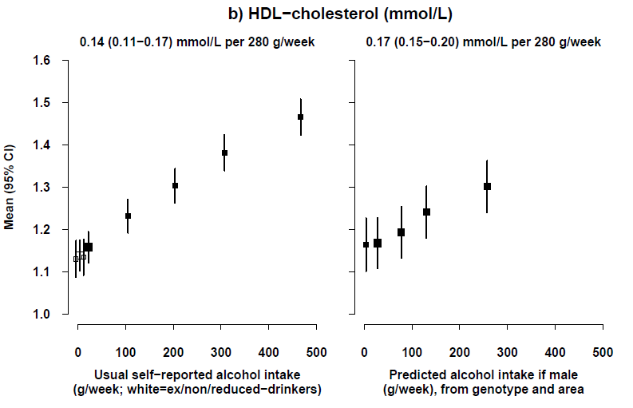
Traditional and genetic evidence on alcohol use
and HDL-C in Chinese men, stratified for study area
Traditional evidence Genetic evidence
(alcohol questions vs HDL) (based on 5 categories)
HDL-C
(mmol
per L)

Slide 21
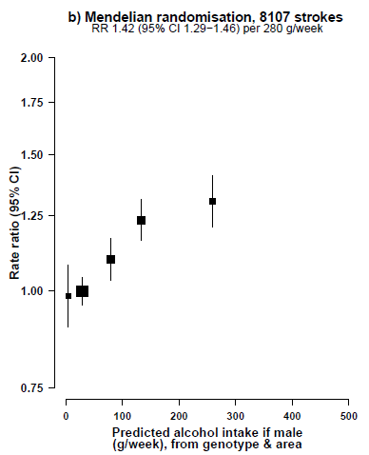
Genetic evidence on alcohol and stroke
in Chinese men, stratified for study area
The 5 categories depend both on genotype and on area, but the RR calculations are stratified for area.
Hence, the plotted RRs depend only on differences in genotype
within each area.
8,000 strokes
P for trend 10⁻¹²

Slide 22
Traditional and genetic evidence on alcohol and
stroke in Chinese men, adjusted for study area
Traditional evidence Genetic evidence
8,000 strokes
P for trend 10⁻¹²

Slide 23
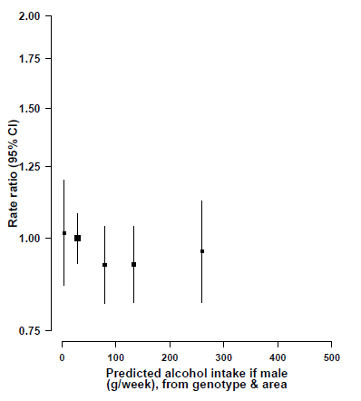
Genetic evidence on alcohol and CHD
in Chinese men, adjusted for study area
Traditional evidence Genetic evidence
2,000 CHD events
P for trend=1x10⁻¹²
P for trend = 0.4

Slide 24
Traditional and genetic evidence on alcohol and
CHD in Chinese men, adjusted for study area
Traditional evidence Genetic evidence
2,000 CHD events
P for trend=1x10⁻¹²
P for trend = 0.4

Slide 25
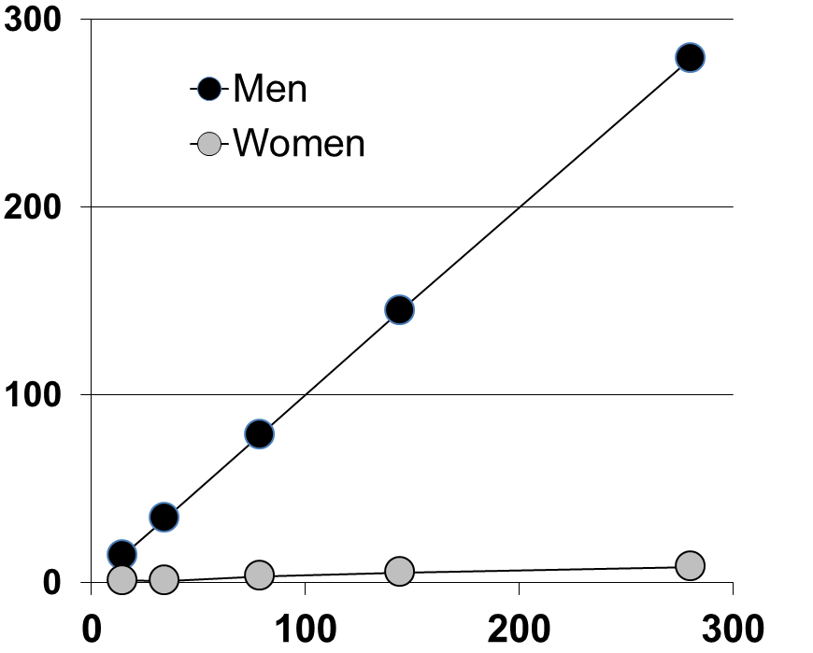
Regardless of their genotype or area, women in China drink little alcohol
Mean
alcohol,
g/week
Predicted alcohol intake if male
(g/week), from genotype & area

Slide 26
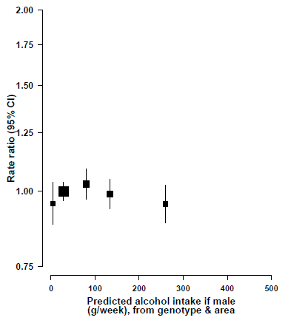
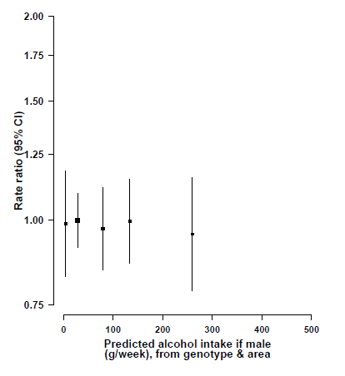
Women: control for pleiotropic effects of genotypes
Effects of genetic factors that would affect Chinese male alcohol use on stroke and CHD in Chinese women
Genetic evidence Genetic evidence
9,000 strokes in women
1,500 CHD events in women
1 1 3 5 7 g/week
1 1 3 5 7 g/week

Slide 27
Men: comparison of effects on stroke and on CHD
of the genetic determinants of alcohol use in China
Genetic evidence Genetic evidence
8,000 strokes in men
2,000 CHD events in men
P for trend=1x10⁻¹²
P for trend 10⁻¹²
P for trend 0.4

Slide 28
Conclusions: alcohol and causality
China: genetic determinants of alcohol use are strongly associated with SBP, HDL-C and stroke, but not CHD
Apparently protective net effects of alcohol against CHD and stroke in traditional epidemiological studies are due largely or wholly to confounding or reverse causation

Slide 29
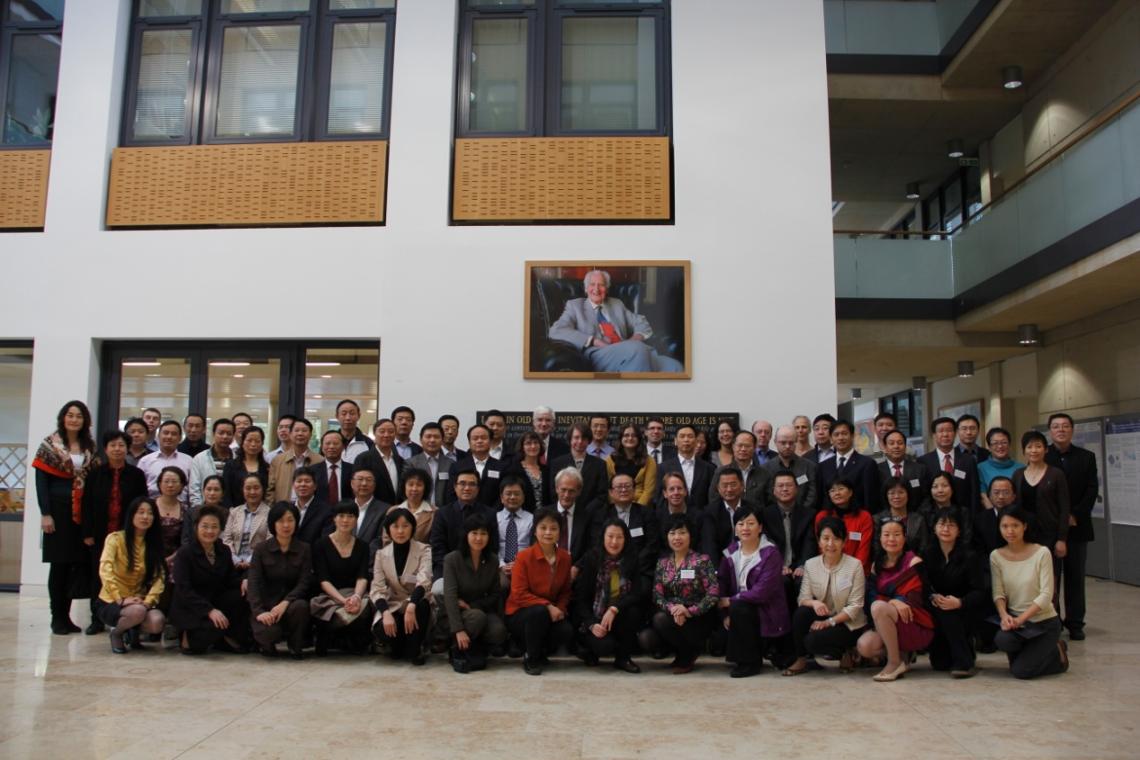

Acknowledgements
500,000 CKB study participants, and all collaborators
in Oxford, Beijing and the 10 study areas

Slide 30
ACST-2:
Implications for tonight’s
Reception and Dinner –
don’t drink moderately!

Slide 32
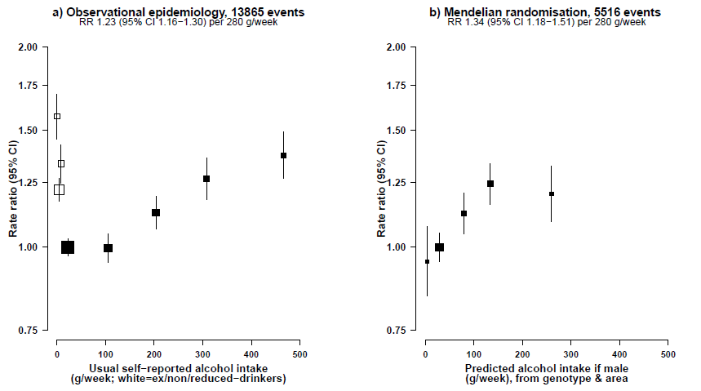
Traditional and genetic evidence on alcohol
in Chinese men, adjusted for study area
Ischaemic stroke

Slide 33
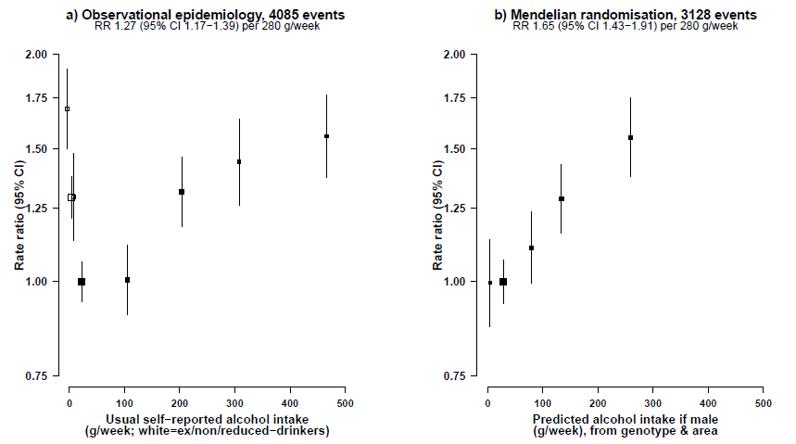
Traditional and genetic evidence on alcohol
in Chinese men, adjusted for study area
Intracerebral haemorrhage

Slide 34
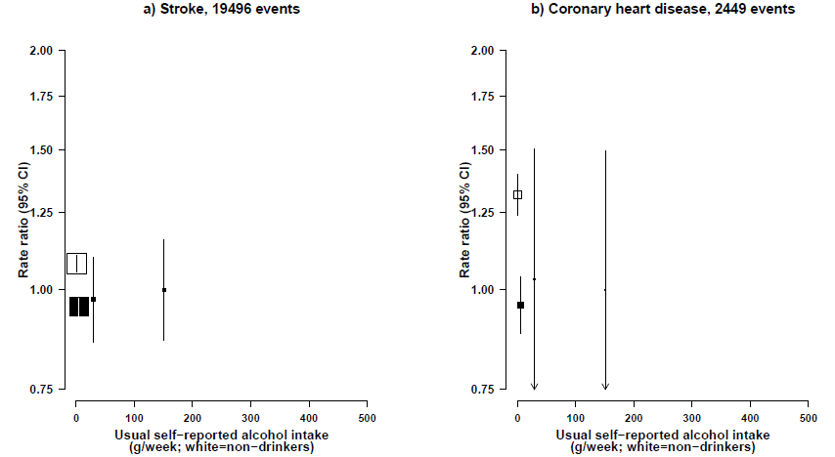
Traditional prospective epidemiology on alcohol, stroke and CHD in Chinese women (but, few drink)

