Slide 1





Long-term follow-up of the
Asymptomatic Carotid Surgery Trial (ACST-1)
Rebecca Llewellyn-Bennett (Clinical Research Fellow)
CTSU, Nuffield Department of Population Health, University of Oxford
Mary Sneade (Project Manager)
Nuffield Department of Surgical Sciences, University of Oxford
5th ACST-2 Collaborators’ Meeting
4th and 5th September 2017
NIHR Oxford Biomedical Research Centre

Slide 2
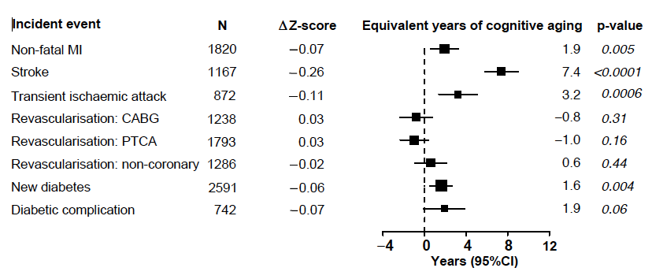
Stroke and TIA associated with cognitive aging
Cognitive aging associated with incident events
Cognitive aging and the incidence of cardiovascular events and diabetes: A meta-analysis of the HPS, SEARCH and HPS2-THRIVE studies, unpublished results, courtesy of Parish et al.

Slide 3
Carotid disease is associated with dementia
Rotterdam Study
Single centre prospective study
1990-1993: All >55 yrs residents of Ommoord invited
7983 (75% of all eligible) participated
Dementia: 1. Brief cognitive test
2. Cognitive and neurological testing
3. Detailed assessment and dementia diagnosis confirmed
Detailed CV assessment including carotid duplex scanning

Slide 4
Carotid plaque is associated with dementia
Rotterdam Study
 | Alzheimer’s Disease (n=207) | Vascular Dementia (n=50) | Other Dementia (n=27) | All Dementia (n=284)
Peripheral Artery Disease (PAD) | 1.3 (0.9-1.8) | 2.5 (1.3-4.8) | 1.0 (0.4-2.4) | 1.5 (1.1-2.0)
Carotid plaque | 1.8 (1.2-2.7) | 3.2 (1.6-6.8) | 1.6 (0.6-4.3) | 1.9 (1.3-2.7)
Wall thickness | 1.3 (1.0-1.6) | 1.9 (1.3-2.8) | 0.8 (0.4-1.5) | 1.3 (1.1-1.6)
Atherosclerosis score 0 1 2 3 | 1.0 2.2 (1.2-3.9) 2.5 (1.3-4.6) 3.0 (1.5—6.0) | 1.0 1.3 (0.4-4.7) 4.8 (1.6-14.2) 9.5 (3.0-30.0) | 1.0 0.1 (0.0-1.0) 0.6 (0.2-2.4) 0.7 (0.1-3.4) | 1.0 1.6 (1.0-2.7) 2.3 (1.4-3.9) 3.2 (1.8-5.7)
3-fold excess risk of vascular dementia associated with carotid plaque

Slide 5
Can drugs prevent dementia?
No trials of aspirin or statins have demonstrated any protective effect against cognitive decline / dementia
Cognitive function assessed by TICSM at end of MRC/BHF Heart Protection Study
(20 000 patients randomised to 40mg simvastatin or placebo for 5 years)
Notes:
The TICS instrument was originally purposed for the evaluation of cognitive functions in patients with Alzheimer's disease (Brandt et al., 1988; Brandt, 1991).TICSM is the TICS modified version, adding a measure of delayed verbal recall.

Slide 6
Can CEA prevent dementia?
Systematic review of 28 “trials”
848 patients (range: 6-145)
Protective 16/28
Harmful 12/28
Lunn et al, Cerebrovasc Disease; 9 (1999) 74-81

Slide 7
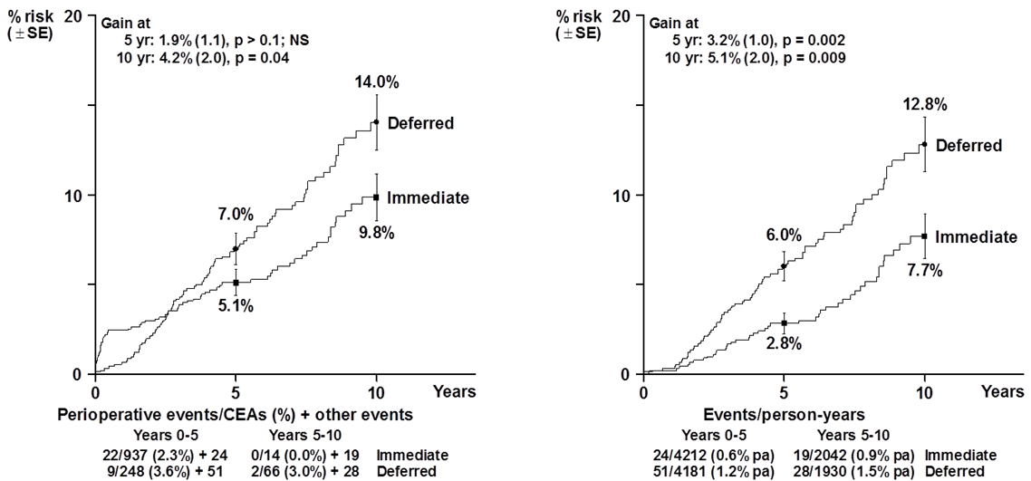
Asymptomatic Carotid Surgery Trial-1
3120 patients (1993-2008) with carotid stenosis and no recent symptoms
randomised to immediate CEA plus medical therapy vs medical therapy alone
Any stroke (or peri-operative death)
Non-peri-operative stroke

Slide 8
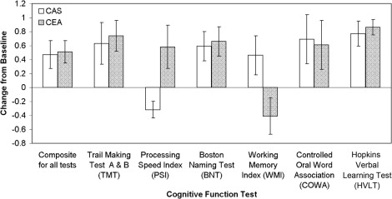
Can CEA or CAS prevent dementia
46 asymptomatic patients undergoing CEA (25) or CAS (21)
Cognitive tests 1-3 days pre- and 3-6 months post-intervention
Revascularisation associated with improved cognitive function
Lal et al: J Vasc Surg 2011;54:691-8

Slide 9

Long-term follow-up of ACST-1
NIHR Oxford Biomedical Research Centre

Slide 10


ACST-1 Long-term follow-up
Follow-up of 1601 participants from the UK and Sweden randomised into ACST-1
ACST-1 Recruited 3120 participants 1993-2008
Estimate up to 80% deceased by 2017
90% power to detect a 30% reduction in dementia
Objective
In the UK (1069) & Sweden (532) does CEA for asymptomatic carotid stenosis reduce the risk of dementia, stroke, death in
the long-term?
NIHR Oxford Biomedical Research Centre

Slide 11
ACST-1 Long-term follow-up:
Phase 1 data linkage:
Regulatory approvals:
UK:
Oxford C Research Ethics Committee (16/SC/0406) August 2016
Confidentiality Advisory Committee (16/CAG/0122) for data linkage without participant consent October 2016
NHS Digital: Hospital Episode Statistics (HES) data August 2017
ONS Mortality data awaiting approval
Sweden:
Lund Ethics Committee December 2016
Swedish National Board of Health & Welfare approved
NIHR Oxford Biomedical Research Centre

Slide 12

ACST-1 Long-term follow-up: flow chart for data linkage
Swedish dataset

Slide 13
ACST-1 Long-term follow-up:
ACST-1 File Investigation:
Folder review 1601 UK and Swedish ACST-1 participants including major event files
Looking for direct evidence of dementia, cognitive impairment (with dates of diagnosis where possible)
Blinded to randomised treatment allocation
Validated and confirmed as dementia or cognitive impairment by clinician
Results will cross reference with electronic data from HES, Mental Health Minimum dataset, ONS Mortality & Swedish registries
NIHR Oxford Biomedical Research Centre

Slide 14
ACST-1 Long-term follow-up:
Phase 2: Informant Questionnaire:
Will send an invitation to the ACST-1 participant if alive to nominate a relative or friend to complete the IQCODE questionnaire
Invitation will be to a relative (named in the original consent) if the ACST-1 participant has died
Informant Questionnaire on Cognitive Decline in the Elderly (IQCODE):
      validated questionnaire for dementia
      completed by a relative or friend
Questions on memory and thinking today compared with 10 years previously
Sensitive issue re-contacting in this way so we are liaising with PPI groups from Alzheimer’s Society, NIHR and the Nuffield Dept. of Population Health
NIHR Oxford Biomedical Research Centre

Slide 15
IQCODE questionnaire: sample questions
The assessment
We want you to remember what your friend or relative was like 10 years ago and to compare it
with what he/she is like now. There are situations where this person has to use
his/her memory or intelligence and we want you to indicate whether this has
improved, stayed the same or got worse over the past 10 years.
Jorm AF Int.Psychogeriat. 2004:16: 275-293
 |  | 1 | 2 | 3 | 4 | 5
1 | Remembering things about family and friends, eg occupations, birthdays, addresses | Much improved | A bit improved | Not much change | A bit worse | Much worse
2 | Remembering things that have happened recently | Much improved | A bit improved | Not much change | A bit worse | Much worse
4 | Remembering her/his address and telephone number | Much improved | A bit improved | Not much change | A bit worse | Much worse
7 | Remembering where to find things which have been put in a different place from usual | Much improved | A bit improved | Not much change | A bit worse | Much worse
11 | Following a story in a book or on TV | Much improved | A bit improved | Not much change | A bit worse | Much worse
14 | Handling financial matters, e.g. pension, dealing with the bank | Much improved | A bit improved | Not much change | A bit worse | Much worse

Slide 16
ACST-1 Long-term follow-up:
In Summary:
50% of dementia is “vascular” or mixed
Stroke 7 years cognitive aging
TIA 3 years cognitive aging
CEA Reduces stroke and TIA
Reduces asymptomatic emboli
Improves cerebral perfusion
?
This study will determine whether CEA reduces the long tem risk of dementia and stroke
Results
2018
NIHR Oxford Biomedical Research Centre

Slide 17






ACST-1 Long-term follow-up: collaborators
Alison Halliday Richard Bulbulia
Nuffield Department of Surgical Sciences Nuffield Department of Population Health
Sarah Parish Sarah Pendlebury
Medical Statistics & Epidemiology, NDPH Nuffield Department of Clinical Neurosciences
Rebecca Llewellyn-Bennett Hongchao Pan
Nuffield Department of Population Health Nuffield Department of Population Health
Mary Sneade
Nuffield Department of Surgical Sciences
William Whiteley
Centre for Clinical Brain Sciences
Martin Björck Anders Gottsäter
Vascular Surgery, Department of Vascular Diseases,
Department of Surgical Sciences Skåne University Hospital
Sponsor: University of Oxford Funder: Alzheimer’s Society Project Grant

