Slide 1


Università degli Studi di Bari “Aldo Moro”
U.O. DI CHIRURGIA VASCOLARE
CATTEDRA E SCUOLA DI SPECIALIZZAZIONE IN CHIRURGIA VASCOLARE ed ENDOVASCOLARE
Direttore : Prof. Raffaele Pulli
Italian Innovation:
Membrane covered stents, MoMa and Filters may all help make CAS safer!
What determines my choice of stent
D. Angiletta
Notes:
Mr Chairmain , dear colleagues good morning and thank you to the organizing committee for the kind invitation

Slide 2
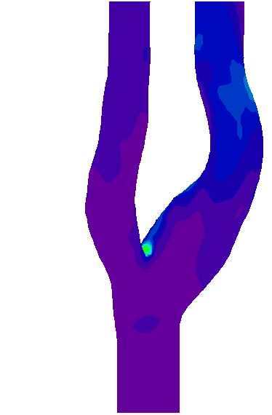
• I routinely use carotid stents
Personal disclosure
• I have no financial relationship with any
stent company
Notes:
These are my disclosures

Slide 3
What determines my choice of stent
Careful evaluation of the plaque and of the vessels anatomy
Careful evaluation of the stent type and characteristics
Notes:
Going to the topic of my talk , choosing a stent means …
The careful evaluation of the plaque and anatomy is important because

Slide 4
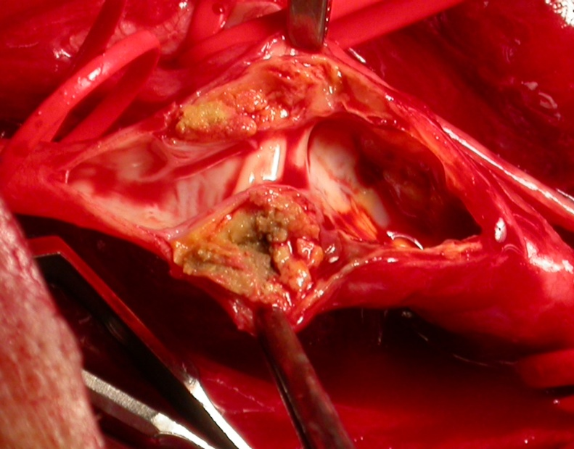
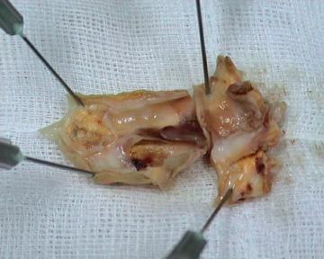
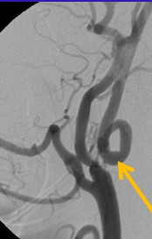
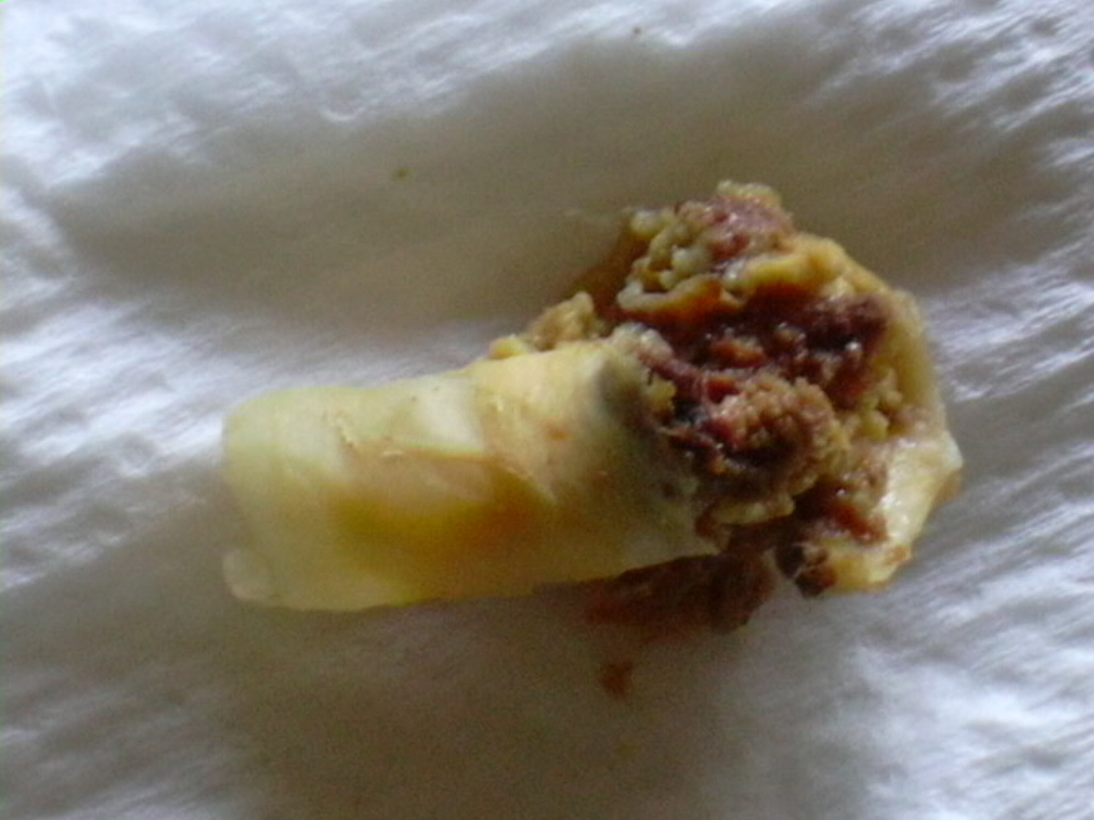

What determines my choice of stent
Careful evaluation of the plaque
Careful evaluation of the vessels anatomy
Notes:
Because plaques and anatomies are different and every patient needs a tailored treatment

Slide 5
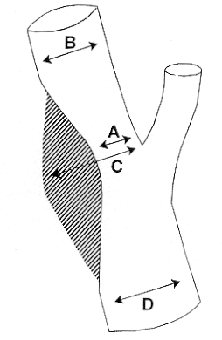
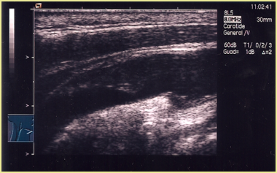

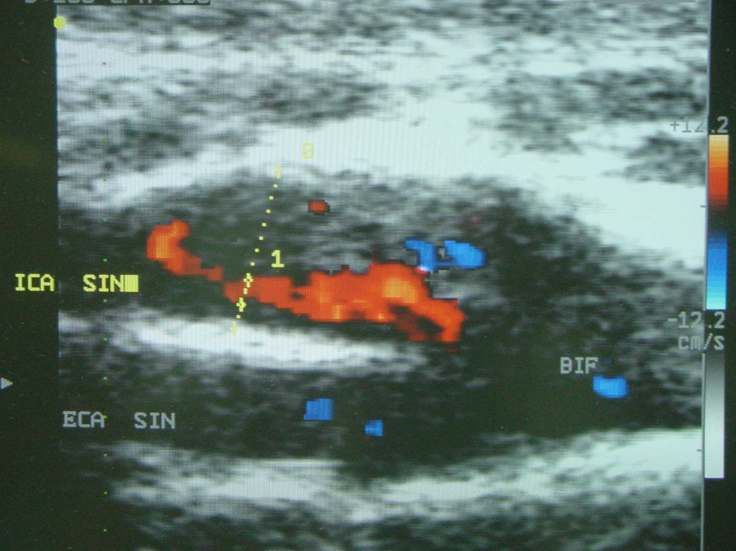
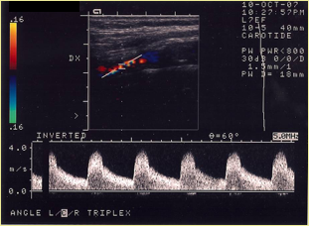
Plaque evaluation
Grade of stenosis
Vessel diameters
Residual lumen
Lenght of the lesion
SAT echolordoppler
Plaque characteristics
Plaque echolucency
Ulcers
Notes:
Routinely we do an echocoloroppler of the supraaortic trunks to study the grade of stenosis, vessel diameters , the residual lumen and the lenght of the lesion .
We evaluate plaque echolucency and the presence of surface abnormalities such as ulcers

Slide 6
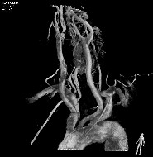
Anatomy evaluation
Angio CT scan : Aortic arch, SAT and intracranial arteries
Notes:
We complete the study with a ct scan in order to a have a complete view of the anatomy from the arch to the willis circle.

Slide 7
What determines my choice of stent
Careful evaluation of the plaque and of the vessels anatomy
Careful evaluation of the stent type and characteristics
Notes:
The second point is the stent

Slide 8

What determines my choice of stent
Type of stent
Characteritstics of the stent
Notes:
A lot of stent are available : open cell, closed cell, dual layer stents. Tapered and autotapering stent
The question is how to choose the right stent

Slide 9
What determines my choice of stent
Type of the stent
Open cell design
Suboptimal plaque coverage
Conforms to the vessel antomy
Closed cell design
Good plaque coverage
Suboptimally conforms to the antomy
Notes:
Considering the type , the open cell provides ……… while the closed ones allow

Slide 10
What determines my choice of stent
Type of stent
Double layer micromesh design
Optimal plaque coverage
Conforms to the vessel antomy
Notes:
On the other side the new generation of stents provide….. But they are different
We started to use these stents two years ago

Slide 11
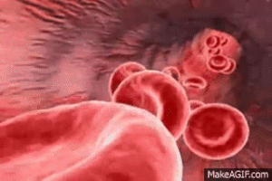
Pore Size
180μ
PS
C GUARD
300μ
PS x2
ROAD SAVER
8 μ
500μ
PS x 3
Gore STENT
1050μ
PS x5
Closed cell stent
PS x 10
1900μ
Open cell stent
Notes:
Concerning the plaque coverage we should consider that the pore size are different, infact if we compare the stents Road saver pore size is 2 times bigger than cguard , while the gore size is 3 times bigger

Slide 12
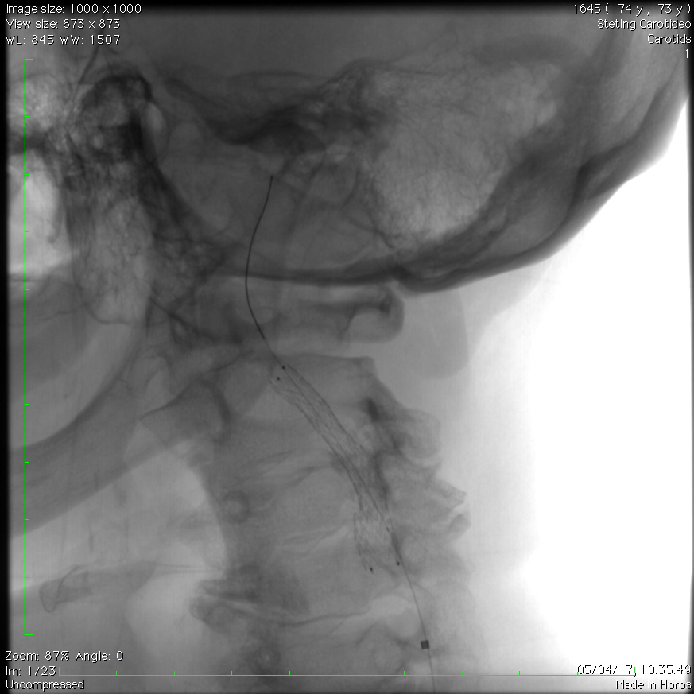
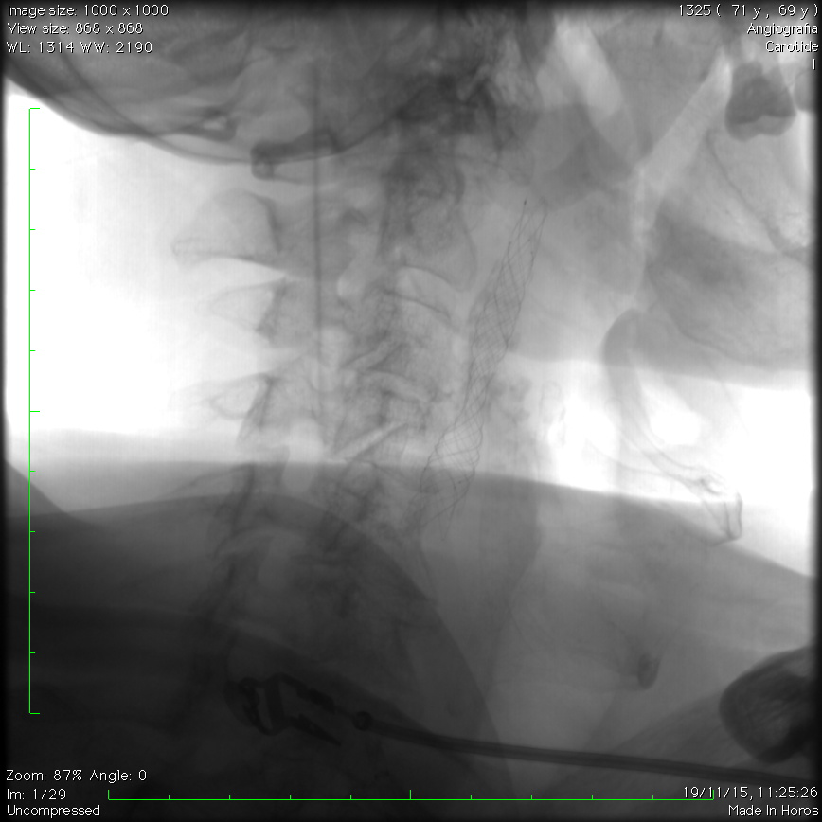
What determines my choice of stent
Both C Guard and Roadsaver stents provide a high radial force and their
structures adapt well to changes in diameter and to the tortous
vascular anatomies.
Roadsaver and Emboshield
C-Guard and MoMa
Notes:
On the other hand Both C Guard and Roadsaver stents provide a high radial force and their structure adapts well to changes in diameter and direction of tortous vascular anatomies
These features togheter with the data published in literature have convinced us and we are now increasing their use
These are two samples of new generation stent

Slide 13
IDEAL STENT
Flexible
Conformable
Radial force
Optimal plaque coverage
And …..Not less important
One stent fits all!
Low profile shaft
Easy & precise to deploy
Completely repositionable
Notes:
Actually the ideal stent does not exist , but i would have in my lab a stent flexible, conformable with an adequate radial force which provides an optimal plaque coverage, with a low profile shaft , easy and precise to deploy and completely repositionable
And last but not least i would have one stent wich fits all

Slide 14
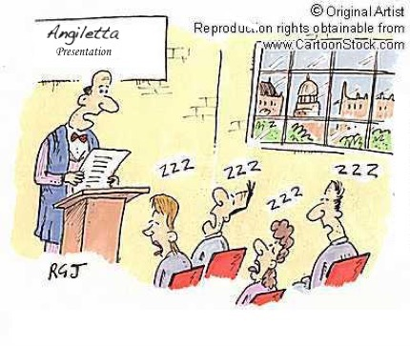

Thank you

