Slide 1
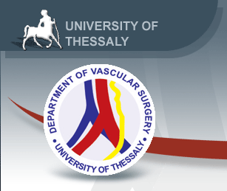


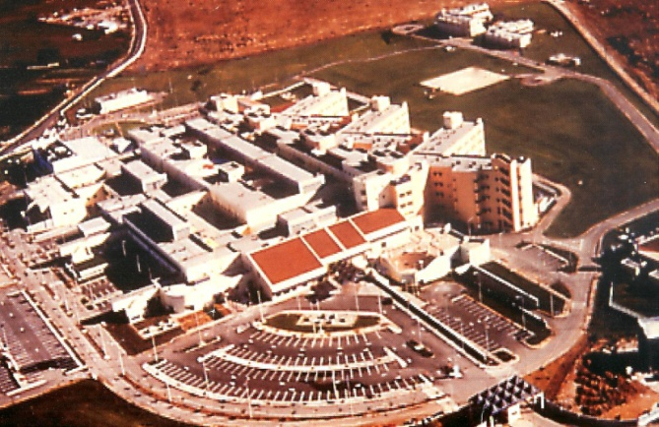
Larissa Registry on CAS and CEA:
A single-centre observational registry on the real-world long-term outcomes of carotid artery interventions
Konstantinos Spanos, Prof. Athanasios D Giannoukas
Vascular Surgery Department, University Hospital of Larissa, Faculty of Medicine, School of Health Sciences, University of Thessaly, Larisa, Greece, Larisa, Greece

Slide 2
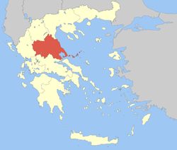
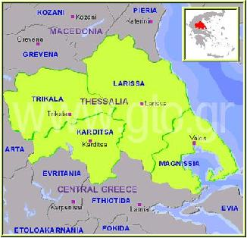
Larissa is the capital of Thessaly region
1.2 million population

Slide 3

LARISSA
the oldest city in Greece (since 20th century B.C.)
Ancient theatre dates back to 4th century BC
Currently has 200,000 population – ranking 4th in size among Greek cities

Slide 4

Hippocrates lived and practiced medicine in Larissa, in the city where he died at the age of 90 and buried.
His tomb was discovered in 1826.

Slide 5


Slide 6


Slide 7


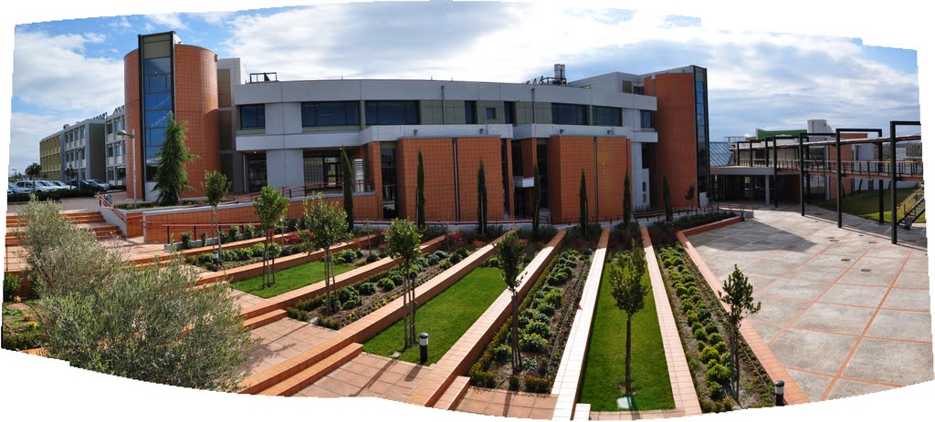
School of Medicine

Slide 8
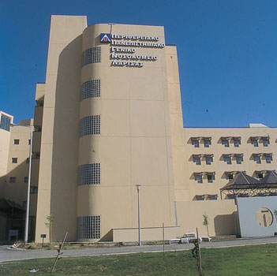
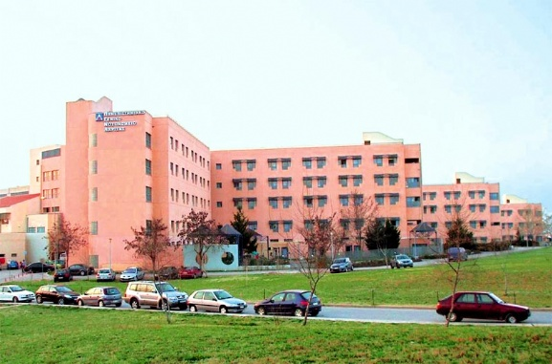
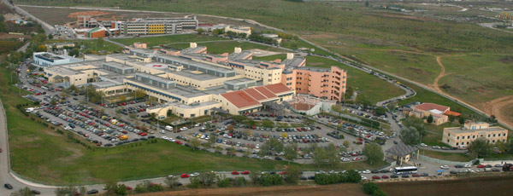
University Hospital of Larissa (700 beds)
Opened in 1999

Slide 9
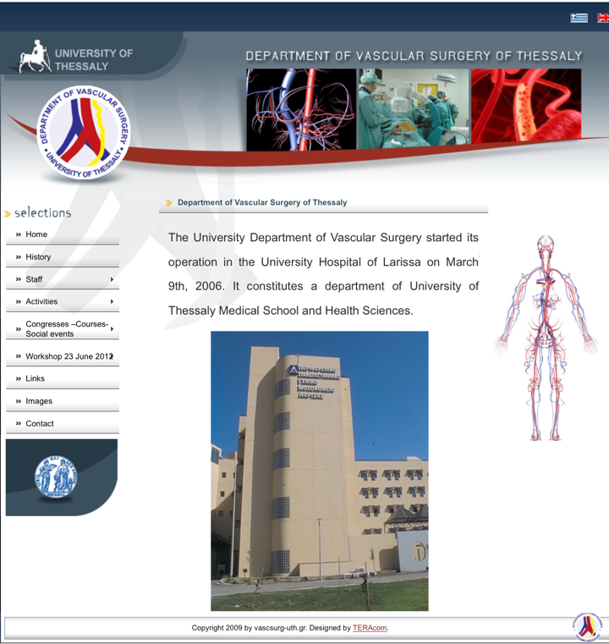

Slide 10
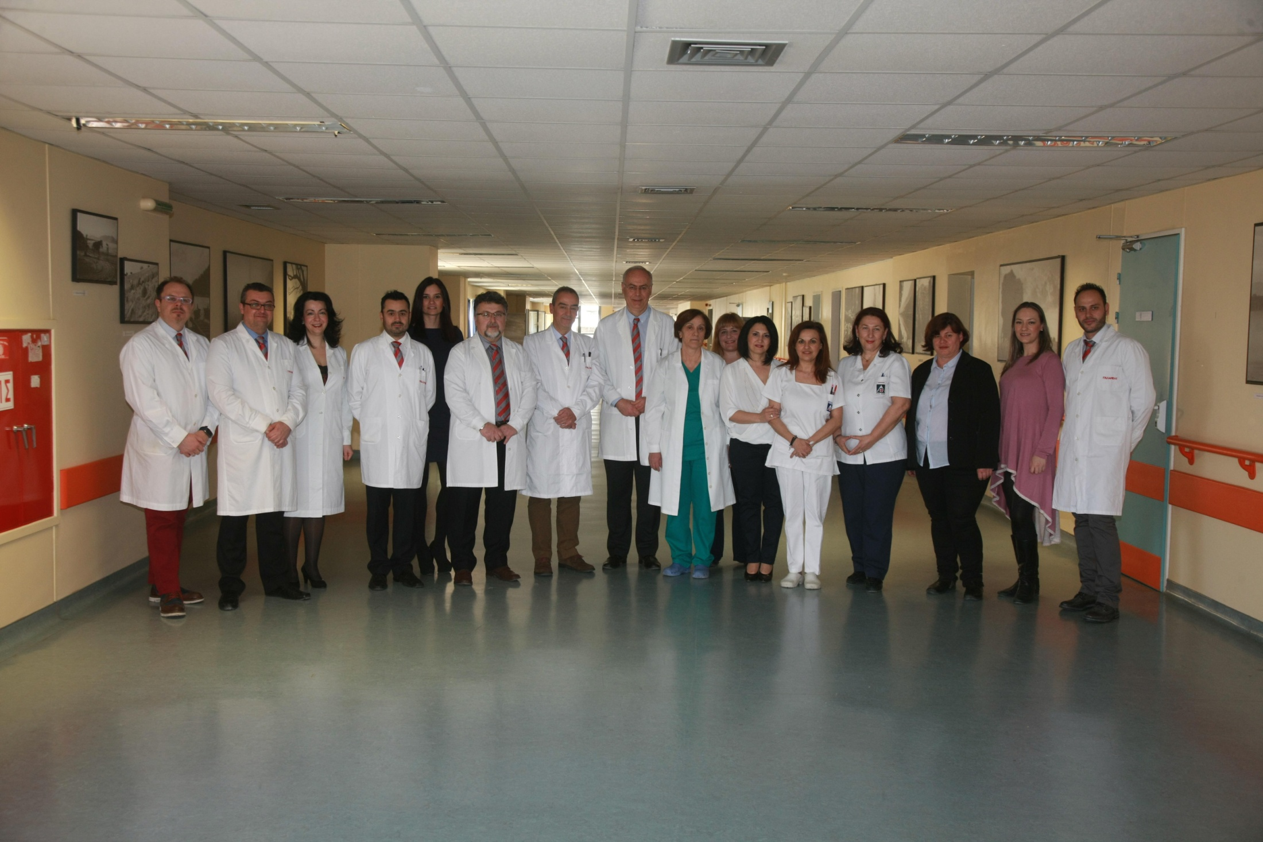

Slide 11
Introduction
The 30-day outcomes after carotid interventions have been extensively investigated in both symptomatic and asymptomatic settings
Information regarding the long-term outcomes of carotid interventions and the patients’ survival exist, but they are sparse
Such information may prove whether there is also a long-term benefit from carotid interventions

Slide 12
Aim
To evaluate the long-term outcome of CAS and CEA in a real-world setting during a 10-year period.
Primary outcomes:
Restenosis
Stroke
Major adverse cardiac events (MACE)
Death
During long-term
follow up period

Slide 13
Methods
A retrospective analysis from a single center during the period 2006-2016 was undertaken.
Demographics
Cardiovascular risk factors
Medication
Carotid surgery: PRIMARY CLOSURE, EVERSION, BOVINE, PTFE, DACRON, STENTING
Recorded

Slide 14
Demographics | 413 patients
Age | 69±8.5y
Gender | 80%; 333/413 males
94%
83%
37%
27%
40%
20%
Statin therapy: 89.5% (370/413)
Anti-coagulant therapy: N/A
Cardiovascular risk factors
Notes:
Cardiovascular Risk factors
HT 94%; 388/413 HL 83.2%; 344/413 CAD 36.8%; 152/413 DM 27.1%; 112/413 Current-Smoker 40%; 165/413 Ex-Smokers 2%; 7/413

Slide 15
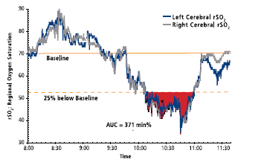

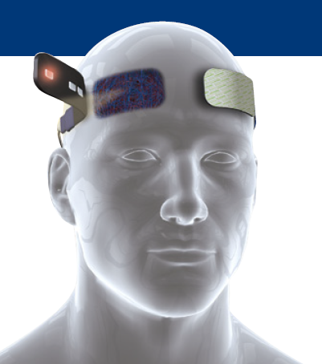
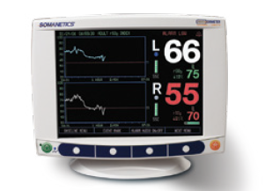
Operative details
Anaesthesia: General: 83.7% (346/413) vs. Local: 16.3% (67/413)
Endarterectomy: 83.7% (346/413) vs. Stenting: 16.3% 67/413
Selective Shunt: 26.8% (93/346)
In-Vivo Optical Spectroscopy
rSO2 of 50 or a 20% decline from baseline: intervention (shunt)
rSO2 of 40 or a 25% decline from baseline (neurologic dysfunction)

Slide 16
Operative details
1%
1%
Asymptomatic (60%, 248/413)
Symptomatic
(40%, 165/413)
21.3%
51/248 (20%) CAS vs. 197/248 (80%) CEA in asymptomatic
16/165 (10%) CAS vs 149/165 (90%) CEA in symptomatic
Notes:
16/165 (10%) CAS vs 149/165 (90%) CEA in symptomatic
51/248 (20%) CAS vs. 197/248 (80%) CEA in asymptomatic

Slide 17
The mean follow up was 3.2±2.2 (1-10) years.
The survival rate at 1, 3 and 5 years was 98%, 94.7% and 90.6%, respectively.
Years of follow up | 1 | 2 | 3 | 4 | 5 | 6 | 7 | 8 | 9 | 10
Number of patients | 413 | 258 | 188 | 138 | 95 | 66 | 49 | 31 | 8 | 2
Number of death | 7 |  | 10 |  | 9 |  |  | 0 |  | 0
The freedom of re-stenosis at 1, 3 and 5 years was 99%, 98% and 90.5%, respectively.
Years of follow up | 1 | 2 | 3 | 4 | 5 | 6 | 7 | 8 | 9 | 10
Number of patients | 413 | 258 | 188 | 138 | 95 | 66 | 49 | 31 | 8 | 2
Number of restenosis | 4 |  | 4 |  | 9 |  |  | 0 |  | 0

Slide 18
The freedom of stroke at 1, 3 and 5 years was 99%, 97% and 94.8%, respectively.
Years of follow up | 1 | 2 | 3 | 4 | 5 | 6 | 7 | 8 | 9 | 10
Number of patients | 413 | 258 | 188 | 138 | 95 | 66 | 49 | 31 | 8 | 2
Number of CVD events | 4 |  | 6 |  | 5 |  |  | 0 |  | 0
The freedom of MACE at 1, 3 and 5 years was 97.6%, 91.5% and 86.3%, respectively.
Years of follow up | 1 | 2 | 3 | 4 | 5 | 6 | 7 | 8 | 9 | 10
Number of patients | 413 | 258 | 188 | 138 | 95 | 66 | 49 | 31 | 8 | 2
Number of MACE | 10 |  | 16 |  | 13 |  |  | 0 |  | 0

Slide 19
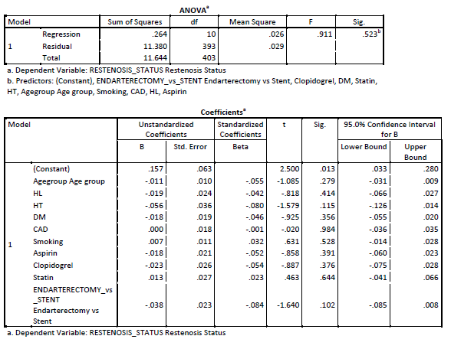
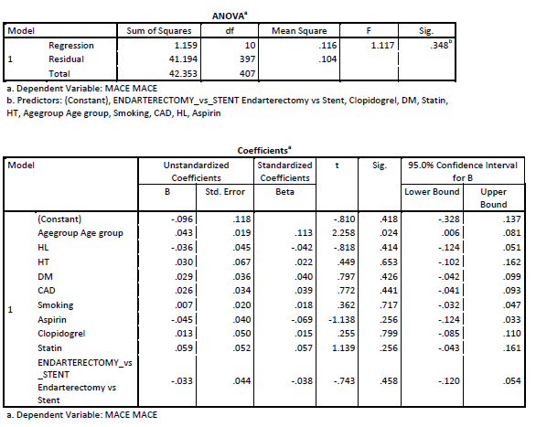
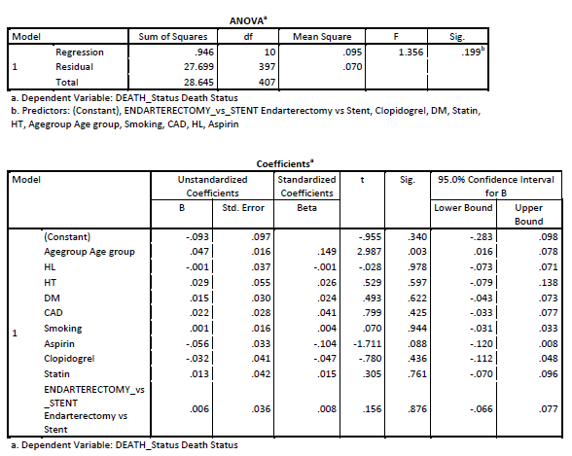
NO IDENTIFICATION OF ANY OTHER ASSOCIATION

Slide 20
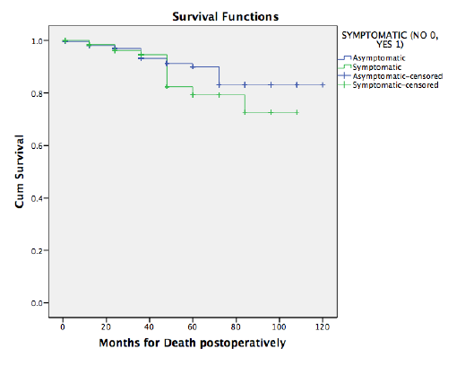
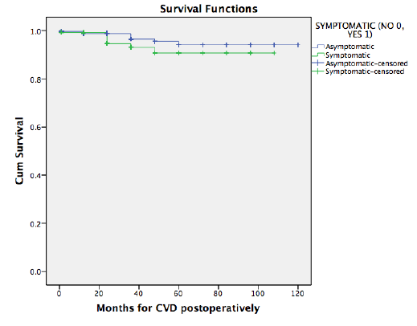
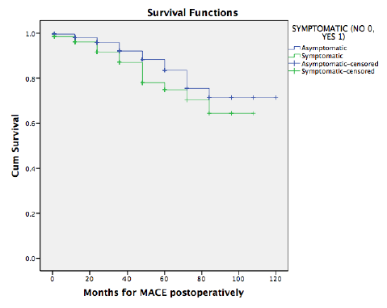
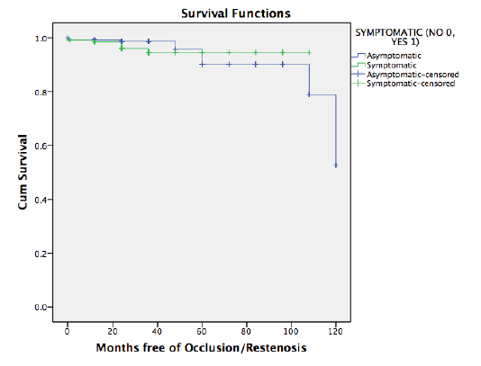

Slide 21
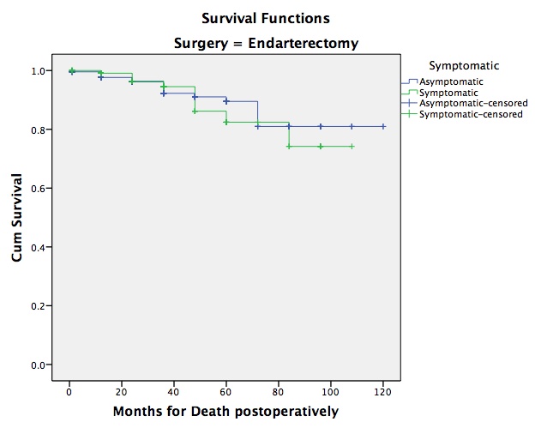
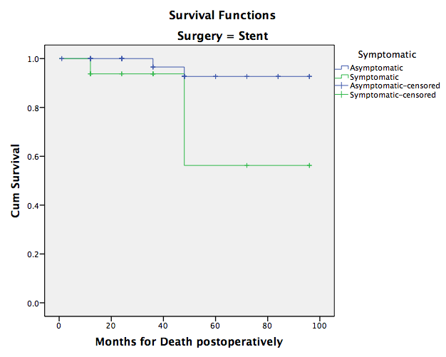
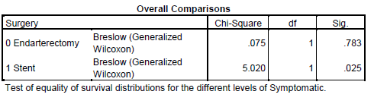
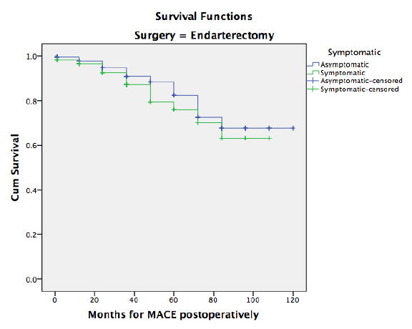
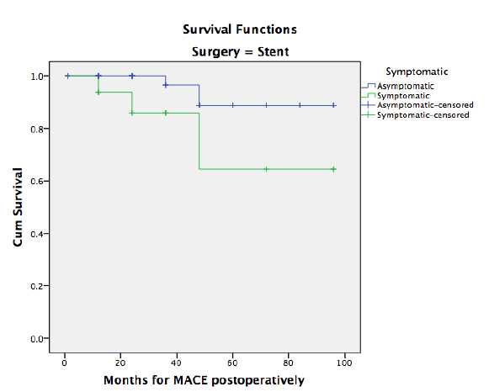
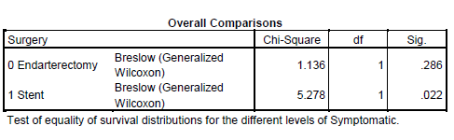
Notes:
3/16 (18%) symptomatic CAS; 2 of them of MI
2/51 (4%) asymptomatic CAS; 1 of them of MI
26 deaths in CEA (12 MI)
9/149 (6%) in symptomatic; 4 of them MI
12/197 (6%) in asymptomatic; 5 of them MI

Slide 22
Conclusions
Carotid interventions remain durable methods of
carotid stenosis treatment
Long-term outcomes regarding restenosis, risk of
stroke, MACE or mortality are similar for both
symptomatic and asymptomatic patients
CAS in symptomatic patients may be associated with
higher cardiovascular morbidity and mortality rate
during long-term follow up

Slide 23
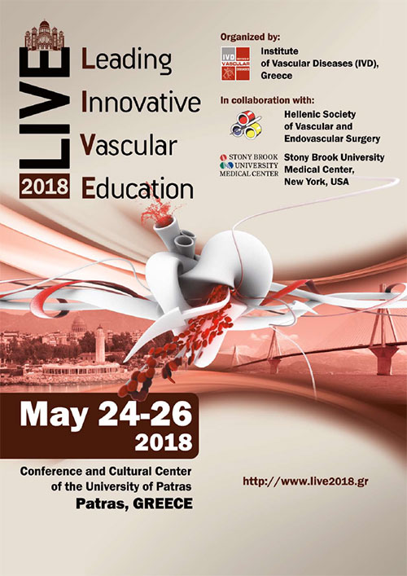

THANK YOU

