Slide 1
ECST-2 and ACTRIS Update
Hirnschlagzentrum/Stroke Center
Prof Leo Bonati
Department of Neurology and Stroke Center
Department of Clinical Resarch
University Hospital Basel
ACST-2 Collaborators’ Meeting, Oxford, 4-5.9.2017

Slide 2
RCTs in Carotid Artery Disease

Slide 3
RCTs in Carotid Artery Disease
Symptomatic
Revascularisation needed, uncertain if CAS or CEA
CAS vs. CEA
EVA-3S, SPACE, ICSS, CREST

Slide 4
RCTs in Carotid Artery Disease
Symptomatic
Symptomatic,
5-year risk <20%
Revascularisation needed, uncertain if CAS or CEA
Revascularisation uncertain
CAS vs. CEA
EVA-3S, SPACE, ICSS, CREST
Revasc vs. BMT
ECST-2

Slide 5
RCTs in Carotid Artery Disease
Symptomatic
Symptomatic,
5-year risk <20%
Asymptomatic
Revascularisation needed, uncertain if CAS or CEA
Revascularisation uncertain
Revascularisation needed, uncertain if CAS or CEA
CAS vs. CEA
EVA-3S, SPACE, ICSS, CREST
Revasc vs. BMT
ECST-2
CAS vs. CEA
SPACE-2 , CREST, ACT-1, ACST-2

Slide 6
RCTs in Carotid Artery Disease
Symptomatic
Symptomatic,
5-year risk <20%
Asymptomatic
Revascularisation needed, uncertain if CAS or CEA
Revascularisation uncertain
Revascularisation needed, uncertain if CAS or CEA
Revascularisation uncertain
CAS vs. CEA
EVA-3S, SPACE, ICSS, CREST
Revasc vs. BMT
ECST-2
CAS vs. CEA
SPACE-2 , CREST, ACT-1, ACST-2
Revasc vs. BMT SPACE-2, ECST-2
CREST-2, ACTRIS

Slide 7
RCTs in Carotid Artery Disease
Symptomatic
Symptomatic,
5-year risk <20%
Asymptomatic
Revascularisation needed, uncertain if CAS or CEA
Revascularisation uncertain
Revascularisation needed, uncertain if CAS or CEA
Revascularisation uncertain
CAS vs. CEA
EVA-3S, SPACE, ICSS, CREST
Revasc vs. BMT
ECST-2
CAS vs. CEA
SPACE-2 , CREST, ACT-1, ACST-2
Revasc vs. BMT SPACE-2, ECST-2
CREST-2, ACTRIS
CAS vs. CEA

Slide 8
RCTs in Carotid Artery Disease
Symptomatic
Symptomatic,
5-year risk <20%
Asymptomatic
Revascularisation needed, uncertain if CAS or CEA
Revascularisation uncertain
Revascularisation needed, uncertain if CAS or CEA
Revascularisation uncertain
CAS vs. CEA
EVA-3S, SPACE, ICSS, CREST
Revasc vs. BMT
ECST-2
CAS vs. CEA
SPACE-2 , CREST, ACT-1, ACST-2
Revasc vs. BMT SPACE-2, ECST-2
CREST-2, ACTRIS
Revasc vs. BMT
CAS vs. CEA

Slide 9
RCTs in Carotid Artery Disease
Symptomatic
Symptomatic,
5-year risk <20%
Asymptomatic
Revascularisation needed, uncertain if CAS or CEA
Revascularisation uncertain
Revascularisation needed, uncertain if CAS or CEA
Revascularisation uncertain
CAS vs. CEA
EVA-3S, SPACE, ICSS, CREST
Revasc vs. BMT
ECST-2
CAS vs. CEA
SPACE-2 , CREST, ACT-1, ACST-2
Revasc vs. BMT SPACE-2, ECST-2
CREST-2, ACTRIS
Revasc vs. BMT
CAS vs. CEA
Carotid Stenosis Trialists’ Collaboration

Slide 10
Coordinating centre: UCL Institute of Neurology, London PI: Martin Brown
The Second European Carotid Surgery Trial (ECST-2)

Slide 11
Symptomatic carotid stenosis: NASCET, ECST und VA n=6092 patients
Perioperative death or stroke, or ipsilateral ischaemic stroke during follow-up
Severe stenosis (≥70%)
Moderate stenosis (50-69%)
Medical
Medical
ARR 5%
ARR 16%
Years
Endarterectomy
Endarterectomy
years

Slide 12
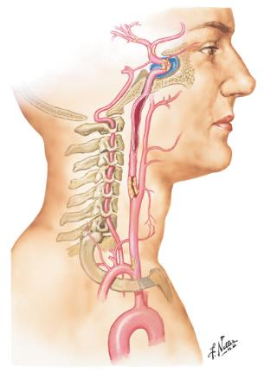




Strokes prevented by CEA in patients with symptomatic 50-99% stenosis after 5 years
Notes:
Cholesterol plaques build up in the carotid wall, leading to stenosis or occlusion of the artery
This plaque can rupture, local thrombus may form and subsequently embolism occurs as the most important way in which carotid stenosis becomes symptomatic.
And it is important to keep this concept in mind, when we discuss advantages and disadvantages of treatments.

Slide 13
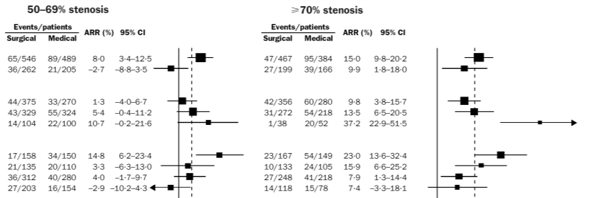
Do all patients with symptomatic stenosis benefit equally from surgery?
ARR
ARR
Sex
Men
Women
Age (years)
<65
65-74
≥74
Weeks since event
<2
2-4
4-12
≥12
→ Benefit is highest in men, older patients, and if treated
within 2 weeks of symptoms

Slide 14
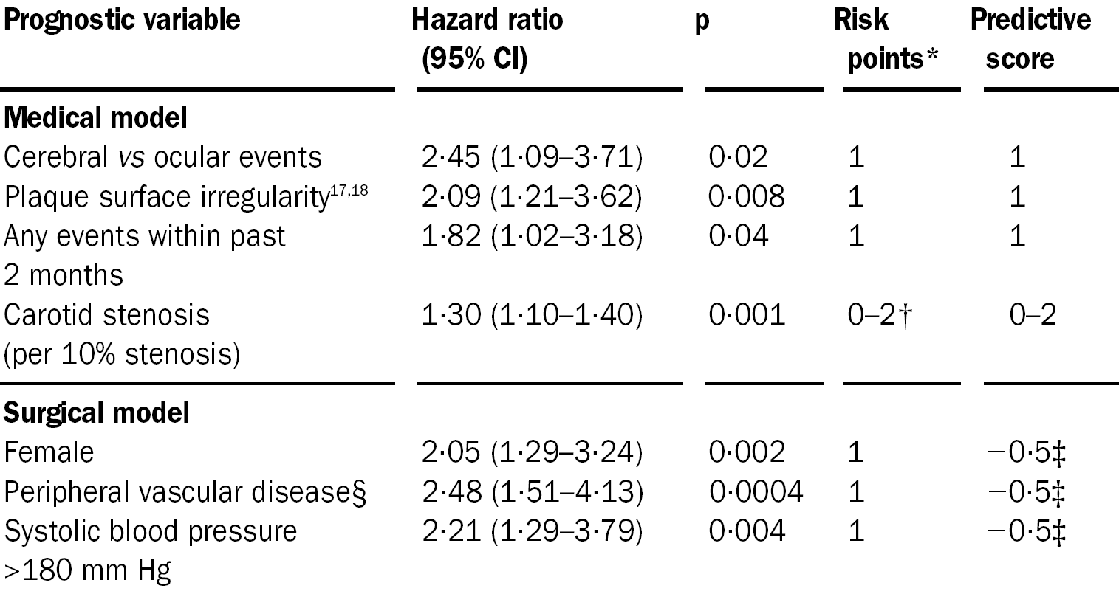
Symptomatic carotid stenosis: ECST risk model
Rothwell et al., Lancet 1999; 353: 2105-10

Slide 15
ECST risk model predicts 5-year stroke risk under medical therapy in NASCET trial population
50
Patients on medical treatment in NASCET
40
30
Observed risk (%)
20
Risk of CEA
in NASCET
10
0
0
10
20
30
40
50
<20%
Predicted medical risk (%)

Slide 16
ECST-2 hypotheses
In patients with ≥50% symptomatic or asymptomatic carotid stenosis and a predicted 5-year stroke risk <20%, optimised medical therapy (OMT) alone is as effective in the long-term prevention of stroke as carotid revascularisation (CEA or CAS) plus OMT
Plaque imaging helps select patients who benefit from revascularisation
Primary outcome: any stroke or myocardial infarction, or procedural death
Secondary outcomes: 2-year risk of cerebral infarcts on MRI, cognitive impairment (MoCa), disability

Slide 17
Carotid Artery Risk (CAR) score
Recalibrated ECST risk model assuming half the risk of stroke under current medical therapy than historically
Patients with symptomatic stenosis are eligible if estimated 5-year stroke <15%
All patients with asymptomatic stenosis are eligible
Baseline variables used to calculate CAR score:
  Age and Sex
  Degree of carotid stenosis
  Plaque morphology – smooth or ulcerated
  Time since event and event severity if symptomatic
  Vascular risk factors (hypertension, diabetes, previous MI and peripheral vascular disease)

Slide 18
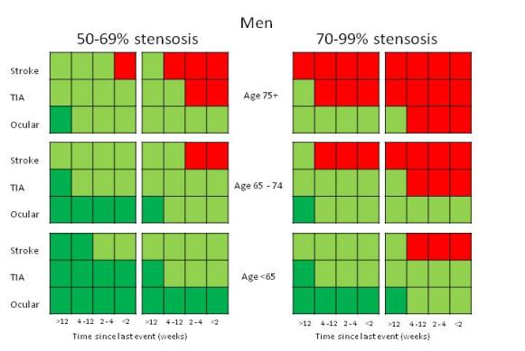
Predicting risk of recurrent stroke in patients with symptomatic stenosis – ECST risk model
50-69% stenosis
Ulcer - Ulcer +
Men
70-99% stenosis
Ulcer - Ulcer +
«ECST-2 CAR Score»
App available on AppStore and PlayStore
Low 5-year risk ipsilateral stroke risk (<10%)
ECST-2
Intermediate 5-year ipsilateral stroke risk (10-19%)
High 5-year risk ipsilateral stroke risk (>20%)

Slide 19
ECST-2 trial profile
Symptomatic or asymptomatic carotid stenosis
CAR Score
(5-year stroke risk)
>20% risk: Revascularisation recommended
≤20% risk:
Eligible for ECST-2
Randomisation in ECST-2
OMT Group
OMT + Revasc Group
Baseline MRI brain + plaque, US plaque
Blood sample
Revascularisation
2-year MRI brain
Blood sample
Clinical follow-up minimum 5 years, maximum 10 years

Slide 20
ECST-2: Optimised medical treatment (OMT)
Antiplatelet therapy: clopidogrel or aspirin and dipyridamole. Anticoagulation allowed if necessary.
Statins adjusted to maintain a target total cholesterol <4.0mmol/L, and an LDL cholesterol level <2.0mmol/L, together with low cholesterol diet.
Antihypertensive treatment, adjusted to maintain a target BP of 140/90 mmHg or less.
Targeted risk factor modification: smoking, body weight, glycaemic control (HbA1c<6.5%), exercise.

Slide 21
Status of ECST-2
Pilot funding from NIHR and Stroke Association
Plaque and brain imaging and biomarker analysis during pilot phase funded by Swiss National Science Foundation
30 active centres
262 patients randomised (target pilot n=320, full trial n=2000 patients)
New centres welcome
Contact: office@ecst2.com

Slide 22





ACTRIS
ENDARTERECTOMY COMBINED WITH OPTIMAL MEDICAL THERAPY VERSUS OPTIMAL MEDICAL THERAPY ALONE
IN PATIENTS WITH ASYMPTOMATIC SEVERE ATHEROSCLEROTIC CAROTID ARTERY STENOSIS
AT HIGH RISK OF IPSILATERAL STROKE
PI: Jean-Louis Mas
Notes:
Email Jean-Louis 6/17:
Dear Leo,
Here are some slides on ACTRIS.
The trial is funded by the French Ministry of Health.
I will start to open centers by the end of this year.
Let me know if you need more information.
Kind regards,
Jean-Louis

Slide 23
ACTRIS
Objectives
Primary objective
  To assess whether carotid endarterectomy combined with optimal medical therapy improves long-term survival free of ipsilateral stroke (or periprocedural stroke or death) when compared with optimal medical therapy alone.
Secondary objectives
  To assess differences between groups with regard to risks of any stroke (or periprocedural death), any disabling or fatal stroke (or periprocedural death), any stroke or death, myocardial infarction, cardiovascular death, symptomatic and asymptomatic lesions on brain MRI at 2 years, disability, cognitive impairment, health-related quality of life and depression.
  To assess to what extent medical treatment objectives can be achieved and identify factors associated with goals achievement.

Slide 24
ACTRIS
Main inclusion criteria
Age 50 years or over
No ipsilateral stroke or TIA within 180 days of randomisation
Atherosclerotic carotid stenosis between 60 and 99% (NASCET method)
At least one of the following:
    TCD-detected microembolic signals
    Impairment of TCD-measured cerebral vasomotor reserve
    Intraplaque haemorrhage on magnetic resonance imaging
    Rapid stenosis progression
High probability to live at least 5 years

Slide 25
ACTRIS
Optimal medical treatment
OMT will follow guidelines for clinical practice and consist of:
  antiplatelet therapy
  high-dose statin treatment (target LDL < 0.7 g/l - <1.8mmol/L)
  antihypertensive treatment (target BP < 140/90 mmHg)
  lifestyle modification (quitting smoking, healthy food, reduction of alcohol consumption, regular physical activity, overweight reduction)
Application of structured programs, such as rigorous stepped-care approach using ranking of antihypertensive and lipid-lowering drugs will be used.

Slide 26
ACTRIS
Number of subjects
Primary endpoint
  Ipsilateral stroke (or periprocedural stroke or death)
Number of subjects = 700
  5-year rate of the primary endpoint of 12.5% in the OMT arm.
  Two-sided significance level of α=5%, power of 80%
  60% reduction of the primary endpoint in the endarterectomy arm
  Accrual period: 3 years, maximal follow-up time: 6 years, 10% anticipated dropouts rate: 10%.

Slide 27

Thank you for your attention

