Slide 1
Efforts put into ACST-2 Why patients were NOT randomized
Barbara Rantner and Gustav Fraedrich
Medical University Innsbruck,
Innsbruck, Austria

Slide 2
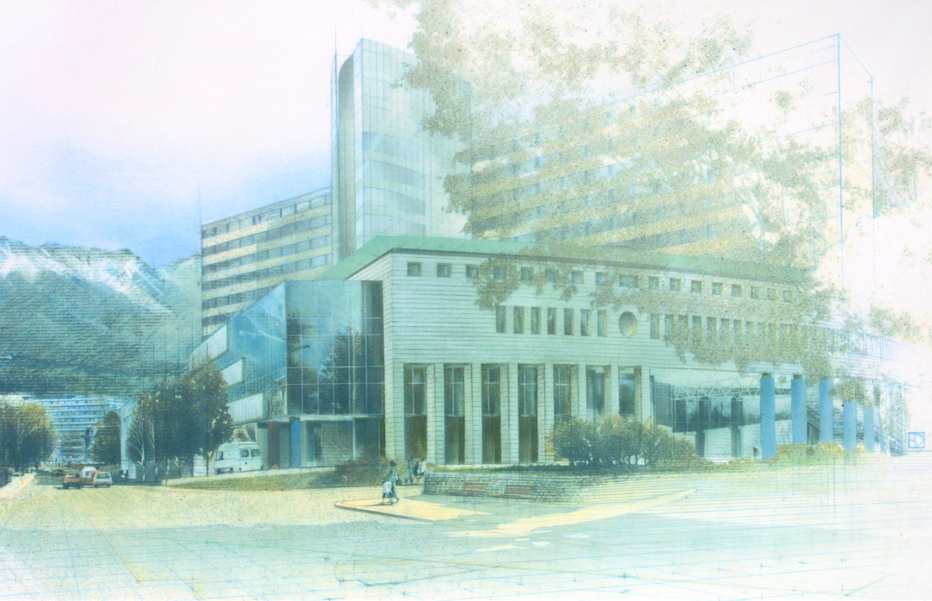
Numbers at a glance
2460 patients seen for ultrasound per year - 800 for follow up with an asymptomatic ICA stenosis (~ 3 per day) (Outpatient Department Stroke Unit)
~ 60 patients treated by surgery/year for asymptomatic stenosis of the ICA
(Department of Vascular Surgery)
About 70 patients possibly eligible for ACST-2/year

Slide 3
Numbers at a glance
2460 patients seen for ultrasound per year - 800 for follow up with an asymptomatic ICA stenosis (~ 3 per day) (Outpatient Department Stroke Unit)
~ 60 patients treated by surgery/year for asymptomatic stenosis of the ICA
(Department of Vascular Surgery)
About 70 patients possibly eligible for ACST-2/year
Number of patients randomized between November 2015 and August 31st 2017
28

Slide 4
Responsibility NEUROLOGY
Indication for treatment by stroke-neurologists
CTA to prove eligibility
Interdisciplinary conference every Monday afternoon
Number of patients randomized:
0
Responsibility VASCULAR SURGERY
Study inclusion and randomization at Department of Vascular Surgery

Slide 5
Responsibility NEUROLOGY
Indication for treatment by stroke-neurologists
Interdisciplinary conference every Monday afternoon
Number of patients randomized:
28
Responsibility VASCULAR SURGERY
CTA to prove eligibility
Study inclusion and randomization at Department of Vascular Surgery

Slide 6
Responsibility NEUROLOGY
Indication for treatment by stroke-neurologists
Interdisciplinary conference every Monday afternoon
Number of patients randomized:
28
Responsibility VASCULAR SURGERY
CTA to prove eligibility
Study inclusion and randomization at Department of Vascular Surgery

Slide 7
Reasons for EXCLUSION from ACST-2
In total 33 patients
Unfavourable anatomy: 11
Patient‘s request: 9
Contrast agent intolerance: 4
Orale anticoagulation: 3
Unknown reason: 3
Renal impairment: 1
Meanwhile symptomatic: 1
Lost to follow up: 1

Slide 8
Outcome of EXCLUDED patients:
NO neurological complications
2 revisions for secondary haemorrhage (patients with unfavourable anatomy – circularly calcification)

