Slide 1
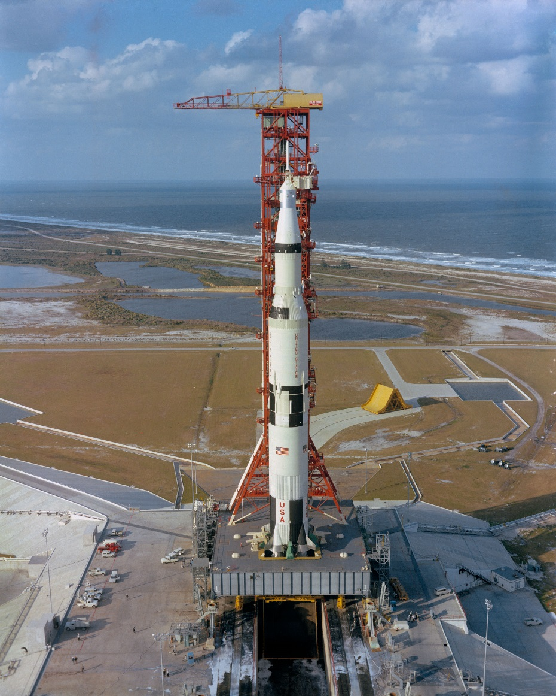
ACST-2 Count Down!
2612 randomised to date
Target = 3600 by end 2019

Slide 2
Achieved/Planned Recruitment
Jan 2010 – end December 2019

