Slide 1
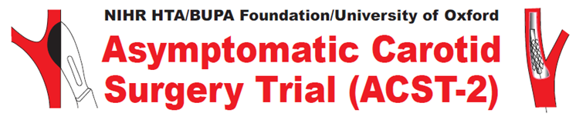

Treatment for asymptomatic carotid artery stenosis…
Surgery or Stenting?
?
This project was funded by the National Institute for Health Research Health Technology Assessment (NIHR HTA) Programme (project number 06/301/233) and will be published in full in Health Technology Assessment. The views and opinions expressed therein are those of the authors and do not necessarily reflect those of the HTA programme, NIHR, NHS or the Department of Health

Slide 2
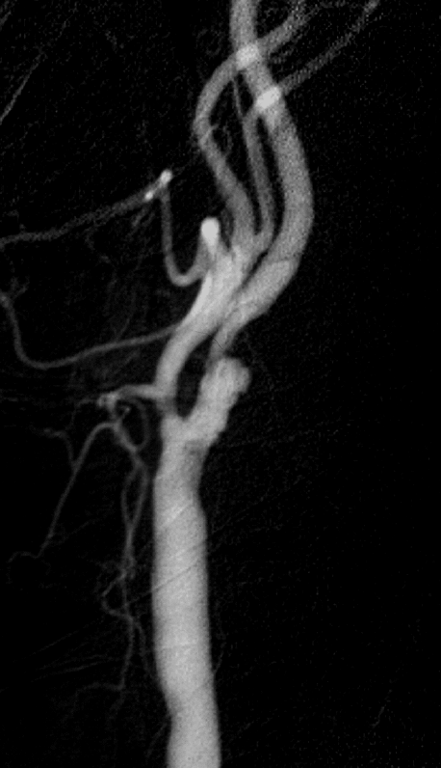
Asymptomatic carotid artery stenosis: narrowing that has not yet caused a stroke

Slide 3
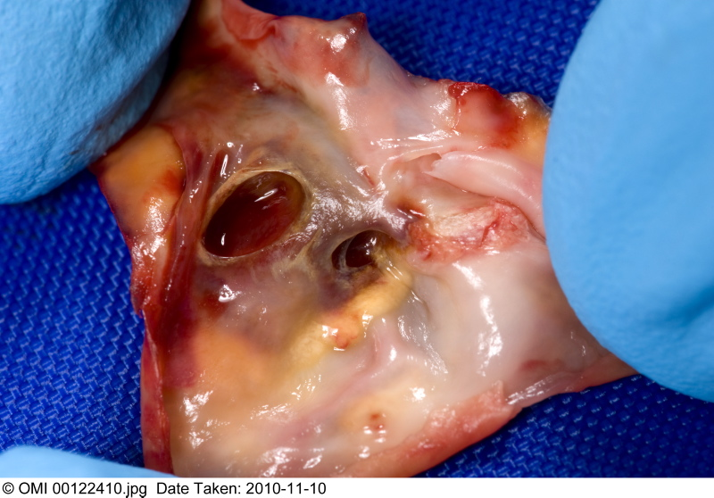
Carotid artery narrowing (stenosis) causes about 25% strokes
3

Slide 4
1990s: ACST-1
Asymptomatic Carotid Surgery Trial
(no symptoms for at least 6 months)
Immediate Operation (CEA)
vs
Deferral (waiting) until symptoms occur

Slide 5
Surgery reduces 10-year stroke risk for men & women under 75 years
5
Notes:
CEA reduced subsequent risk of stroke by ~50% and there was a 10 year absolute stroke reduction of 6%.

Slide 6
Stenting might be better than CEA –
no incision, quick discharge,
no cranial nerve damage…

Slide 7
In asymptomatic carotid stenosis,
hazard from stenting is also ~3%*
Hazards of CEA and stenting may be similar,
but long-term benefits are not yet known
*4832 US patients. Circ Cardiovasc Intervent 2009; 2: 159

Slide 8
>250,000 Carotid Interventions Worldwide but Wide Variation in Practice
 | Asymptomatic (%) | Proportion Stented (%)
US | 90 | 40
Europe UK | 60 20 | 40 10
Means much uncertainty
about choosing CEA or CAS

Slide 9
International Carotid Stenting Study (ICSS)
Long-term results from ICSS showed that disability, quality of life and restenosis rates are similar for CAS & CEA.
Most patients in Europe having interventions have not had recent symptoms and ACST-2 is the only trial comparing CAS & CEA in this group.

Slide 10
2010s: ACST-2 research question
For asymptomatic patients with stenosis:
carotid surgery (CEA)
vs
carotid stenting (CAS)?
10

Slide 11
Joining ACST-2 is simple:
Each site needs:
Surgeon(s)
Stenting Interventionalist(s)
Neurologist or Stroke Physician
Research Staff (if available)
The following documentation (we will help you):
Track Records (records clinical experience)
Memorandum of Intent (official contract)
Ethical Approval

Slide 12
ACST-2 Inclusion Criteria:
Tight carotid artery stenosis on ultrasound
No carotid territory symptoms on that side for at least 6 months
MRA or CTA shows both CEA and CAS feasible
Doctor and patient substantially uncertain about treating with one procedure rather than the other
Patient likely to live for next 10 years
NB: A patient is still eligible even if they’ve had a symptom or an endarterectomy on the contralateral side

Slide 13
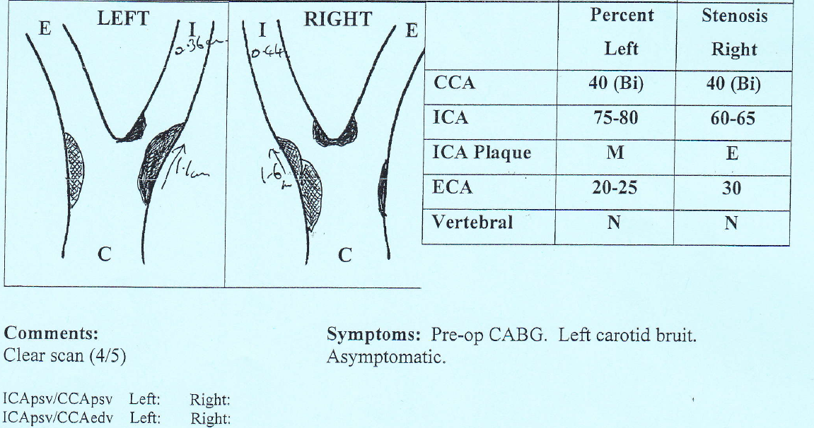
Carotid stenosis is detected by ultrasound (or by CT/MR)

Slide 14
60-99% carotid stenosis but no recent symptoms
If it is decided that a carotid procedure should be done, consider ACST-2
CAS vs CEA

Slide 15
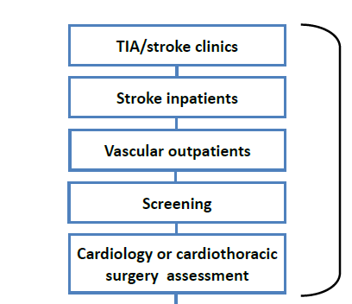
Finding suitable patients for ACST-2

Slide 16
How to randomise a patient
Very simple!
  1. Via 24 hour telephone service
  2. On-line via our website:
  www.acst.org.uk

Slide 17
What happens next?
e-mail confirms randomisation
Do procedure as soon as possible
(preferably within one month of randomisation)
One Month Follow-up
Duplex (check carotid patency)
Independent post-procedural examination (by Neurologist / Stroke Physician)
If any major events, please contact us ASAP!
Return form to ACST-2

Slide 18


Join us today!
Visit: www.acst.org.uk for more information or contact ACST-2 on:
Tel: +44 (0) 1865 221345 | e-mail: acst@nds.ox.ac.uk

