Slide 1
Mechanism of Procedural Stroke Following CAS and CEA
Collaborators’ Meeting ACST-2
Oxford, 19-9-2014
Anne Huibers, PhD student
Utrecht (Gert Jan de Borst) – Oxford (Alison Halliday)

Slide 2
Background
Prevalence of severe asymptomatic carotid stenosis (≥70%) 0–3.1%
Annual risk of stroke 1 %
Main objective CEA/CAS is stroke prevention
…. However,
Procedural stroke feared complication

Slide 3
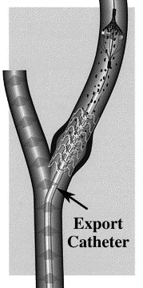
Etiology intraprocedural stroke
EMBOLIZATION
Spontaneously – unstable plaque
Manipulation – stent insertion, dissection phase, shunt insertion,
shunt dysfunction
Cardio embolization
HYPOPERFUSION
difficulty placing the shunt
prolonged clamping
balloon dilation
hypotension (manipulation carotid sinus;
baroreceptor dysfunction)
THROMBOTIC OCCLUSION CAROTID ARTERY
Shunt thrombosis
Secondary to hypotension

Slide 4
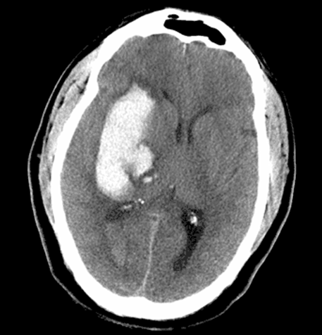
Etiology postprocedural stroke
EMBOLIZATION
embolism from endarterectomized surface
loose intimal flap
external carotid artery
cardio embolization
HYPOPERFUSION
decrease in BP first day after intervention
3. HYPERPERFUSION SYNDROME
4. THROMBOTIC OCCLUSION CAROTID ARTERY
technical failure
secondary to hypotension
Disturbed haemostasis.

Slide 5
Timing of procedural stroke International Carotid Stenting and Surgery trial (ICSS)
Excess in CAS mainly day 0
Different etiology / related to procedure ?
Unpublished data

Slide 6
Scoring Strokes in ACST-2 substudy
Opportunity to prospectively classify strokes according to their mechanism
Potential problem: no standardised assessment of patients with procedural strokes

Slide 7
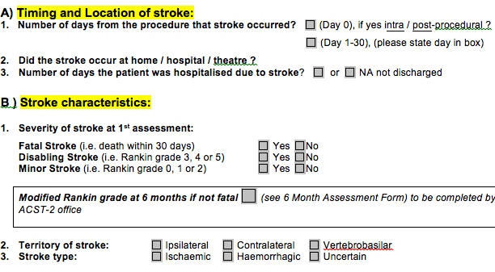
Stroke mechanism FORM (1)

Slide 8
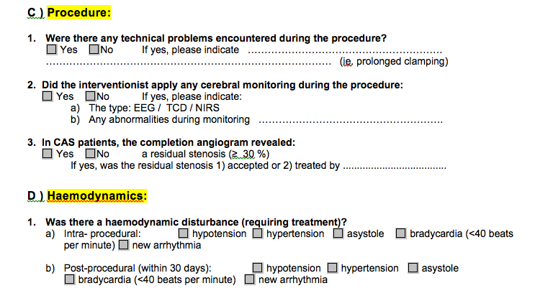
Stroke mechanism FORM (2)

Slide 9
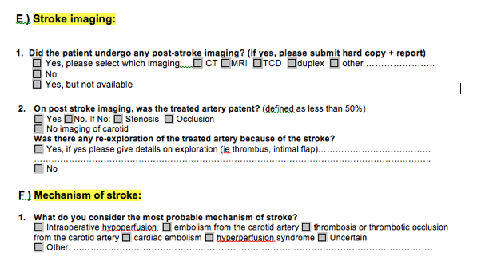
Stroke mechanism FORM (3)

Slide 10
Ultimate goals
Define the most probable cause of stroke
Better understand pathophysiological mechanism, detect strokes that are preventable ?
…….
Improve the safety of carotid surgery and stenting.

