Slide 1


Slide 2

Will Scotland become an Independent Country?
Vote ‘YES’ for independence, ‘NO’ to remain in the UK

Slide 3
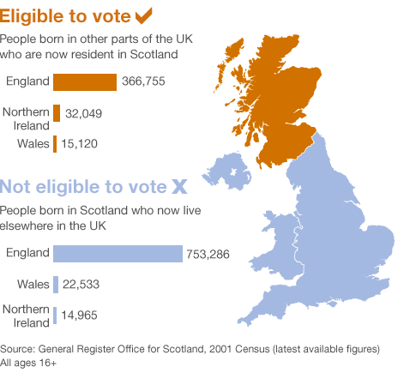

Slide 4


Slide 5

History and fear

Slide 6


Slide 7


Slide 8


Slide 9

Humour and politics………….

Slide 10
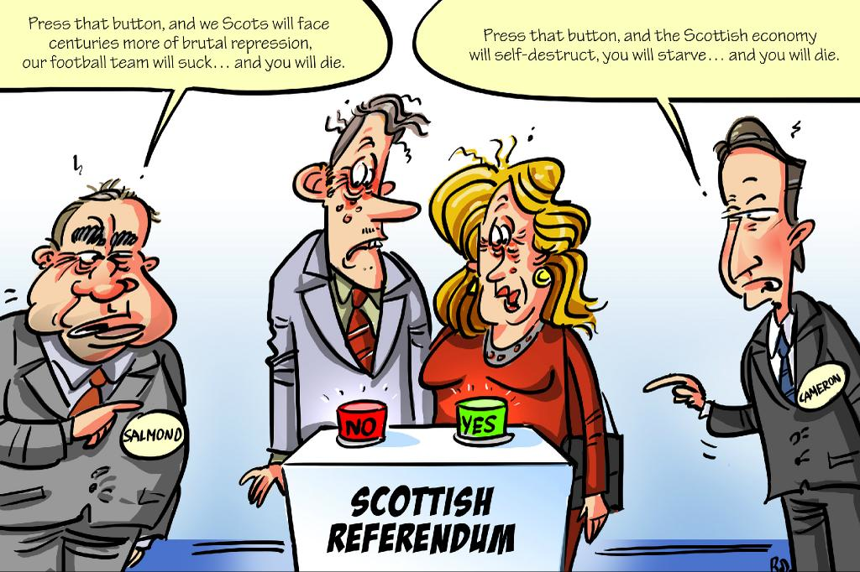

Slide 11


Slide 12


Slide 13


Slide 14
The ACST Trials – a better collaboration!
(although fear, history, politics and emotion do fuel the controversy!)

Slide 15
European Research 126 centres in 30 countries
ACST-1: 3120 patients
Finland 18
Russia 10
Norway 47
Netherlands 132
Sweden 532
UK 1069
Ireland 7
Czech Republic 18
Belgium 1
Poland 88
Germany 98
Hungary 59
France 2
Yugoslavia 77
Switzerland 6
Bulgaria 6
Austria 30
Italy 328
Israel 245
Cyprus 13
Slovenia 44
Portugal 13
Spain 196
Croatia 2
Greece 10
Notes:
15

Slide 16
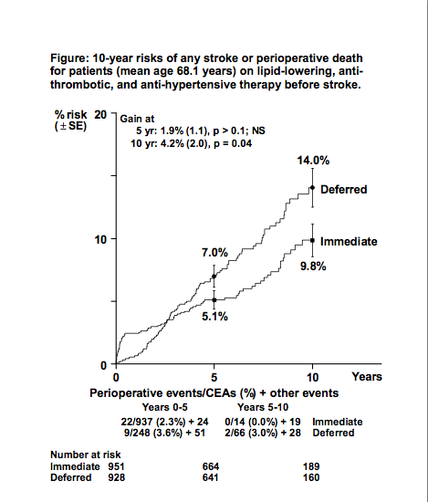
ACST-1: even for those on BP lowering, aspirin, statin therapy, immediate carotid surgery helps, despite its 2% risk

Slide 17
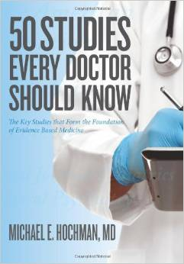
ACST is a classic evidence-based study known worldwide
Collaborators create the Guidelines for the future

Slide 18
Recent guidelines clearly show the evidence from ACST-1 and the need for ACST-2
AHA Carotid Disease Management Guidelines (2011)
It is reasonable to perform CEA in asymptomatic patients who have > 70% stenosis (Evidence Level: A)
Prophylactic CAS might be considered in highly selected patients with asymptomatic carotid stenosis (Evidence Level: B)
Society for Vascular Surgery Carotid Guidelines (2011)
Asymptomatic > 60% stenosis
should be considered for CEA (Evidence Level: A)
CAS should not be performed except as part of an on-going clinical trial (Evidence Level: B)
NICE Carotid Intervention Guidelines (2011)
“NICE encourages clinicians either
to enter patients into the ACST-2 trial, or to submit data to
the Endovascular Carotid Register”
RCP Stroke Guidelines
(2012)
Surgery or stenting (CEA or CAS) for
asymptomatic carotid artery stenosis should not routinely be performed unless as part of a randomised trial.
Notes:
18

Slide 19
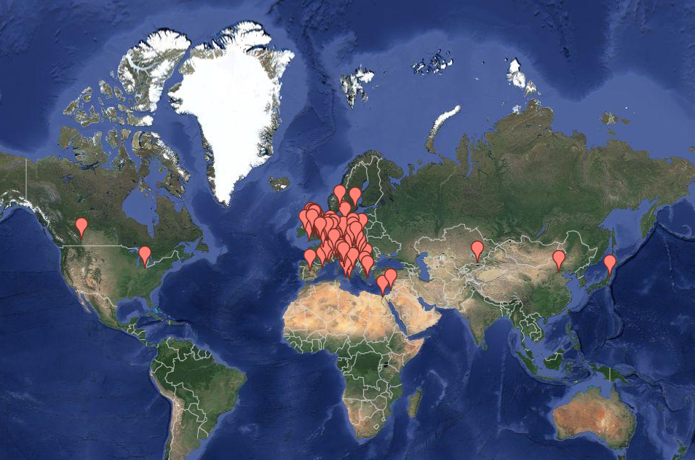
ACST-2: now in 28 countries
Belgium
Italy
Japan
Bulgaria
Kazakhstan
Canada
Norway
China
Poland
Czech Republic
Russia
Egypt
Serbia
Estonia
Slovak Republic
France
Slovenia
Germany
Spain
Greece
Sweden
Switzerland
Hungary
The Netherlands
Republic of Ireland
United Kingdom
Israel
USA

Slide 20
2010s: ACST-2 research question
For asymptomatic patients with tight stenosis requiring intervention:
Which procedure is generally better
(in addition to good medical treatment)? :
carotid surgery (CEA)
or
carotid stenting (CAS)?
20

Slide 21
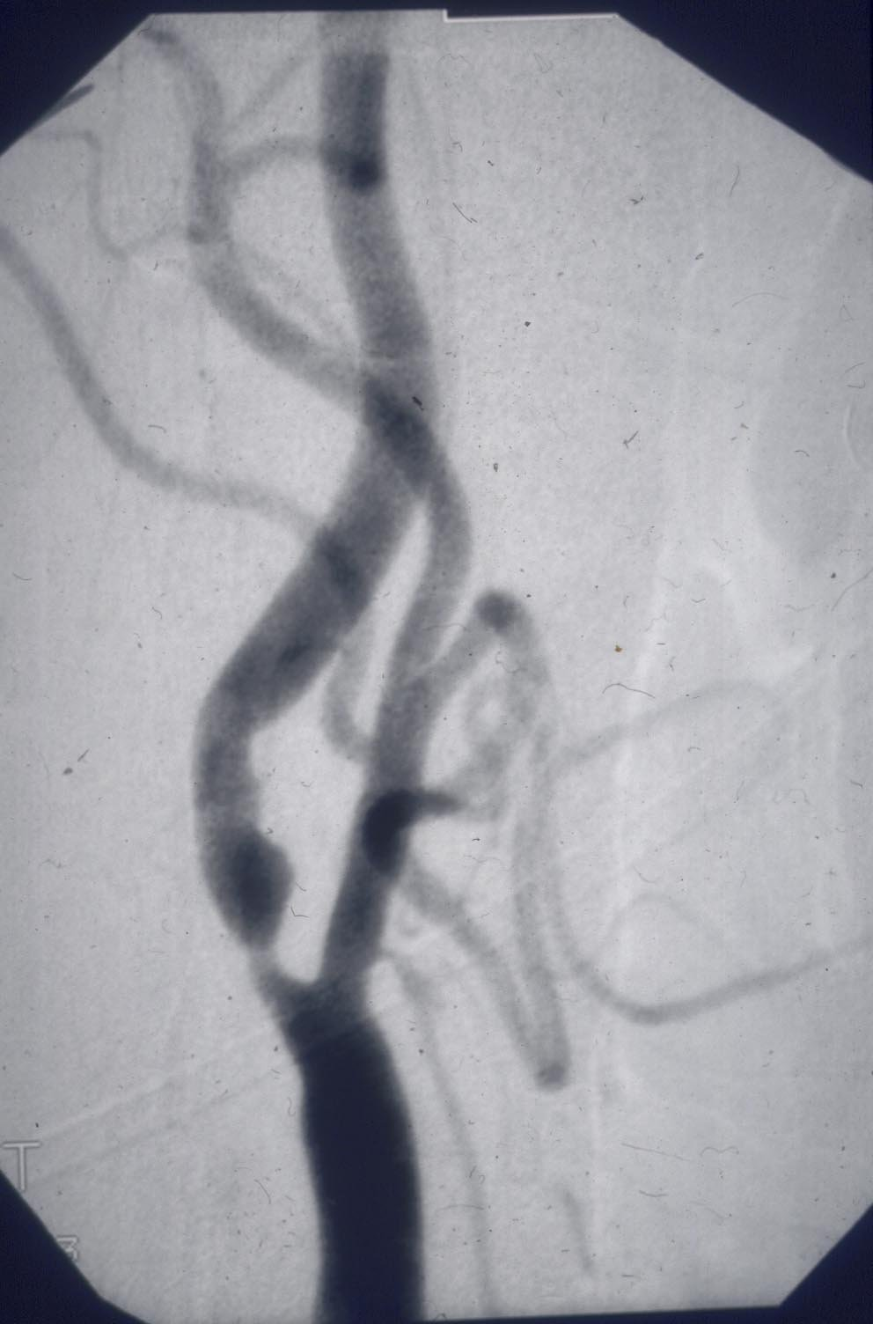
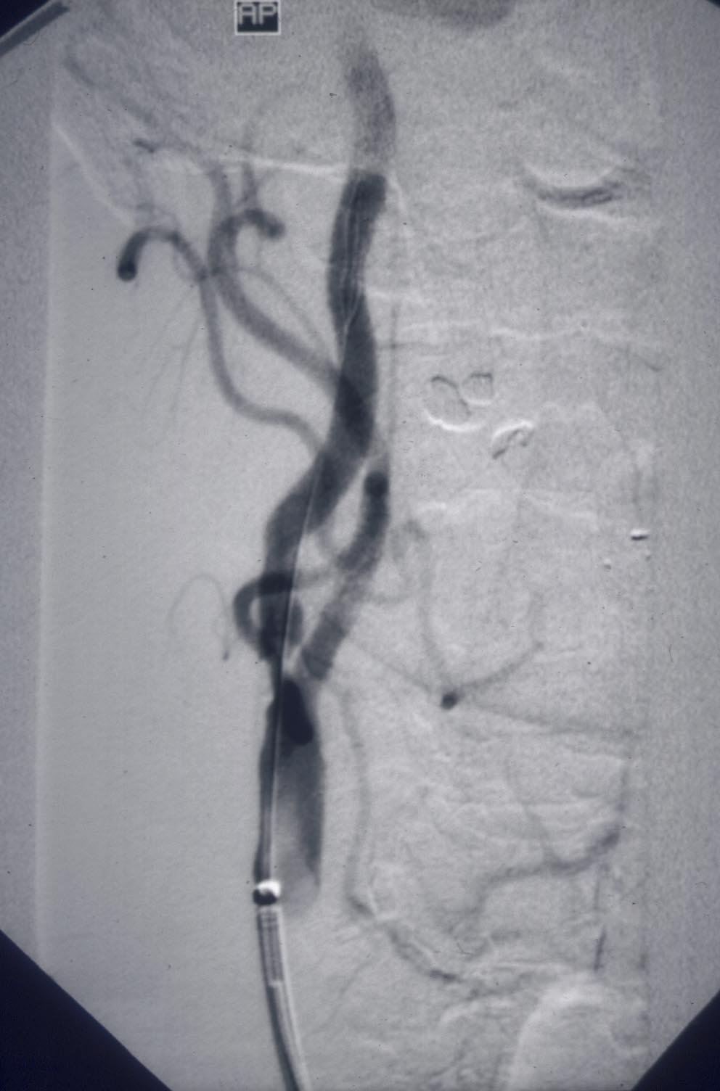
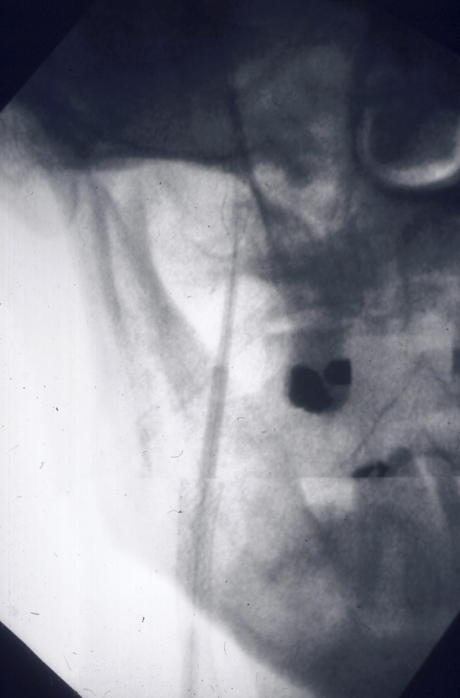
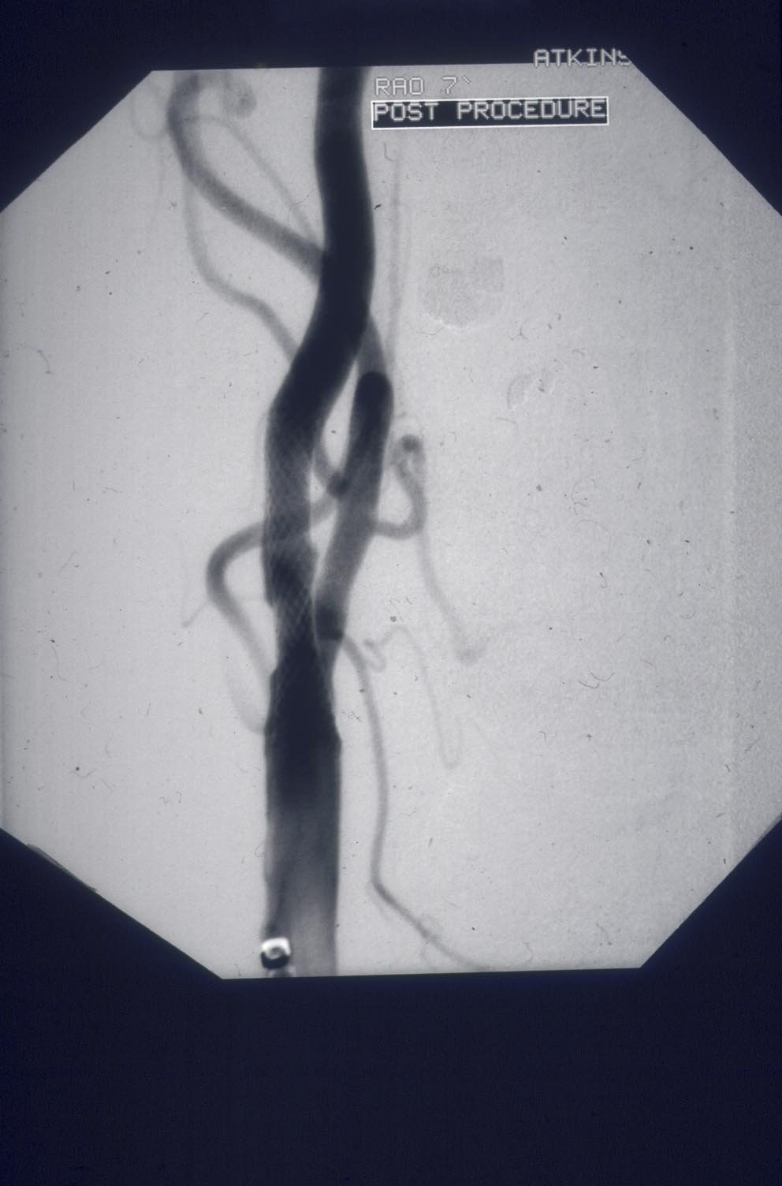
Techniques, devices, experience have all
changed since the symptomatic trials…

Slide 22
Open cell vs closed-cell stent design
Closed–cell safer?
Notes:
22

Slide 23
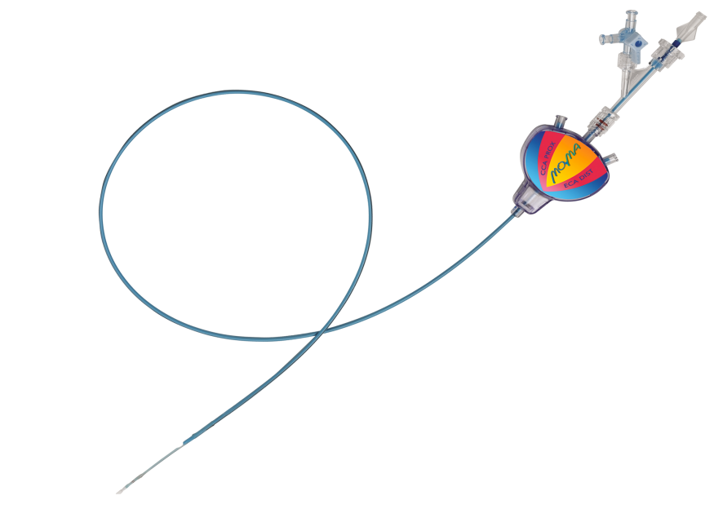
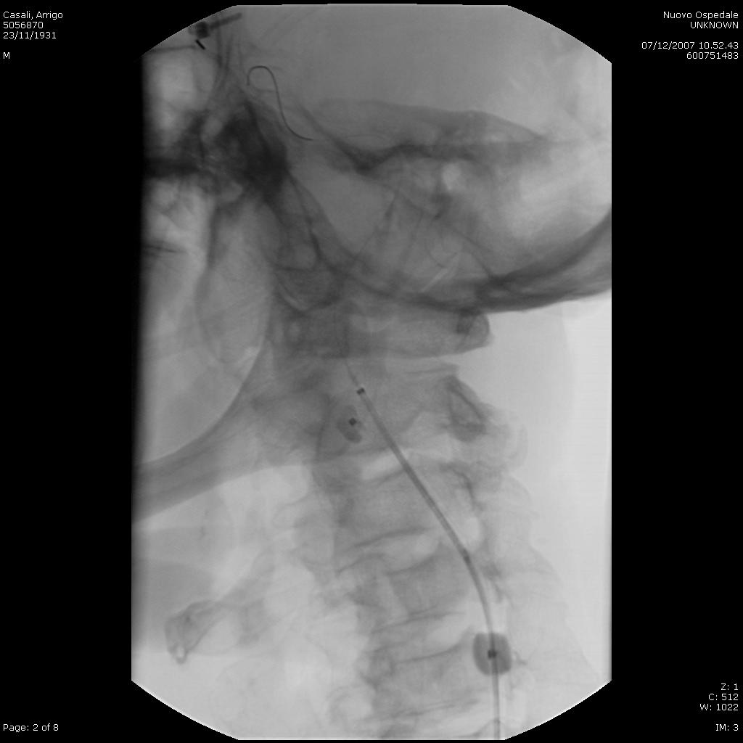
FLOW-reversal systems (and direct puncture)

Slide 24
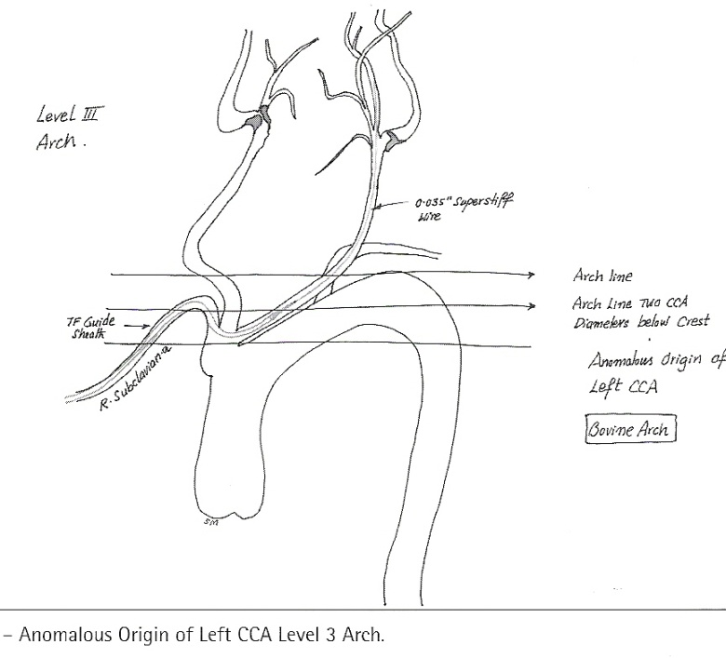
if arch imaging shows patients are suitable for both procedures
- then randomise
ACST-2 directly compares
CEA vs CAS
24

Slide 25

ACST-2: Excellent Data
Return Rate
 | Form Retention
 | Randomisation and 1 month follow up | Annual forms
2012 | 96% | 96%
2013 | 96% | 97%

Slide 26
ACST-2 - Stents and CPDs
Stent | CP Device | Type
Boston Wallstent | Emboshield | Filter
Cordis Precise | Filterwire | Filter
Ev3 Protégé® RX | Mo.Ma | Prox occ
Cristallo Ideale | Spider | Filter
Abbott RX Acculink | AngioGuard | Filter
Abbott Xact | Accunet | Filter
Boston Adapt | Gore Flow Reversal | Prox occ
Optimed Sinus Carotid RX | Twin One | Dist balloon

Slide 27
ACST-2: Open vs Endovascular treatment
Sex, Age, Co-morbidities:
Men 70%
Mean age 72 years
Ischaemic heart disease 36%
Diabetic 30%
Renal impairment 6%
Treatments:
CEA: patch 45%, shunt 24%
CAS: 9 CE-marked stents; open/closed
hybrid, tapered/straight
8 CE marked ‘protection’ devices in 84% CAS

Slide 28
ACST-2: Open vs Endovascular treatment
Stroke risk factors:
Atrial Fibrillation 6%
Age >75 yrs 39%
Previous stroke symptoms or infarct 43%
Medical Treatments:
BP drugs 85%
Lipid-lowering 86%
Anti-thrombotic 99%

Slide 29
ACST-2: Open vs Endovascular treatment
Blinded procedural outcomes
Interventional fatal or disabling stroke 1.0%
Blinded annual follow up (about 2 years)
Disabling or fatal stroke rate low
Death (not stroke-related) 2.1% pa

Slide 30
Procedural hazards (≤ 30 days) in ACST-2 are much lower than in symptomatic trials
And are lower than in previous ACST-1 trial of CEA 1.7%
Despite increasing age, and risk factors for stroke compared with ACST-1;
ACST-2 procedural risk of disabling/fatal Stroke or fatal MI:
1.0%
30

Slide 31
Future best evidence will come from Large Trials (ACST-2, SPACE 2, CREST-2, ECST-2) collaborating….
We will be able to determine the impact of:
current medical treatment (mostly more statins)
greater operator experience (especially CAS)
newer devices and techniques
on older, but often fitter patients

Slide 32


Slide 33
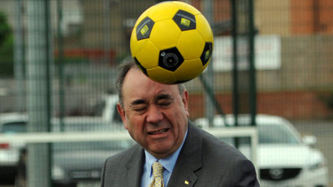

Slide 34


Slide 35
ACST-2: Overview
First patient randomised: 2008
Those patients are now in their 6th year of follow up
113 Centres in 28 countries

Slide 36

European
Society for
Vascular
Surgery
ACST-2

Slide 37
All presentations will be on
acst.org.uk very soon
Your centres are on the website already
Let us know what other information you want us to put there

Slide 38
ACST-2 Recruitment - almost 1600
Target 3600; 2000 to be recruited by end of 2019

Slide 39
2000 more patients by Dec 2019
400/year
Hign Recruiting centres
High recruitment for your centre with target?
Or, Steady recruitment with a yearly target?
VERY well done so far! Together, we can do it!!

Slide 40


Slide 41
OXFORD ACTIVITIES!

Slide 42
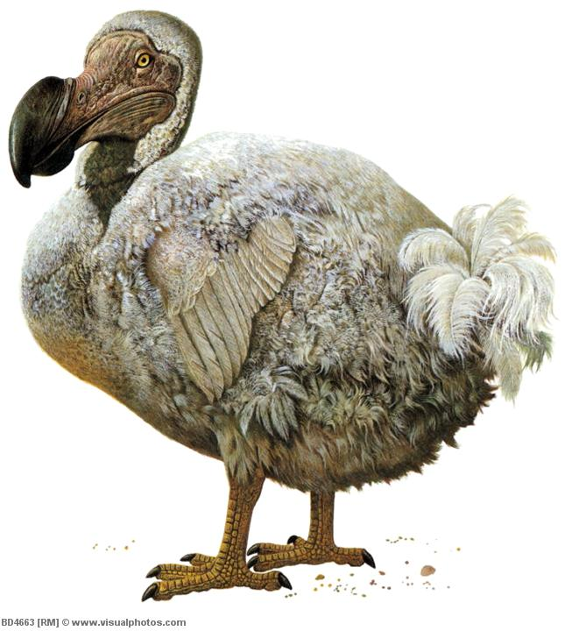
The Pitt Rivers Museum

Slide 43

The Ashmolean

Slide 44

The Covered Market

