Slide 1

ACST-2 Collaborators Meeting:
Qualitative Recruitment Investigation (QRI)
Initial Findings
Daisy Townsend & Jenny Donovan
School of Social and Community Medicine
University of Bristol

Slide 2
Outline today
Importance but difficulty of recruitment
Findings from other recruitment studies
Key findings from ACST-2 recruitment study
Discussion about findings

Slide 3

RCTs and recruitment
Highest level of empirical evidence
  Most robust scientific design
Recruitment
  Of critical importance, but often difficult – slower and harder than anticipated
  Solutions are also difficult – systematic reviews have identified few robustly evaluated improvement strategies
Recruitment study (QRI)
  Aim - to understand recruitment and then suggest and support improvements

Slide 4
Other QRI recruitment studies
ProtecT (Prostate testing for cancer and Treatment) trial
      Recruitment difficult initially – but ultimately successful
      1,645 randomised (65% of those eligible)
Currently 16 (10) completed/underway QRIs
QRI underway in with ACST-2

Slide 5

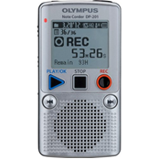
ACST-2 QRI methods
  Phase I:
  Understanding recruitment (and identifying challenges)
  Interviews with
    Six members of TMG
    Thirteen staff from eight participating sites in UK
      Five surgery/non-surgery PIs; eight research nurses
Analysis of UK screening logs
  Eligibility and recruitment rates
Audio recordings of consultations (we need your help!)
Phase II:
  Confidential individual and group feedback
  ‘Tips’ document; other information for recruiters

Slide 6
Key ACST-2 recruitment issues
  Explaining ACST-2 can be difficult
  There can be organisational challenges
    Patients are asymptomatic
    Pathways are complex – various specialists, interventions not always in same hospital
    Diagnosis is often incidental
  Patients have preferences about intervention
    Strong views about medical therapy or need for intervention
    Clinicians also have preferences
  How is ACST-2 best presented to patients?

Slide 7
ACST-2
Organisational challenges

Slide 8
Recruitment challenge:
Identifying patients
Recruitment can be ‘slow’
  Screening logs: Average of two patients per month
Difficulty identifying patients
  “I think where the main difficulties lie at the moment, is trying to identify the patients. It’s not for the want of trying.”
  “It’s just not easy to describe the pathway.”

Slide 9
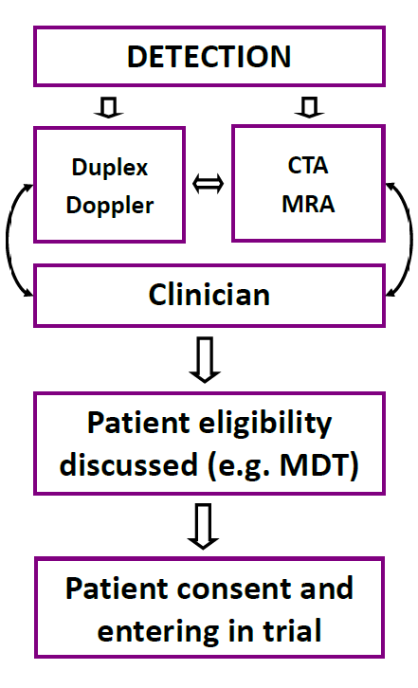
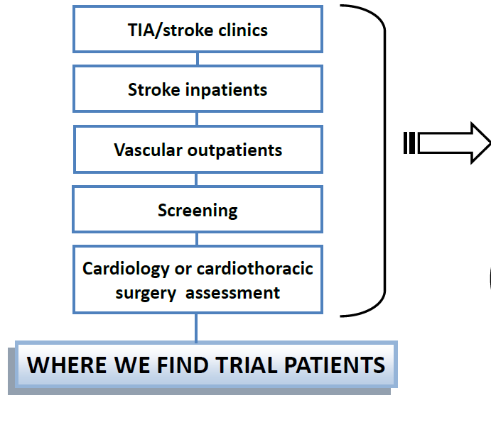
A potential pathway

Slide 10

Recruitment solution: Identifying patients
  Be proactive
    “There’s a reservoir of people there that have been scanned over the years who may be eligible.”
  Consider
    Having a ‘recruitment champion’ responsible for screening all eligible patients
    Maintain a screening log
      Important to capture accurate information

Slide 11
ACST-2
Equipoise

Slide 12
Recruitment challenge: Equipoise
  Collective/group/expert equipoise
    There is no robust evidence that either surgery or stenting is superior
      “There has been a huge amount of debate which treatment is better, and there’s also a massive variation in practice around the world.”
      “You would find, if you went to any of the surgeons, that they aren’t really in equipoise because they are fairly sure surgery is better and if you went to any of the radiologists, they wouldn’t be in equipoise because they think radiology is better… As a group there is no consensus. There’s group equipoise.”
  But issues (discomfort) can arise with the eligibility of particular patients

Slide 13
Equipoise
Comfort with equipoise
  ‘Having worked on the stroke wards and seeing what happens when we do have a really big stenosis and they have a massive stroke, you almost think it’s lovely thinking that we’re saving them from that potentially in the future.’

Slide 14
Equipoise
Comfort with equipoise
  ‘Having worked on the stroke wards and seeing what happens when we do have a really big stenosis and they have a massive stroke, you almost think it’s lovely thinking that we’re saving them from that potentially in the future.’
Discomfort with equipoise
  ‘…are you potentially putting patients at risk with a procedure that you’re not 100% sure is better than the other one. That’s always something you consider as a practitioner when you’re giving information to patients. That there is that sense that it… I don’t know, I suppose it does sit a little bit at the back of your mind.’

Slide 15
  ACST-2
  Explaining the trial
  What are the most important things to convey?

Slide 16

ACST-2: A very important study
Stroke prevention important:
  “ACST2 – a trial that hopefully will be able to help a lot of people.”
  ACST-1 showed that even for patients on BP lowering, aspirin and statin therapies, immediate carotid surgery halved the 5 year risk of stroke
  No other trials comparing surgery v. stenting
  Cochrane review and UK NICE guidelines encourage clinicians to enter patients into ACST-2 to compare stenting and surgery
When ACST-2 completes, it will triple randomised evidence comparing surgery and stenting
ACST-2 – a study to be enthusiastic about….

Slide 17
ACST-2
What about patient preferences for particular treatments?

Slide 18
Patient preferences
Patients’ treatment preferences can appear to be strong and well-informed
  “Most people have got some sort of fixed idea of what they want.”
  “They’re quite clued up, a lot of them.”
  “Some say they’re just not keen on having any form of surgery or intervention if they don’t necessarily require it.”

Slide 19
Patient preferences
Patients’ treatment preferences can appear to be strong and well-informed
  “Most people have got some sort of fixed idea of what they want.”
  “They’re quite clued up, a lot of them.”
  “Some say they’re just not keen on having any form of surgery or intervention if they don’t necessarily require it.”
But are they well-informed?
    “They read the internet and read the Daily Mail and things like that, and talk to their mates in the pub.”
    “It’s amazing the amount of people who come in and say, “Oh my friend had one of those …”

Slide 20
Patient preferences
Patients’ treatment preferences can appear to be strong and well-informed
  “Most people have got some sort of fixed idea of what they want.”
  “They’re quite clued up, a lot of them.”
  “Some say they’re just not keen on having any form of surgery or intervention if they don’t necessarily require it.”
But are they well-informed?
    “They read the internet and read the Daily Mail and things like that, and talk to their mates in the pub.”
    “It’s amazing the amount of people who come in and say, “Oh my friend had one of those …”

Slide 21
Where do some other patient preferences come from?
Int: If you were a patient in the position of being eligible for the trial, do you think that you would choose to be randomised?
PI: Are you talking specifically about ACST-2?
Int: Yes.
PI: Well, I think I would probably want to have control over who was going to do the operation rather than which procedure I was going to have … So if I could do my own carotid endarterectomy, that would be my choice, but there are some people who can do a carotid stent and I’d be very happy for them to put a carotid stent in me....

Slide 22
Where do some other patient preferences come from?
Int: If you were a patient in the position of being eligible for the trial, do you think that you would choose to be randomised?
PI: Are you talking specifically about ACST-2?
Int: Yes.
PI: Well, I think I would probably want to have control over who was going to do the operation rather than which procedure I was going to have … So if I could do my own carotid endarterectomy, that would be my choice, but there are some people who can do a carotid stent and I’d be very happy for them to put a carotid stent in me.... I suppose on balance, if you really pushed me, I’d probably err towards surgery. I am a surgeon. The surgery side of it doesn’t have any mysteries, or it’s not frightening for me…. I probably would have surgery.”

Slide 23
Where do some other patient preferences come from?
Int: If you were a patient in the position of being eligible for the trial, do you think that you would choose to be randomised?
PI: Are you talking specifically about ACST-2?
Int: Yes.
PI: Well, I think I would probably want to have control over who was going to do the operation rather than which procedure I was going to have … So if I could do my own carotid endarterectomy, that would be my choice, but there are some people who can do a carotid stent and I’d be very happy for them to put a carotid stent in me.... I suppose on balance, if you really pushed me, I’d probably err towards surgery. I am a surgeon. The surgery side of it doesn’t have any mysteries, or it’s not frightening for me…. I probably would have surgery.”
Many patient preferences come from
clinicians or recruiters

Slide 24
Screening logs
Screening logs: those who declined ACST-2
    47% chose medical therapy
    23% chose endarterectomy
    7% chose stenting

Slide 25
ACST-2
What should you do about patient preferences?

Slide 26
Screening logs: patient preferences
Screening logs: those who declined ACST-2:
    47% chose medical therapy
    23% endarterectomy
    7% stent
Dealing with patient preferences
    “We tell them about the study... Then they have their decision. That’s it, really. Then it’s up to them.”
  “So to start with people are usually, you can tell within two minutes, I reckon, whether people are just absolutely against any sort of intervention. They look terrified when you talk about it.’’
  “I don’t even talk to them about the study because they are the ones where any sort of intervention is too scary.”

Slide 27
Another example of a patient preference
PI: “On the whole, people quite prefer the idea of having something percutaneous than having a cut in their neck.”
Int: “How do you respond to that then?”
PI: “In a sense, the line we have taken is the standard treatment for this condition is carotid surgery. If you do want to be in the study, then you can have a carotid operation if you want one; if you don't want one, then you just go on best medical treatment.”
Int: “What about if they’ll say they prefer endarterectomy?”
PI: “Yes, that's fine.”

Slide 28

Exploring patient preferences: Tips
  Important to try to discuss ACST-2 with all eligible patients
  Try to suspend your own beliefs
Find out the reasons why a patient prefers one option over the other
  Gently ask them why they prefer it
Be sure that they have not misunderstood or been misinformed
    Important to inform patients about the potential benefits of intervention as well as side-effects

Slide 29
Exploring patient preferences: Tips
  Important to try to discuss ACST-2 with all eligible patients
  Try to suspend your own beliefs
Find out the reasons why a patient prefers one option over the other
  Gently ask them why they prefer it
Be sure that they have not misunderstood or been misinformed
    Important to inform patients about the potential benefits of intervention as well as side-effects
[keep screening logs…]

Slide 30
ACST-2
How best to present the trial to patients?

Slide 31
Providing information about ACST-2:
‘Tips’
Introducing the study
Treatment details
Study design aspects

Slide 32
Introducing the study: Tips
Try to approach all patients about ACST-2 if they:
  Have a tight carotid artery stenosis, confirmed by duplex ultrasound
  Have had no ipsilateral carotid territory symptoms for six months
  Are likely to live for a minimum of five years
Reassure patients they will be on appropriate medical therapy
  Explain the benefits and risks of each intervention so the patient is fully informed
  As they have significant stenosis, intervention alongside medical therapy could further reduce the long-term risk of stroke by half
  There are two main procedures – stent and surgery - which have been shown to be effective in reducing the risk of stroke
  For both procedures there is a risk of having a stroke or heart attack or wound infection (less than 1 in 100)
  Surgery can lead to discomfort and numbness in neck and hoarse voice; stent can lead to bruising/soreness where stent inserted

Slide 33
Describing the treatment arms
Recruiters would state they were equipoise
  ‘Truthfully we don’t know which is best.’
  But say to patients…
    “I say, “Standard intervention is an operation. There is also the option of stenting. We don’t know about stenting.””
    “Then there’s stenting, which we’re doing this trial because we don’t know if it’s as good as surgery.”

Slide 34
Describing the treatment arms: Tips
Encourage patient to keep an ‘open mind’ until they have heard all the information about both procedures
Avoid terms such as ‘gold standard’, ‘conventional’, ‘testing’ and ‘experimental’
Provide information about both treatment arms
  Outline advantages and disadvantages of each

Slide 35
Describing randomisation: Tips
Talking about randomisation
  Need to explain how and why
  “Currently we do not know which operation is best. The only way to compare them fairly is to create groups of patients that are the same by a process called randomisation (so you cannot choose the treatment and neither can I). You will have an equal chance of having either of these two established procedures. The groups will be as identical as possible and we can then compare them fairly...
  You will be followed up carefully. In the future, patients will be able to be informed and not have the uncertainty that you have to cope with.”
Avoid ‘tossing a coin’ (or other metaphors) or implying computer decides best treatment based on patient information

Slide 36
Information provision: Tips
You can discuss the benefits of study participation as well as risks
  Study participation as a solution to the dilemma of uncertainty
  Benefits to future patients
Important to not sound apologetic
Present ACST-2 with the confidence and enthusiasm you feel about it

Slide 37


Information provision: Tips
Keeping an open mind
  Works well to request patients to
  ‘keep an open mind’ until all
  information is heard
Balancing and tailoring Information
  Balance procedures against each other
  Balance them in relation to patients’ views

Slide 38
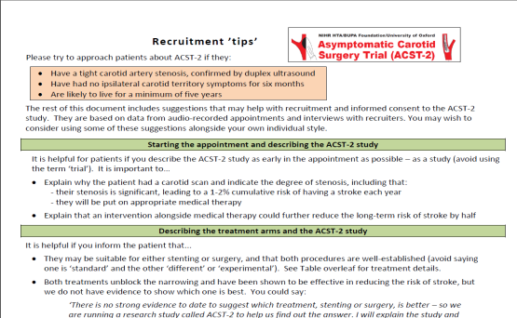
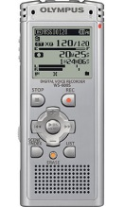
We are here to help!
Use the ‘guidance for recruiters’ sheet
developed by the QRI team (copies available
today)
Audio-recording appointments gives us insights into what works so that we can feedback to you
  If you’d like to discuss the process, contact Daisy on: daisy.townsend@bristol.ac.uk

Slide 39
QRI references
Donovan et al. Clear obstacles, hidden challenges… Trials 2014, 15:5
Donovan et al. Intellectual challenges and emotional consequences of equipoise… J Clinical Epidemiology, 2014, 67:8

